Slide 1
Announcements
Midterm grades available next week
Quiz 8B on Chapter 13 due Monday, practice problems in Problem Set 8B
Next topic: the Solar System (Chapters 4-8, but we won’t cover all of it )
Upcoming schedule:
  Today: Chapter 4 Sections 4.1 and 4.2
  Monday March 31: Section 4.3
  Wednesday April 2: Start Chapter 6 (+ a bit of Ch 5)

Slide 2
Astronomy 103
The Solar System
Please read chapter 4

Slide 3
Inventory of the Solar System

Slide 4
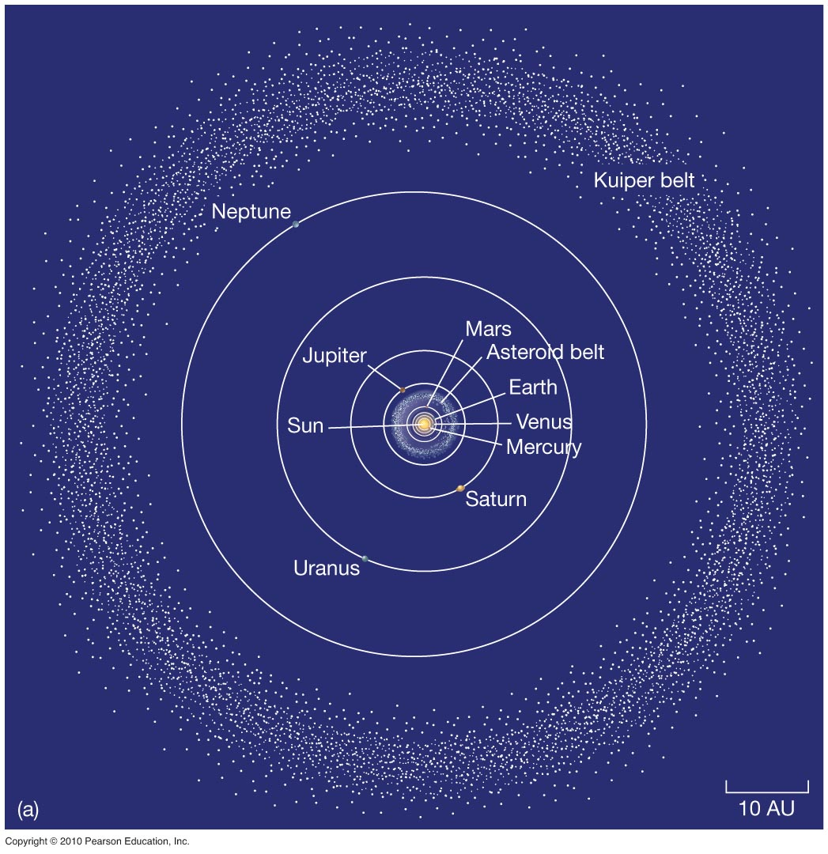
An Inventory of the Solar System
Early astronomers knew Moon, stars, Mercury, Venus, Mars, Jupiter, Saturn, comets, and meteors.
Now known: Solar system has 166 moons, one star, eight planets (added Uranus and Neptune), asteroids, comets, meteoroids, dwarf planets, and Kuiper Belt objects.

Slide 5
An Inventory of the Solar System
The Solar System consists of the sun and everything in orbit around it.
  Nearly all the mass is in the Sun (~ 99.8%)
  Nearly all the rest is in the planets and moons
  The rest are
    Plutoids – balls of ice and rock in the Kuiper belt
    Asteroids – rocky piles mostly between Mars and Jupiter
    Comets – Piles of ice and rocks
    Meteoroids – pebbles from comets that got ejected when comets came close to the Sun and fragments of asteroids

Slide 6
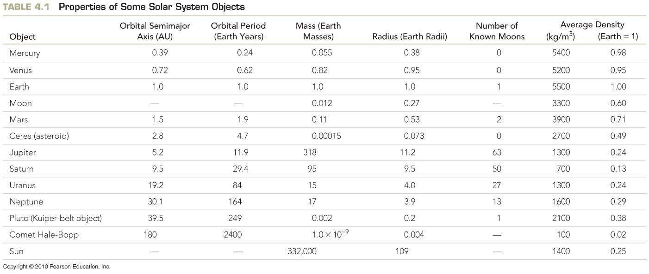
An Inventory of the Solar System

Slide 7
An Inventory of the Solar System
How do we measure the Solar System?
Distance from Sun known by Kepler’s laws
Orbital period can be observed
Radius known from angular size
Masses known from Newton’s laws
Rotation period known from observations
Density can be calculated knowing radius and mass

Slide 8
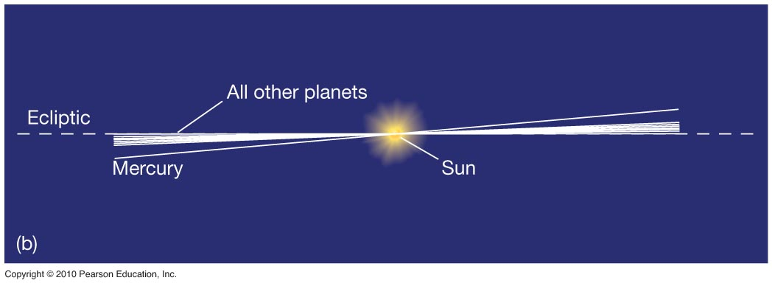
An Inventory of the Solar System
All planetary orbits except Mercury’s are close to the same plane.

Slide 9
An Inventory of the Solar System
The planets orbit the sun from W to E along the plane of the ecliptic – looking down from Earth’s North pole, planets orbit counterclockwise.

Slide 10
An Inventory of the Solar System
The planets orbit the sun from W to E along the plane of the ecliptic – looking down from Earth’s North pole, planets orbit counterclockwise.
Orbits are nearly circular – yes, Kepler says that they are ellipses, and they are, but they are nearly perfectly circular ellipses
Nearly all in the same plane – without Pluto, they are perfect to 1%
Inner planets are called terrestrial planets
Outer planets are called Jovian planets

Slide 11
Planets of the Solar System
Planets vary a bit in size
Jupiter is 1/10 the diameter of the sun
Earth is 1/10 the diameter of Jupiter

Slide 12
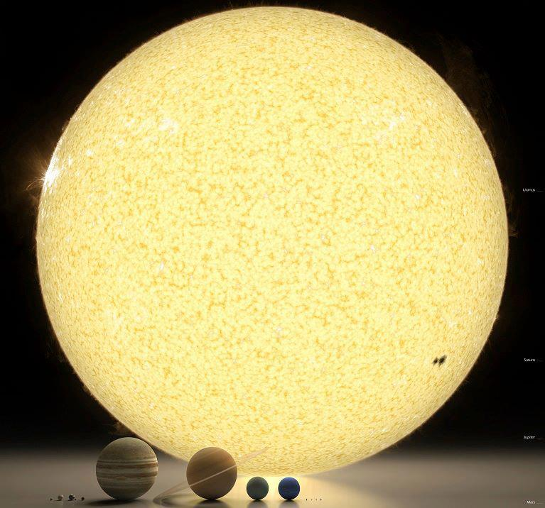

Slide 13
Density
Density of a object is:
Density = mass / volume
Density of some common materials:
Water ~ 1000 kg/m³
Rock ~ 2000-3000 kg/m³
Iron ~ 8000 kg/m³
For objects like the Sun, Jupiter, Saturn: density is ~ 1000 kg/m³
For terrestrial bodies like Earth, Mercury, Venus: density is around 5000 kg/m³

Slide 14
Terrestrial Planets
Close to the Sun
Made of rocks (silicon) and iron
High density
Small (~10,000 km in diameter)

Slide 15
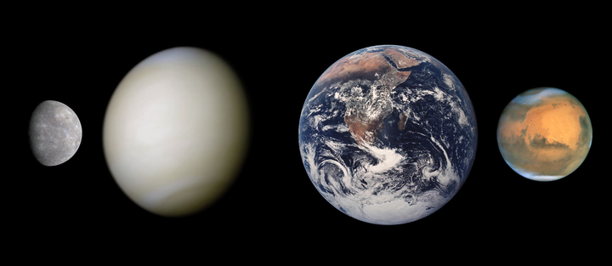
Terrestrial Planets
Close to the Sun
Made of rocks (silicon) and iron
High density
Small (~10000 km in diameter)
Mercury
Venus
Earth
Mars

Slide 16
Jovian Planets
Farther from the Sun
Made of gases (hydrogen, helium, methane, water, ammonia)
lower density
large (~100,000 km in diameter)

Slide 17
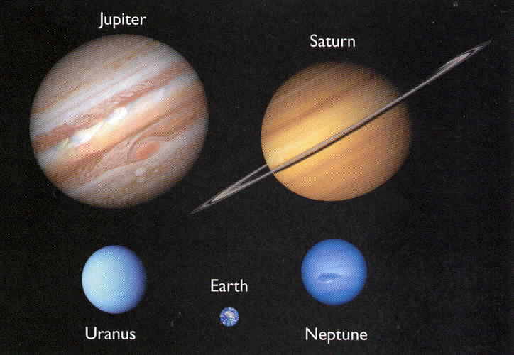
Jovian Planets
for comparison

Slide 18
Comparison of Terrestrial and Jovian Planets

Slide 19
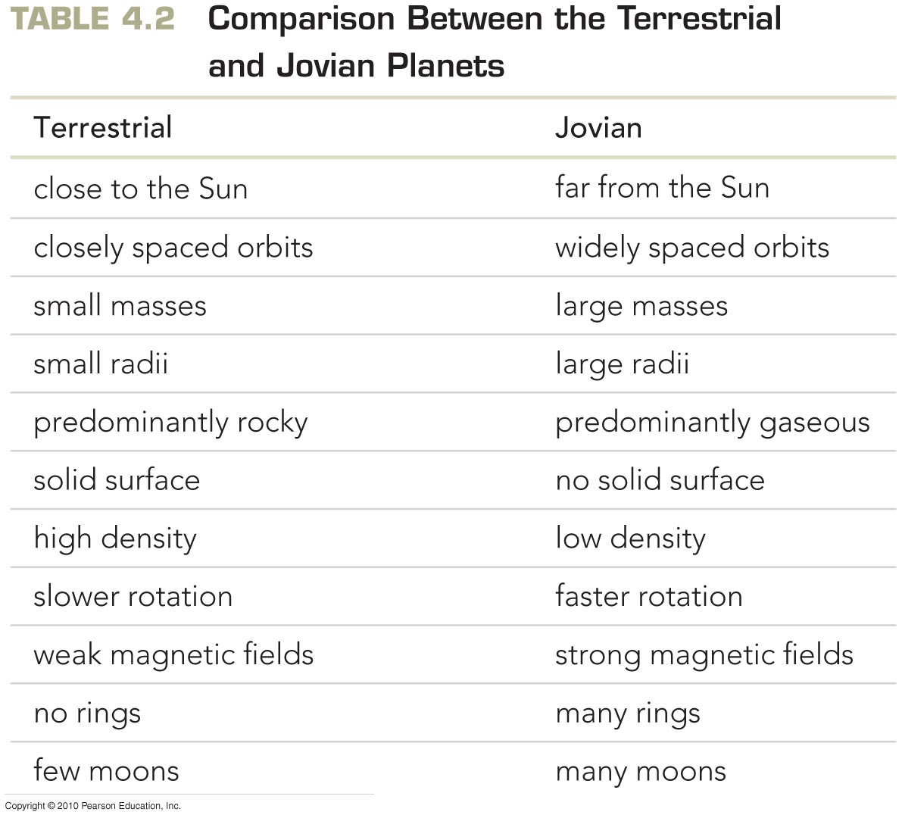
An Inventory of the Solar System
Terrestrial planets:
Mercury, Venus, Earth, Mars
Jovian planets:
Jupiter, Saturn, Uranus, Neptune

Slide 20


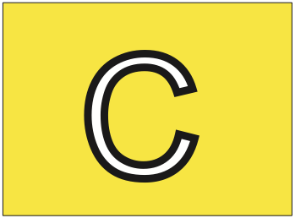

Compared with terrestrial planets, Jovian planets have all of the following characteristics EXCEPT
Low density
Many moons
Larger size
Slower rotation

Slide 21
Compared with terrestrial planets, Jovian planets have all of the following characteristics EXCEPT
Low density
Many moons
Larger size
Slower rotation

Slide 22
An Inventory of the Solar System
Differences between the terrestrial planets:
Atmospheres and surface conditions are very dissimilar
Only Earth has oxygen in atmosphere and liquid water on surface
Earth and Mars rotate at about the same rate; Venus and Mercury are much slower, and Venus rotates in the opposite direction
Earth and Mars have moons; Mercury and Venus don’t
Earth and Mercury have magnetic fields; Venus and Mars don’t

Slide 23
History of the Solar System
We want to understand the history of the solar system
However, large bodies like planets evolve
  Volcanism, erosion, plate tectonics…
So it is important to look at things that hold a better record of the past: small bodies that don’t change much
The small bodies that have the best clues are asteroids, comets, meteoroids (coming from asteroids and comets) and plutoids
The age and chemical composition of these things can tell us about the early solar system

Slide 24
Asteroids
Rocky bodies that are held together by gravity
Most live in a belt between Mars and Jupiter at 2.8 A.U. called the asteroid belt
  about 100,000 rocky objects bigger than 1km exist
Ceres is the largest asteroid with a diameter of ~1000 km
A few thousand have orbits that cross Earth’s orbit – called near-Earth asteroids (NEAs)
Some are near Jupiter (60 degrees ahead and behind) and are called Trojans

Slide 25
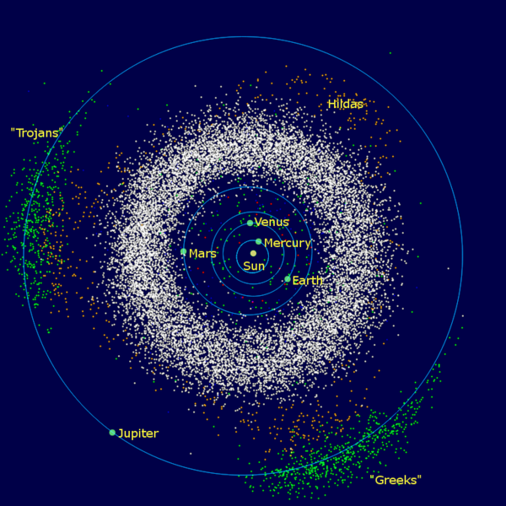
Asteroids
Trojans
Asteroid Belt
Near Earth Asteroids

Slide 26
Asteroids are faint because they shine only in reflected light and they are small. But they can be differentiated from stars because they move.
Over a long exposure, they appear as streaks.

Slide 28
Asteroids
Their composition is not well known, but it is believed that some of them have iron cores and rocky or icy exteriors, or are rocky all the way through.
Some are dark and have lots of water ices and organic material on the surface – known as carbonaceous asteroids
Others are more reflective and are mainly bare rock – known as silicate asteroids
Total amount of mass in asteroids is about the mass of the Moon

Slide 31
More Asteroid Properties
Measurements of their density from Galileo (the space probe) and NEAR (Near Earth Asteroid Rendezvous) gives asteroid densities from 1000 – 3000 kg/m³
Remember that the terrestrial planets have densities of about 5000 kg/m³
This means that while these object are rocky, they are probably very porous – sometimes referred to as “rubble piles”
Might be important to know if you want to stop a killer asteroid

Slide 32
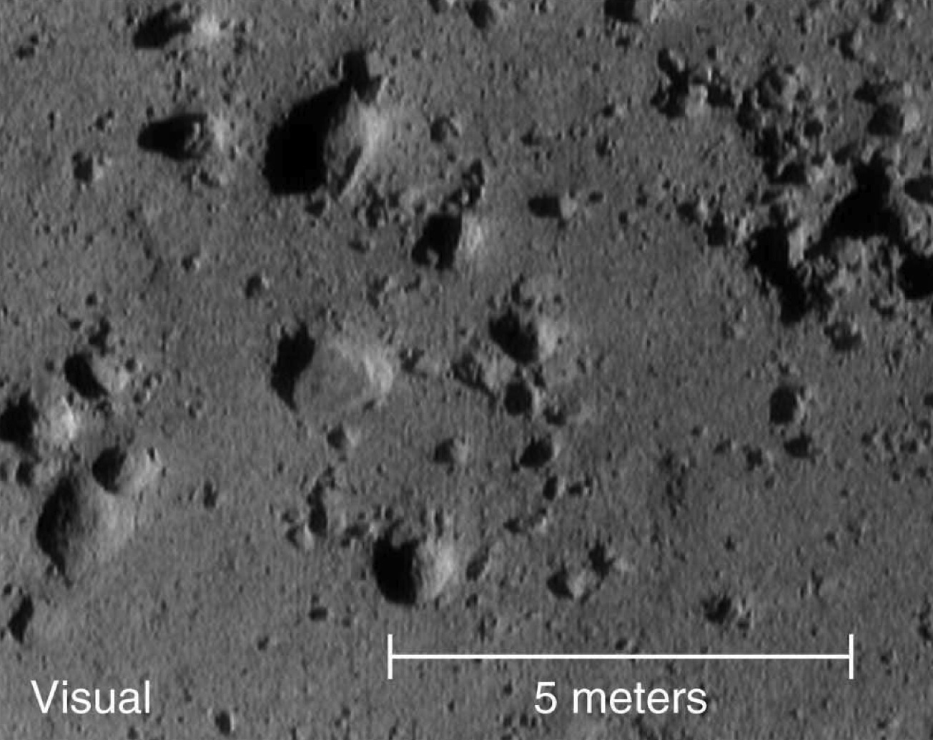
Picture from NEAR/Shoemaker spacecraft right before landing/crashing on an asteroid

Slide 33
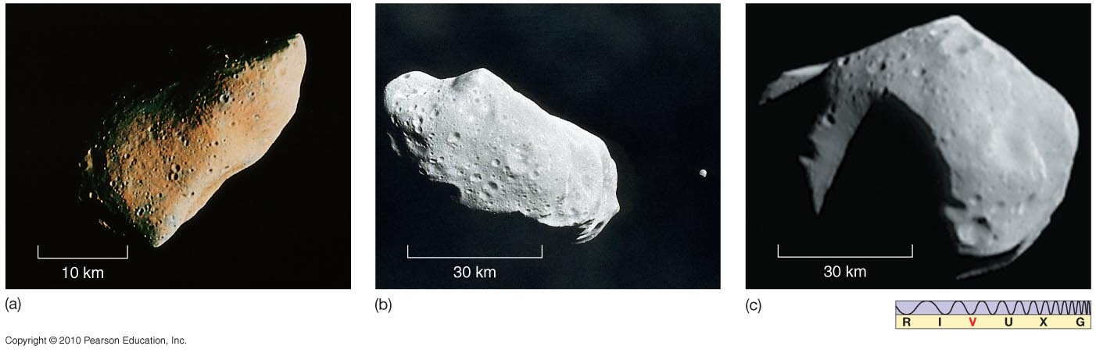
Asteroids and Meteoroids
Asteroids and meteoroids have rocky composition; asteroids are bigger.
(below) Asteroid Gaspra
(above) Asteroid Ida with its moon, Dactyl
(above) Asteroid Mathilde

Slide 34
Comets
Icy bodies – called “dirty snowballs” – made of rocks, water ice, frozen methane, frozen ammonia, and frozen carbon dioxide
~1 – 10 km in size.
When they pass close to the sun, the ices sublimate: solid -> gas. Blows out a halo of gas and rocks (pebbles), which is called a coma
Sunlight and the solar wind push on the gas and dust blowing the tail away from the sun
Comet tails point away from the sun, NOT opposite of direction of motion

Slide 35
Comets
Consist of the nucleus – main solid body of the comet
And the coma – diffuse halo of gas and dust around it
Very low density ~ 100 kg/m³ << water ice (1000 kg/m³), so they are loosely packed snowballs
Orbits are typically 1000s of years and originate far beyond the orbit of Pluto in the Oort cloud.
Short period comets (<200 years) originate in the region near Pluto known as the Kuiper belt

Slide 36
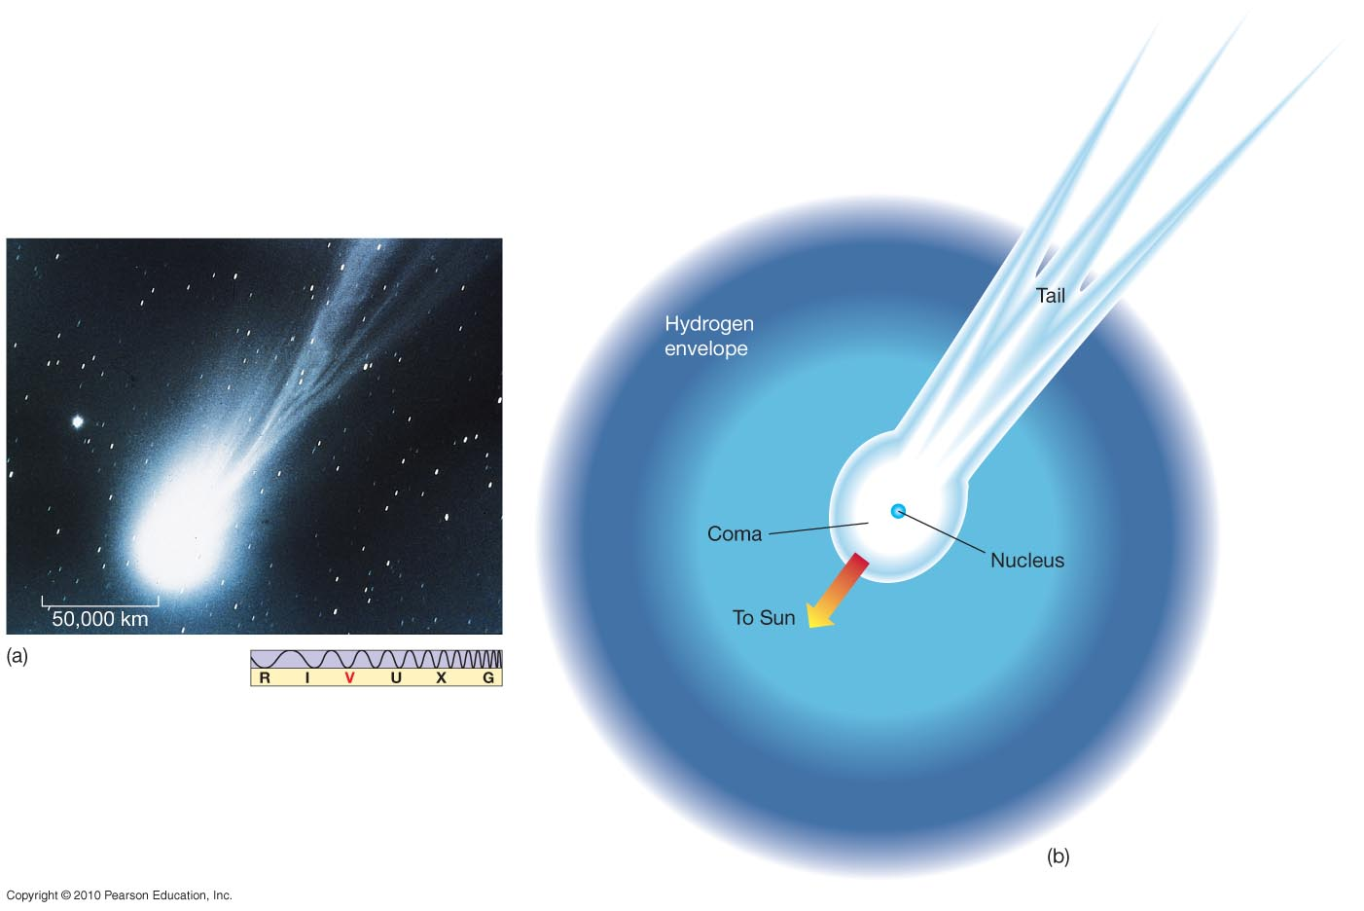
Comets
Comets are icy, with some rocky parts.
The basic components of a comet

Slide 37
Comets

Slide 38
Comets

Slide 39
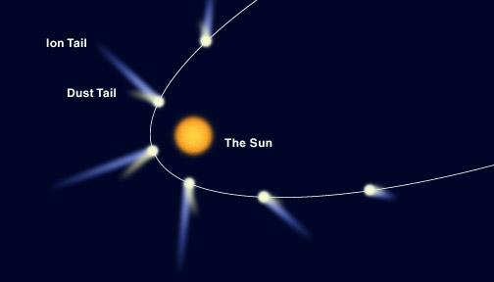
Comet’s tail
Comet tails point away from the sun due to the solar wind and the light from the Sun.

Slide 40
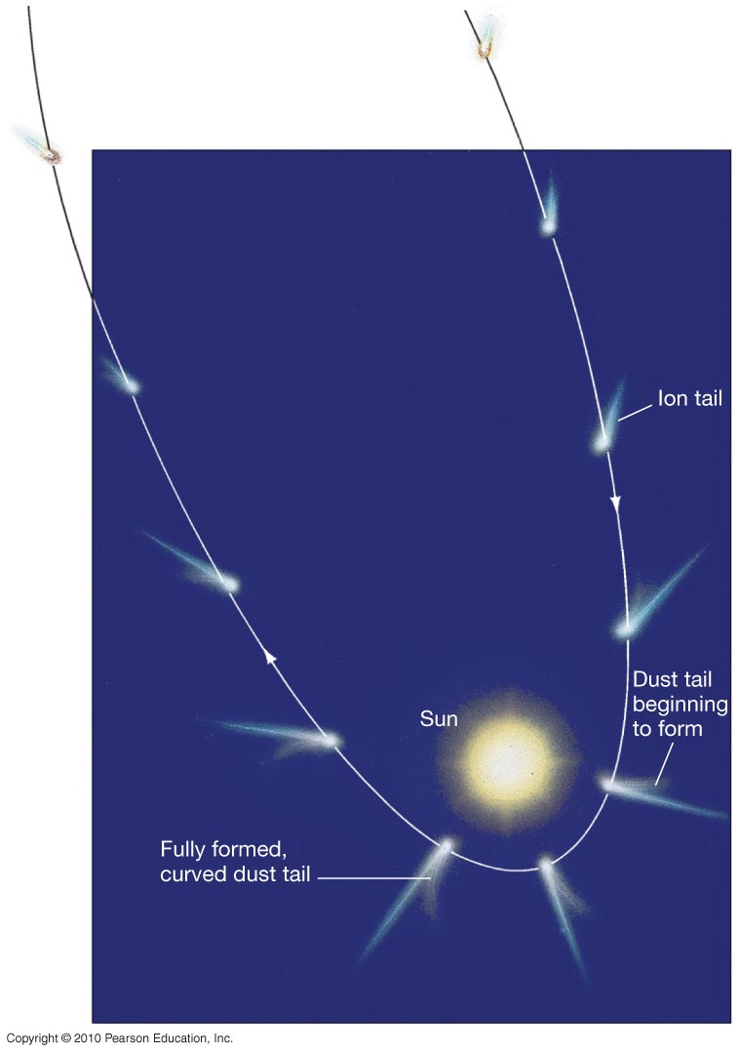
Comets
The solar wind means the ion tail always points away from the Sun.
The dust tail also tends to point away from the Sun, but the dust particles are more massive and lag somewhat, forming a curved tail.

Slide 41
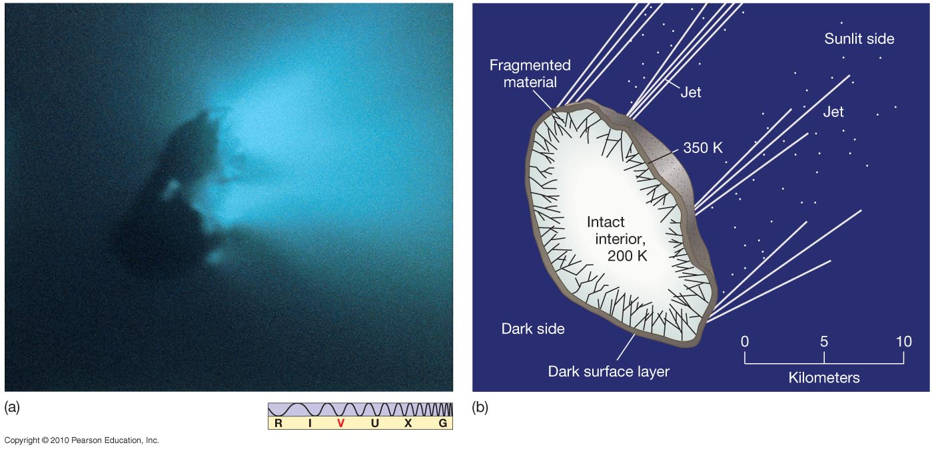
Comets
The internal structure of the cometary nucleus

Slide 42
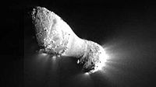
Comet Hartley 2 – showing plumes of material from Deep Impact spacecraft

Slide 43
Halley’s
Comet
Nucleus ~ 10 km across

Slide 44
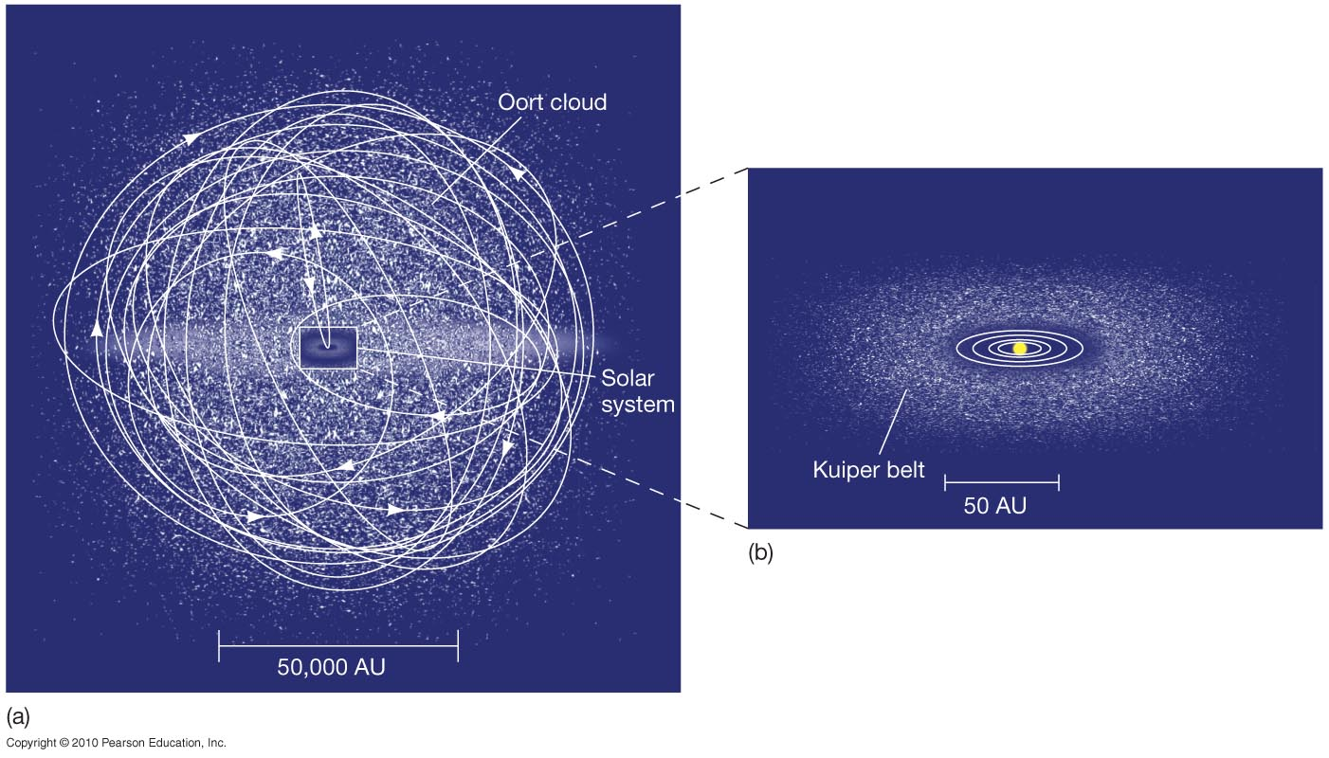
Orbits of Comets
The size, shape, and orientation of cometary orbits depend on their location. Oort cloud comets rarely enter the inner solar system.

Slide 45
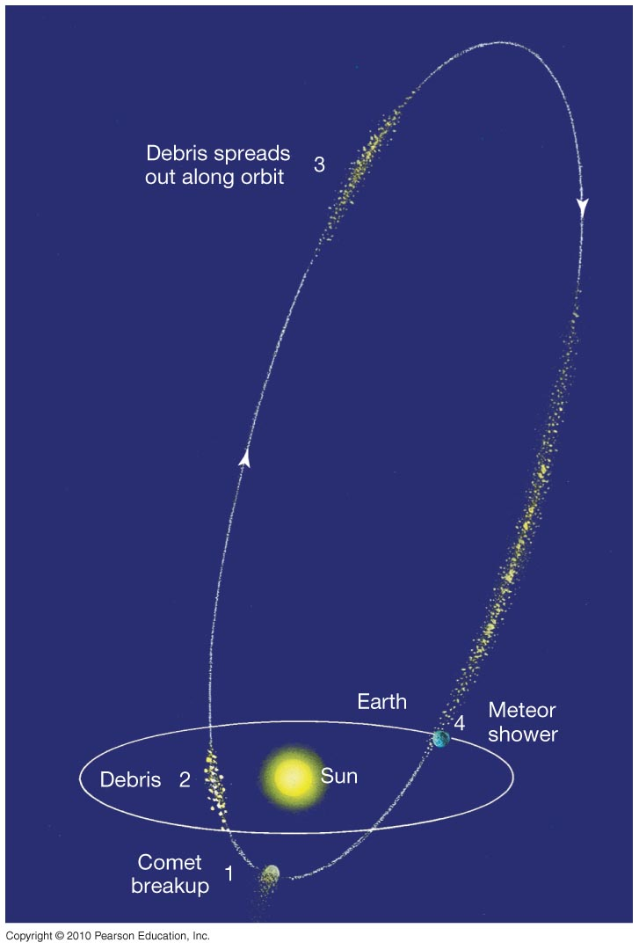
Comets and Meteor Showers
Meteor showers are associated with comets – they are the debris left over when a comet breaks up.

Slide 46
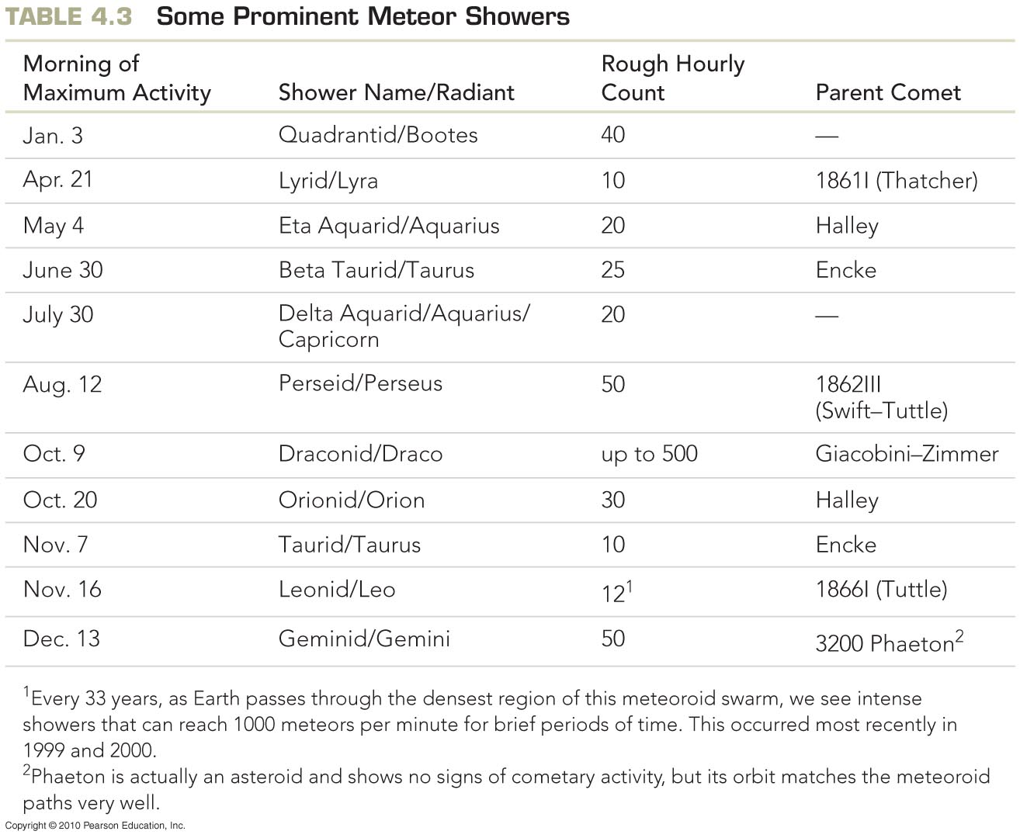
Comets and Meteor Showers

Slide 47
Meteoroids
Small rocks in the solar system
Asteroid: >100 m in size
Meteroid: <100 m in size
If they enter the Earth’s atmosphere and burn up they are called meteors
Meteorites are meteors that penetrate though the atmosphere to hit the ground

Slide 48
Most meteorites (95%) are rocky

Slide 49
Most of the rest are iron

Slide 50
The rarest are carbonaceous chondrite – lots of carbon and hydrocarbons

