Slide 1
Announcements
Next week is spring break: no quiz for Monday March 17
Quiz 8 on Chapter 12 due Monday March 24, available on D2L now
Next midterm: Wednesday after spring break, March 26
Midterm will cover Chapter 3 and Chapters 9-12 – material since last midterm
Review in class Monday March 24

Slide 2
Announcements II
Reminder: astronomy news summary for extra credit due by Friday
Summary in your own words of an astronomy-related story in the news
Explain what, how and why it’s important
At least three sources required, must be cited
Turn in any time in class until Friday, or email electronic copy
Info on D2L
+1% on final grade

Slide 3
Pulsars usually show all of the following EXCEPT
extremely rapid rotation
high-temperature fusion reactions
a narrow, regular pulse of radiation
an intense magnetic field

Slide 4
Pulsars usually show all of the following EXCEPT
extremely rapid rotation
high-temperature fusion reactions
a narrow, regular pulse of radiation
an intense magnetic field

Slide 5
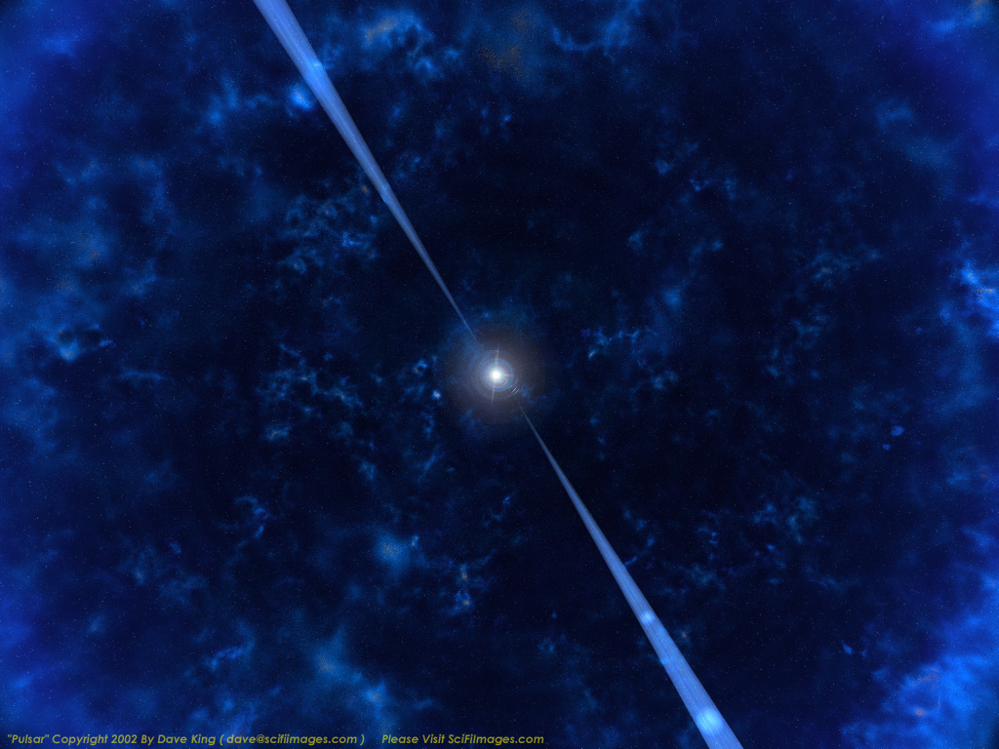
Pulsars are neutron stars no longer undergoing fusion in their cores. They are stellar remnants, the dead cores of massive stars.

Slide 6
Neutron Star Recap
After a Type I supernova, little or nothing remains of the original star.
After a Type II supernova, part of the core may survive. It is very dense – as dense as an atomic nucleus – and is called a neutron star.

Slide 7
Neutron Star Fun Facts
R≈15 km and M≈1.5 M_{Sun}
Central density 2-10 times that of atomic nucleus
1 teaspoon is about 10¹² kg
a cube 300 meters on a side has the same mass as the Earth
Magnetic field >10¹² times that on Earth
erase credit cards from 30,000 km & kill from 200 km
Spin frequencies from 0.1 Hz to 716 Hz → pulsars
faster than a kitchen blender!

Slide 8
Neutron Stars
Important properties of neutron stars:
Mass and size – neutron stars are 10-20 km in radius and have approximately the mass of the sun, so they are extremely dense
Rotation – as the parent star collapses, the neutron core spins very rapidly, conserving angular momentum. Typical periods are fractions of a second.
Magnetic field – again as a result of the collapse, the neutron star’s magnetic field becomes enormously strong.

Slide 9
Pulsars
The first pulsar was discovered in 1967. It emitted extraordinarily regular pulses; nothing like it had ever been seen before.
After some initial confusion, it was realized that this was a neutron star, spinning very rapidly.

Slide 10
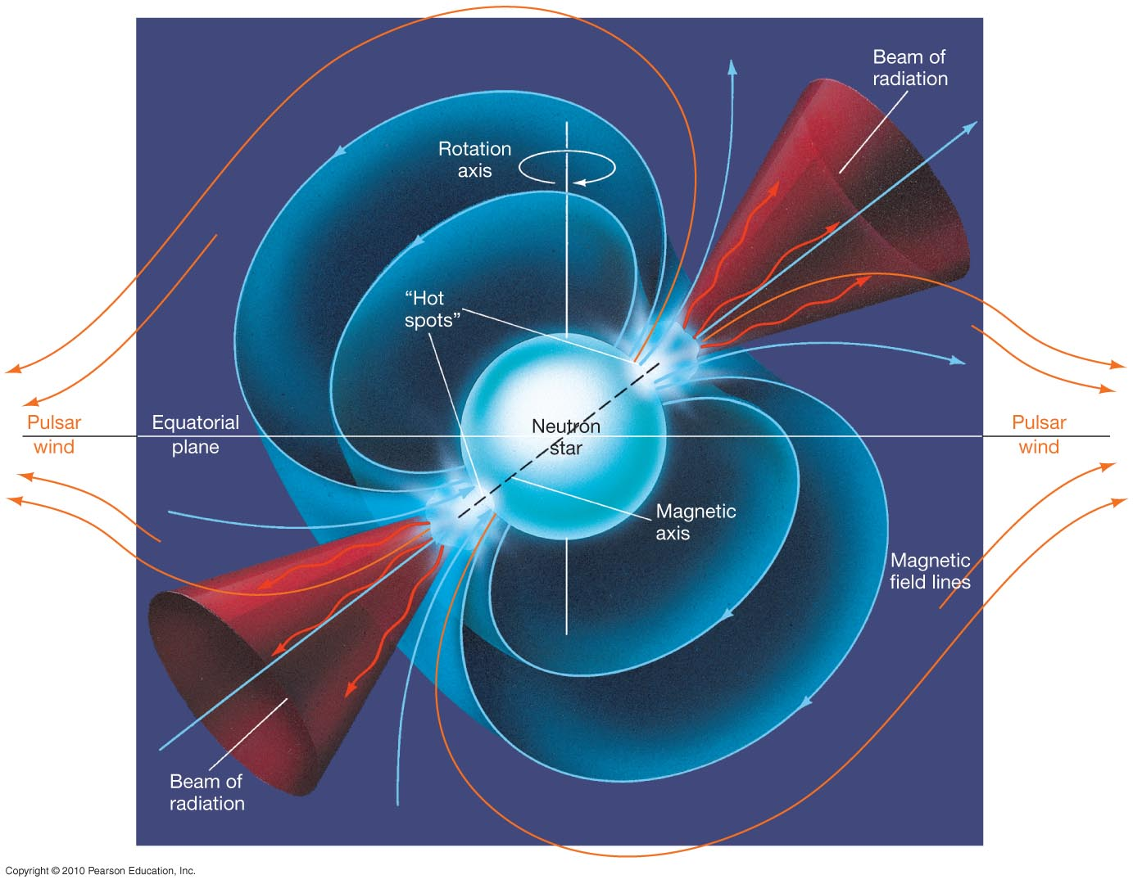
Pulsars
But why would a neutron star flash on and off?
This figure illustrates the lighthouse effect responsible.
Strong jets of matter are emitted at the magnetic poles, as that is where they can escape. If the rotation axis is not the same as the magnetic axis, the two beams will sweep out circular paths. If Earth lies in one of those paths, we will see the star blinking on and off.

Slide 11
Pulsars
Pulsars radiate their energy away quite rapidly; the radiation weakens and stops in a few tens of millions of years, making the neutron star virtually undetectable.
Pulsars also will not be visible on Earth if their jets are not pointing our way.
However, some pulsars – millisecond pulsars – have been spun up; their rotation rate has increased to nearly 1000 times per second. This is believe to happen because of accretion from a binary companion.

Slide 12
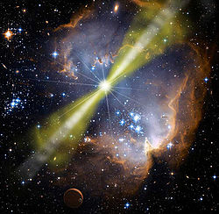
Gamma Ray Bursts
Artist’s conception of a gamma ray burst
First discovered by military satellites looking for nuclear tests in the 1960s, made public in 1970s
Very bright, irregular gamma ray flashes lasting only a few seconds
What are these??

Slide 13
Gamma Ray Bursts
Artist’s conception of a gamma ray burst
Two varieties – short bursts and long bursts
Gamma ray bursts give off huge amounts of energy in ~ 1 sec in gamma rays – equal to the energy of a supernova explosion
We will first discuss the long bursts, then the short bursts

Slide 14
More on the deaths of massive stars
Really massive stars (> 20 solar masses or so) may end their lives in the most violent explosions in the universe
When the star collapses it piles up onto the 1.4 solar mass proto-neutron star core and builds up its mass
At around 2-3 solar masses, the proto-neutron star becomes a black hole
Because the star is rotating, some of the material forms a disk and powers a powerful jet that punches it way through the remnants of the star

Slide 15
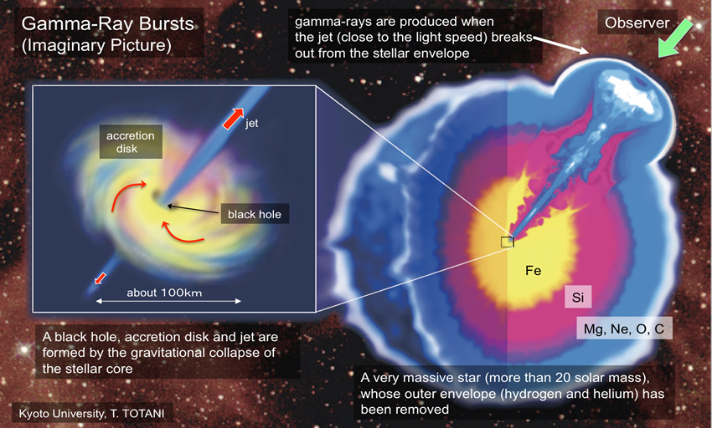
These explosions are called hypernova, and if the jet is pointed toward Earth this produces a gamma‐ray burst.

Slide 16
Gamma Ray Bursts
A long burst is probably caused by the explosion of a very massive star in a hypernova
But the short bursts are still a bit of a mystery. We think that they may be powered by merging neutron stars.
When two neutron stars merge, they create a black hole which starts eating the remaining parts of the two stars.
This generates enormous magnetic fields, which drive a powerful jet. If the jet points toward us, we see a short gamma-ray burst.

Slide 17
Here is an artist’s conception of what a short gamma-ray burst might look like.

Slide 18
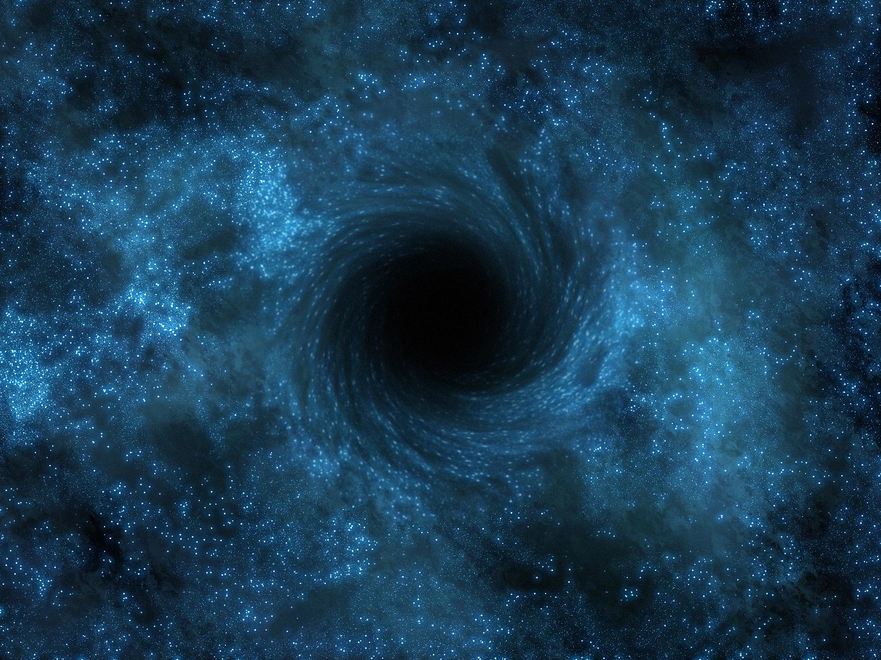
Black holes and an upper limit on the mass of neutron stars
The pressure from nuclear forces in a neutron star keep the star from collapsing.
But there is a maximum pressure that nuclear forces can exert and beyond 3 times the mass of the Sun, gravity must win.
At this point, the neutron star will collapse to a black hole, an object whose gravity is so strong that not even light can escape.
Nothing can escape from a black hole. How does this work?

Slide 19
No Exit: Black Holes
“Gravity is an essentially unstable force. For small concentrations of mass, the instability is masked by enormously larger short-range forces. But when the density of matter is sufficiently large or its mass sufficiently great, gravity becomes dominant and collapse inevitable.”
Stephen Hawking
Roger Penrose

Slide 20
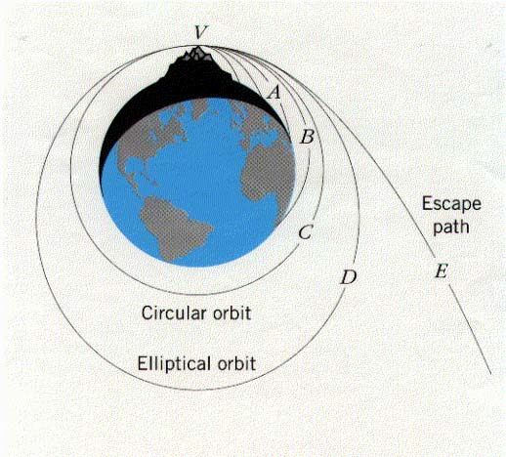
To escape from a star or planet, you need to reach the escape velocity.

Slide 21
To escape from the surface of the Earth, never to return, you have to move at at least 11 km/s (7 miles/second)
To escape from the Sun, you have to move at more than 600 km/s
To escape from the surface of a neutron star, you need to travel at 100,000 km/s, one third the speed of light.

Slide 22
As we add more mass to a neutron star, eventually the escape velocity matches and then exceeds the speed of light. At this point, everything (including light) falls inward toward a small speck.
This region in space becomes black because light cannot escape and thus a black hole is born.

Slide 23
Suppose that the Sun were suddenly replaced by a black hole of exactly the same mass. What would happen?
The Earth and the rest of the planets in the solar system would be sucked in very quickly.
The Earth and the rest of the planets would continue to orbit as usual.

Slide 24
Suppose that the Sun were suddenly replaced by a black hole of exactly the same mass. What would happen?
The Earth and the rest of the planets in the solar system would be sucked in very quickly.
The Earth and the rest of the planets would continue to orbit as usual.

Slide 25
Newton’s law of gravity: Any two objects in the universe attract each other with a force given by
As long as we’re far enough away, this law doesn’t care what sort of object has mass M – it could be a star or a black hole. It’s only very close to the black hole where things get weird, as we’ll see later.
m
M
r
M: mass of object 1
m: mass of object 2
r: distance between the objects

Slide 26
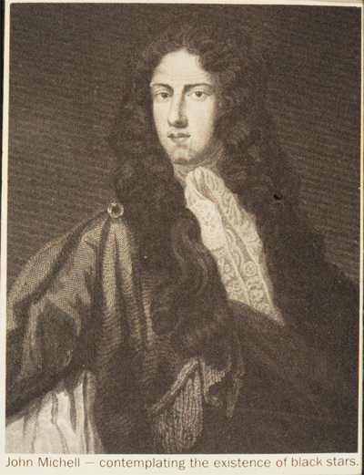
John Michell 1784
First published suggestion of the existence of black stars
“supposing light to be attracted by the same force in proportion to its vis inertiae, all light emitted from such a body would be made to return towards it, by its own proper gravity”
vis inertiae = inertia

Slide 27
Pierre Simon Laplace
1799
“Proof of the theorem, that the attractive force of a heavenly body could be so large, that light could not flow out of it.”

Slide 28
The matter collapses to a speck, surrounded by empty space.

Slide 29
Near the speck the gravitational field is so intense that the escape velocity is greater than the speed of light, the upper limit on speed in our universe. Because nothing can travel faster than this, nothing can escape. The region from which nothing can escape is the black hole. Its boundary is called an event horizon because no one outside can see events that occur inside:
You can’t see anything inside the event horizon.
Event horizon

Slide 30
Outside the black hole, the escape velocity is smaller than the speed of light.
Far from the black hole, the gravitational field is the same as it would have been if the core had not collapsed. If the Sun were to collapse to a black hole (it won’t), its gravity would be the same as it is now.
black hole: nothing inside the event horizon can get out
Outside: escape is still possible
Companion star feels the same old gravitational field of the mass that collapsed.

Slide 31
BLACK HOLES
A black hole is a region of space from which nothing can escape to the outside
The boundary of a black hole is called the event horizon because no events occurring beyond the horizon can be seen from the outside.
After a star has collapsed to within the event horizon, it continues to collapse to a tiny speck – actually a point of infinite density called a singularity.

Slide 32
No Exit: Everything within a few miles of the speck is pulled by gravity into it.
Star has collapsed to a speck

Slide 33
How big is the event horizon? It depends on the mass of the black hole
If the Sun collapsed to a black hole, its event horizon would have a radius of about 3 km
This is why the planets would continue to orbit as usual; they are very, very far beyond where the event horizon would be
The Earth would have an event horizon of about 9 mm, the size of a peanut

Slide 34
OBSERVING BLACK HOLES
Black holes are black, so how do we see them?
If a black hole is in a binary system with a companion star that is close enough for some of its matter to be caught by the black hole, the matter spirals in at speeds close to the speed of light, heats up by its own enormous friction, and emits energetic x-rays.
But matter spiraling in to neutron stars also emits x-rays. How do we know we’re looking at a black hole and not a neutron star? From the energy of x-rays, we know about how fast the infalling matter is moving and can conclude that it is caught by either a neutron star or a black hole.

Slide 35
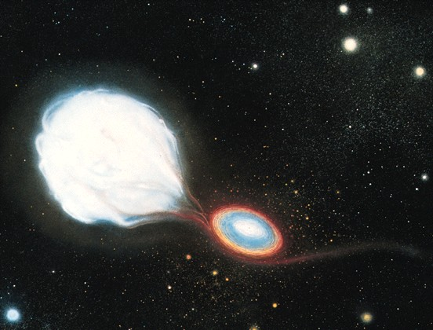
Matter falling on a black hole from its companion in a binary system

Slide 36
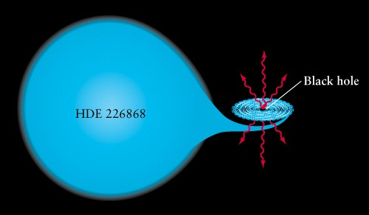
Diagram of the same system

