Slide 1
Announcements
Quiz 7 due tonight, practice problems in Problem Sets 7A, 7B
Approximate schedule for this week:
  Today: Finish Chapter 12, Sections 13.1 – 13.3
  Wednesday: 13.4 – 13.6
  Friday: 13.7 – 13.8
Next midterm: Wednesday after spring break, March 26
Midterm will cover Chapter 3 and Chapters 9-12 (first part of today’s lecture) – this is the material since last midterm
Review in class Monday March 24

Slide 2
Announcements II
Reminder: this is the last week to turn in astronomy news summary for extra credit
Summary in your own words of an astronomy-related story in the news
  Explain what, how and why it’s important
  At least three sources required, must be cited
Turn in any time in class until Friday, or email electronic copy
Info on D2L
+1% on final grade

Slide 3
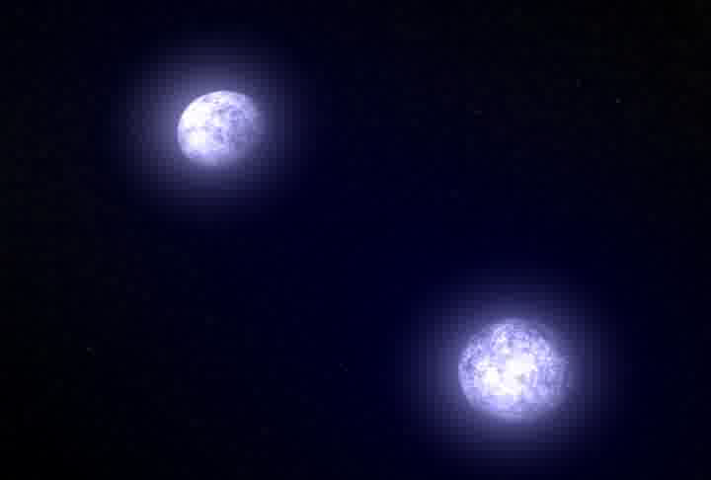
Type I supernova: collapse of a white dwarf star pushed over its upper mass limit

Slide 4
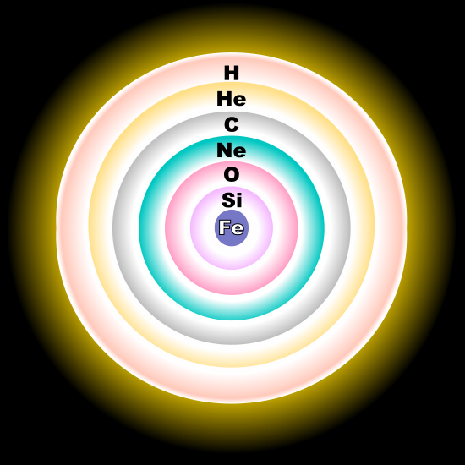
At the end of the life of a massive star (more than about 8 solar masses), its core is iron, and nuclear reactions around the core add more iron to it. But iron is the stablest element --- it will not fuse to make anything heavier.

Slide 5
The iron core then acts like a white dwarf --- it contracts until it can’t contract any more, held apart not by energy released in fusion, but by the degeneracy pressure of its electrons.

Slide 6
As more iron is added to the inert core, its mass approaches 1.4 solar masses, and then the iron core collapses, blowing off the rest of the star.

Slide 7
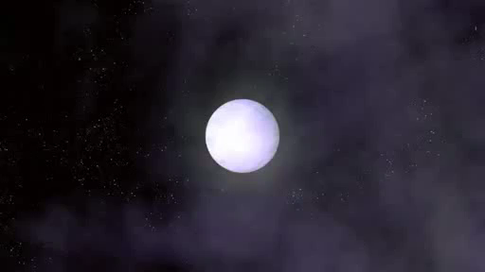
This is a Type II supernova,
or core collapse supernova

Slide 8
The Deaths of Massive Stars
• No dead iron core of a star can have a mass greater than 1.4 solar masses
• A Type II supernova is the explosion caused by the violent gravitational collapse of the core of a massive star at the end of its evolution (when enough iron has been added to it to exceed the 1.4 solar mass limit)
• Most of the star is blown away, and the expanding cloud it becomes is called a supernova remnant
• The most massive main-sequence stars end their lives in supernovae

Slide 9
Elements that are formed in low mass stars stay inside the stars. Elements heavier than helium are distributed throughout the galaxy by the supernova explosions that blow apart the most massive stars.
Nearly everything in you except hydrogen was once in a massive star that blew itself apart in a supernova.
Supernovae are the way elements heavier than helium get out of the stars where they form and are distributed through the universe.

Slide 10
Summary: Two types of supernovae
Type I: The collapse of an accreting white dwarf when its mass reaches 1.4 solar masses.
Type II: The collapse of the iron core of a massive star when its mass reaches 1.4 solar masses. The energy of matter falling during the gravitational collapse (and then rebounding) is the energy that explodes the rest of the star.

Slide 12
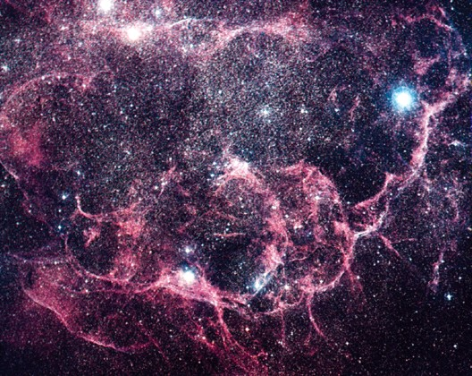

Slide 13
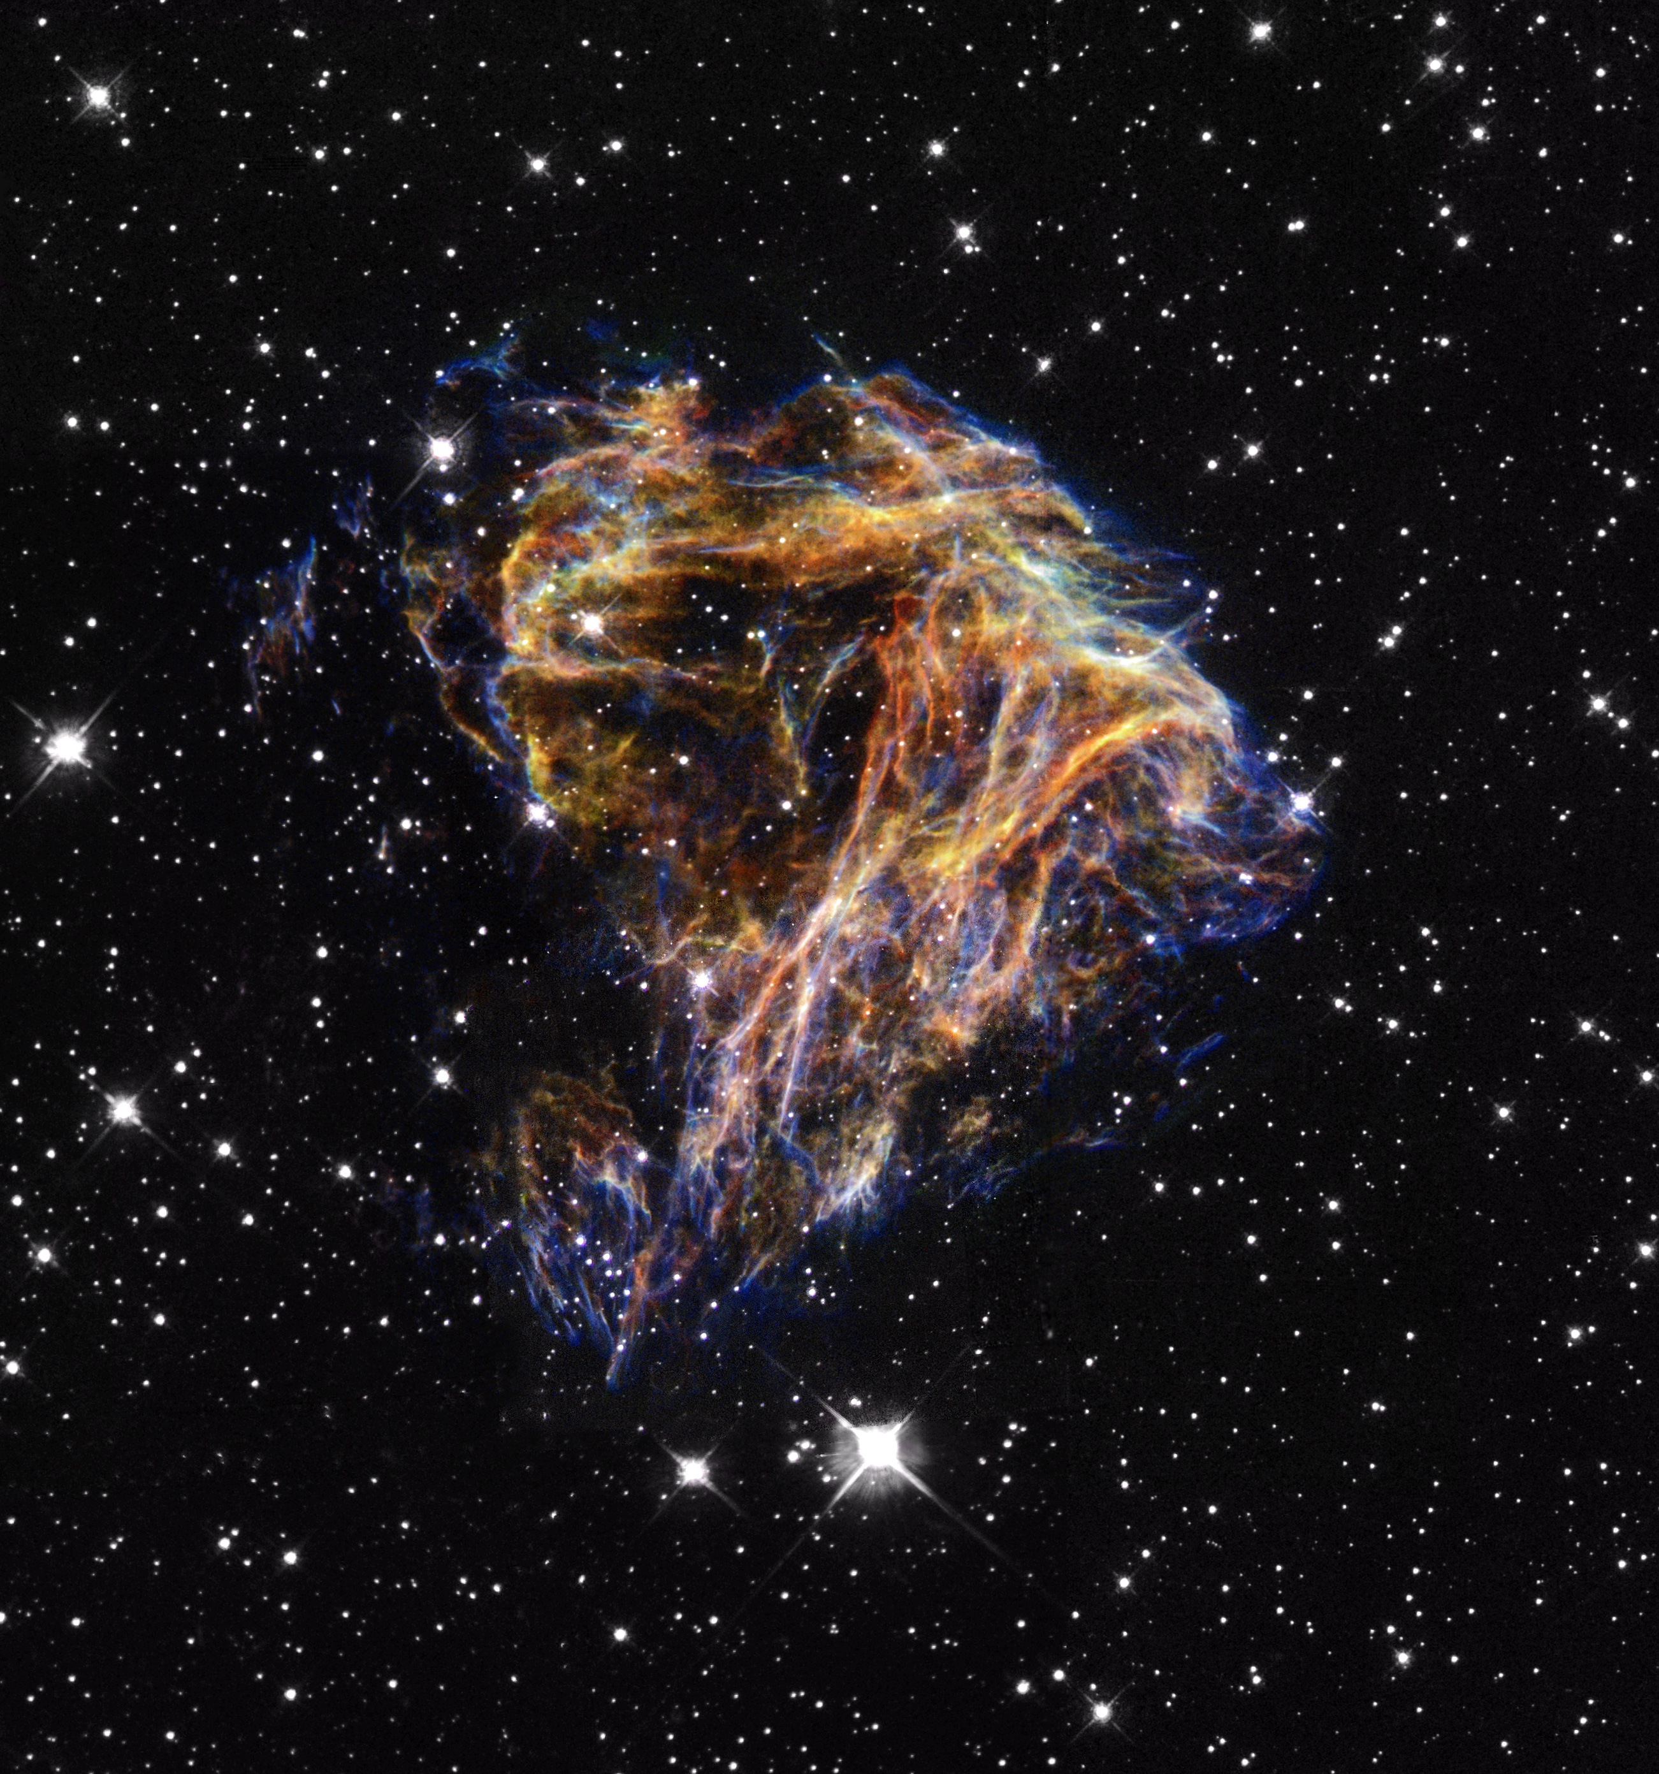

Slide 14
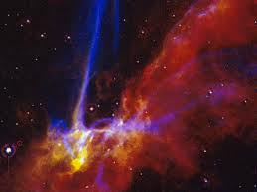
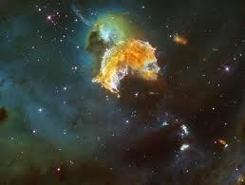
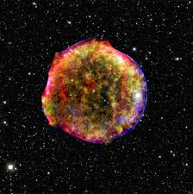
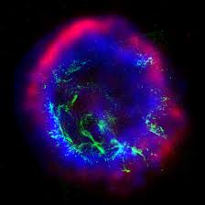
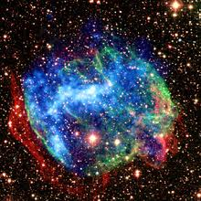
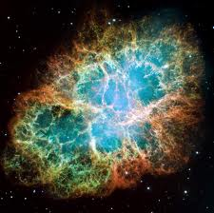
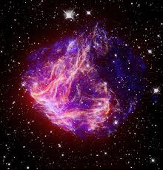
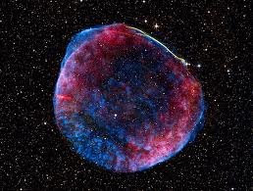

Slide 15
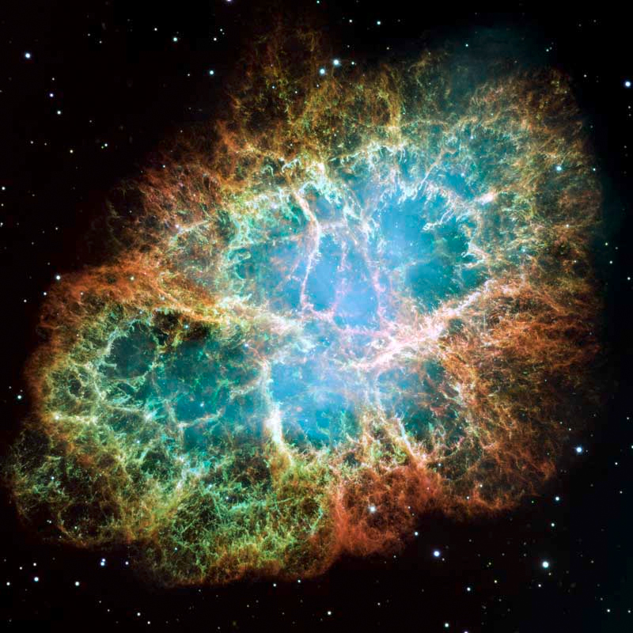
One of the most famous supernova remnants is the Crab Nebula
Supernova was in 1054: recorded by Chinese astronomers

Slide 16
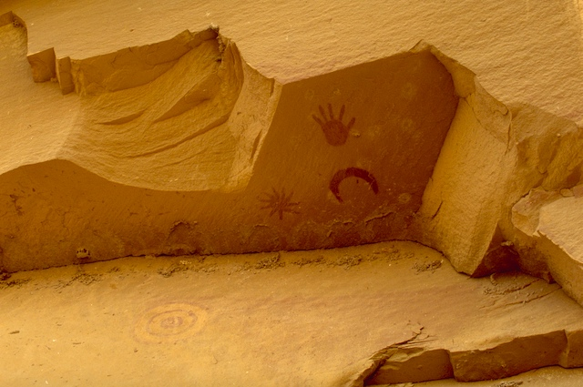
Crab Supernova was in 1054 -- probably also observed by the Anasazi in North America

Slide 17
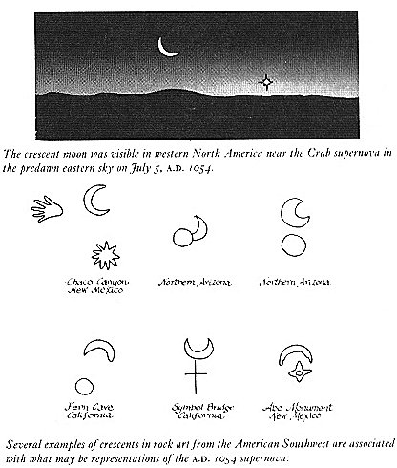

Slide 18
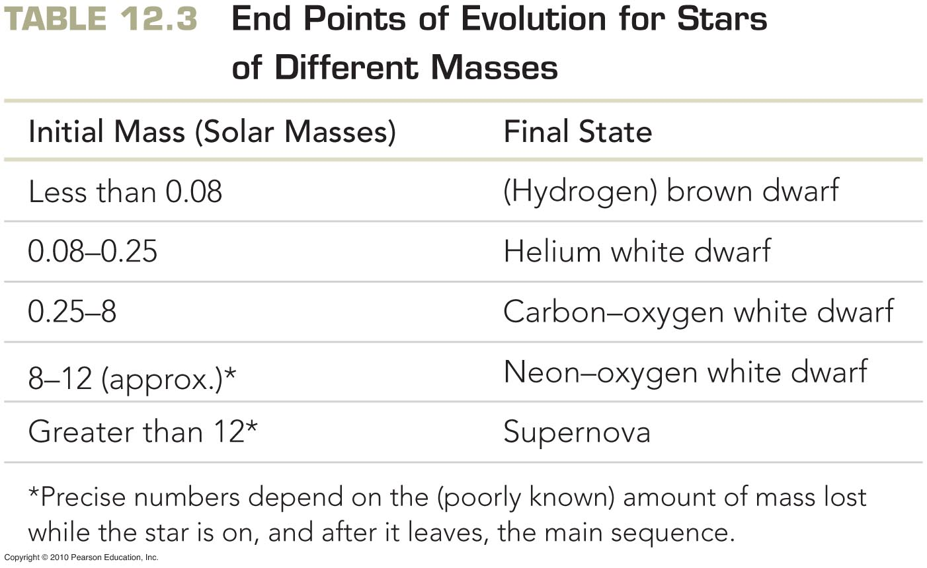
Evolution of Stars More Massive than the Sun

Slide 19
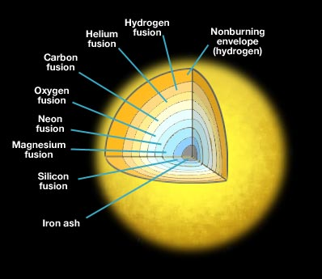




Which of these is the most likely mass of the star shown in this diagram?
0.4 M_{sun}
1 M_{sun}
4 M_{sun}
10 M_{sun}

Slide 20
Which of these is the most likely mass of the star shown in this diagram?
0.4 M_{sun}
1 M_{sun}
4 M_{sun}
10 M_{sun}

Slide 21
The Ages of Star Clusters
The more massive a star is, the more quickly it evolves.
One can find the age of a cluster of stars by observing which stars have left the main sequence
In the youngest clusters even the most massive stars (O and B) are still on the main sequence
In the oldest clusters, stars with mass as small as the Sun’s (spectral types O, B, A, F, G) have
evolved to red giants

Slide 22
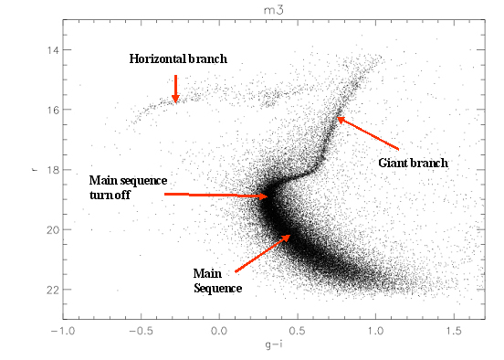
Luminosity ➔
⬅Temperature
Find a star cluster, plot all the stars on an H-R diagram
Find the point where stars leave the main sequence: main sequence turnoff
The age of the cluster is the main sequence lifetime of a star with the mass of the stars that have just left main sequence

Slide 23
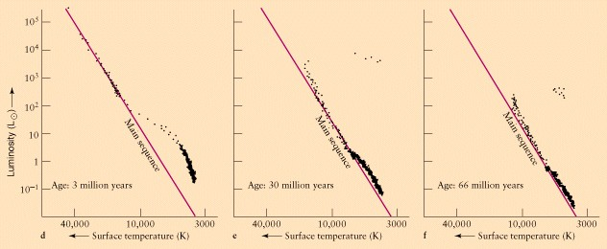
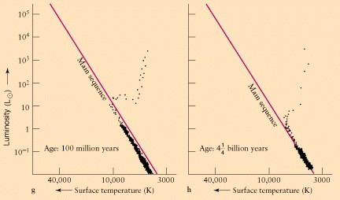
Younger clusters
Older clusters

Slide 24
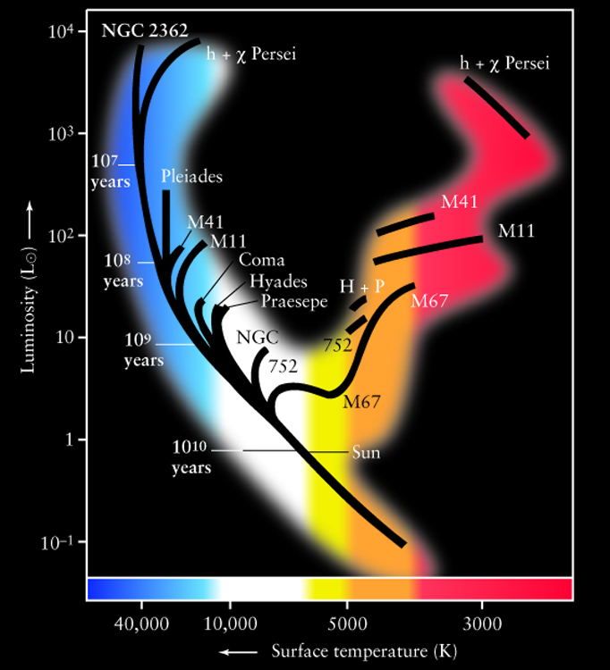
All of the low mass stars ever formed are still on the main sequence!

Slide 25
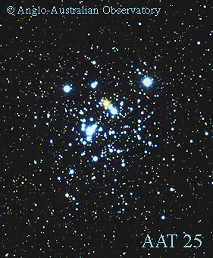
Jewel Box:
a young
open cluster

Slide 26
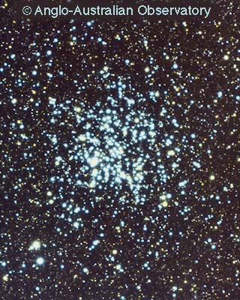
Young open cluster, about
500 million
years old
Μ11

Slide 27
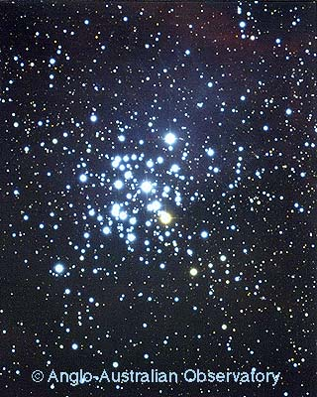
An even younger open cluster
ΝGC 3293

Slide 28
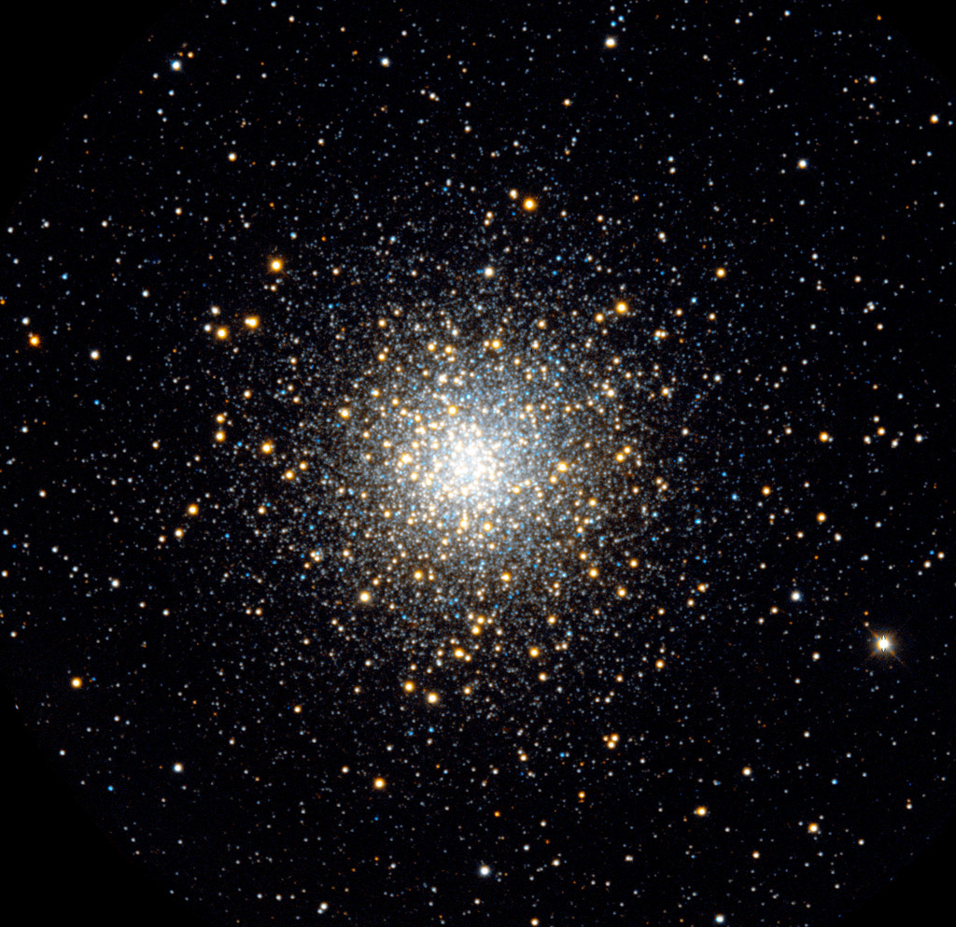
Old globular clusters
M10

Slide 29
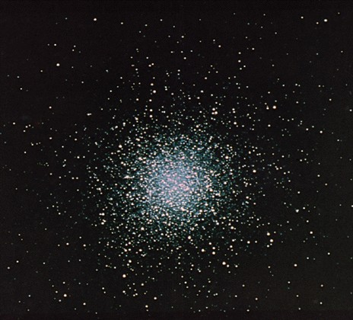
Old globular clusters
M13 in Hercules

Slide 30
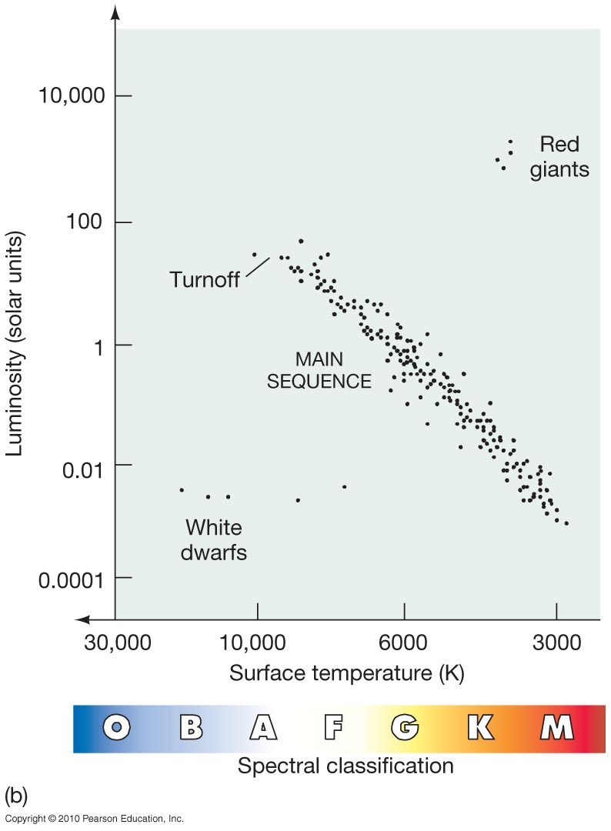
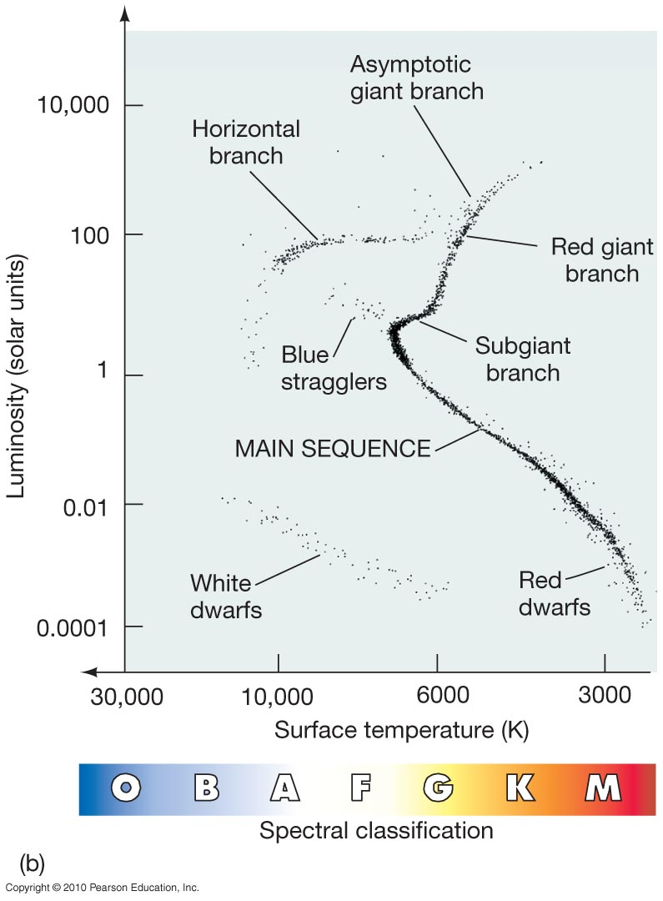
H-R diagram of young cluster
H-R diagram of older cluster

Slide 31
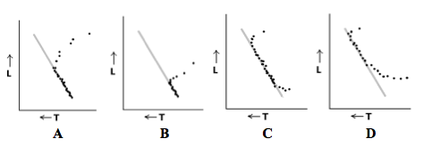
This figure shows H-R diagrams for four star clusters. Which one is the oldest?
A
C
B
D

Slide 32
This figure shows H-R diagrams for four star clusters. Which one is the oldest?
A
C
B
D

Slide 33
Astronomy 103
Neutron stars, black holes, and spacetime
Please read Chapter 13

Slide 34
At the end of the life of a massive star, we have seen that its iron core collapses. When the core collapses, the electrons are pushed down onto the nuclei – the core collapses from the size of the Earth to the size of a city, about 20 km (13 mi) in diameter. 100 times more energy is released in these few seconds by the collapse than the star released during its entire lifetime.
This creates a neutron star: a star that is composed of neutrons – a star that is almost a giant atomic nucleus.

Slide 35
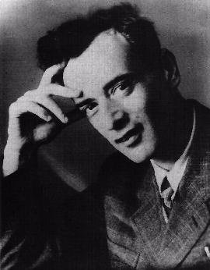
Neutron stars
Immediately after the neutron was discovered in 1930, physicist Lev Landau suggested the possibility that the pressure in the cores of stars might push the electrons onto their protons to make a core entirely of neutrons. He wasn’t quite right: The pressure is high enough only when the star collapses in a supernova.
proton
electron

Slide 36
Neutron stars
Immediately after the neutron was discovered in 1930, physicist Lev Landau suggested the possibility that the pressure in the cores of stars might push the electrons onto their protons to make a core entirely of neutrons. He wasn’t quite right: The pressure is high enough only when the star collapses in a supernova.
proton
electron

Slide 37
Neutron stars
Immediately after the neutron was discovered in 1930, physicist Lev Landau suggested the possibility that the pressure in the cores of stars might push the electrons onto their protons to make a core entirely of neutrons. He wasn’t quite right: The pressure is high enough only when the star collapses in a supernova.
neutron
neutrino

Slide 38
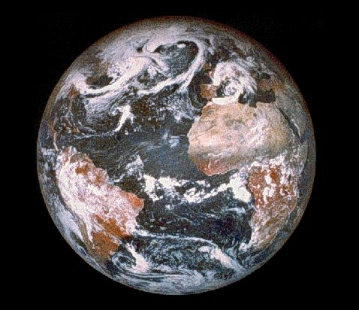
How does this work?
a white dwarf is roughly the size of the Earth

Slide 39
How does this work?
A neutron star has a radius of about 10 km, roughly 1/1000 that of the Earth
Remember that atoms are mostly empty space

Slide 40
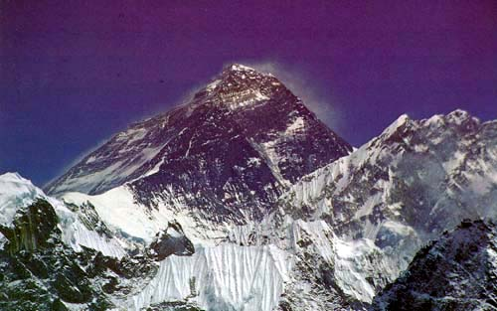
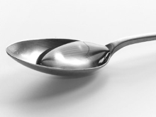
If you compressed all of Mt. Everest, pushing its electrons onto their nuclei, you would get a single teaspoonful of neutron-star matter.
!

Slide 41
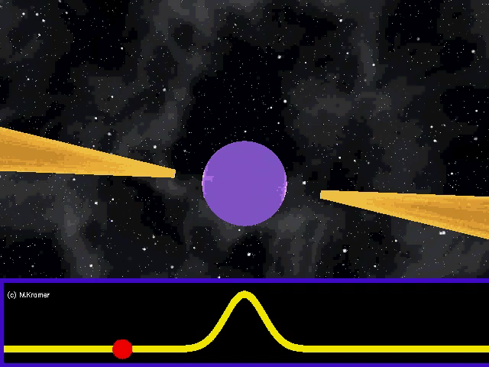
Neutron Star Fun Facts
R≈15 km and M≈1.5 M_{Sun}
Central density 2-10 times that of atomic nucleus
  1 teaspoon is about 10¹² kg
  a cube 300 meters on a side has the same mass as the Earth
Magnetic field >10¹² times that on Earth
  erase credit cards from 30,000 km & kill from 200 km
Spin frequencies from 0.1 Hz to 716 Hz → pulsars
  faster than a kitchen blender!

Slide 42
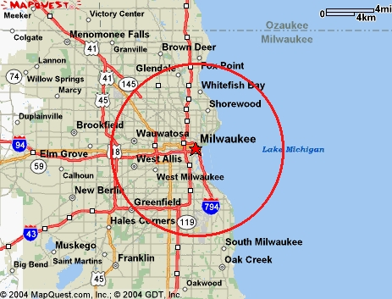
10 km

Slide 43
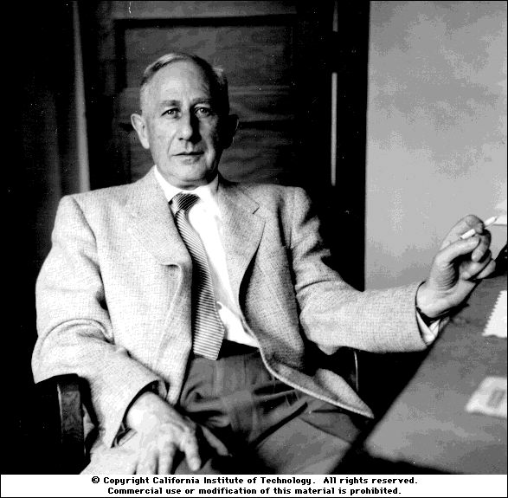
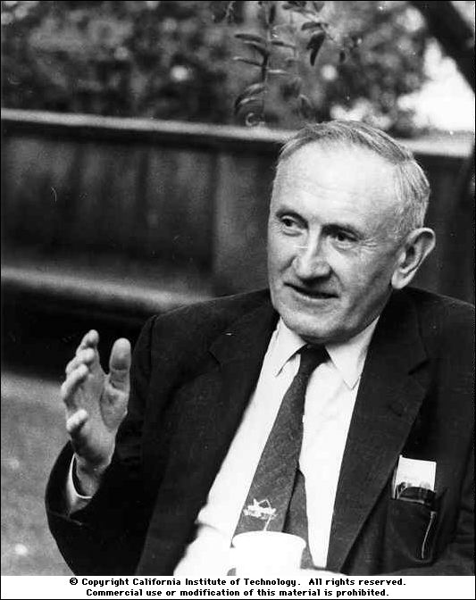
Energy of a supernova
Walter Baade
Baade and Zwicky pointed out that the gravitational energy released by a star falling inward to become a neutron star would be about 1 billion times as large as the energy emitted by the Sun over its entire lifetime — the observed energy of a supernova. Based on this observation, they suggested that “...supernovae represent the transitions from ordinary stars into neutron stars.” This was two years after the discovery of neutrons and 33 years before discovery of neutron stars.
Fritz Zwicky

Slide 44
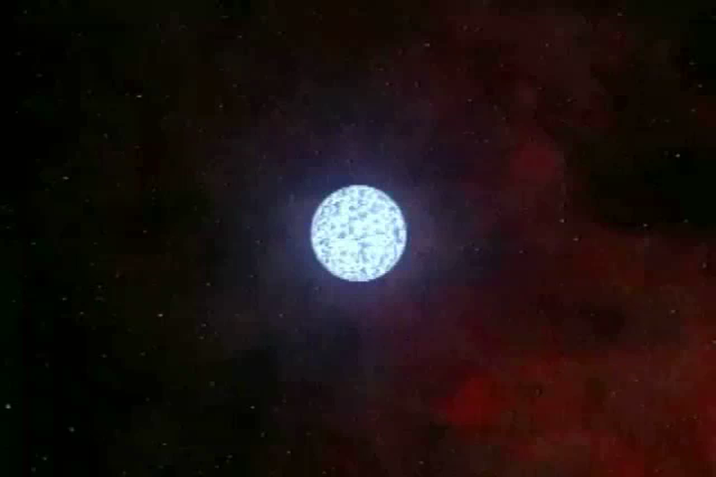
Baade and Zwicky realized that the energy released by a star collapsing to a neutron star would be about the same as the observed energy of a supernova

Slide 45
Although Baade and Zwicky suggested in 1934 that neutron stars might exist and might be the outcome of a supernova, no neutron stars were seen for the next 33 years.
In 1967 Jocelyn Bell, a graduate student at the University of Cambridge, saw a set of mysterious radio sources that they called pulsars, because they saw from each object a pulse of radio waves once every second or so, with extremely regular periods. What was Bell looking at?

Slide 46
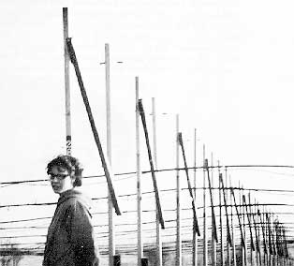
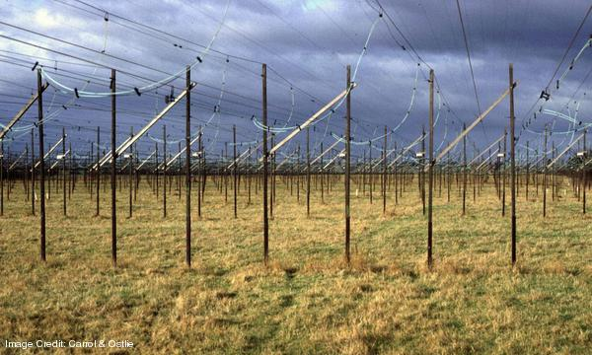
Jocelyn Bell and her radio telescope

Slide 47
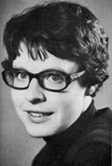
Jocelyn Bell, at about the time she discovered the first neutron stars.
Her discovery won the Nobel prize, but for her advisors and not for her – one of the great mistakes in Nobel Prize history.

Slide 48


This is what she saw, converted to an audio signal
PSR B0329+54
0.7 s period
Pulses happen with great regularity. Here in this case it is once every 0.7 seconds.
Because they didn’t know what these objects were at first, this was dubbed LGM-1 or Little Green Men-1.
Not the cause of the pulses!

Slide 49
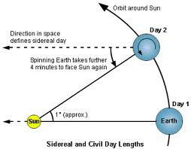

Remember this?
To distant star
To distant star
Solar day: Sun returns to same position
Sidereal day: Stars return to same position
Because of Earth’s rotation around Sun, it takes 4 minutes longer for Sun to return to same position
Sidereal day is 4 minutes shorter, and stars rise 4 minutes earlier each day
Mysterious pulsing radio source rose 4 minutes earlier each day, and was therefore not coming from the Earth!

Slide 50
It was soon realized that these pulsating stars had to be neutron stars because anything larger that rotated with a period of 1.3 seconds would fly apart.
The radio waves are thought to be generated by the intense, rotating magnetic field of neutron stars – a electric generator in space. For these pulsing stars or pulsars, the magnetic field is 10¹² or one trillion times stronger than the earth’s magnetic field.
As the N or S pole of the pulsar points toward us, we see a flash of radio emission.

Slide 51
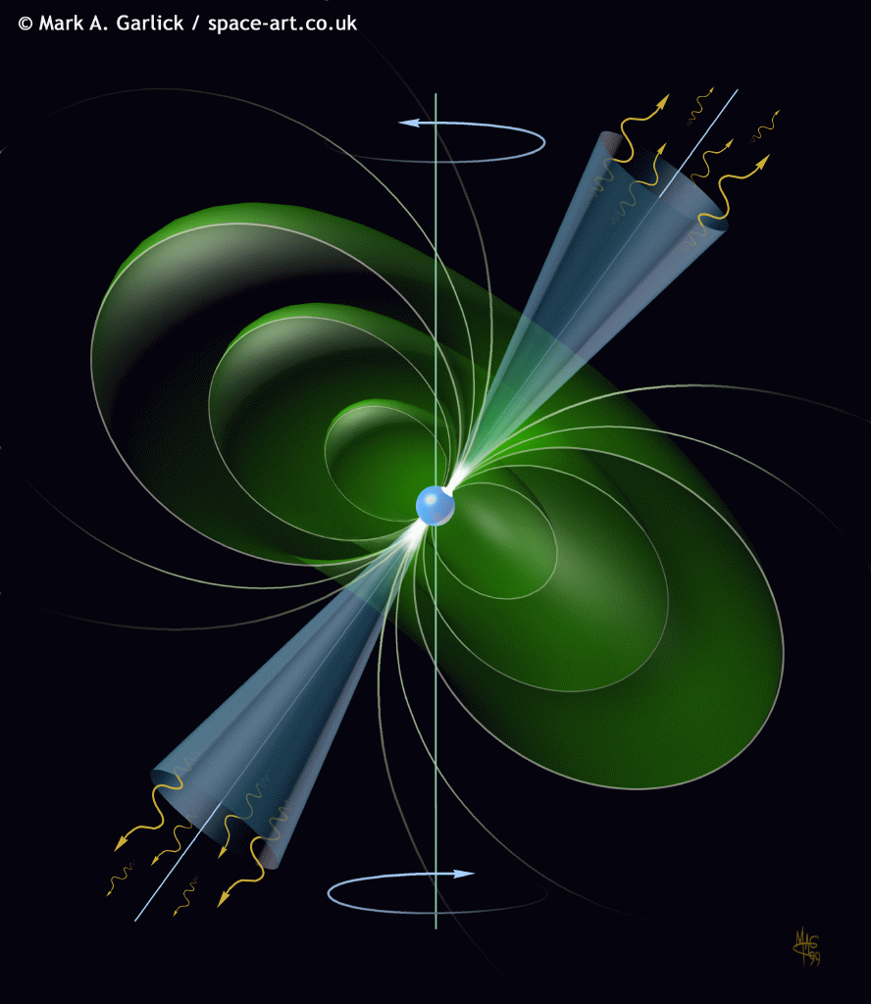
Pulsar
Beams of radio waves
Magnetic axis
Magnetic field
Rotational axis

Slide 52
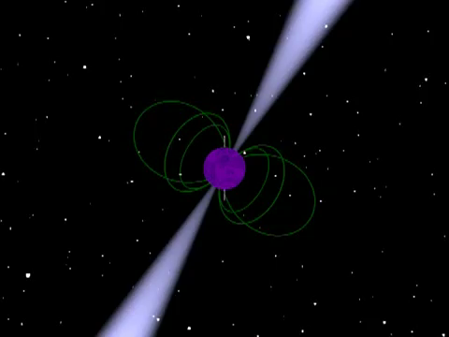
Pulsar

Slide 54
At the center of the Crab supernova remnant, just where you would expect one to be, a pulsar was discovered – so neutron stars are associated with supernovae.
After a year of watching it, the Crab pulsar was found to be less regular than a perfect clock – it was slowing down. And the energy lost by the spinning neutron star is equal to the energy emitted by the Crab nebula: energy from the pulsar is deposited in the surrounding gas, heating it.

Slide 55
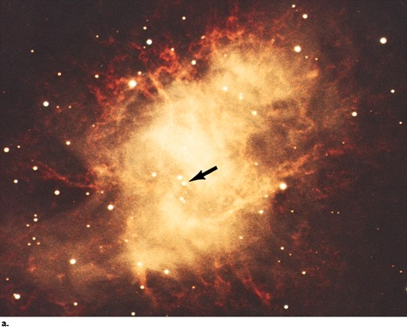

Slide 56
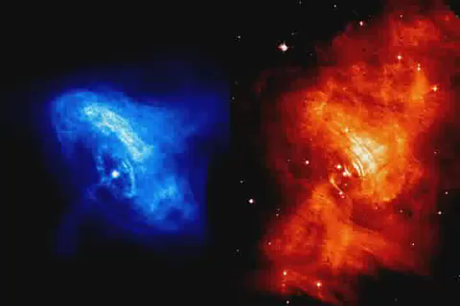
Crab Pulsar Wind Nebula
X-rays
Visible

Slide 57
Crab Pulsar Wind Nebula
The Crab pulsar also powers much of the emission from the Crab nebula
This is most evident in the center of the nebula, where we see the pulsar wind nebula
Wind of charged particles is accelerated by the rapidly rotating, superstrong magnetic field of the spinning pulsar
Pulsar wind streams into the interstellar medium, creating a shock wave

Slide 58
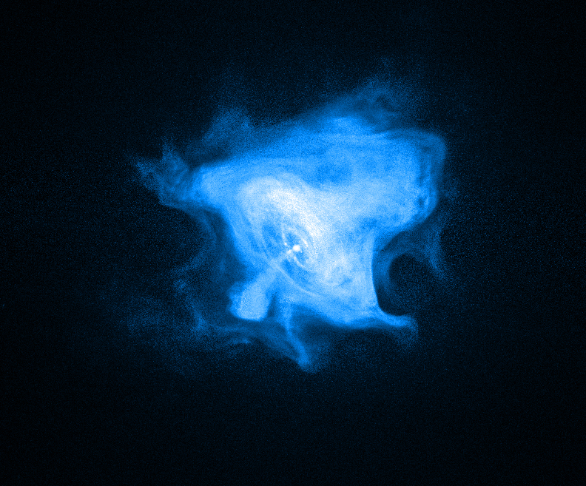
X-ray image of Crab
Pulsar Wind Nebula
Intense equatorial wind
Jets directed away from poles

Slide 59
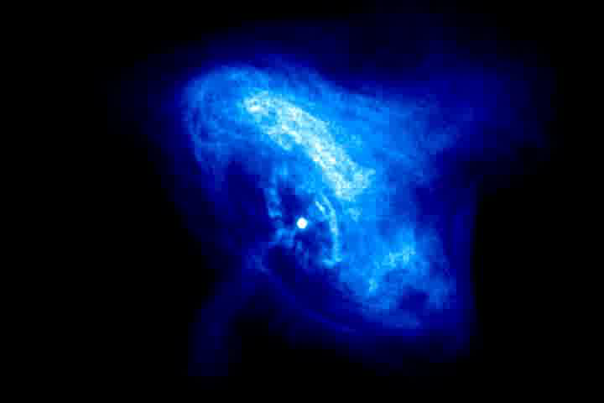
X-ray image of nebula + model

Slide 60
Pulsars come in a great variety:
Vela Pulsar
89 ms period
Crab Pulsar
67 ms period
PSR B1937+21
1.5 ms period
PSR B1937+21 is the second known fastest pulsar and is known as a millisecond pulsar because its period is < 10 ms.

Slide 61
Millisecond pulsars
Some pulsars spin nearly 1000 times a second
  More massive than the Sun, only around 20 km across!
  Equator of star moving at around 20% of the speed of light!
As we saw with the Crab pulsar, pulsars lose energy over time and slow down
So how do some of them end up spinning so fast?

Slide 62
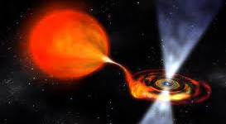
Millisecond pulsars
A neutron star accretes matter from a close binary companion, and the infalling matter makes the star spin faster

Slide 63

Millisecond Pulsars
Binary star system: one star becomes red giant, supernova, neutron star
Neutron star then accretes matter from companion, spins faster, becomes millisecond pulsar

Slide 64

Pulsar Planets
First planets discovered outside our solar system orbit a pulsar!
Discovered by very precise timing of pulses with radio telescopes – orbit of planets causes changes in pulsations

Slide 65

Pulsar Planets
Artist’s conception of planets around a pulsar
How do planets form around a pulsar? Do they survive supernova explosion, or form later?

