Slide 1
Announcements
Quiz 6 due tonight, covers Stars, Chapter 10
  Problem sets 6A, 6B for practice
Quiz 7 on Chapters 10 and 11 due next Monday
Today: finish Chapter 10, start Chapter 11
Wednesday and Friday: Chapters 11 and 12

Slide 2
Astronomy 103
The Stars, continued
Please read chapter 10

Slide 3
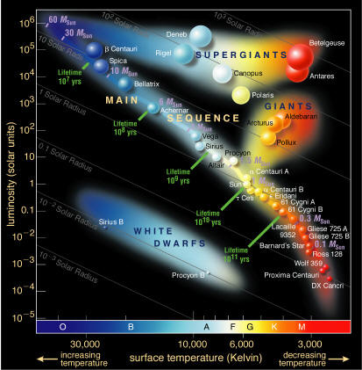
The H-R Diagram

Slide 4
From the masses of stars, one can understand the main sequence.
What determines where on the main sequence a star will be when it forms?
Stars on the main sequence are only distinguished by their mass

Slide 5
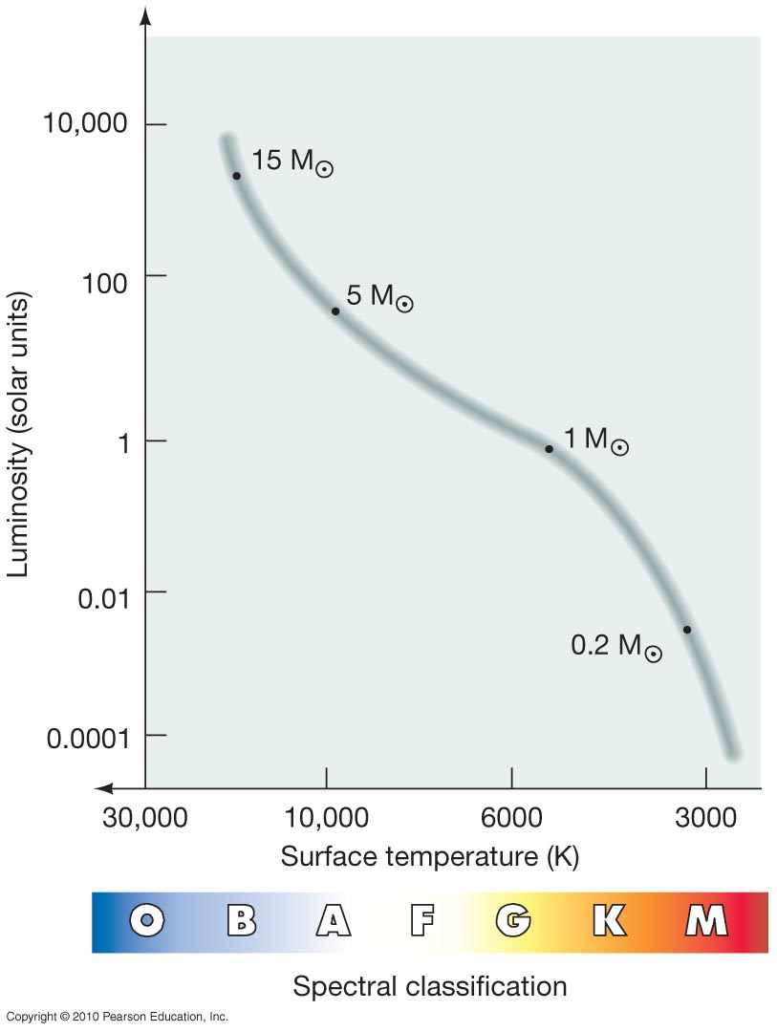
Stars with small masses are the stars that are low on the main sequence. They burn much more slowly, so they are much dimmer and their surfaces are cooler. Stars with larger masses burn much more quickly and have hotter surfaces (and hotter interiors).
High mass stars
Low mass stars

Slide 6
Stars don’t move along the main sequence – that would require them to change their mass.
Instead they just sit on the main sequence until their time there is up.
The main sequence is a waystation, where stars spend MOST of their lives.

Slide 7
Summary:
• The difference between stars on the main sequence is due to the difference in their masses.
• Low mass stars are low on the main sequence, and are much dimmer --- a star of 1/10 of a solar mass is only 1/1000 as bright as the Sun.
• Similarly, high mass stars are high on the main sequence, and are much brighter --- a star of 10 solar masses is 10,000 times brighter than the Sun

Slide 8
How long does a star live?
A star spends nearly all of its life burning hydrogen to helium in its core. The time it can do that is limited by it supply of hydrogen.
We will figure out how long it takes the star to fuse the hydrogen in its core to helium.

Slide 9
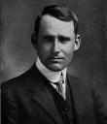
Review: The Energy of Starlight
The mass of a helium atom is slightly less than the mass of 4 hydrogen atoms (by 0.7%=0.007):
Eddington’s guess (1920):
Hydrogen can turn into helium, and when it does, 0.7% of its mass changes to energy – and that energy powers the Sun

Slide 10
The lifetime of a star
There are 3 steps in this problem
Use the amount of energy the star emits per second to find the mass the star changes into energy each second: m=E/c²
We have already done this for the Sun.

Slide 11
The lifetime of a star
Now we know how much mass the star changes into energy each second. Next:
Find the amount of hydrogen consumed per second this represents. Only 0.7% of the total mass of hydrogen burned is actually changed into energy, so the amount of hydrogen used is 1/0.007 = 143 times the mass found in step 1.

Slide 12
The lifetime of a star
Now we can calculate the lifetime of the star.
Lifetime:
The amount of fuel a star has is equal to the mass of its core, so:

Slide 13

How long can you stay underwater?
Until you use up all your air!
How many hours will this be?
Total amount of air divided by amount of air used per hour

Slide 14
Step 1. How much mass does a star change into energy each second? (you’ve already done this part)
Example: For the Sun, luminosity = :

Slide 15
Step 2 : How much hydrogen does the star burn per second?
For the sun, which converts 4.4 x 10⁹ kg into energy per second

Slide 16
Step 3. How long does a star live?
Example: For the Sun,

Slide 17
Lifetime of other stars
Once we know the lifetime of the Sun, the lifetime of other stars can be found much more quickly:
The total mass changed to energy is proportional to the mass of the star. If a star has 5 times the mass of the Sun it will change 5 times as much mass to energy in its lifetime.
The mass changed to energy each second (the amount of fuel consumed) is proportional to the luminosity of the star. If a star has 1000 times the luminosity of the Sun, it will change 1000 times as much mass to energy each second.

Slide 18
Lifetime of other stars
A star with 5 times the mass and 1000 times the luminosity of the Sun then has a lifetime 5/1000 = 0.005 times as long
Mass compared to mass of Sun
Lifetime of star!
Lifetime of Sun
Luminosity compared to luminosity of Sun

Slide 19
The math we just did can be summarized as the following formula:
Here’s the same example:
A main sequence star has mass and luminosity What is the star’s lifetime? The calculation is again

Slide 20
Lifetimes of Stars
To understand what this means for the lifetimes of stars, we need to understand how mass M and luminosity L are related for stars of different masses

Slide 21
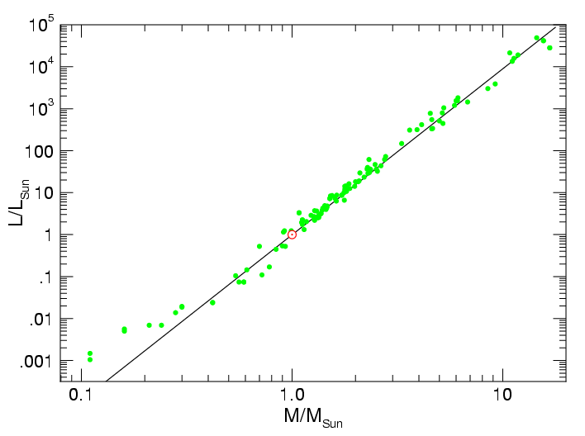
What is the luminosity of stars of different masses?
Factor of 10 increase in mass, factor of 10,000 increase in luminosity!

Slide 22
What is the luminosity of stars of different masses?
L increases much faster than M as stars increase in mass, so M/L gets very small!

Slide 23
Massive stars burn bright, die young
M/L gets very small for more massive stars!
This tells us that massive stars have very short lifetimes
They burn very brightly and use up their fuel very quickly
You will find problems about the lifetimes of stars in Quiz 7

Slide 24

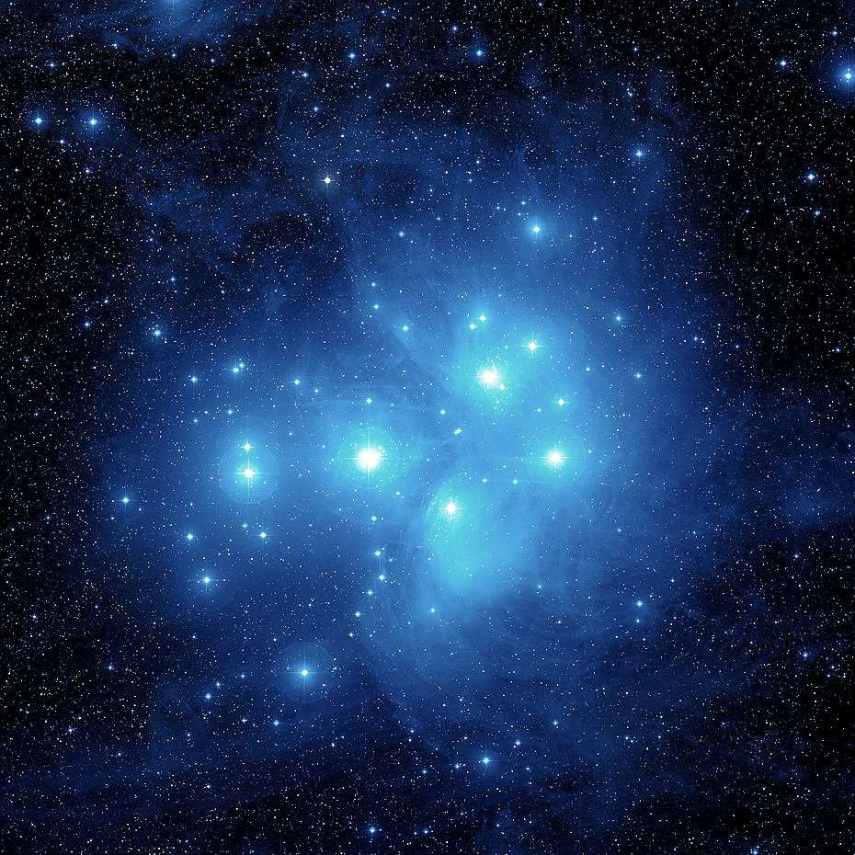

Slide 25
Astronomy 103
The Interstellar Medium and Star Formation
Please read Chapter 11

Slide 26
The Interstellar Medium (ISM)
Space is empty.
Almost….
In interstellar space (the space between the stars), there is around 1 atom/cm³. By contrast the earth’s atmosphere is 10²⁰ atoms/cm³ and the best vacuum on earth is 1000 atoms/cm³.
There are also dust grains in interstellar space, but only about 1 grain/km³.

Slide 27
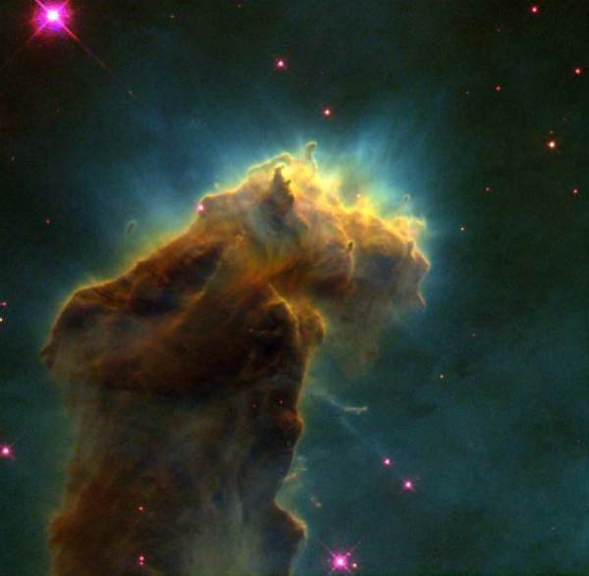
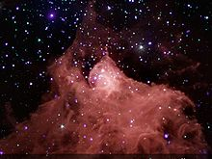
Gas in the ISM
Gas in the ISM is mostly hydrogen. It is in three phases:
  Cold (10-100s K)
  Warm (around 8000 K)
  Hot (10⁶ K)
Most of the volume is hot, but hot gas is very diffuse – most of the gas is warm or cold. This cold gas is important because it is found in clouds that form stars. Cold gas clouds are what stars come from.

Slide 28
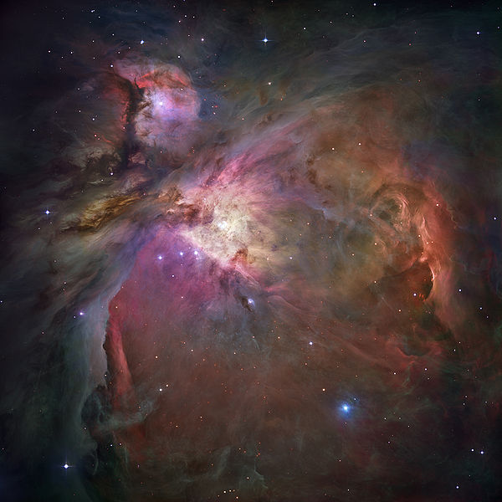
Some of these cold clouds have formed hot, massive stars that have heated up the gas hot enough for the hydrogen to be ionized. These regions of hot gas are called HII regions.
HII (“H two”) is astronomer-speak for ionized hydrogen.

Slide 29
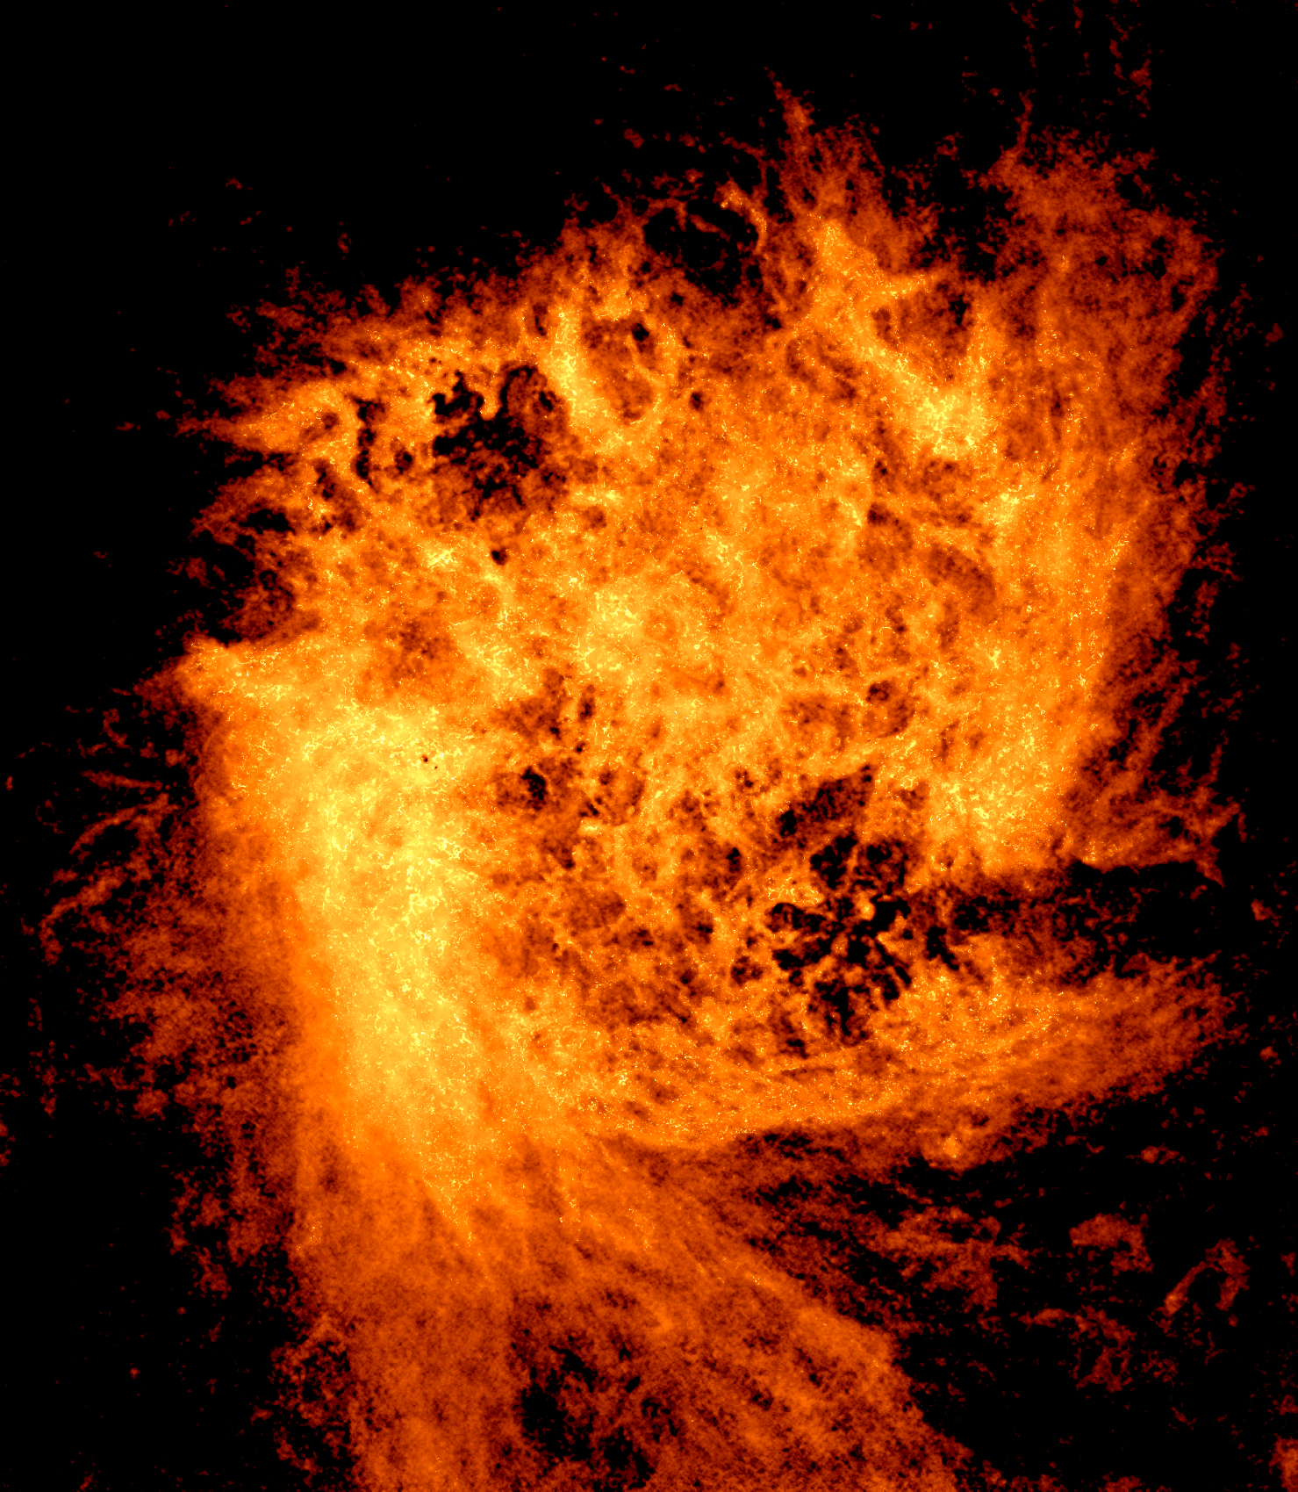
Gas cool enough that its hydrogen is in the form of atoms is called HI.
HI (“H one”) is astronomer-speak for neutral hydrogen.
Neutral hydrogen gas cannot be seen in visible light. This is a radio image of HI gas in a small nearby galaxy called the Large Magellanic Cloud.

Slide 30
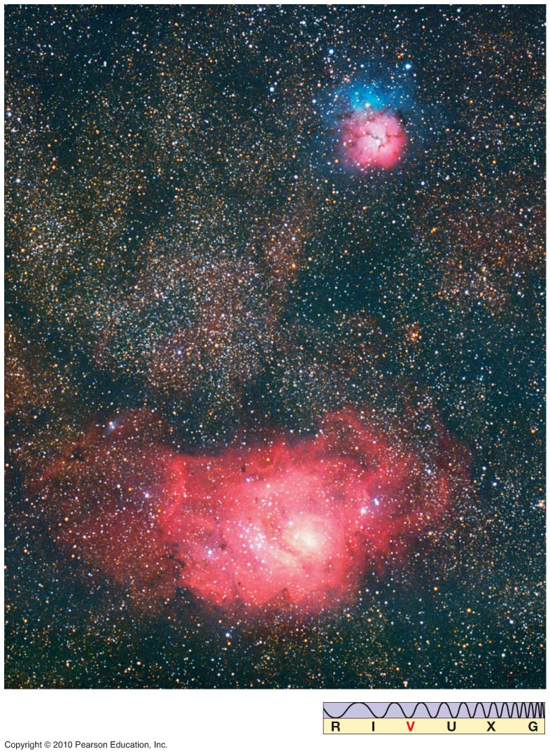
Hot clouds are bright and the light they emit can be seen.
This picture shows visible light from ionized hydrogen gas.

Slide 31
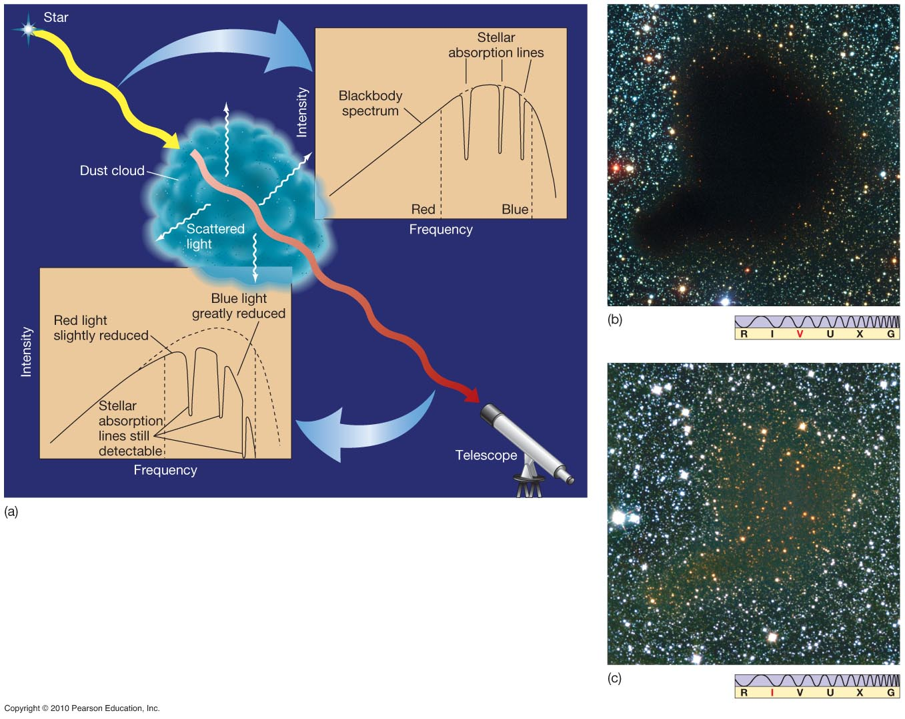
Cool clouds emit little visible light and are observed as dark nebulae,
dark clouds that block the light from the stars behind them. Cool clouds also contain dust, which scatters light of wavelengths shorter than the size of a typical dust grain, reddening the light that goes through it.
Dusty clouds become transparent in infrared light.

Slide 32
These cold clouds are cold enough to have a lot of dust.
The dust grains are a few hundred nm in size, about the wavelength of visible light. Because they are this size, they affect different colors differently.
Light is scattered by things about the same size as its wavelength. Blue light is shorter in wavelength than red light, and blue light is scattered more by dust than red light. This makes dusty regions look redder.

Slide 33
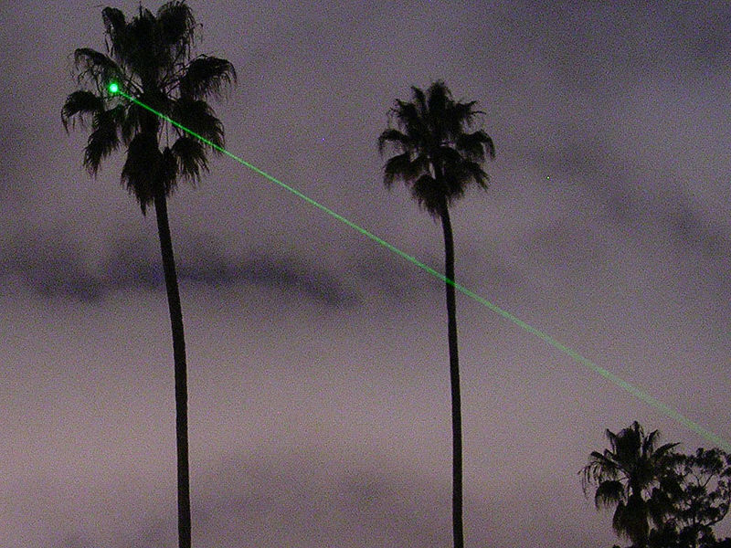
Laser beams! The green laser is strongly scattered by the atmosphere, so we see the beam more easily than a red laser

Slide 34
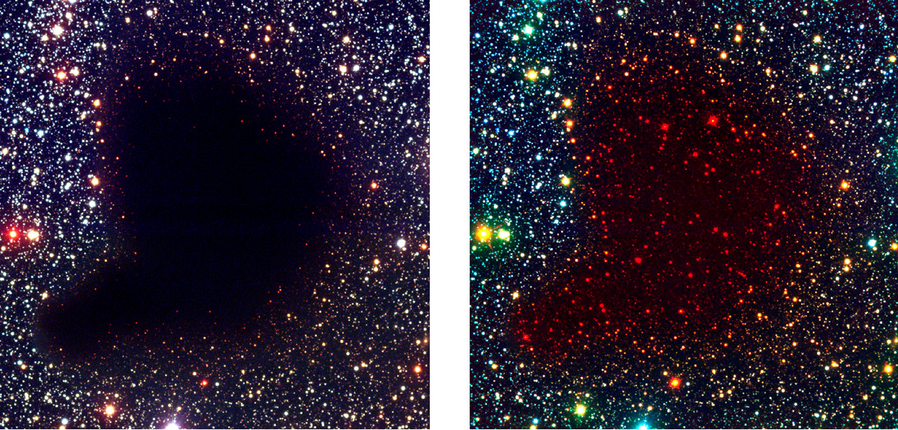
Reddening due to Barnard 68.

Slide 35
Visible wavelength image of star formation in the M17 nebula

Slide 36
Infrared image of star formation in the M17 nebula
Dusty regions are bright in infrared but dark in visible light.

Slide 37
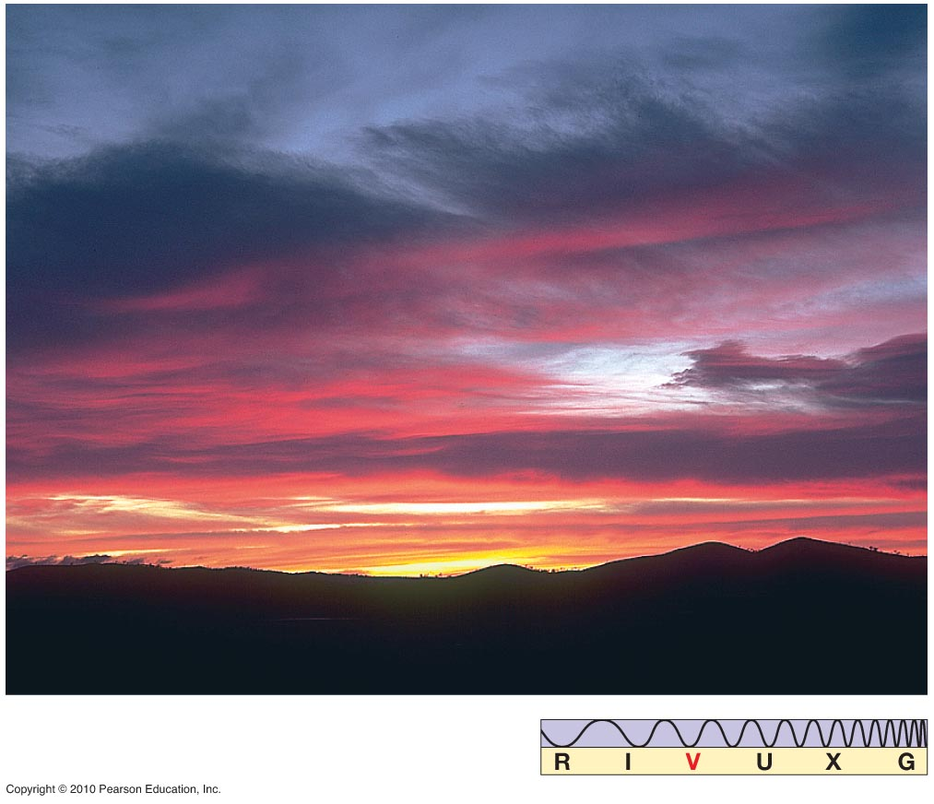
The same effect is responsible for sunsets

Slide 38
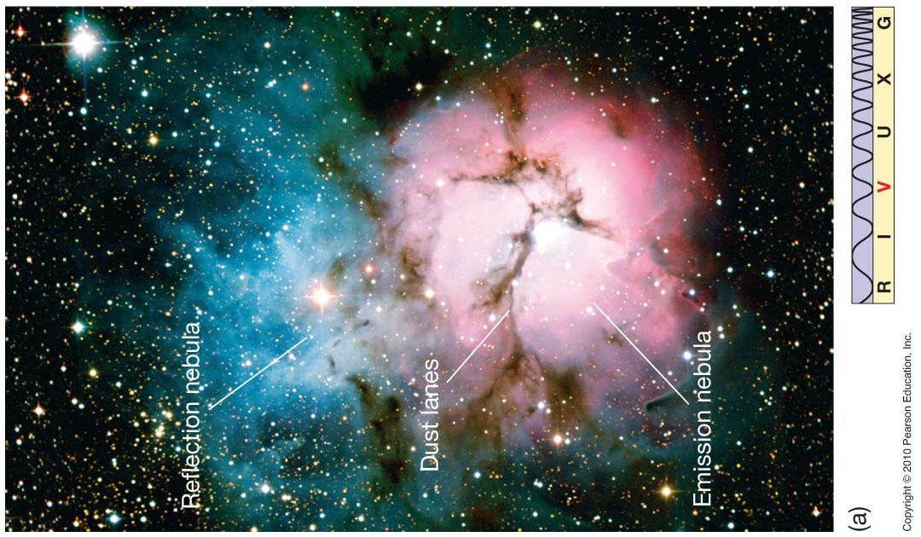
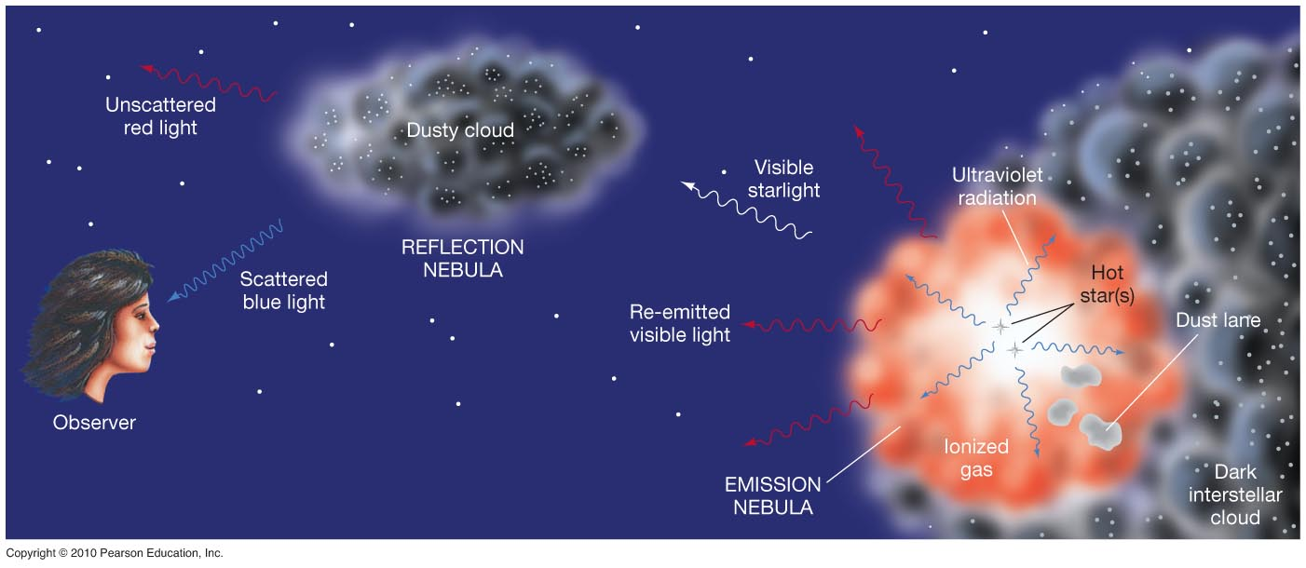
Un-scattered red light
Emission nebula
Scattered blue light
Reflection nebula

Slide 39

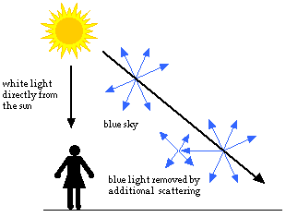
The reflection nebula is blue for the same reason the sky is blue.

Slide 40
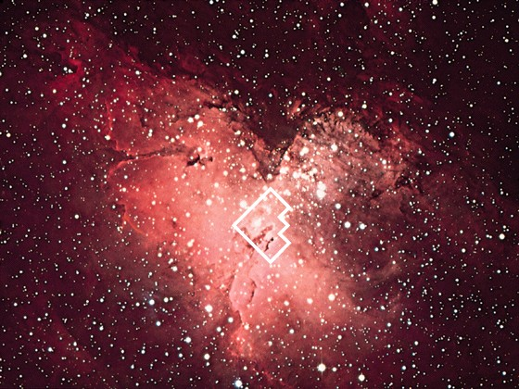
The Eagle Nebula (M16)
50 ly

Slide 41
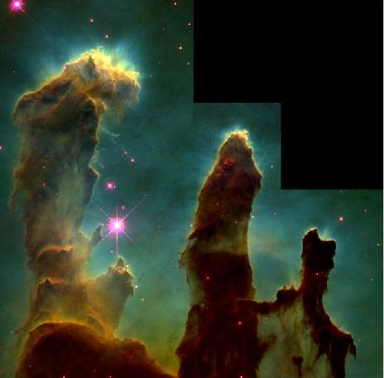
Close-up of the Eagle nebula. The pillars are molecular clouds, nurseries that partly hide their newborn protostars

Slide 42
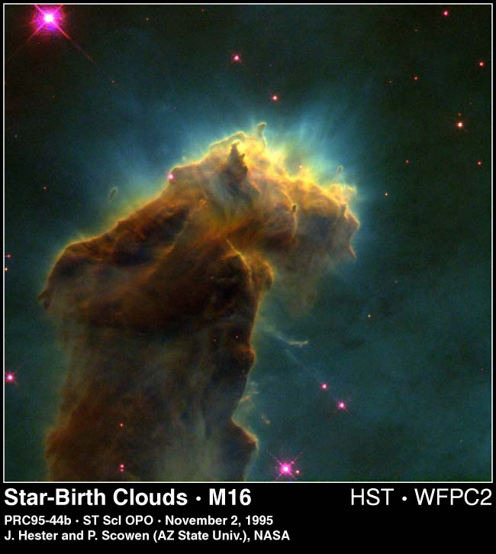

Slide 44
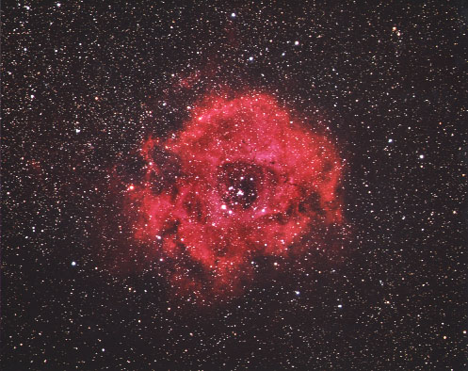
Rosette Nebula

Slide 45
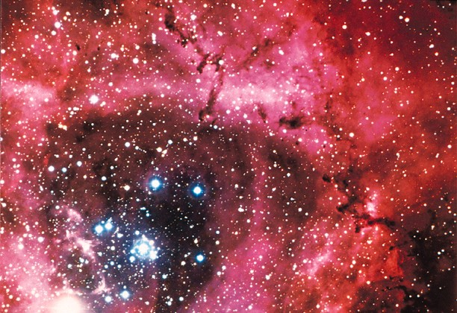
Rosette Closeup: Newly formed O and B stars have heated the center of this cloud, and the pressure of their starlight has blown gas away from the center.

Slide 46
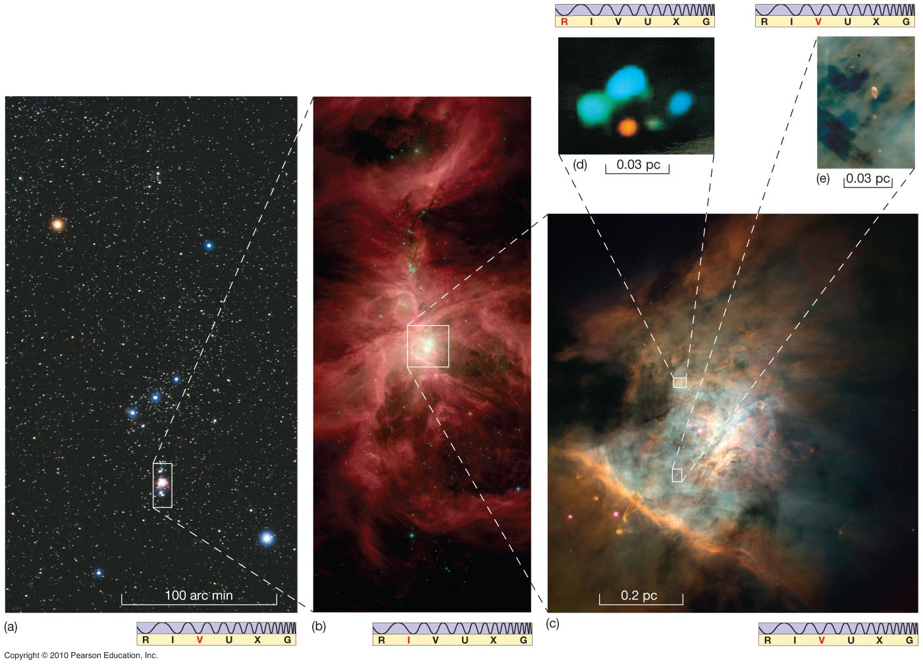
Orion Nebula

Slide 47
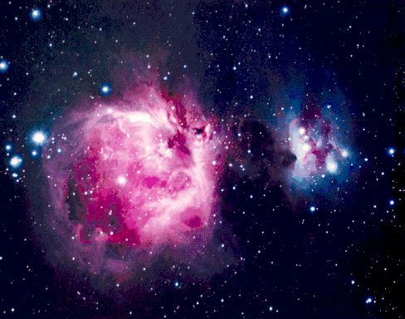
Orion Nebula

Slide 48
Spitzer Space Telescope (IR): Star formation in the Orion nebula
Radiation and wind from massive stars blows away gas and dust

Slide 49
The Cygnus Wall of Star Formation

Slide 50
Radio Emission from Gas
The clouds also give off radiation at radio wavelengths. This happens via two methods:
Molecular radio lines: works best for the densest clouds
21 cm radiation from hydrogen
Gas radio emission allows you to map the gas without looking at emission from stars.

Slide 51
Looking for Molecular Gas
Stars form in regions where the gas is coldest and densest
Under these conditions, hydrogen forms molecules
Molecular hydrogen gas (two hydrogen atoms bonded together to form a molecule) is hard to see, but it’s usually accompanied by more complex molecules like carbon monoxide (CO)
These more complex molecules have emission lines we can see with radio telescopes

Slide 52
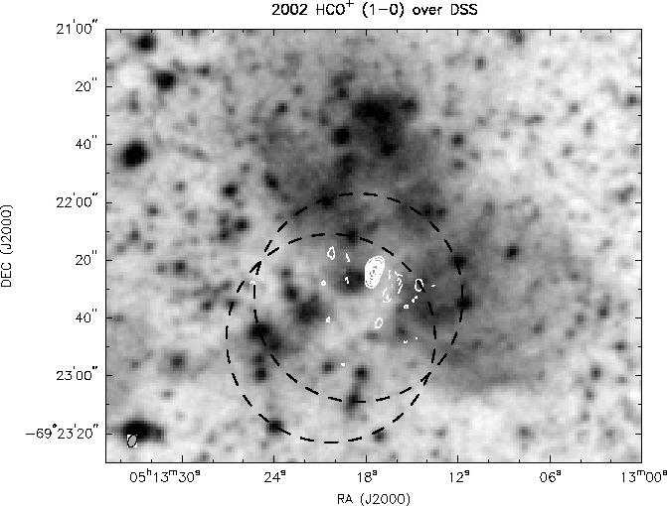
Molecular lines: like carbon monoxide or CO

Slide 53
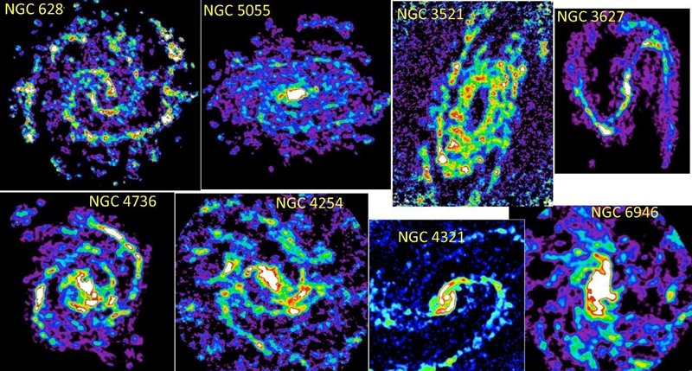
Images of the Carbon Monoxide (CO) emission tracing the molecular cloud distribution in 8 spiral galaxies. The basic spiral pattern seen in the starlight is also clear in the molecular gas. The blue-to-purple represents the lowest level emission and the red-to-white the brightest.
Credit: Jin Koda, Stony Brook University

Slide 54
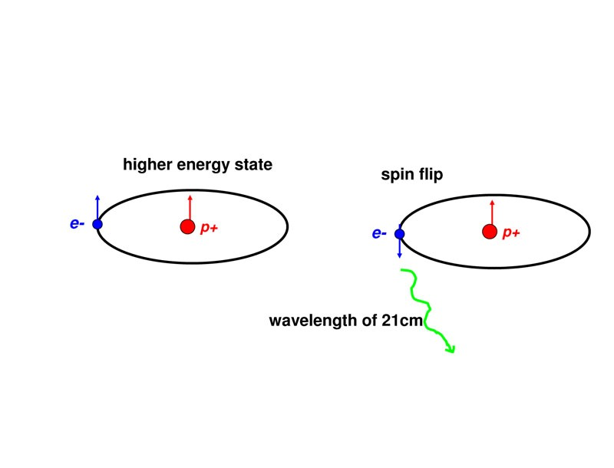
The electron and proton in an atom of neutral hydrogen have spin. Their spins can be aligned, or they can point in opposite directions. Sometimes the spin of the electron flips, and when this happens a photon is emitted with wavelength 21 cm. This can be observed in the radio, and is used to map neutral hydrogen gas.
21 cm radio emission

Slide 55
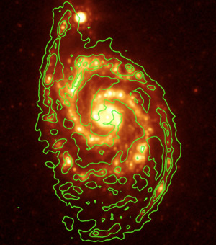
Contours of 21 cm emission overlaid on an IR image
M51 in 21 cm + IR

Slide 56
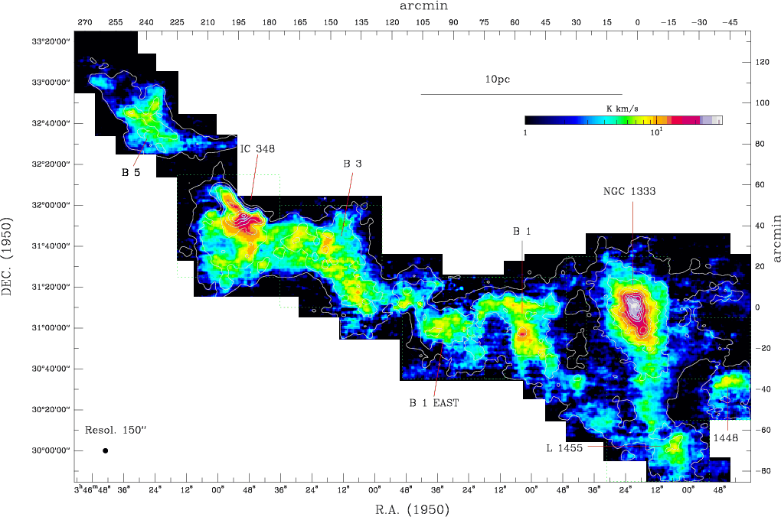
By mapping gas in CO (molecules) and HI (atomic hydrogen), we know that molecular clouds contain an enormous amount of gas, > 1 million times the mass of the sun. They are also in enormous collections known as molecular cloud complexes

