Slide 2
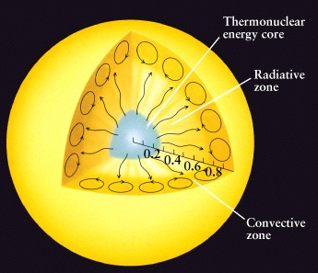
The Sun’s interior has three layers: (1) core (2) radiative zone (3) convective zone
Energy generated in the core of the Sun propagates outward through these different layers, and finally, through the atmosphere of the Sun. This process takes tens of thousands of years or more.

Slide 3
The Sun’s atmosphere also has three layers…
Photosphere - the layer we see, 5800 K
Chromosphere - the red layer observed using a hydrogen filter, 10,000 K
Corona - the incredibly thin outer atmosphere, 1,000,000 K

Slide 4
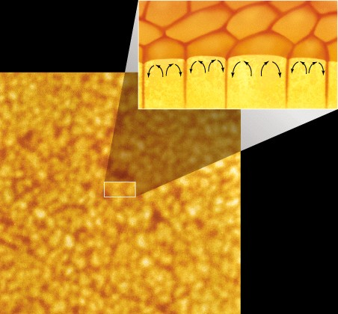
The photosphere is the visible layer of the Sun
Granulation caused by convection

Slide 5
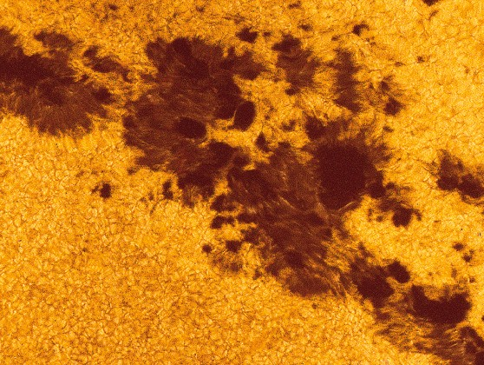
Sunspots are the most well known feature on the photosphere
Granulation caused by convection

Slide 6
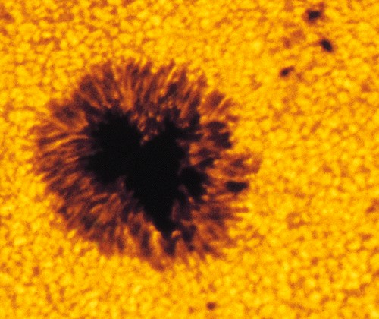
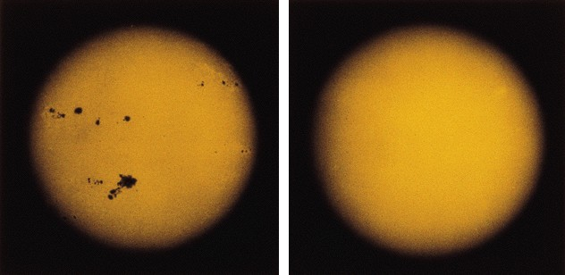
Sunspots are the most well known feature in the photosphere. Monitoring sunspots reveals the Sun’s rotation.

Slide 7
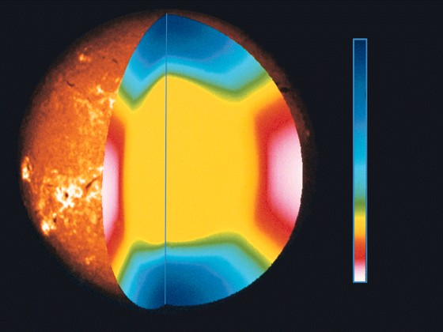
Rotation Period
35 days
35 days
27 days
25 days
25 days
Different parts of the Sun rotate at different speeds. This is called differential rotation.

Slide 8
The Sun: Recap Which part of the Sun rotates the fastest?
The poles
The equator
The core
All parts rotate at the same rate

Slide 9
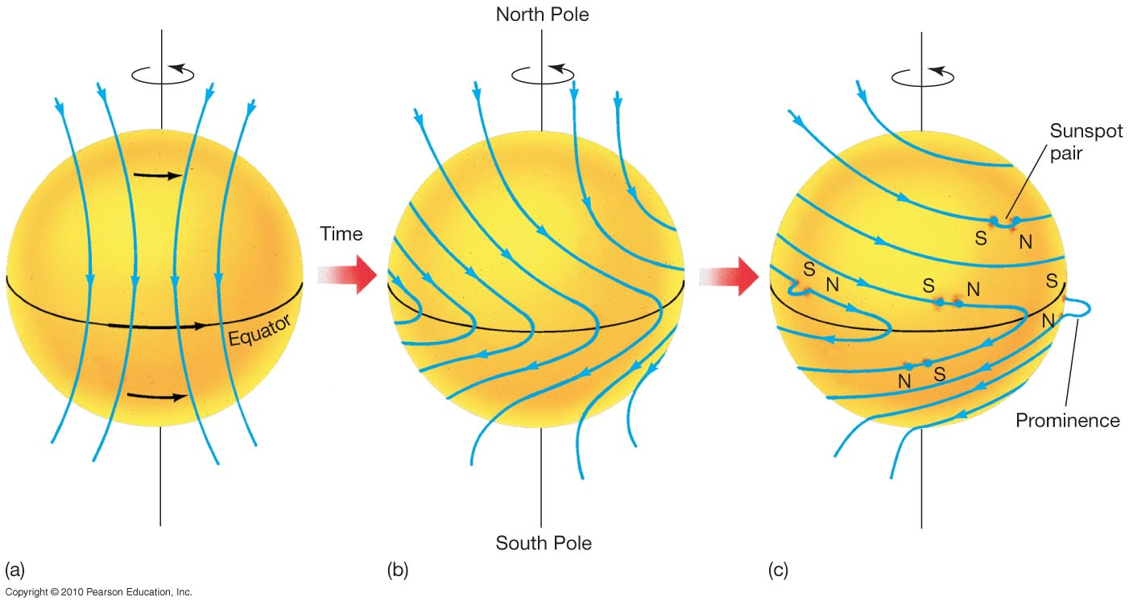
The rotation of the Sun drags magnetic field lines around with it, causing kinks in the field lines.
Remember: The sun spins faster at the equator than the poles

Slide 10
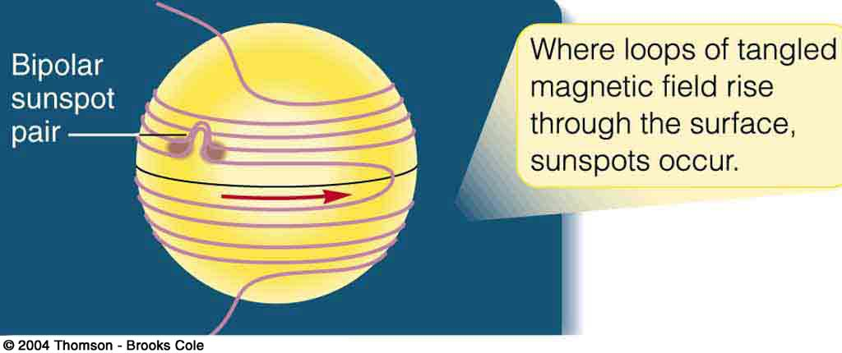
Fig. 7-14e, p. 122
Notes:
Figure 7.14: The Babcock model of the solar magnetic cycle explains the sunspot cycle as a consequence of the sun’s differential rotation gradually winding up the magnetic field.

Slide 11
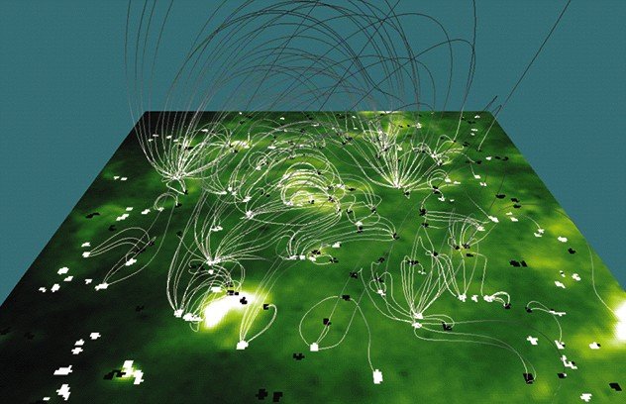
Magnetic field lines connect sunspots on the Sun’s photosphere

Slide 12
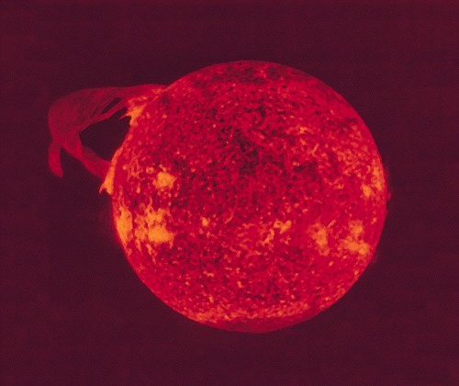
Solar magnetic fields also create other atmospheric phenomena
prominences

Slide 13
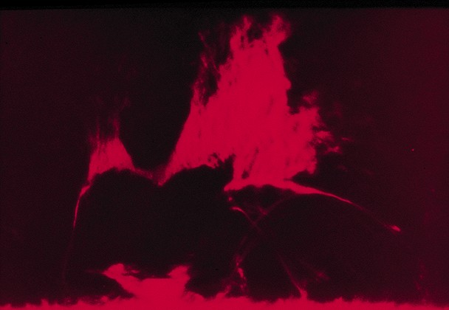
Solar magnetic fields also create other atmospheric phenomena
prominences
solar flares

Slide 14
Solar Flare in action
35 days
35 days
27 days
25 days
25 days
Temperature in the flares can reach 100 Million K.
Gas is blown out – untrapped.

