Slide 1
Announcements
Quiz 5 extended 24 hours, due Tuesday – includes material that will be covered in lecture today
Problem Set 5 for practice
Today: more on the Sun
We will start Chapter 10 on Wednesday

Slide 2
Astronomy 103
The Sun
Please read chapter 9

Slide 3
Which part of the Sun rotates the fastest?
The poles
The equator
The core
All parts rotate at the same rate

Slide 4
Which part of the Sun rotates the fastest?
The poles
The equator
The core
All parts rotate at the same rate

Slide 5
1
2
3
4
Notes:
Figure 7.14: The Babcock model of the solar magnetic cycle explains the sunspot cycle as a consequence of the sun’s differential rotation gradually winding up the magnetic field.

Slide 6
Notes:
Figure 7.14: The Babcock model of the solar magnetic cycle explains the sunspot cycle as a consequence of the sun’s differential rotation gradually winding up the magnetic field.

Slide 7
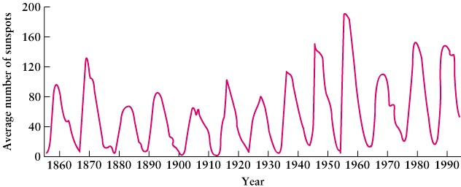
The direction of the Sun’s magnetic field changes with a 22-year cycle, as if it were a rotating magnet. North and south magnetic poles exchange positions every 11 years.
Sunspots follow this cycle, with the largest number of sunspots (sunspot maxima) occurring every 11 years.

Slide 8
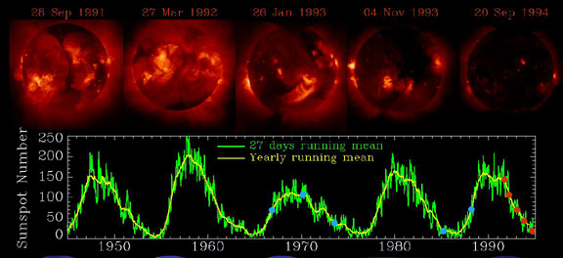
The 11 Year Sunspot Cycle
X-ray photos of the Sun from the Yohkoh spacecract for half a cycle, maximum to minimum
solar maximum
near minimum

Slide 9
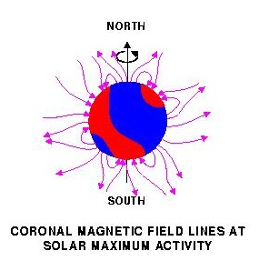
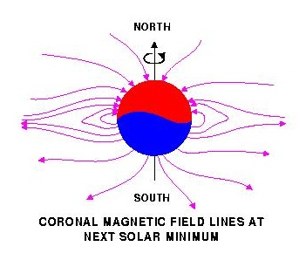
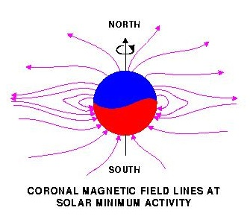
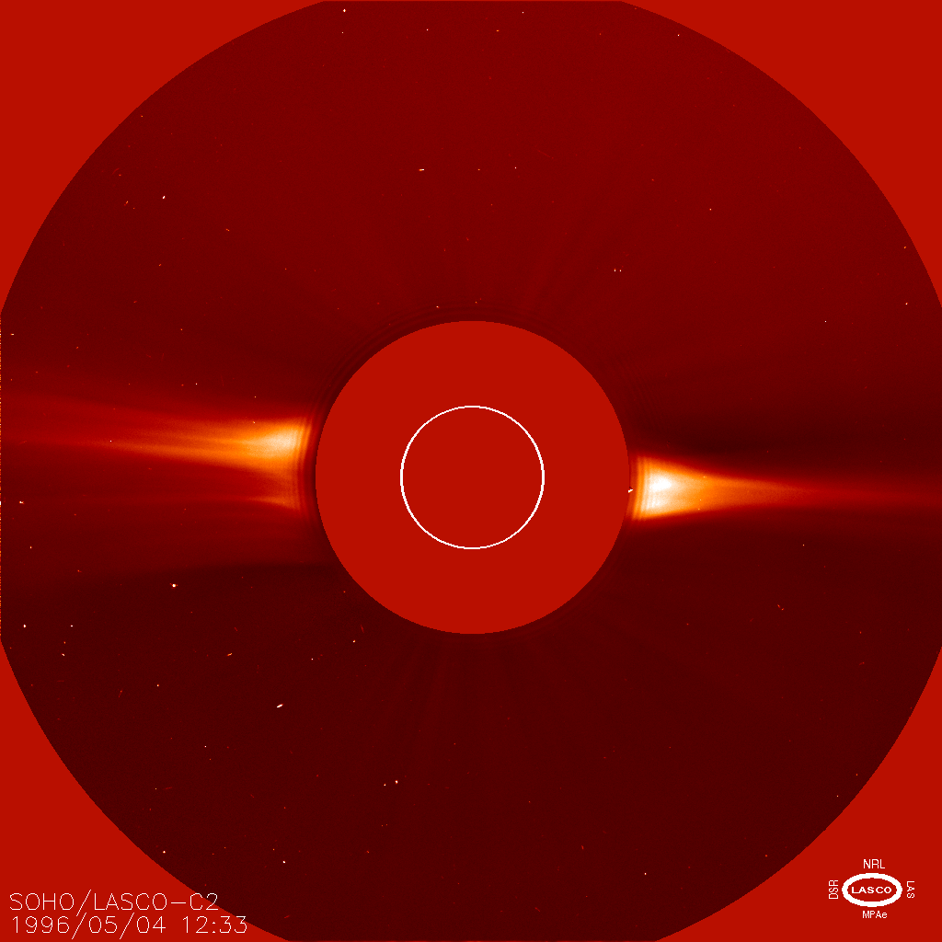
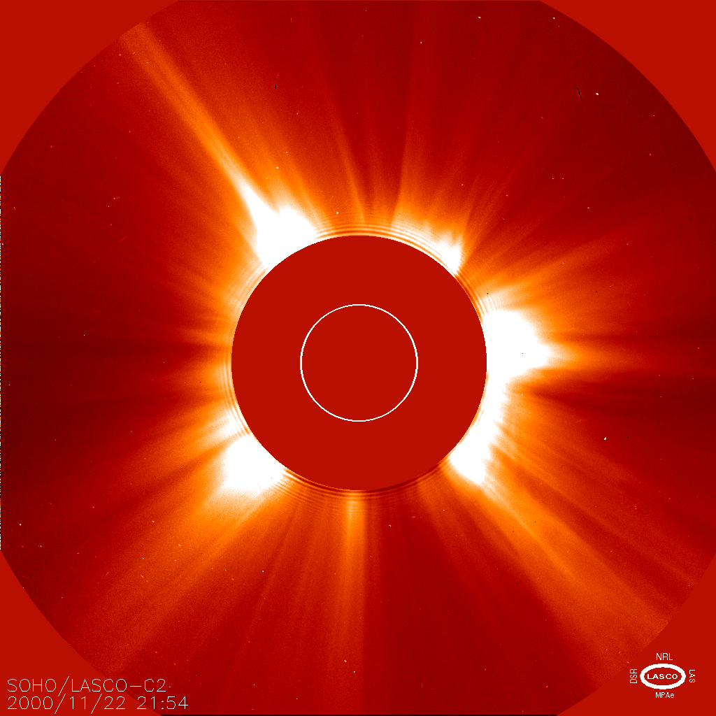
The 11 year sunspot cycle corresponds to a magnetic field flip of the sun.
Solar minimum
Solar maximum

Slide 10
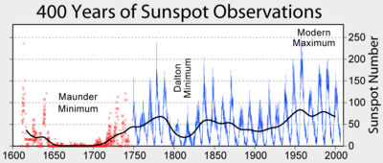
Maunder minimum
Period from 1645-1715 where very few sunspots were seen. Corresponds to low solar activity.

Slide 11
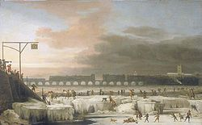
Maunder minimum
Maunder minimum corresponds to coldest part of the “Little Ice Age” (1550-1850)
Frozen Thames River in ~1680. The River Thames does not freeze in modern times.

Slide 12
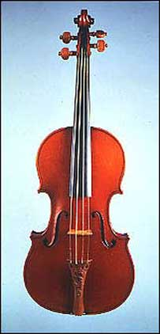
Maunder minimum
Stradivarius violins were produced during this period. Slower growing trees give denser wood = better sound.

Slide 13
Features Above the Photosphere
Associated with sunspots are magnetic storms that give rise to:
Flares: spectacular, hot explosions that release UV and X-rays and eject electrons and protons from the Sun’s surface.
Prominences: Trapped gas from the surface of the sun. Trapped by magnetic fields

Slide 14
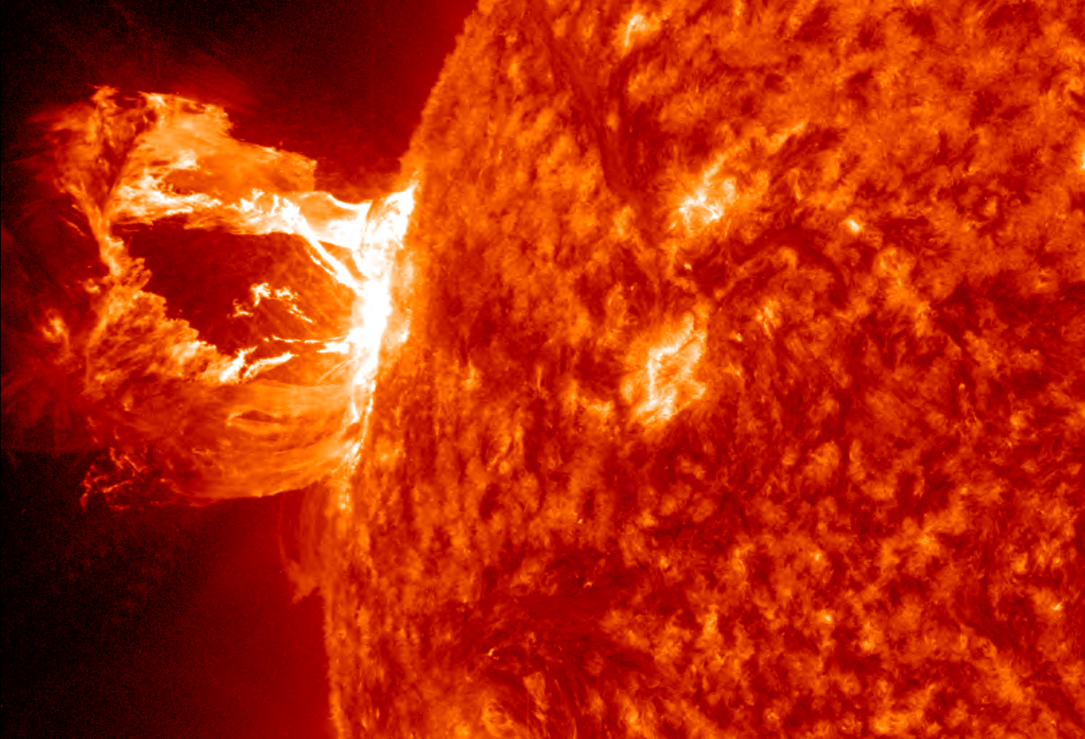
Giant Prominence

Slide 15
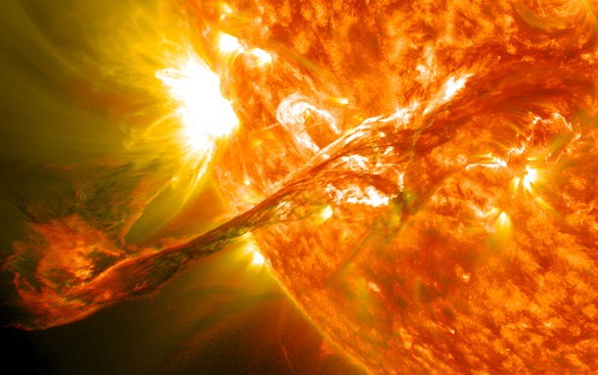

Slide 16
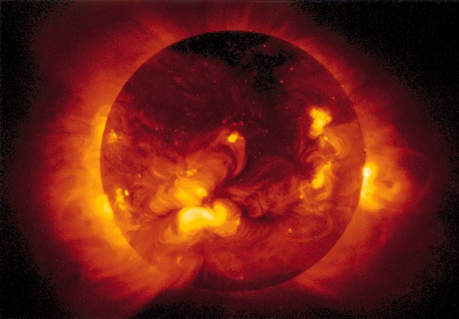
Flares seen in X-ray photo

Slide 17
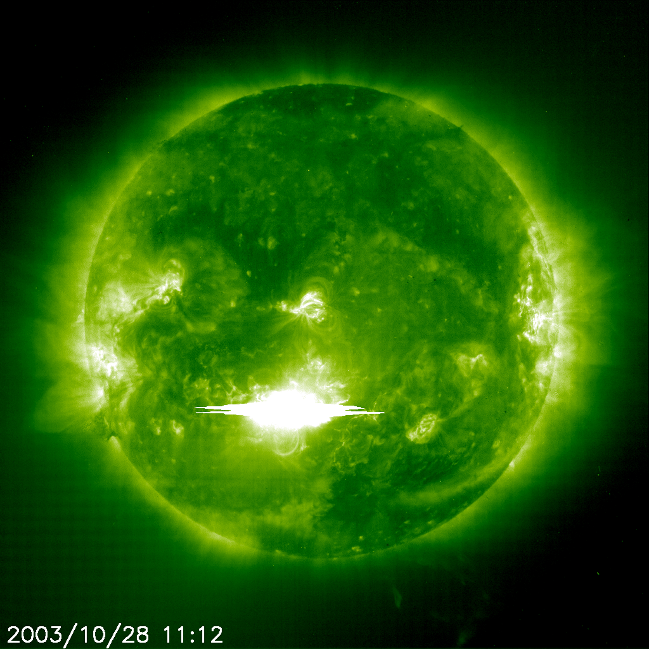
Solar flares in x-rays from SOHO (Solar and Heliospheric Observatory)

Slide 18
The Sun is the Largest Object in the Solar System
The Sun contains more than 99.85% of the total mass of the solar system
If you put all the planets in the solar system into the Sun, they would not fill up the volume of the Sun
110 Earths or 10 Jupiters fit across the diameter of the Sun

Slide 19
The mass of the Sun is 300,000 times larger than that of Earth, and the radius of the Sun is about 100 times the radius of the Earth. How much would you weigh on the surface of the Sun compared to on Earth?
Gravity again!
300,000 times more because of the larger mass, and 1/100² times more because of the larger radius
300,000/100² = 30, so you would weigh 30 times more
(You won’t have to calculate this on an exam.)

Slide 20
Why does the Sun shine?
Only one known process can account for the huge amount of energy generated by the Sun:
Conversion of mass into energy via nuclear fusion
E = mc²
Energy = mass x (speed of light)²

Slide 21
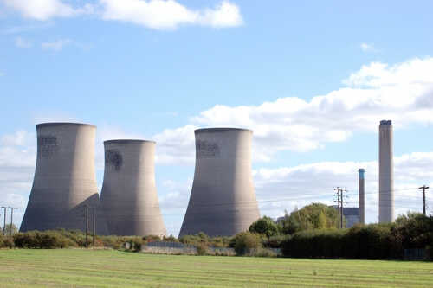
Nuclear fusion vs nuclear fission
Cooling towers of a nuclear fission reactor
Nuclear reactors on Earth use fission: heavy elements are split into lighter ones
Stars generate power through nuclear fusion: light elements are fused into heavier ones

Slide 22
E=mc²
Mass m given in kg
Speed of light c is 3x10⁸ meters/second
Example: How much energy do you get if you can change 1 kg of matter entirely to energy?
This is more than 200 times the energy released by the most powerful nuclear bombs

Slide 23
Example: Luminosity of the Sun
If the Sun changes 4 x10⁹ kg to energy each second, how much energy does it produce each second?
This is the luminosity of the Sun! Also notice that we’ve given the answer with the same precision (the same number of digits) we were given in the question.

Slide 24
Example: Luminosity of a star
If the luminosity of a star is 9 x 10²⁶ watts, how much mass does it change into energy each second?
Luminosity measures energy per second, so a star with a luminosity of 9 x 10²⁶ watts produces 9 x 10²⁶ watt-seconds of energy every second

Slide 25
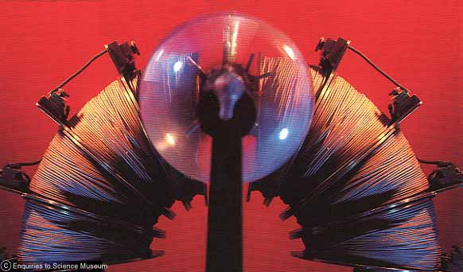
The Energy of Starlight
The mass of a helium atom is slightly less than the mass of 4 hydrogen atoms (by 0.7%=0.007):
This is the apparatus he used. The coil of wire is a large electromagnet. Aston carefully measured how much the magnet bends the paths of helium and hydrogen nuclei . The more massive the nucleus, the less the path bends.
Mass of Helium precisely measured by Aston, 1920

Slide 26
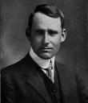
The Energy of Starlight
The Sun turns hydrogen into helium, and the mass of a helium atom is slightly less than the mass of 4 hydrogen atoms (by 0.7%=0.007)
Arthur Eddington (1920): Hydrogen can turn into helium, and when it does, 0.7% of its mass changes to energy, and that energy powers the Sun

Slide 27
The whole is less than the sum of the parts
When hydrogen changes to helium, a small fraction of its mass changes into energy.
Because c² is so large, a small amount of mass produces a large amount of energy.
1 helium nucleus contains 2 protons, 2 neutrons
He⁴
+ ENERGY
4 H nuclei (protons)

Slide 28
Fusion of H to He in stars like the Sun Overall reaction: Proton-proton chain
4 protons + 2 electrons → Helium nucleus

Slide 29
Fusion of H to He in stars like the Sun Overall reaction: Proton-proton chain
4 protons + 2 electrons → Helium nucleus
(2 protons, 2 neutrons)

Slide 30
Fusion in the Sun
Protons are positively charged, and things with the same charges repel each other
So how do protons manage to fuse together?
Must collide at very high speeds, to get close enough for the strong nuclear force to take over
This is why fusion can only happen at very very high temperatures
Speed of protons depend on temperature, and temperature of at least 10 million K required for fusion: only in center of Sun

Slide 31
Particles and antiparticles
Each particle has a corresponding antiparticle with the same mass and opposite charge. E.g. proton and antiproton, electron and positron
When a particle and its antiparticle meet, they annihilate one another and turn into light, with energy given by E=mc²

Slide 32
Particles and antiparticles
Each particle has a corresponding antiparticle with the same mass and opposite charge. E.g. proton and antiproton, electron and positron
When a particle and its antiparticle meet, they annihilate one another and turn into light, with energy given by E=mc²

Slide 33
Particles and antiparticles
Each particle has a corresponding antiparticle with the same mass and opposite charge. E.g. proton and antiproton, electron and positron
When a particle and its antiparticle meet, they annihilate one another and turn into light, with energy given by E=mc²

Slide 34
Neutrino
In addition to protons, electrons, and neutrons, there is one other stable, massive, almost invisible particle, the neutrino, a neutral (uncharged) particle, with mass much much smaller than that of the electron.
A proton, hit hard enough, can change into a neutron, a positron and a neutrino.
proton

Slide 35
Neutrino
In addition to protons, electrons, and neutrons, there is one other stable, massive, almost invisible particle, the neutrino, a neutral (uncharged) particle, with mass much much smaller than that of the electron.
A proton, hit hard enough, can change into a neutron, a positron and a neutrino.
neutrino
neutron
positron

Slide 36
Fusion of H to He in stars like the Sun Step 1
proton
electron
Two protons combine, forming a deuteron (“heavy hydrogen,” proton and neutron) and releasing a positron and a neutrino
The positron annihilates with an electron, producing gamma rays
proton

Slide 37
Fusion of H to He in stars like the Sun Step 1
proton
proton
electron
Two protons combine, forming a deuteron (“heavy hydrogen,” proton and neutron) and releasing a positron and a neutrino
The positron annihilates with an electron, producing gamma rays

Slide 38
Fusion of H to He in stars like the Sun Step 1
neutrino
neutron
positron
proton
electron
Two protons combine, forming a deuteron (“heavy hydrogen,” proton and neutron) and releasing a positron and a neutrino
The positron annihilates with an electron, producing gamma rays

Slide 39
Fusion of H to He in stars like the Sun Step 1
neutrino
neutron
positron
proton
electron
Two protons combine, forming a deuteron (“heavy hydrogen,” proton and neutron) and releasing a positron and a neutrino
The positron annihilates with an electron, producing gamma rays

Slide 40
Fusion of H to He in stars like the Sun Step 1
neutron
light
proton
Two protons combine, forming a deuteron (“heavy hydrogen,” proton and neutron) and releasing a positron and a neutrino
The positron annihilates with an electron, producing gamma rays

Slide 41
Fusion of H to He in stars like the Sun Step 1
H²
Two protons combine, forming a deuteron (“heavy hydrogen,” proton and neutron) and releasing a positron and a neutrino
The positron annihilates with an electron, producing gamma rays

Slide 42
Fusion of H to He in stars like the Sun
Step 2
H²
proton
Deuteron then combines with another proton to produce helium-3 (two protons, one neutron)

Slide 43
Fusion of H to He in stars like the Sun
Step 2
Deuteron then combines with another proton to produce helium-3 (two protons, one neutron)

Slide 44
Fusion of H to He in stars like the Sun
Step 2
He³
light
Deuteron then combines with another proton to produce helium-3 (two protons, one neutron)

Slide 45
Fusion of H to He in stars like the Sun
Step 3
He³
He³
Two helium-3 nuclei combine to form helium-4 (two protons, two neutrons) and two protons

Slide 46
Fusion of H to He in stars like the Sun
Step 3
He³
He³
Two helium-3 nuclei combine to form helium-4 (two protons, two neutrons) and two protons

Slide 47
Fusion of H to He in stars like the Sun
Step 3
Two helium-3 nuclei combine to form helium-4 (two protons, two neutrons) and two protons

Slide 48
Fusion of H to He in stars like the Sun
Step 3
Two helium-3 nuclei combine to form helium-4 (two protons, two neutrons) and two protons

Slide 49
Fusion of H to He in stars like the Sun
Step 3
He⁴
light
Two helium-3 nuclei combine to form helium-4 (two protons, two neutrons) and two protons

Slide 50
Fusion of H to He in stars like the Sun
Basic process, neglecting intermediate steps:
4 protons ➔ helium-4 + 2 neutrinos + energy
neutrino
neutrino
proton
He⁴
proton
Gamma rays

Slide 51
Powering the Sun
Current energy output of Sun requires 600 million tons of hydrogen fused into helium every second
That’s a lot, but only a very tiny fraction of the total mass available
Sun can sustain this rate of fusion for another 5 billion years

Slide 52
Evidence of fusion in the Sun
Light
Gamma rays produced in the center are absorbed and re-emitted many many times before they reach the surface of the Sun, more than 10,000 years later
As they pass through cooler outer layers blackbody spectrum shifts to lower temperatures
We finally see visible radiation from the photosphere – this is not direct evidence of fusion
Neutrinos

Slide 53
Solar Neutrinos
Fusion in the Sun produces a lot of neutrinos!
Flux at Earth is about 7x10¹⁰ neutrinos per square centimeter per second – that’s about 70 billion neutrinos passing through your little fingernail every second!
But they interact with almost nothing and are very difficult to detect… need a very big, specialized detector.
neutrino

Slide 54
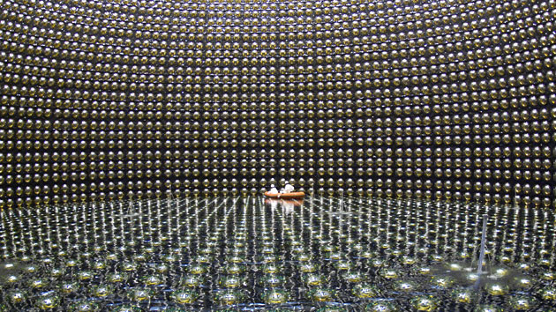
Solar Neutrinos
Super Kamionkande or Super K in Japan

Slide 55
Solar Neutrinos
For many years there was a puzzle: we detected only about 1/3 of the number of neutrinos we expected to see from the Sun – the solar neutrino problem.
This was a conflict between reliable experimental results and the very well understood model of the Sun.

Slide 56
Solar Neutrinos
Resolution of the problem: There are 3 kinds of neutrinos – electron neutrino, muon neutrino, tau neutrino.
The sun only produces electron neutrinos, but they can change into other kinds of neutrinos on their way to us – they “change flavor” or “oscillate.”
These other neutrinos were not detected in early experiments, resulting in solar neutrino problem – but now we have seen them, problem is resolved!

Slide 57
How is energy generated in the Sun?
Gravitational collapse
Nuclear fission
Nuclear fusion
Solar wind power

Slide 58
How is energy generated in the Sun?
Gravitational collapse
Nuclear fission
Nuclear fusion
Solar wind power

