Slide 1
Announcements
First midterm is this Wednesday Feb 19 in class
  Will cover Lectures 1-8 + beginning of 9
  Textbook through Chapter 2
  Problems will be similar to those on quizzes
    45 problems
    Problems on material through Chapter 2 – includes parts of quiz 4
  No book, notes or calculator
    Sheet of formulas will be given
    Calculations will be doable without a calculator
  Bring a #2 pencil (and an extra!)

Slide 2
The following information will be provided:

Slide 3
Astronomy 103
Review for Midterm 1

Slide 4
Outline
Scientific notation and powers of ten
Units, scale of the Universe
The celestial sphere
  Motions of the stars
  The seasons
  Precession
  The phases of the Moon
Eclipses: lunar and solar
The scientific method

Slide 5
Outline II
Ancient astronomy and the motion of the planets
  Retrograde motion of the planets
  Ptolemaic model of the solar system
Copernicus, Copernican model of solar system
Tycho Brahe
Kepler: Kepler’s three laws of Motion
Galileo: observations and experiments
Newton
  Three laws of motion
  Circular motion
  Law of gravity

Slide 6
Outline III
Light and electromagnetic waves
  Frequency and wavelength
  The electromagnetic spectrum
  Temperature
  Thermal or blackbody radiation
    Relation between wavelength and temperature
Atoms: electrons and energy levels
  Absorption and emission lines
Doppler shift

Slide 7
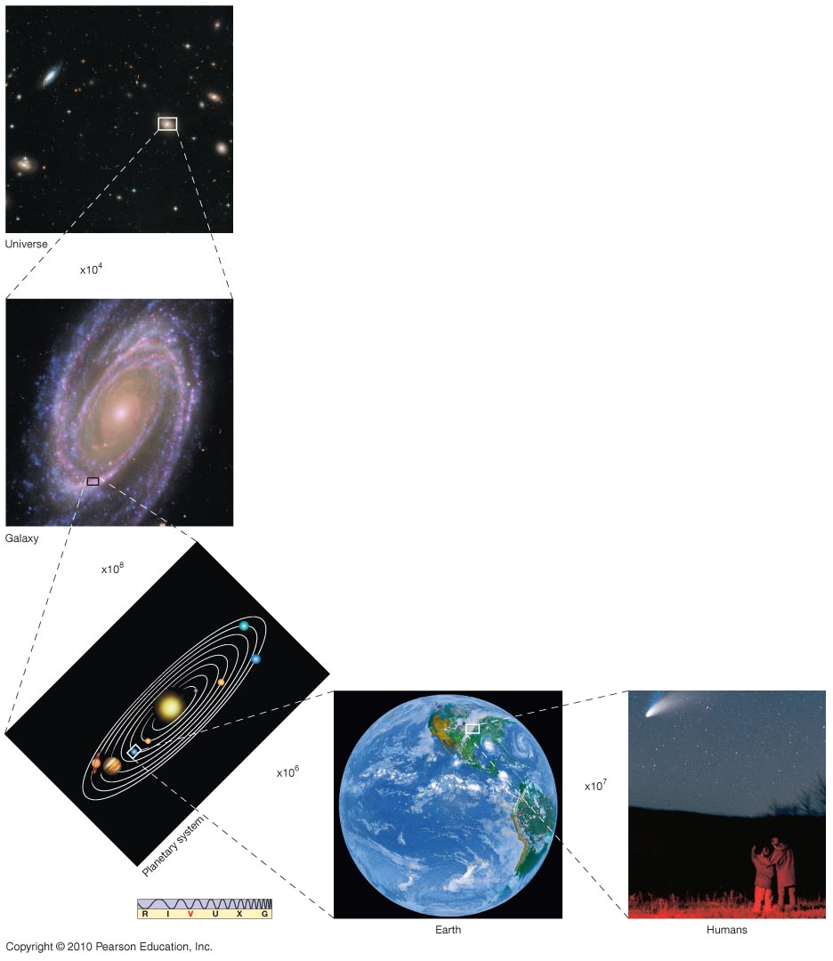
Why powers of 10?
Astronomy deals with the very large (stars, galaxies, the universe) and the very small (wavelengths of light)
Need a convenient way to express large and small numbers

Slide 8
Powers of 10

Slide 9
GEOGRAPHY OF THE UNIVERSE
Notes:
Don’t need to memorize all this, but should have some rough, common sense idea of the sizes of things

Slide 10
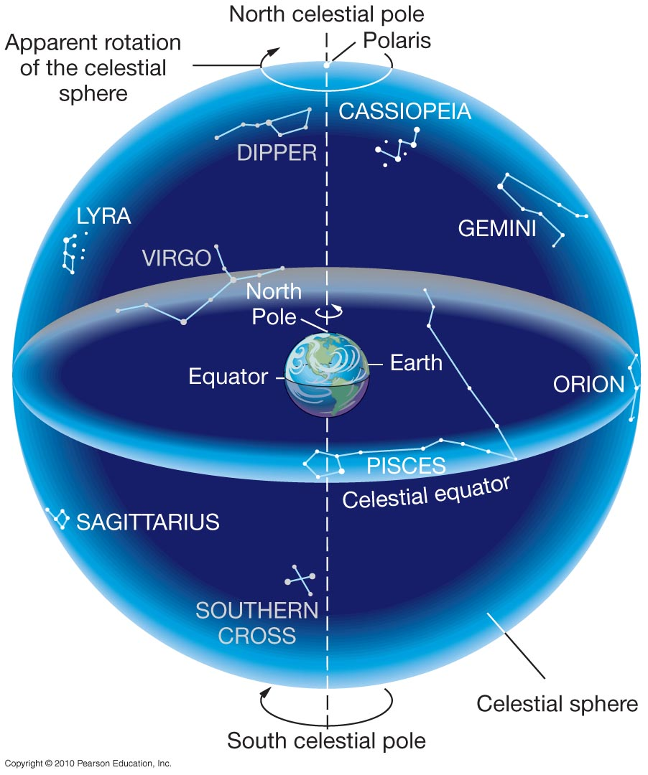
The celestial sphere
The sky has the appearance of a sphere, and at night it looks like the sphere rotates, with all of the stars moving as if the sphere were rotating. The name given to this imaginary sphere is the celestial sphere
The celestial sphere appears to rotate once a day from east to west (counterclockwise looking up at the north celestial pole). This is because the Earth really rotates once a day from west to east: counterclockwise, looking down at the north pole.
The North Celestial Pole and South Celestial Pole are the points on the celestial sphere directly over the Earth’s North and South poles.

Slide 11
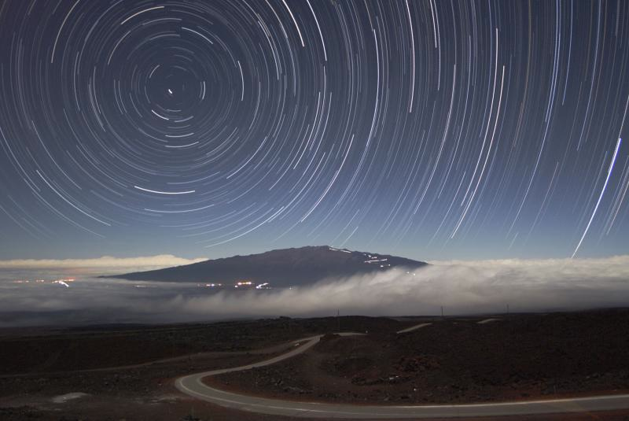
From northern hemisphere, stars, Sun, Moon and planets appear to move from east to west in a circle around North Celestial Pole: Polaris, the North Star
In a day, celestial sphere appears to rotate once
  rotates 360° in 24 hours, so each hour rotates 360° / 24 = 15°
  stars appear to move 15° per hour east to west

Slide 12
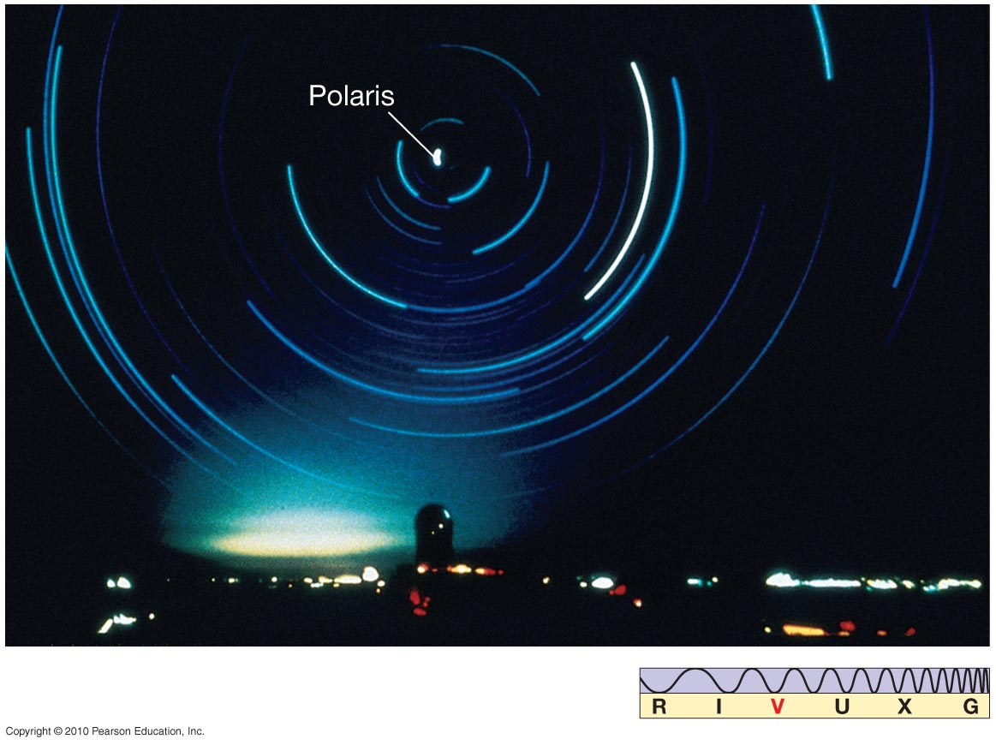
What you see at night depends on where you are standing
You can see only half the sky: The Earth blocks light from stars that are below the horizon. As the Earth rotates, stars rise along the east half of the horizon, move in circles centered about the NCP, and set along the west half of the horizon.
•The star Polaris (North Star)
is close to the NCP. Stars appear
to move in circles about Polaris.
Some stars close enough to Polaris
on the celestial sphere never rise or
set and are called circumpolar

Slide 13
As seen from the equator, Polaris is at the horizon. If you travel 1° north from the equator, Polaris will be 1° above your horizon.
By the time you reach the North Pole, 90° N, Polaris is directly overhead, 90° above the horizon. In general:
• The altitude of Polaris = your latitude
• Because Milwaukee is 43 degrees north of the equator,
Polaris is 43 degrees above our horizon. From south of equator,
Polaris is below the horizon, never visible.
There is no southern pole star
Celestial navigation:
Altitude of Polaris = latitude!

Slide 14
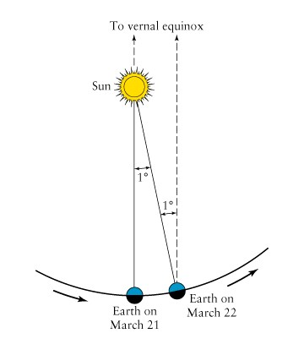
Earth’s Orbital Motion (seasonal changes)
In a year the Earth moves 360 degrees about the Sun, so each day it moves about 1°.
The Sun appears to move against the background stars. As the Earth moves 1° from west to east, the Sun appears to move 1° from east to west.

Slide 15
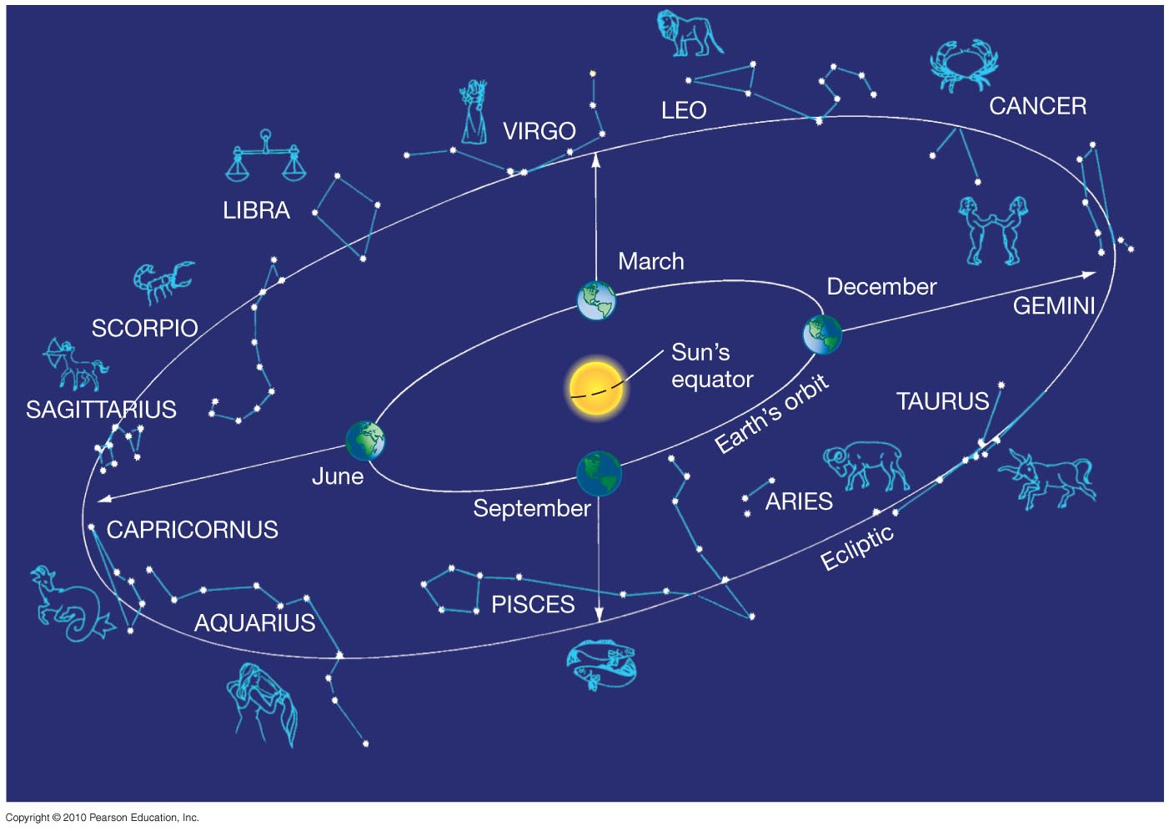
The stars that the sun appears to move over are the constellations of the Zodiac – If we could see the stars in the day when the Sun is out (and we can in fact see them during a total eclipse of the Sun) we would see the Sun move through these constellations during the course of the year.
The path the Sun sweeps out against the
background of stars is called the ecliptic.

Slide 16
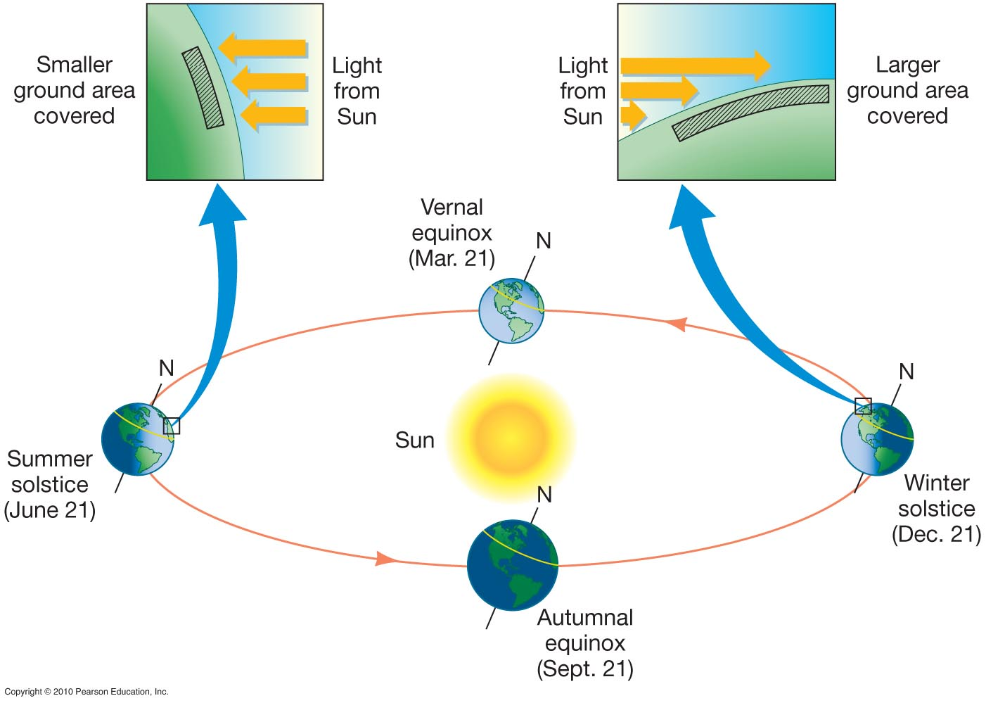
The seasons and the tilt of the Earth
The Earth’s axis of rotation is not perpendicular to the plane of the Earth’s orbit about the Sun:
•The Earth's rotation axis is tilted by 23 1⁄2 degrees away from perpendicular to its orbit— the plane of the equator is 23 1⁄2 degrees from the plane of the orbit.
On the summer solstice, when the axis is most directly tilted toward the Sun, the Sun is directly over a point 23 1⁄2 degrees north of the equator. On the winter solstice, with the north part of the axis tilted away from the Sun, the Sun is over a point 23 1⁄2 degrees south of the equator.

Slide 17
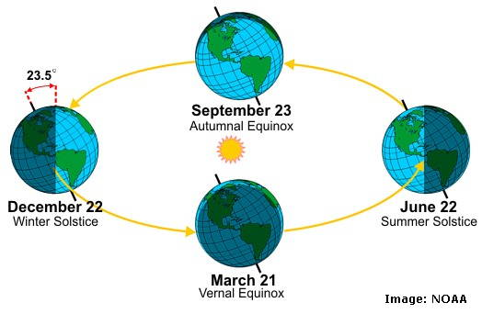
The Sun is directly over the equator on the Vernal Equinox (spring) and the Autumnal Equinox (fall). These are the two points where the ecliptic intersects the celestial equator.

Slide 18
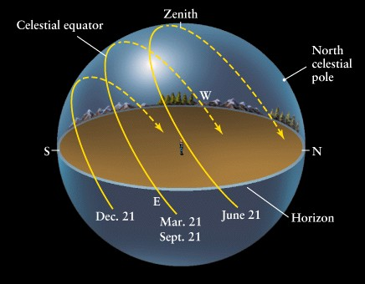
The seasons are caused by the tilt of the Earth's axis. The tilt has two effects:
Sunlight is more direct in the summer. In our summer, the northern hemisphere is tilted toward the Sun, in winter it is tilted away from the Sun.
The Sun is up longer in summer than in winter.

Slide 19
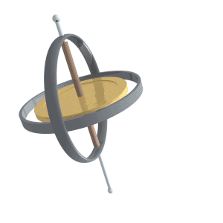
Precession
Precession: change in the orientation of the rotational axis of a rotating body
Direction of axis of Earth’s rotation changes on 26,000 year cycle: precession of the equinoxes

Slide 20
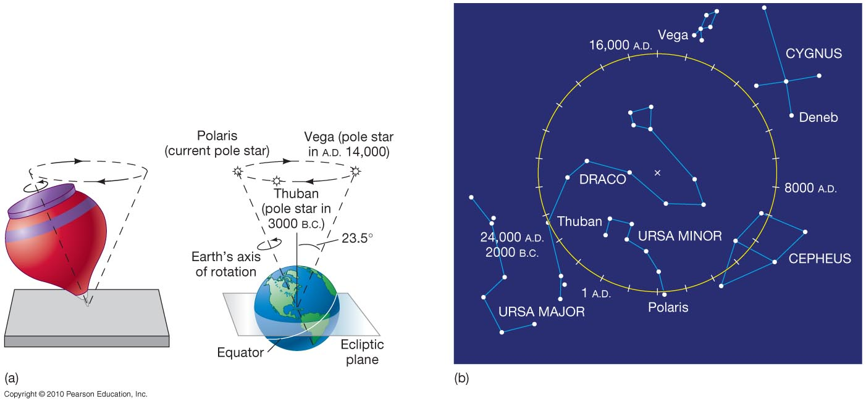
Earth’s axis of rotation precesses with a 26,000 year period: In 13,000 years, what are now winter stars will be summer stars, and vice-versa. In 13,000 years, Vega, not Polaris will serve as our north star. In 26,000 years, the Earth’s axis will again point in the direction it now points, and Polaris will again be the North Star.

Slide 21
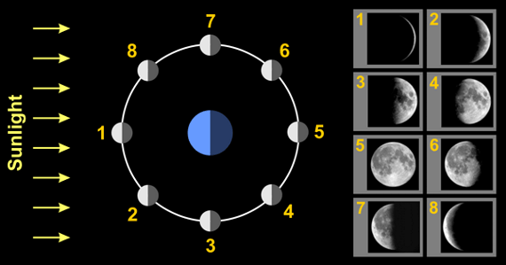
Phases of the Moon
Why does the Moon shine?
Reflected sunlight
  The side of the Moon facing the Sun is lighted
  The side of the Moon facing away from the Sun is dark
Moon orbits Earth in 1 month (29 days)

Slide 22
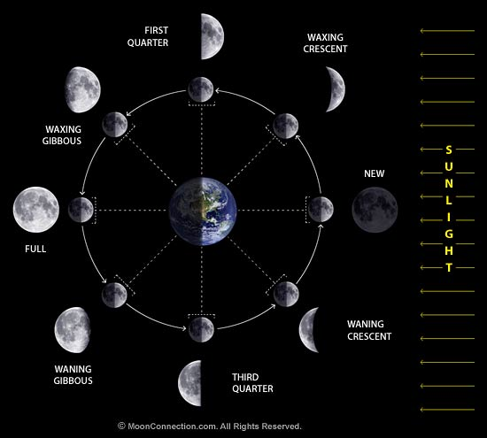
Phases of the Moon
Due to relative positions of Moon and Sun
We see illuminated portion of Moon only
Fraction of disk visible = fraction of night Moon is up

Slide 23
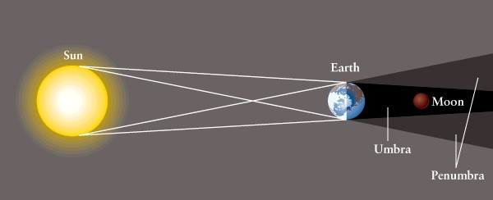
Total eclipse of the Moon:
Shadow of the Earth covers the Moon
Visible simultaneously from everywhere on night side of Earth

Slide 24
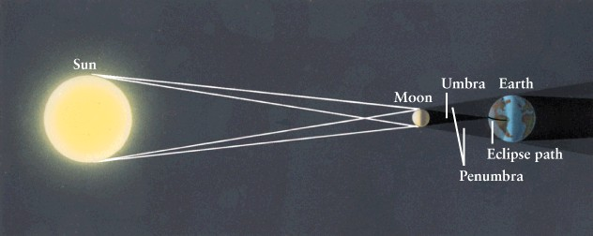
Eclipse of the Sun
Total: umbra of Sun’s shadow falls on the Earth (Moon blocks all of Sun)
Partial: penumbra of Sun’s shadow falls on Earth (Moon blocks part of Sun)

Slide 25
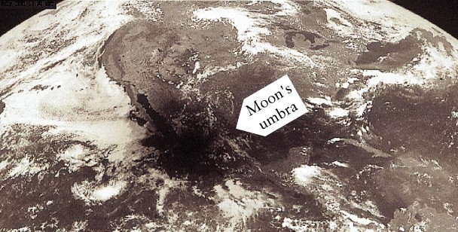
You can see an eclipse of the Sun only if you are on the path of the Moon’s shadow.

Slide 26
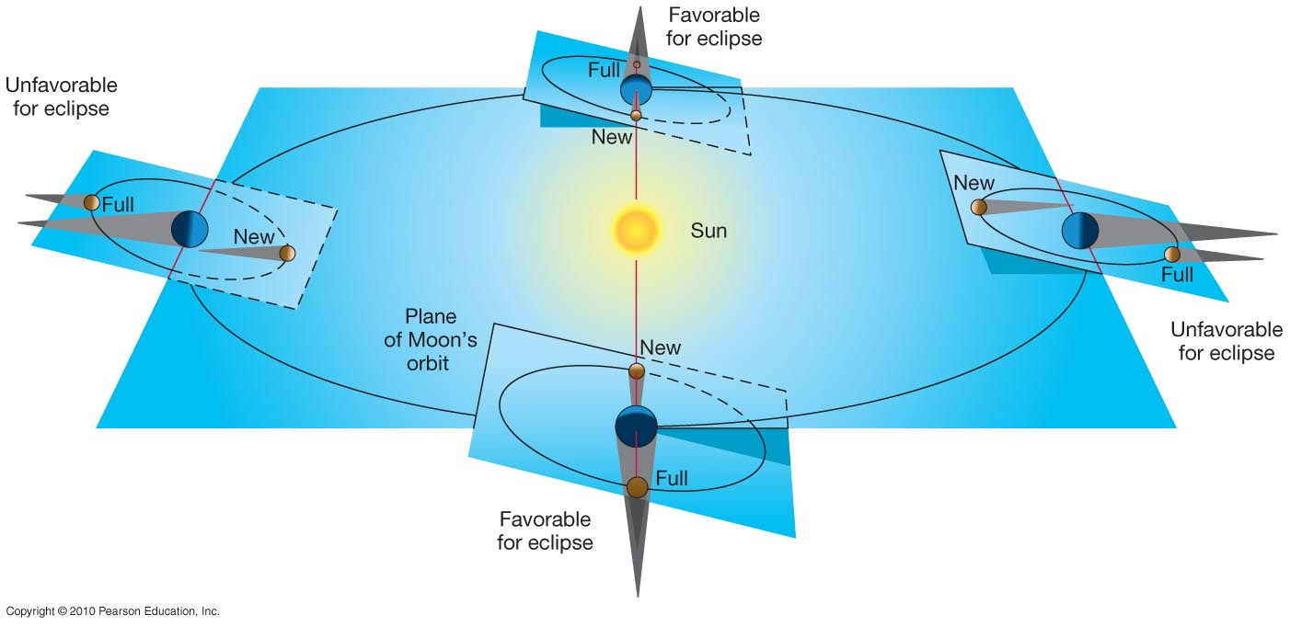
About once every 6 months, the line from Sun to Earth lies in the plane of the Moon’s orbit. Eclipses of Moon and Sun occur at these
eclipse seasons

Slide 27
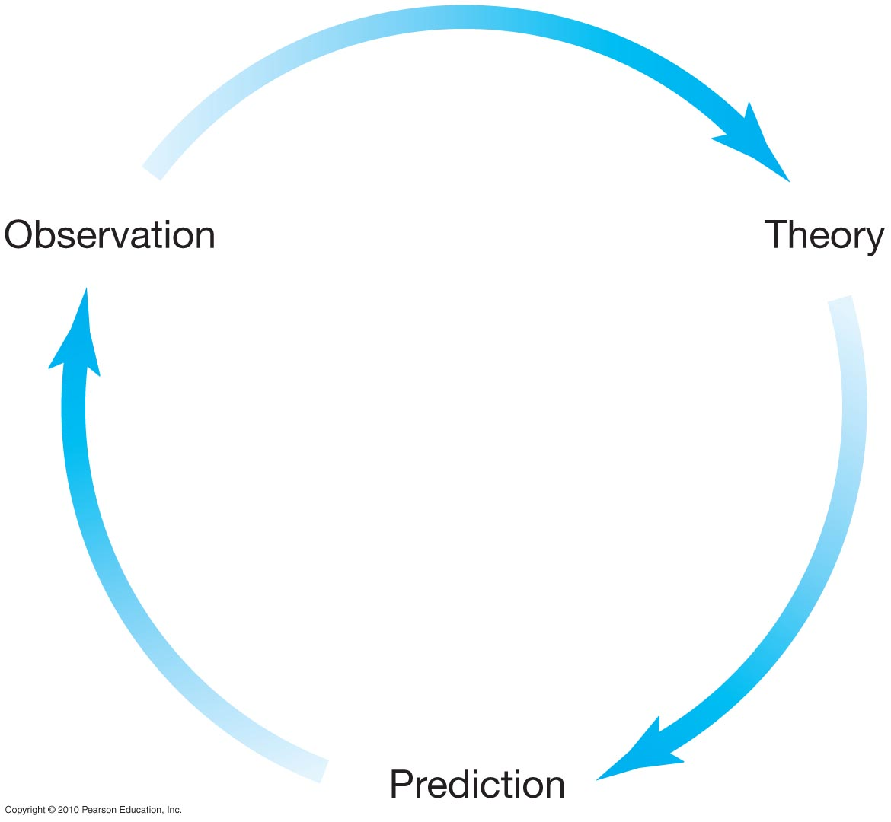
The scientific method
2
1
Develop a theory to explain our observations
Study the world around us
Examples of theories:
gravity, electromagnetism
5
Revise theory to account for new observations
4
Do we observe what we predicted?
3
A theory must make testable predictions!
What else does the theory predict we should observe?

Slide 28
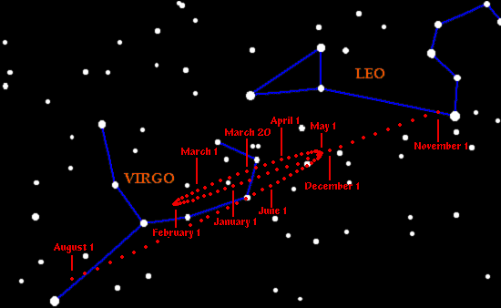
Apparent motion of the planets across the sky
The backward motion is called retrograde motion.

Slide 29
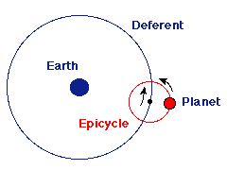
Ancient astronomy: Ptolemaic model of the solar system
Each planet moves on a small circle (called an epicycle) while the center of the epicycle moves around the Earth in a larger circle known as the deferent. This produces overall west-to-east motion of each planet, while the looping motion is reproduced in the model by the motion of each planet along its epicycle – the planet moves backwards when it is at the part of the epicycle closest to the earth.

Slide 30
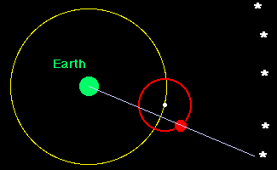
How do you get retrograde motion in the Ptolemaic model?

Slide 31
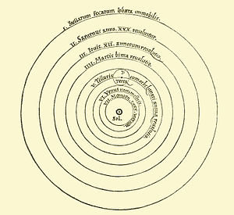
The Copernican model of the solar system
Circular orbits
Sun at center
Planets closer to the Sun move faster
The Stars
Mars
Earth and the moon
Venus
From Copernicus’ original manuscript

Slide 32
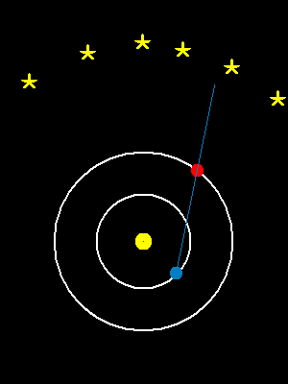
How does this give us retrograde motion?
When the Earth passes an outer planet, that outer planet appears to move backwards relative to the background stars. It is the same effect you see when you pass a car on a highway. If you watch that car, you see it appear to move backwards relative to the background trees, even though both you and the other car are moving in the same direction.

Slide 33
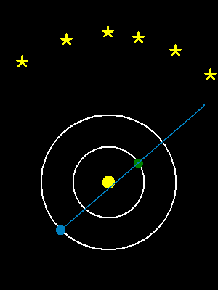
By adjusting the different speeds of the orbits, you can get different amounts of retrograde motion. Similar to Ptolemaic model, where the speed of the deferent and epicycles were adjustable.
Mars
Venus

Slide 34
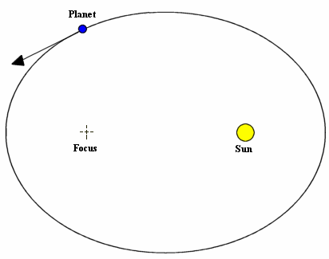
Kepler’s First Law:
Planets moves in ellipses with the Sun at one focus
Semi-major axis
Semi-minor axis

Slide 35
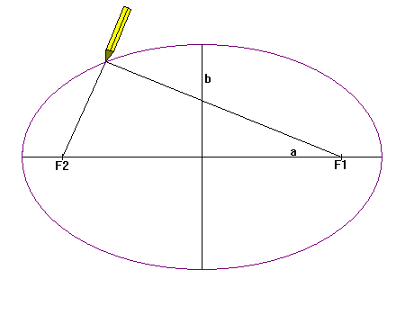
Kepler’s First Law:
Planets moves in ellipses with the Sun at one focus
Semi-major axis
Semi-minor axis

Slide 36
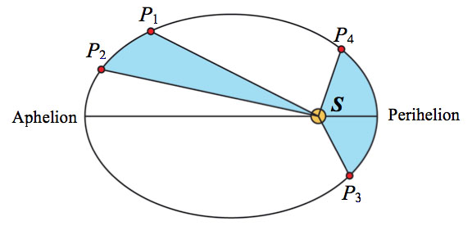
Kepler’s Second Law:
The line from the Sun to a planet sweeps out equal areas in equal intervals of time.

Slide 37
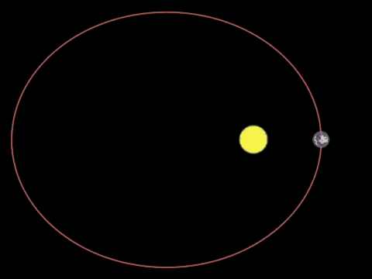
Kepler’s Second Law:
The line from the Sun to a planet sweeps out equal areas in equal intervals of time.

Slide 38
Kepler’s Second Law:
The line from the Sun to a planet sweeps out equal areas in equal intervals of time. This means the planet moves fastest when it’s closest to the Sun (perihelion) and slowest when it’s farthest from the Sun (aphelion).

Slide 39
Kepler’s Third Law:
The period of each planet is related to its average distance from the Sun by the formula
a = planet’s average distance from Sun
(semimajor axis of ellipse) in AU
P = planet’s period in years

Slide 40
Galileo built a telescope and made important observations
• Four moons of Jupiter (Their orbits about Jupiter turned out to obey Kepler's laws)
• Craters on our Moon
• Spots on the Sun --- found that the Sun rotated by watching the spots move.
• Venus has phases like the moon, and they agree with the Copernican, not the Ptolemaic model.
• He also found far more stars and clusters of stars than anyone had seen before, and he resolved the Milky Way, showing that it is a myriad of stars
In addition, Galileo's experiments with rolling balls show that you do not need a force to keep an object moving, only to change its motion.

Slide 41
Newton’s First Law of Motion
An object at rest will stay at rest unless acted upon by a force. A moving object will continue to move forever in a straight line at constant speed, unless acted upon by a force.
Sometimes called the law of inertia:
Inertia is the tendency of an object to keep moving at the same speed and in the same direction unless acted upon by a force
Massive objects have more inertia: it takes more force to change their motion

Slide 42
Newton’s Second Law of Motion
The acceleration of an object is directly proportional to the force applied, and inversely proportional to the object’s mass.
mass
force
acceleration
The same force will make an object with a small mass accelerate more than an object with a larger mass.

Slide 43
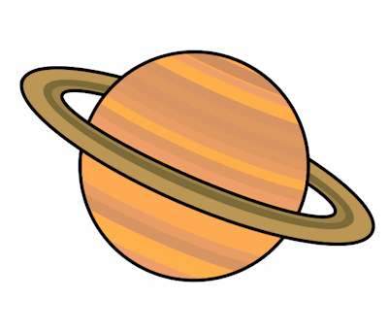
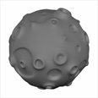
Newton’s Third Law of Motion
For every action there is an equal and opposite reaction: if body A exerts a force on body B, then body B exerts a force on body A that is equal in magnitude but oppositely directed.

Slide 44
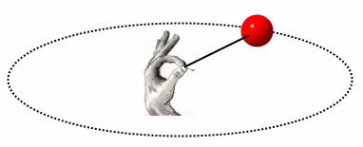
In what direction is the force on an object that moves at constant speed in a circle?
Toward the center of the circle:
This is the force of a cord on a ball you swing around in a circle

Slide 45
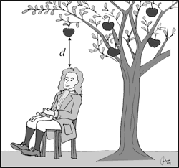
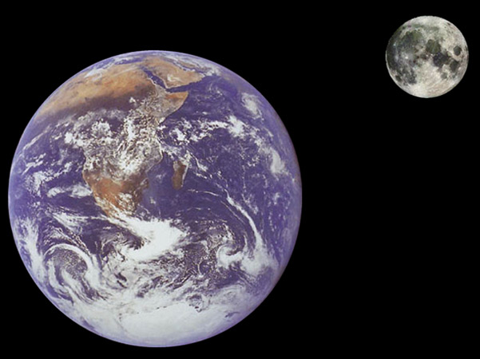

Gravity
The force on the apple and the force on the Moon both point toward the center of the Earth

Slide 46
Newton’s law of gravity: Any two objects in the universe attract each other with a force given by
With
r in meters
m in kg
F in Newtons, where
1 Newton = 4.5 lb
G = 7x10⁻¹¹
m
M
r
Newton’s gravitational constant
M: mass of object 1
m: mass of object 2
r: distance between the objects

Slide 47
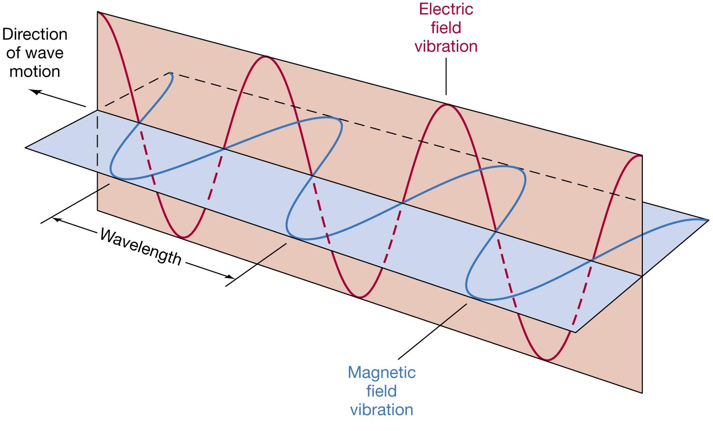
Light is a wave in the electric field (there is also a magnetic field), and the wave travels at the speed of light.
So light is also called electromagnetic radiation

Slide 48
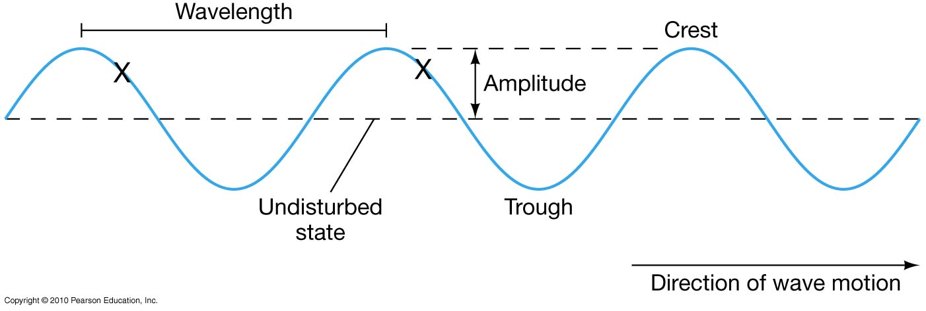
So light is a wave. There are two important characteristics about waves:
Frequency – number of waves that pass a point per second – units of Hertz or Hz
Wavelength – distance between wave crests
λ − Lambda

Slide 49
Wavelength and Frequency
For a frequency of f crests per second, the time between crests is T = 1/f . The distance between crests is then given by distance = speed x time:
i.e. λ = c T or
We can also reverse the relation to solve for the frequency

Slide 50
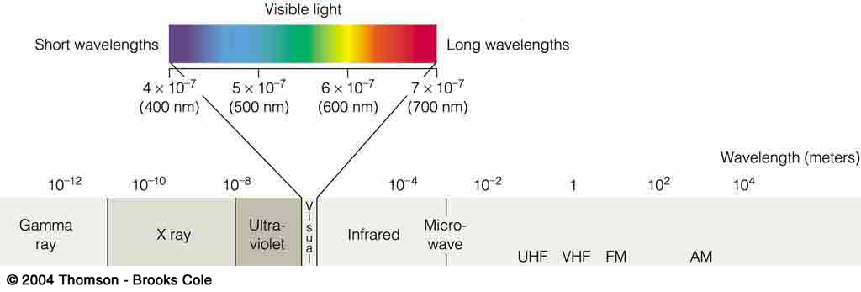
The complete spectrum of light
Visible light is only a narrow part of the full spectrum of electromagnetic radiation.
Visible wavelengths have wavelengths between
400 nm (violet) and 700 nm (red)
1 nm = 1 nanometer = 10⁻⁹ m.
There is stuff at longer and shorter wavelengths.
(
)
Radio

Slide 51
  Temperature
Temperature is a measure of how fast atoms or molecules are moving.
Hot – atoms moving fast
Cold – atoms moving slowly
When atoms stop moving – lowest possible temperature.
This lowest temperature is called absolute zero, which is -273°C (-459°F).

Slide 52
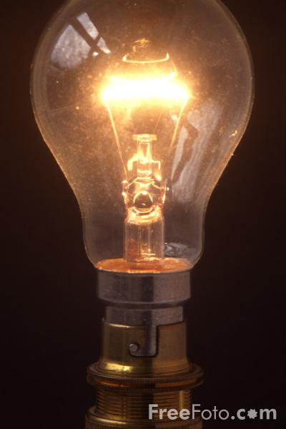
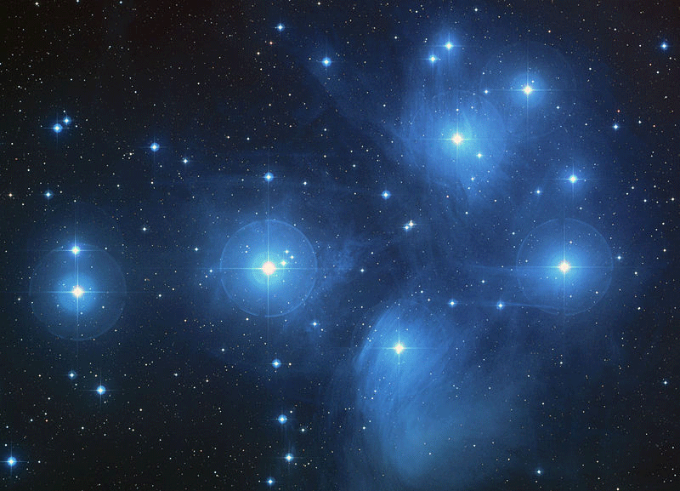
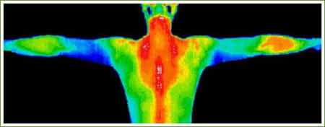
Thermal radiation:
The continuous blackbody spectrum
All objects with some temperature emit electromagnetic (EM) radiation – light
If you break up this radiation, you find some radiation at all wavelengths – it is continuous. So this is called a continuous spectrum

Slide 53
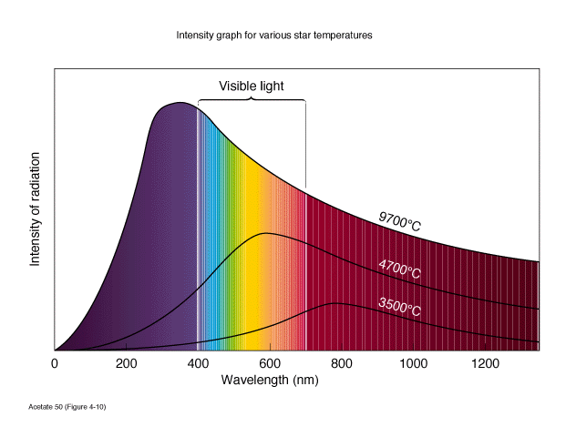
The radiation that something emits because of its temperature is called thermal or blackbody radiation, and we can use the peak wavelength of the blackbody curve to determine the temperature of an object.
Nothing radiates as a perfect blackbody, but stars come close!
Hotter stars emit more radiation, and the radiation peaks at a shorter wavelength.

Slide 54
With wavelength λ measured in nanometers and T in degrees Kelvin, the relation between the average wavelength of light emitted by a hot object and the temperature of the object is
To 2 decimal-place accuracy and with λ measured in cm

Slide 55
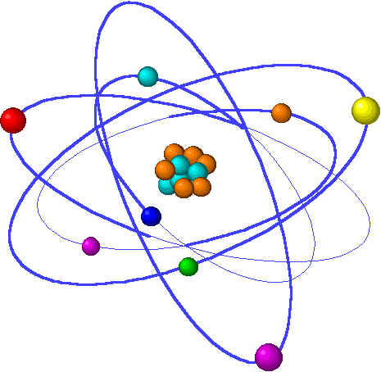
All things are made of atoms.
Atoms are about 1/10 nm (about 10⁻¹⁰ m) in diameter.
Atoms are collections of neutrons, protons and electrons. The neutrons and protons form a very small, very dense nucleus. The electrons orbit the nucleus, bound by electric attraction to the protons.
An atom is about 100,000 times larger than its nucleus
Opposite charges attract: electrons are negatively charged, and protons are positively charged. Neutrons have no charge.

Slide 56
When light hits an electron in an atom, it can kick the electron outward to a more energetic orbit, called an excited state. An excited electron will spontaneously fall back down to a closer orbit, and the electron then emits light of a fixed wavelength that depends only on the difference in energy between the two orbits. Longer wavelength light corresponds to a smaller energy difference.
•When an electron absorbs light, it moves from a closer to a more distant orbit.
•When an electron moves from a more distant to a closer orbit, it emits light.

Slide 57
Atoms emit and absorb only those wavelengths of light that can correspond to the energy differences between orbits.
The light emitted or absorbed by isolated atoms is called a discrete spectrum because only discrete wavelengths are emitted and absorbed: one sees the spectrum as a set of distinct lines. Each type of atom (each element) has a different set of energy levels and therefore a different set of spectral lines.
•Each element can be identified by its discrete spectrum.
•The spectral lines (wavelengths) that an atom emits are the same as the spectral lines it absorbs

Slide 58
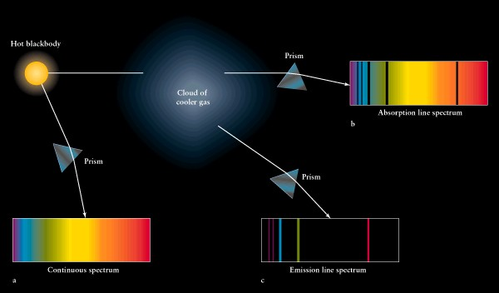

Slide 59
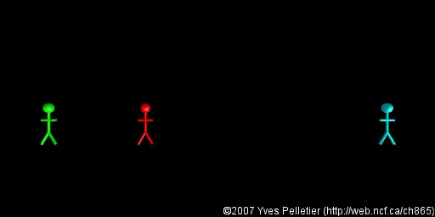
Doppler Shift
When a source of light (or sound) is moving away from you, its wavelength, seen by you, is longer.
When a source moves toward you, its wavelength, seen by you, is shorter.

