Slide 1
Announcements
Quiz 3 due Monday
  Problem set 3 for quiz 3 practice
Approximate reading schedule for the upcoming week
  Friday Feb 7: Chapter 2, sections 2.1 to 2.3
  Monday Feb 10: Chapter 2, sections 2.4 to 2.8
  Wednesday Feb 12: Chapter 3, sections 3.1 to 3.3
  Friday Feb 14: Chapter 3, sections 3.4 and 3.5

Slide 2
Astronomy in the News
SN2014J:
A Supernova in M82
Or, (almost) everything we’ll cover in this class!

Slide 3
Supernova: an exploding star
Two types of supernova
Type II: A massive star reaches the end of its fuel supply, collapses into a neutron star or black hole

Slide 4
Supernova: an exploding star
Two types of supernova
Type Ia: Explosion of a white dwarf star, dense remnant of a lower mass star.

Slide 5
Discovery
January 21, 2014: As clouds close in during a practical astronomy class, students at University College London spot a new star in the galaxy M82

Slide 6
Discovery
One of ULO’s two 0.35-metre Celestron C14 telescopes. These were used to find the supernova in M82
Photo: UCL MAPS/O. Usher

Slide 7
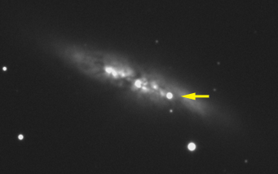
Followup observations
Location precisely determined with 10 m Keck telescope in Hawaii
First optical spectrum with 3.5 m ARC telescope in New Mexico reveals this is a Type Ia supernova
SN2014J is currently near maximum brightness, bright enough to see with a small telescope

Slide 8
Why is this important?
Closest Type Ia supernova since 1972, and closest of any type since 2004
Can study in detail!
Distance to M82:
11.5 million light years
This is close!

Slide 9
More on Type Ia Supernovae

Slide 10
“Standard candles”
If you know how bright it is, you can tell how far away it is

Slide 11
“Standard candles”
Brightness
Brightness
After some calibration, Type Ia supernovae all have the same peak brightness

Slide 12
Type Ia supernovae and cosmology
Distant Type Ia supernovae are fainter than we expected them to be
This appears to be because the universe is not only expanding, but accelerating!

Slide 13
Dark energy and the accelerating universe

Slide 14
What is dark energy?

Slide 15
These observations depend on Type Ia Supernovae...
… and we don’t understand them yet!

Slide 16
Astronomy 103
Copernican Revolution Wrap-up
Light and Matter
Please read Chapter 2

Slide 17

CONCEPTS OF SPACE AND TIME
PRE-GREEK
The Earth is flat
There is a preferred direction (up)
The Earth is at rest. Space is absolute – there is an unmoving place from which positions and velocities can be measured
Time is absolute:
You know what it means for two events to occur
at the same time
Space is flat

Slide 18
Pre-Greek

Slide 19
Pre-Greek

Slide 20
Pre-Greek

Slide 21
Pre-Greek

Slide 22
Pre-Greek

Slide 23

GREEK
The Earth is curved
Up depends on where you are
The Earth is at rest. Space is absolute – there is an unmoving place from which positions and velocities can be measured
Time is absolute:
You know what it means for two events to occur
at the same time
Space is flat

Slide 24
Greek

Slide 25
Greek

Slide 26
Greek

Slide 27
Greek

Slide 28
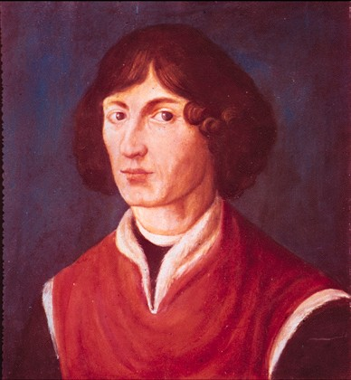
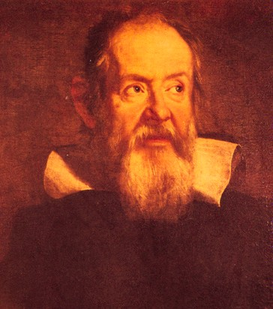
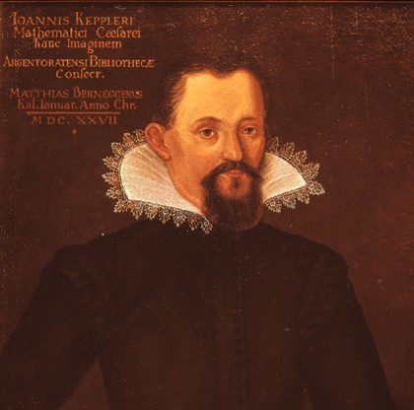
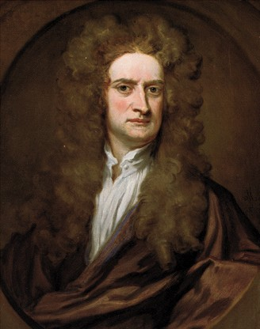
Galilean

Slide 29
GALILEAN
Meaning of the Copernican Revolution
The Earth is curved
Up depends on where you are
The Earth is moving – we no longer have an absolute, unmoving reference point
Time is absolute:
You know what it means for two events to occur
at the same time
Space is flat
It will take another 200 years before these last two assumptions are modified – more on that later!

Slide 30
Light and Matter
Please read chapter 2
Today we will cover sections 2.1 to 2.3

Slide 31
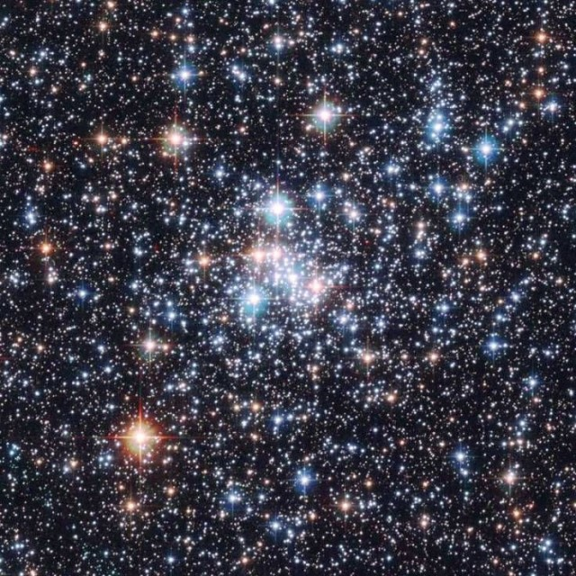
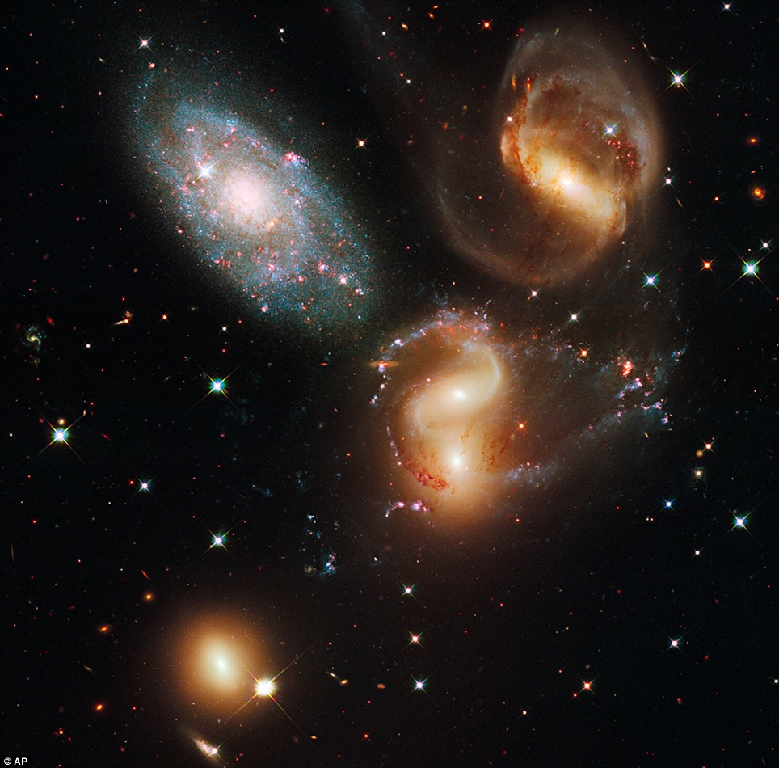
Everything* we know about the universe outside our solar system comes from light
We can’t put stars and galaxies in lab and do experiments on them – we can only look at the light they emit
*Almost. There are also some charged particles, and soon we may detect gravitational radiation that isn’t light.

Slide 32
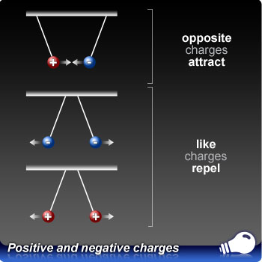
To understand light and how it is produced, we first need to review some facts about the electric force
Charges can be positive or negative
Particles or larger objects with the same charges (two positively charged particles or two negatively charged particles) repel each other
Particles with opposite charges (one positive and one negative) attract each other
Charged particles create an electrical force, just as massive particles create a gravitational force.

Slide 33
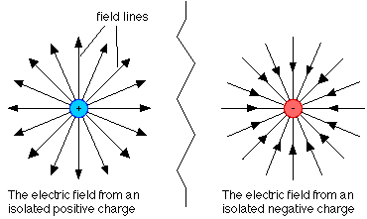
The electric force is caused by the electric field – imagine it as a bunch of outward pointing lines from a positive charge (and inward for negative charge). These electric field lines stretch out to infinity, but weaken as they go outward.

Slide 34
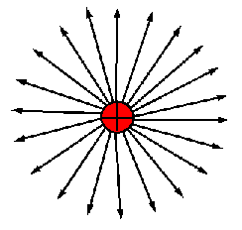
What does this have to do with light?
When a charge changes its position, its field changes, and the information that the particle has moved is transmitted by the electric field.

Slide 35
What does this have to do with light?
When a charge changes its position, its field changes, and the information that the particle has moved is transmitted by the electric field.

Slide 36
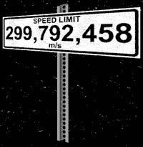
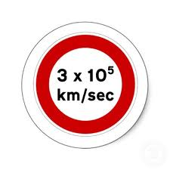
This information moves at a speed of 300,000 km/s, the speed of light, or the maximum speed in the universe
But the information that the particle has moved is not communicated instantaneously:
There is a maximum speed of information in our universe.

Slide 37
This speed limit means that light travels in a wave
When a charge moves, the information that it is at a new position travels outward at 300,000 km/s.
electric field
electric charge moving up and down
Light is a wave in the electric field

Slide 38
After 1 second, the electric field has changed only within a distance 1 light-second from the charge (about the distance from the Earth to the Moon).
Light is a wave in the electric field

Slide 39
After 2 seconds, the electric field has changed within a distance 2 light-seconds from the charge.
Light is a wave in the electric field

Slide 40
After 3 seconds, the electric field has changed within a distance 3 light-seconds from the charge.
Light is a wave in the electric field

Slide 41
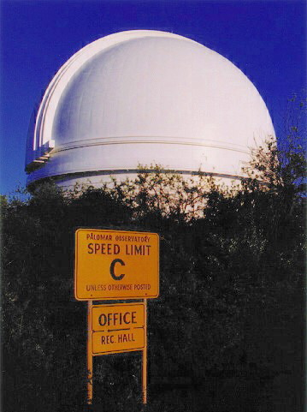
This charge moving up and down creates a wave in the electric field that moves at 300,000 km/s.
This wave in the electric field is what we call light,
and the speed at which it travels is called the
speed of light. We always use the letter c for the speed of light.
E=mc²
speed of light

Slide 42
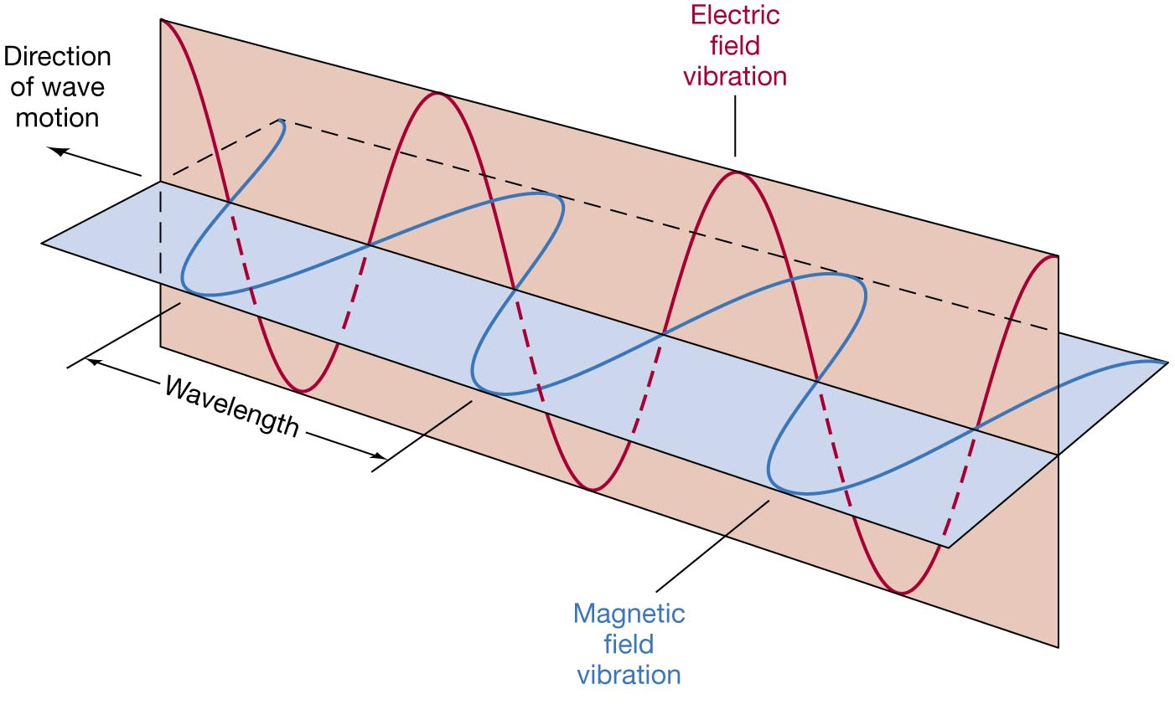
This is not quite the whole story. A changing electric field turns out to produce a magnetic field, so the wave is really a wave in both the electric field and magnetic field. But it is the electric field that we see:
So light is also called electromagnetic radiation

Slide 43
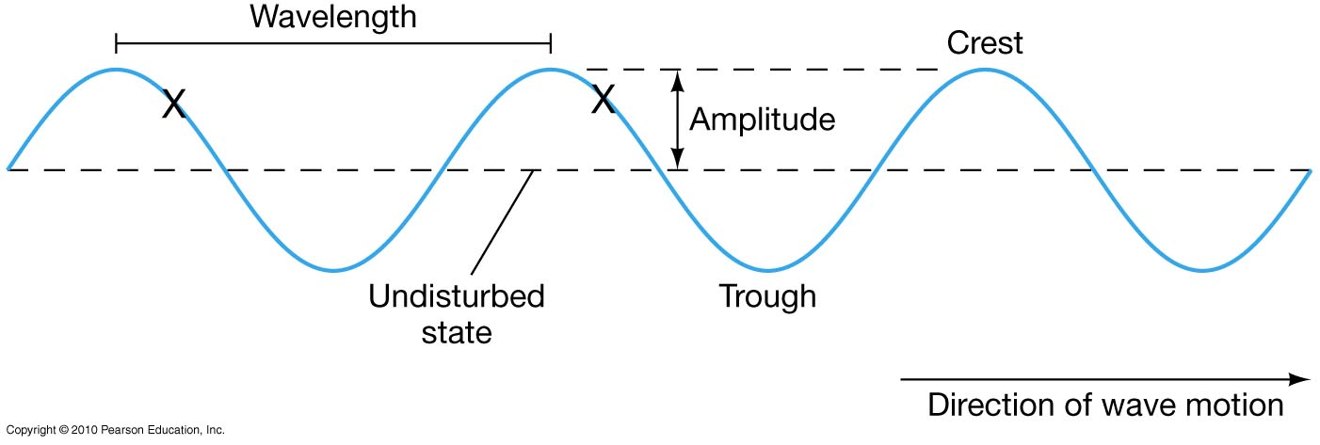
So light is a wave. There are two important characteristics about waves:
Frequency – number of waves that pass a point per second – units of Hertz or Hz
Wavelength – distance between wave crests
λ − Lambda

Slide 44
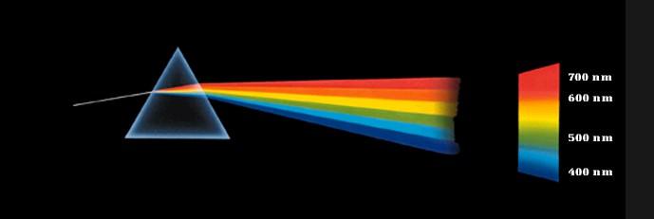
All electromagnetic radiation (light) is defined by its wavelength (or frequency).
For visible light the longest wavelength is red and the shortest is violet.
A prism can break up light into its colors, which are defined by wavelength – discovered by Newton.

Slide 45
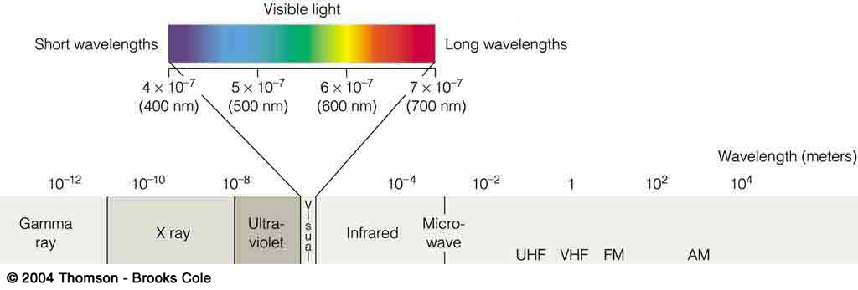
The complete spectrum of light
But visible light is only a narrow part of the full spectrum of electromagnetic radiation.
Visible wavelengths have wavelengths between
400 nm (violet) and 700 nm (red)
1 nm = 1 nanometer = 10⁻⁹ m.
There is stuff at longer and shorter wavelengths.
(
)
Radio

Slide 46

What is the relation between frequency and wavelength?
This is a distance = speed x time problem.
Look again at a wave moving by you, with one crest passing you each second, for a slow frequency of 1 crest per second or 1 Hz.
In the second between crests the first crest has moved away at the speed of light.
Here is the first crest passing you.

Slide 47
The second crest is now passing you. The first crest has moved one second at the speed of light, so it is 300,000 km away from the second crest
This means that the distance between crests is 300,000 km. This is the wavelength of the wave.
2nd crest
1st crest
300,000 km

Slide 48
This is a very long radio wave with wavelength
λ = 300,000 km, nearly the distance to the Moon.
Now suppose that in 1 second, 100 crests pass you
(frequency f = 100 Hz).
Then the time between crests is 1/100 s and the wavelength is
λ = 300,000 km/s x 1/100 s = 3,000 km.
A higher frequency (faster, more energetic electron) gives a shorter wavelength.

Slide 49
In general, for a frequency of f crests per second, you can see that the time between crests is T = 1/f . The distance between crests is then given by
distance = speed x time: i.e. λ = c T or
We can also reverse the relation to solve for the frequency

Slide 50




Which of the following waves has the highest frequency?
A radio wave with λ=21 cm
X-rays with λ=10⁻¹⁰ m
Visible red light with λ=700 nm
Infrared radiation with λ=10⁻⁶ m

Slide 51
Which of the following waves has the highest frequency?
A radio wave with λ=21 cm=0.21 m
shortest wavelength = highest frequency
X-rays with λ=10⁻¹⁰ m
Visible red light with λ=700 nm=7x10⁻⁷ m
Infrared radiation with λ=10⁻⁶ m

Slide 52
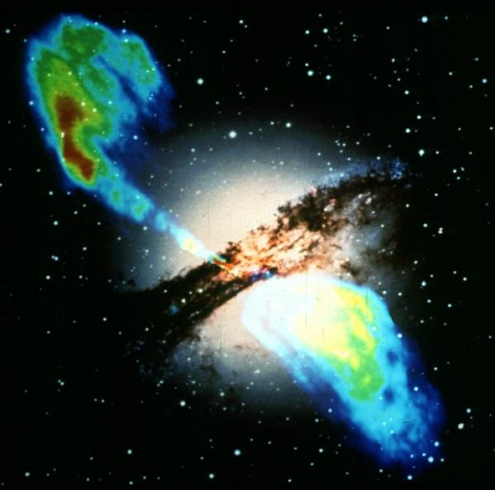
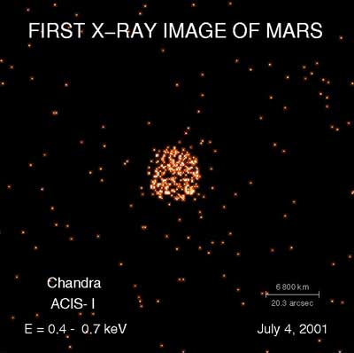
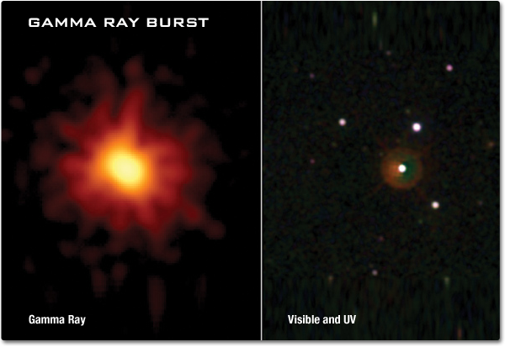
Astronomical objects produce radiation from the full electromagnetic spectrum, from very high frequency gamma rays to very low frequency radio waves – so astronomers observe at all wavelengths
Radio
Visible and IR

Slide 53
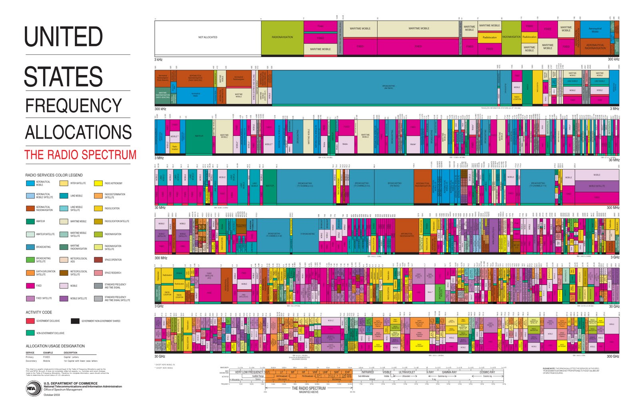
The radio spectrum is crowded!
Reserved for radio astronomy!

