Slide 1
Announcements
Remember stargazing this week
Please finish reading Chapter 1
Quiz 3 due Monday
Problem Set 3 for practice

Slide 2
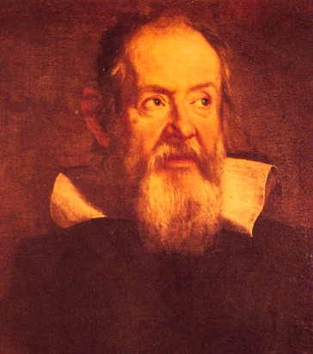
Galileo’s astronomical observations
Phases of Venus, agreeing with Copernican model
Craters on the Moon
4 moons of Jupiter
The Milky Way seen as a vast collection of stars
Sunspots, whose motion showed that the Sun rotates slowly
Rings of Saturn (he couldn’t see them well enough to know they were rings)
Galileo also made essential contributions to physics, studying the nature of motion and gravity in particular

Slide 3
Galileo’s experiments
What does an object do when there are no forces acting on it?
Greeks: It comes to rest
Is the Earth at rest?
If, like the Greeks, you think the Earth is at rest in the center of the universe, it makes sense to say that an object is at rest.
But the Earth is not at rest!
And if it is not, what does it mean to say an object is “at rest”?
What really happens?
With no force on it, an object will not change its velocity: the direction and speed of its motion will be constant. This is indistinguishable from being at rest!

Slide 4
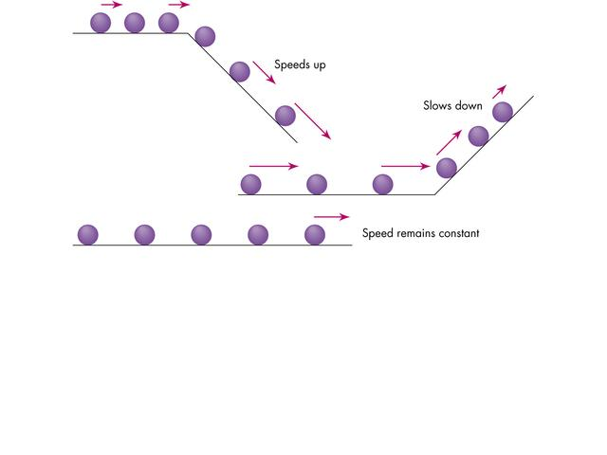
Galileo’s experiments
speeds up

Slide 5
slows down

Slide 6
Speed remains constant

Slide 7
Galileo’s experiments
Galileo set up a gently sloping plank, some 12 yards in length, and made polished steel balls roll down a narrow groove cut into it. With this simple apparatus, he was able to verify his conjecture that the speed of fall increased uniformly with time – the law of uniform acceleration. It was one of the great moments in the history of science.
It became clear that the effect of force was not to produce motion, but to change motion: to produce acceleration. A body on which no force acts moves at uniform speed.

Slide 8
By rolling balls and timing their descent Galileo concluded that when no force acts on an object the object moves forever at constant speed in a straight line.
This is the final meaning of the Copernican revolution: we no longer know what absolute space means.
There is no measurement you can make to find out whether you are moving or at rest.

Slide 9
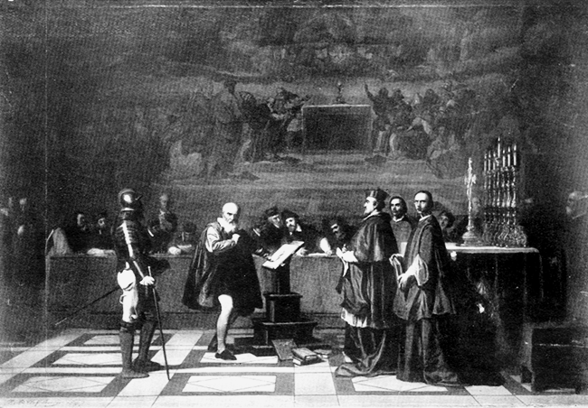
Galileo, initially supported by the Church, was ultimately brought for heresy in front of the Holy Office of the Inquisition in 1633. Giordano Bruno had been burned at the stake in Rome in 1600 for supporting the Copernican system, and Galileo recanted.

Slide 10
1 Chron. 16:30 He fixed the earth firm and immovable.
Galileo, initially supported by the Church, was ultimately brought for heresy in front of the Holy Office of the Inquisition in 1633. Giordano Bruno had been burned at the stake in Rome in 1600 for supporting the Copernican system, and Galileo recanted.

Slide 11
Psalm 93:1 The world also is established, that it cannot be moved.
Galileo, initially supported by the Church, was ultimately brought for heresy in front of the Holy Office of the Inquisition in 1633. Giordano Bruno had been burned at the stake in Rome in 1600 for supporting the Copernican system, and Galileo recanted.

Slide 12
"Because I have been enjoined by this Holy Office to abandon the false opinion that the Sun is the center and immovable, I abjure, curse, and detest the said errors and heresies contrary to the said Holy Church.” Galileo Galilei, Rome 1633
Galileo, initially supported by the Church, was ultimately brought for heresy in front of the Holy Office of the Inquisition in 1633. Giordano Bruno had been burned at the stake in Rome in 1600 for supporting the Copernican system, and Galileo recanted.

Slide 13
Fall 1980: Pope John Paul II orders a new look at the evidence against Galileo. In 1992 a commission found Galileo Galilei had been "more perceptive" in his interpretation of the Bible than his prosecutors. The commission conceded that the Bible should be regarded as not always telling the literal truth, but sometimes as metaphor. Galileo was formally pardoned on October 31, 1992 almost 360 years after his trial.
Galileo, initially supported by the Church, was ultimately brought for heresy in front of the Holy Office of the Inquisition in 1633. Giordano Bruno had been burned at the stake in Rome in 1600 for supporting the Copernican system, and Galileo recanted.

Slide 14
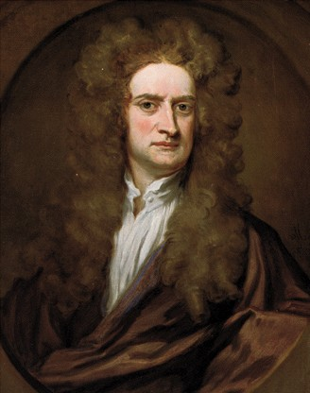
Newton (1642-1727)
Established the laws of classical mechanics.
Invented the reflecting telescope.
Invented calculus.

Slide 15
What does an object do when there is no force on it?
After reading Galileo, Newton realized:
With no force on it, an object will not change its velocity: the direction and speed of its motion will be constant.

Slide 16
Newton’s First Law of Motion
An object at rest will stay at rest unless acted upon by a force. A moving object will continue to move forever in a straight line at constant speed, unless acted upon by a force.
Sometimes called the law of inertia:
Inertia is the tendency of an object to keep moving at the same speed and in the same direction unless acted upon by a force
Massive objects have more inertia: it takes more force to change their motion

Slide 17
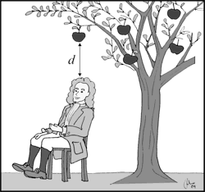
Force makes an object accelerate: change its speed or the direction of its motion
What gravity does to a falling apple is to increase the apple’s speed
The longer an apple falls, the faster it goes

Slide 18
Newton’s Second Law of Motion
The acceleration of an object is directly proportional to the force applied, and inversely proportional to the object’s mass.
mass
force
acceleration
The same force will make an object with a small mass accelerate more than an object with a larger mass.

Slide 19
When you slam on your brakes, the force (“friction”) of the pavement on the tires of your car stops the car.
…unless the pavement is icy and the force of friction much smaller. Then the car changes its speed much more slowly.
For a perfectly frictionless sheet of ice, the car would slide in a straight line at the same speed forever.

Slide 20
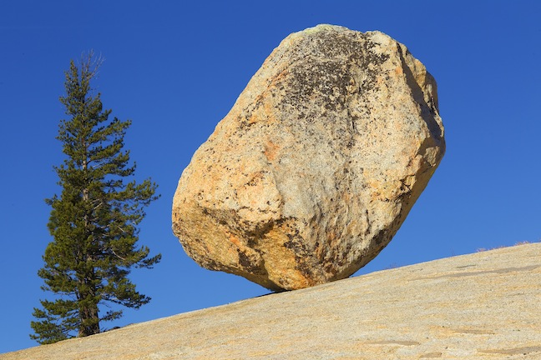
Friction from the air and ground is always present under normal circumstances
This is what led the Greeks to believe that the natural tendency of objects is to come to rest

Slide 21
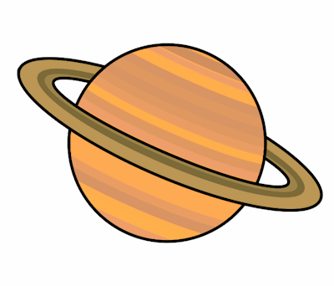
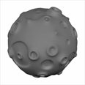
Newton’s Third Law of Motion
For every action there is an equal and opposite reaction: if body A exerts a force on body B, then body B exerts a force on body A that is equal in magnitude but oppositely directed.

Slide 22
A small asteroid collides with a planet. Which of the following is true?
The planet exerts more force on the asteroid than the asteroid exerts on the planet.
The asteroid exerts more force on the planet than the planet exerts on the asteroid.
The asteroid and the planet exert the same forces on each other.

Slide 23
A small asteroid collides with a planet. Which of the following is true?
The planet exerts more force on the asteroid than the asteroid exerts on the planet.
The asteroid exerts more force on the planet than the planet exerts on the asteroid.
The asteroid and the planet exert the same forces on each other.

Slide 24
A small asteroid collides with a planet. Which of the following is true?
The acceleration of the planet is greater than the acceleration of the asteroid.
The acceleration of the asteroid is greater than the acceleration of the planet.
The asteroid and the planet experience the same acceleration.

Slide 25
A small asteroid collides with a planet. Which of the following is true?
The acceleration of the planet is greater than the acceleration of the asteroid.
The acceleration of the asteroid is greater than the acceleration of the planet.
The asteroid and the planet experience the same acceleration.

Slide 26
Newton’s third law: the low mass asteroid and the high mass planet exert equal and opposite forces on each other when they collide.
Newton’s second law: in response to the force, the low mass asteroid accelerates more than the high mass planet.

Slide 27
Is there a force on an object that moves at constant speed in a circle?

Slide 28
Is there a force on an object that moves at constant speed in a circle?

Slide 29
Is there a force on an object that moves at constant speed in a circle?

Slide 30
Is there a force on an object that moves at constant speed in a circle?
Yes: The speed is constant but the direction of the motion changes.

Slide 31
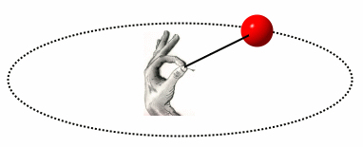
In what direction is the force on an object that moves at constant speed in a circle?
Toward the center of the circle: This is the force of a cord on a ball you swing around in a circle

Slide 32
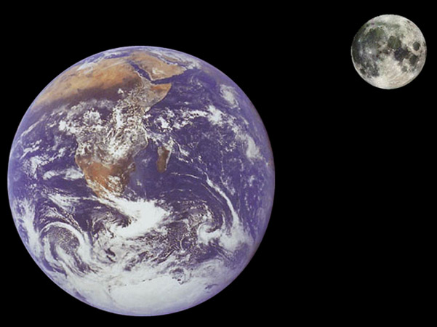
Gravity
The force on the apple and the force on the Moon both point toward the center of the Earth

Slide 33
Newton’s law of gravity: Any two objects in the universe attract each other with a force given by
With r in meters m in kg
F in Newtons, where 1 Newton = 4.5 lb
G = 7x10⁻¹¹
m
M
r
Newton’s gravitational constant
M: mass of object 1
m: mass of object 2
r: distance between the objects

Slide 34
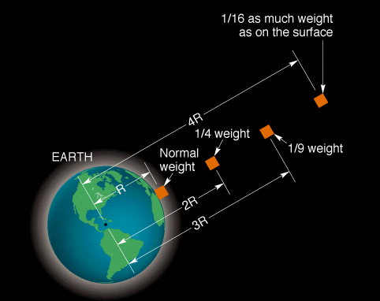
Force of gravity on an object proportional to 1/r²
Note: weight is a measurement of force, not mass. How much you weigh depends on your mass and on the strength of gravity where you are. Pounds are a unit of force; kilograms are a unit of mass.

Slide 35
Using Newton’s law of Gravity
An astronaut weighs 140 pounds on Earth. How much would she weigh on a planet that is the same size as Earth but ½ the mass?
35 pounds
140 pounds
70 pounds
280 pounds

Slide 36
Using Newton’s law of Gravity
An astronaut weighs 140 pounds on Earth. How much would she weigh on a planet that is the same size as Earth but ½ the mass?
35 pounds
140 pounds
70 pounds
280 pounds

Slide 37
Mass of new planet is ½ mass of Earth:
So the gravitational force on the new planet is half as strong as on Earth, and the astronaut weighs half as much.
Remember that weight is gravitational force! The mass of the astronaut m does not change!

Slide 38
Using Newton’s law of Gravity
An astronaut weighs 150 pounds on Earth. How much would she weigh on a planet that is the same size as Earth but 0.1 times the mass?
1.5 pounds
150 pounds
15 pounds
1500 pounds

Slide 39
Using Newton’s law of Gravity
An astronaut weighs 150 pounds on Earth. How much would she weigh on a planet that is the same size as Earth but 0.1 times the mass?
1.5 pounds
150 pounds
15 pounds
1500 pounds

Slide 40
Using Newton’s law of Gravity
An astronaut weighs 120 pounds on Earth. How much would she weigh on a planet that is the same mass as Earth but double the radius?
30 pounds
240 pounds
60 pounds
480 pounds

Slide 41
Using Newton’s law of Gravity
An astronaut weighs 120 pounds on Earth. How much would she weigh on a planet that is the same mass as Earth but double the radius?
30 pounds
240 pounds
60 pounds
480 pounds

Slide 42
Radius of new planet is twice the radius of Earth:
The gravitational force on the new planet is ¼ as strong as on Earth, and the astronaut weighs ¼ as much.

Slide 43
Using Newton’s law of Gravity
An astronaut weighs 100 pounds on Earth. How much would she weigh on a planet that is the same mass as Earth but 1/3 the radius?
11 pounds
300 pounds
33 pounds
900 pounds

Slide 44
Using Newton’s law of Gravity
An astronaut weighs 100 pounds on Earth. How much would she weigh on a planet that is the same mass as Earth but 1/3 the radius?
11 pounds
300 pounds
33 pounds
900 pounds

Slide 45
Radius of new planet is 1/3 the radius of Earth:
The gravitational force on the new planet is 9 times stronger than it is on Earth, and the astronaut weighs 9 times as much!

Slide 46
Using Newton’s law of Gravity
An astronaut weighs 120 pounds on earth. How much would she weigh on a planet that is both ½ the mass and ½ the radius of Earth?
30 pounds
120 pounds
60 pounds
240 pounds

Slide 47
Using Newton’s law of Gravity
An astronaut weighs 120 pounds on earth. How much would she weigh on a planet that is both ½ the mass and ½ the radius of Earth?
30 pounds
120 pounds
60 pounds
240 pounds

Slide 48
Using Newton’s law of Gravity
The International Space Station orbits at about 400 km above the Earth’s surface, or about 6770 km from the center of the Earth. The radius of the Earth is about 6370 km. Which of the following is true?
The force of gravity on the space station is much weaker than it is on the surface of the Earth.
The force of gravity is almost as strong on the space station as it is on the surface of the Earth.
There is no force of gravity on the space station.

Slide 49
The International Space Station orbits at about 400 km above the Earth’s surface, or about 6770 km from the center of the Earth. The radius of the Earth is about 6370 km. Which of the following is true?
The force of gravity on the space station is about 90% of the force of gravity on the Earth!
The force of gravity on the space station is much weaker than it is on the surface of the Earth.
The force of gravity is almost as strong on the space station as it is on the surface of the Earth.
There is no force of gravity on the space station.

Slide 50
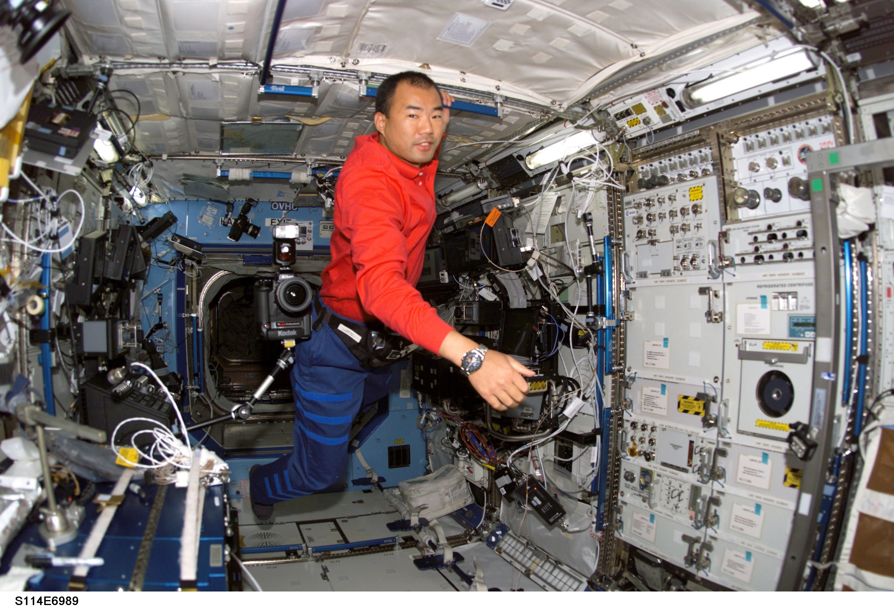
So why are astronauts on the Space Station weightless??

Slide 51
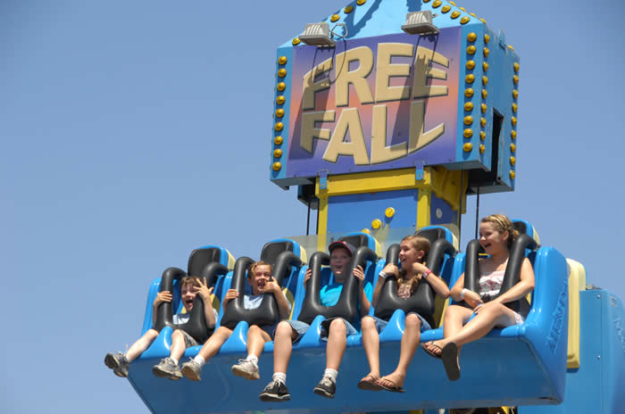
So why are astronauts on the Space Station weightless??
The space station orbits due to Earth’s gravity – if this disappeared it would fly off into space in a straight line
It does not fall back to Earth because it’s going very fast – in fact it’s always falling, but it falls “over the horizon”
The astronauts do not feel the force of gravity because they are in free fall

Slide 52
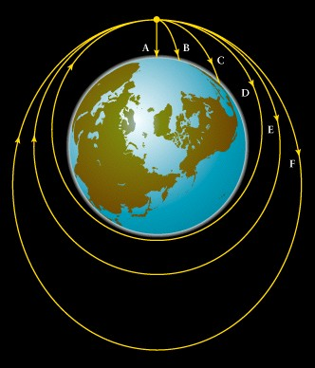
“Newton’s Cannon”
A cannonball launched from above the Earth’s surface will, if launched fast enough, orbit the Earth instead of falling back to the ground.

Slide 53
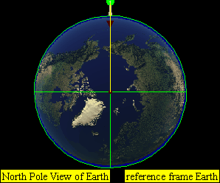
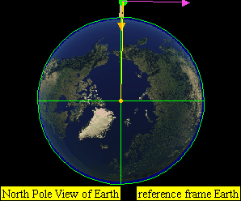
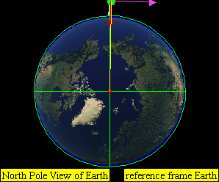
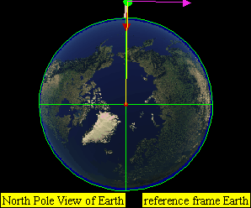
v = 8000 m/s
v = 0 m/s
v = 6000 m/s
v = 10,000 m/s
v = 7300 m/s

Slide 54
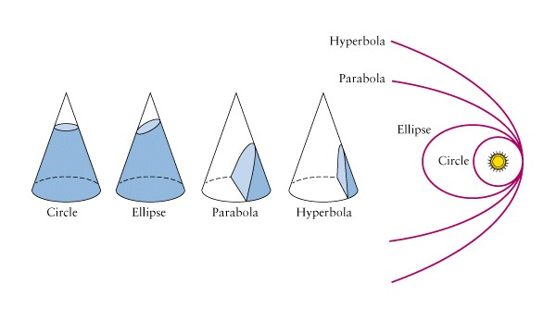
There are two types of orbits, depending on whether an object is moving faster than its escape velocity. Bound orbits are ellipses Unbound orbits are hyperbolas
Turns out these shapes can be constructed by taking so-called conic sections

Slide 55
Just to reiterate:
Bound orbits are ellipses Unbound orbits are hyperbolas

Slide 56
Newton’s Theory of Gravity provided an explanation for Kepler’s Laws
Kepler’s second law: The line from the Sun to a planet sweeps out equal areas in equal intervals of time. This means the planet moves fastest when it’s closest to the Sun (perihelion) and slowest when it’s farthest from the Sun (aphelion).
Newton’s law of gravity tells us that the gravitational force on the planet is strongest when it’s closest to the Sun: when r is smallest. Newton’s second law (F = ma) tells us that force causes acceleration: as the force increases, the acceleration of the planet increases. This is why the planet moves faster as it gets closer to the Sun and slower as it gets farther away.

Slide 57
Newton’s Theory of Gravity provided an explanation for Kepler’s Laws
And resulted in a couple of corrections
Kepler’s first law: The orbit of a planet around the Sun is an ellipse with the center of mass of the planet-Sun system at one focus
Kepler’s third law: The relationship between the period and semi-major axis of an orbiting planet is
P in Earth years
a in AU
M_{total} is the combined mass of the two objects in units of the mass of the Sun
This correction doesn’t matter much for a planet which is much, much less massive than the star it orbits, but for two objects of similar masses, like a binary star system, it is very important!

Slide 58
Predictions from Newton’s Theory of Gravity
Precise orbits of planets, moons, comets . . .
Reappearance of Halley’s comet
Discovery of Neptune from discrepancy in orbit of Uranus. Predicted by Adams and Le Verrier

