Slide 1
Announcements
If your last name starts with L-Z, you should be in the planetarium now!
Please turn in your planetarium summary
Begin reading Chapter 1
Quiz 2 due Monday: motions of the Earth, phases of the Moon and eclipses
Problem sets 2A and 2B for practice

Slide 2
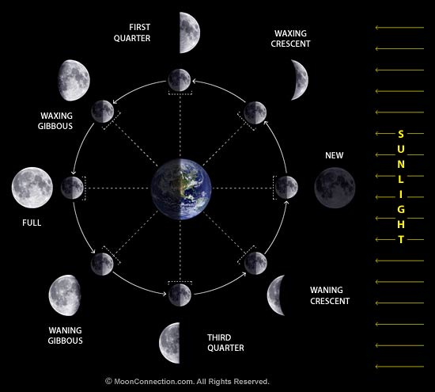
Recap: Phases of the Moon
Due to relative positions of Moon and Sun
We see illuminated portion of Moon only
Fraction of disk visible = fraction of night Moon is up

Slide 3
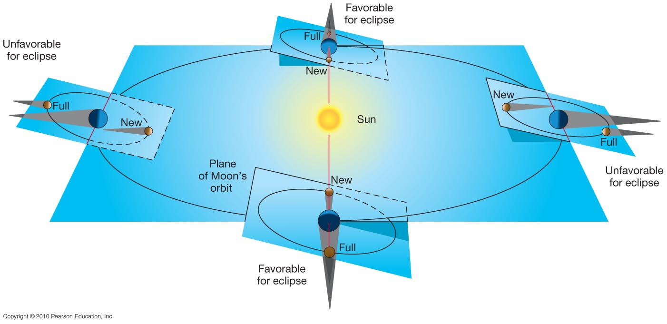
Solar eclipse: shadow of Moon falls on the Earth Lunar eclipse: shadow of Earth falls on the Moon
Because of tilt of Moon’s orbit relative to ecliptic, eclipses happen only about twice a year: eclipse seasons

Slide 4
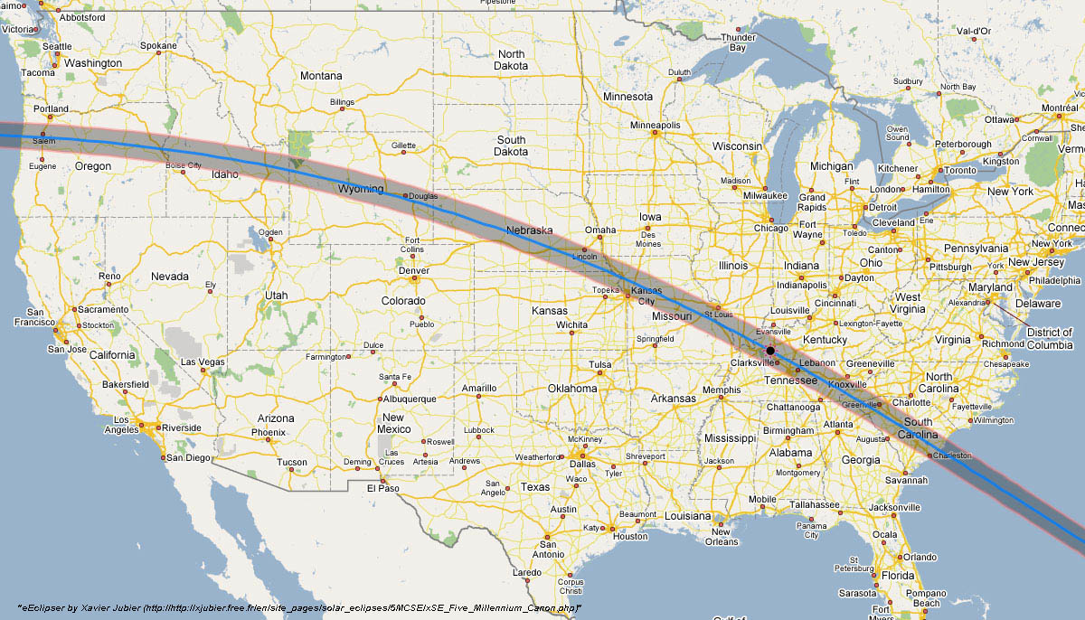
August 21, 2017
First total solar eclipse visible from mainland US since 1979
Mark your calendars!

Slide 5
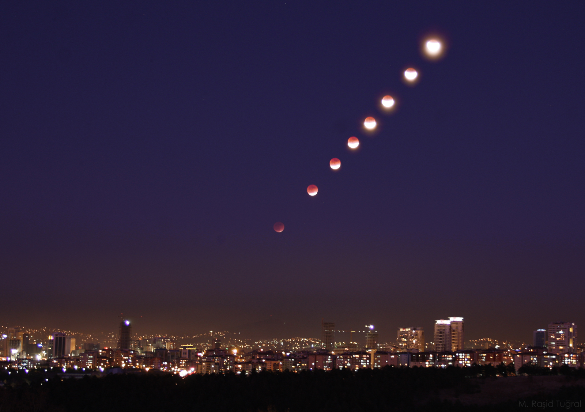
Next Lunar Eclipse
April 15, 2014
Next total lunar eclipse visible from the Americas
Will need to stay up late: 2:06 to 3:24 am in Milwaukee

Slide 6
In what phase and location is the Moon when a solar eclipse occurs?
New phase and above plane of Earth’s orbit
Full phase and above plane of Earth’s orbit
New phase and crossing plane of Earth’s orbit
Full phase and crossing plane of Earth’s orbit

Slide 7
In what phase and location is the Moon when a solar eclipse occurs?
New phase and above plane of Earth’s orbit
Full phase and above plane of Earth’s orbit
New phase and crossing plane of Earth’s orbit
Full phase and crossing plane of Earth’s orbit

Slide 8
Astronomy 103
The Scientific Method
Reading: Section 0.5
(we’ll cover the material in 0.4 later)

Slide 9
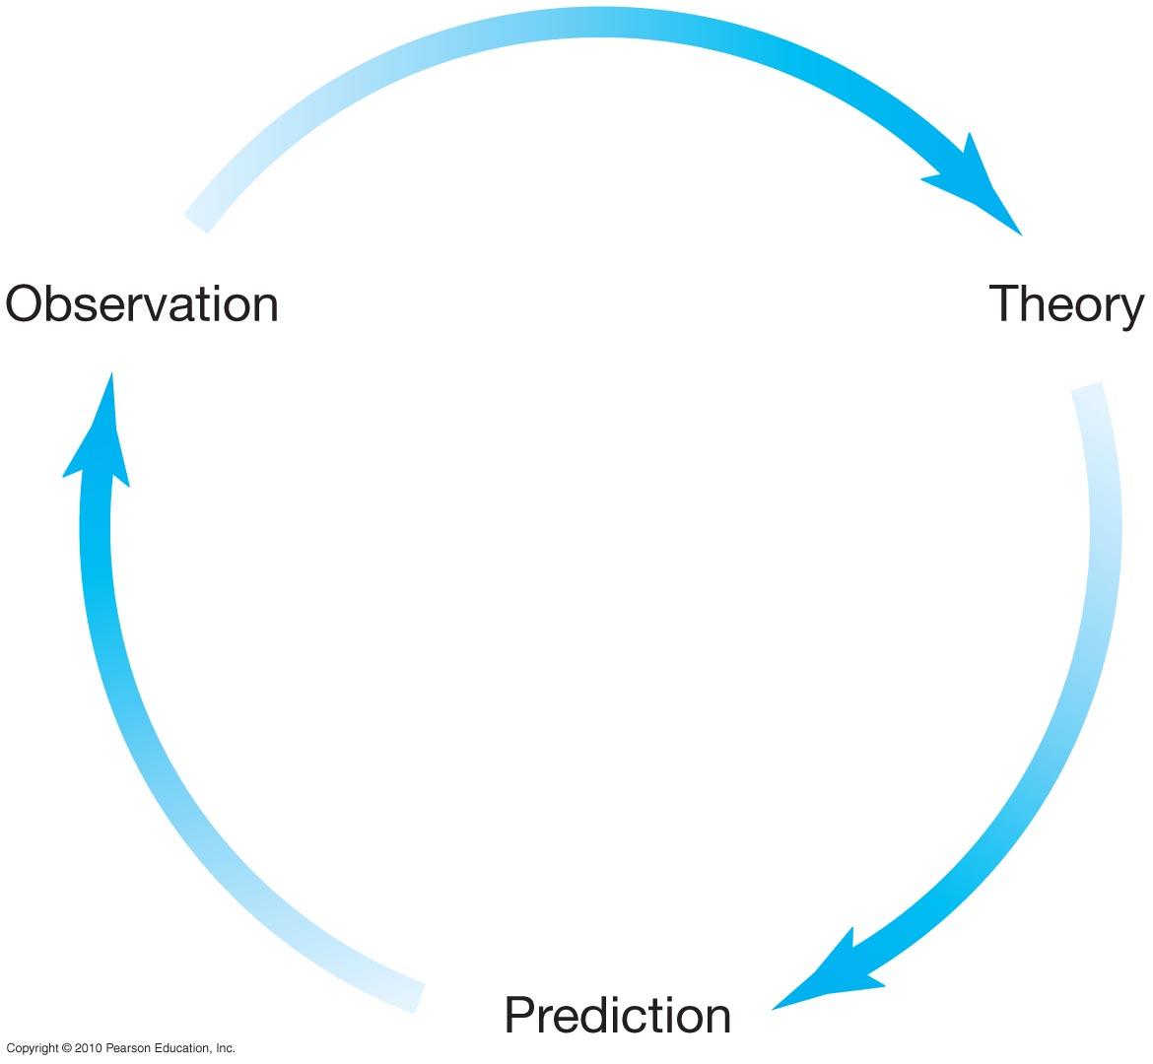
The scientific method
2
1
Develop a theory to explain our observations
Study the world around us
Examples of theories:
gravity, electromagnetism
5
Revise theory to account for new observations
4
Do we observe what we predicted?
3
A theory must make testable predictions!
What else does the theory predict we should observe?

Slide 10
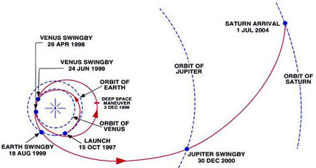
The use of a theory
Gravity
Explain why a ball falls
Predict complex trajectories of spacecraft

Slide 11
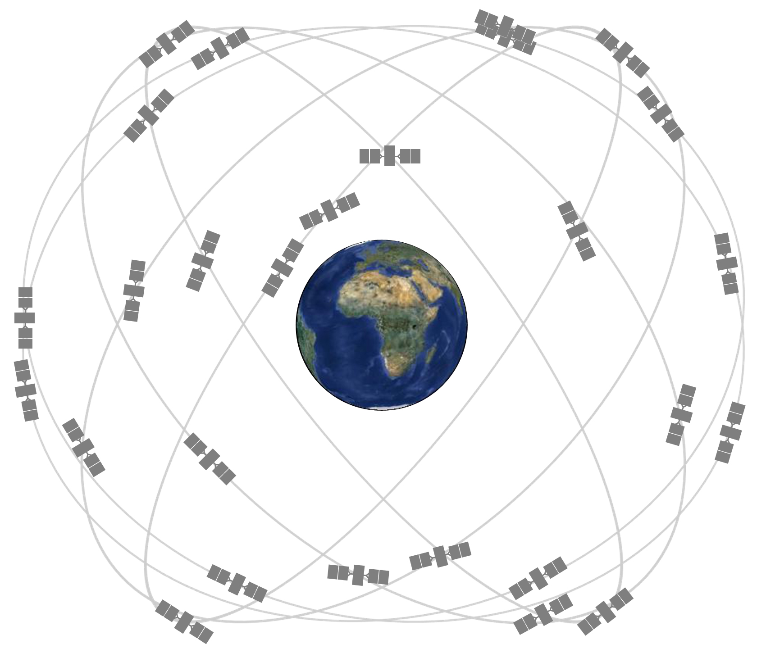
The use of a theory
GPS: how does it work?
Each satellite continually transmits message: time message was sent, position of satellite when message sent
Receiver records time messages received, uses speed of light to calculate distance to satellite
Messages from four or more satellites then used to determine position

Slide 12
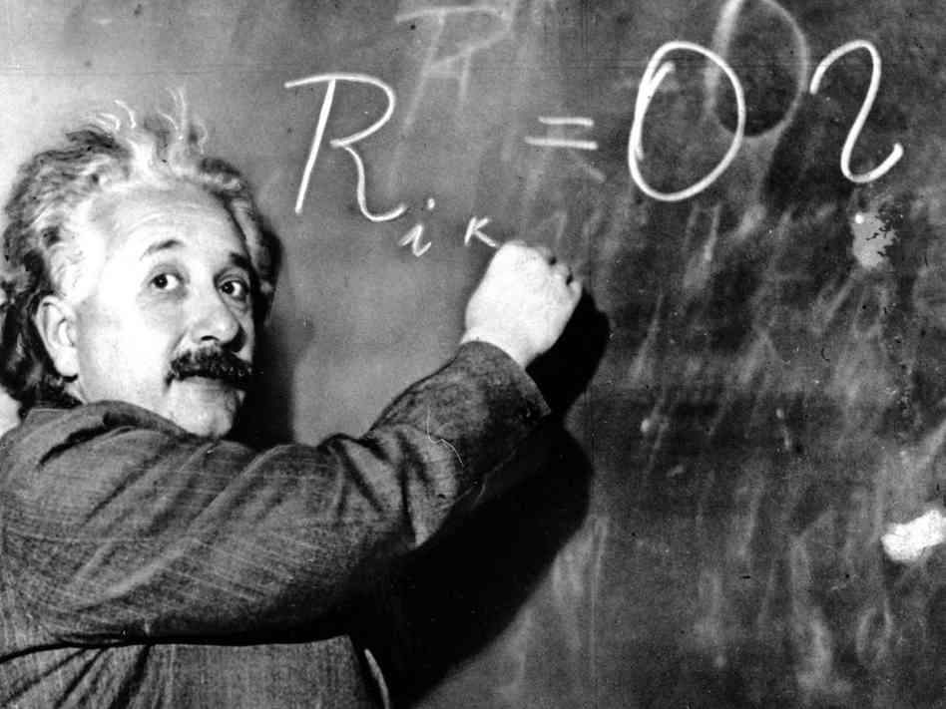
The use of a theory
Albert Einstein
Special relativity: clocks run slower at high speeds (1905)
General relativity: clocks run slower in a strong gravitational field (1907-1915)

Slide 13
The use of a theory
GPS satellites: need to correct clocks on satellites!
Special relativity: clocks run slow because satellites move fast
General relativity: clocks run fast because satellites are farther from Earth
Without these corrections, GPS positions would be wrong after 2 minutes, and errors would accumulate at a rate of 10 km per day!

Slide 14
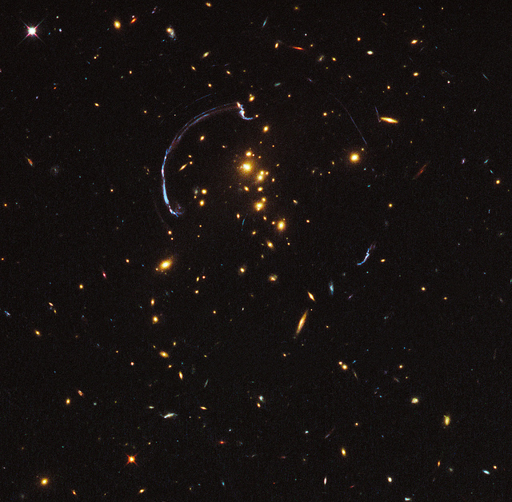
The use of a theory
Another consequence of general relativity: Gravitational lensing – massive objects change the path of light (more on this later!)

Slide 15
The scientific method
Observation, theory, predictions, and testing of the predictions by observation
A theory must make numerical predictions, and those predictions must be testable
It must be possible to show that a theory is false by making a series of observations that disagree with its predictions
Important things about theories:
Laws of nature tend to be vastly more accurate than the observations on which they’re based
When you get it right things that appeared to be coincidences are not accidental at all
A scientific theory is the best explanation for our observations – theory doesn’t mean that we’re not confident it’s right. Gravity is a theory, supported by extensive evidence.

Slide 16
Astronomy 103
From the Greeks to Newton: Part 1
Please read chapter 1

Slide 17
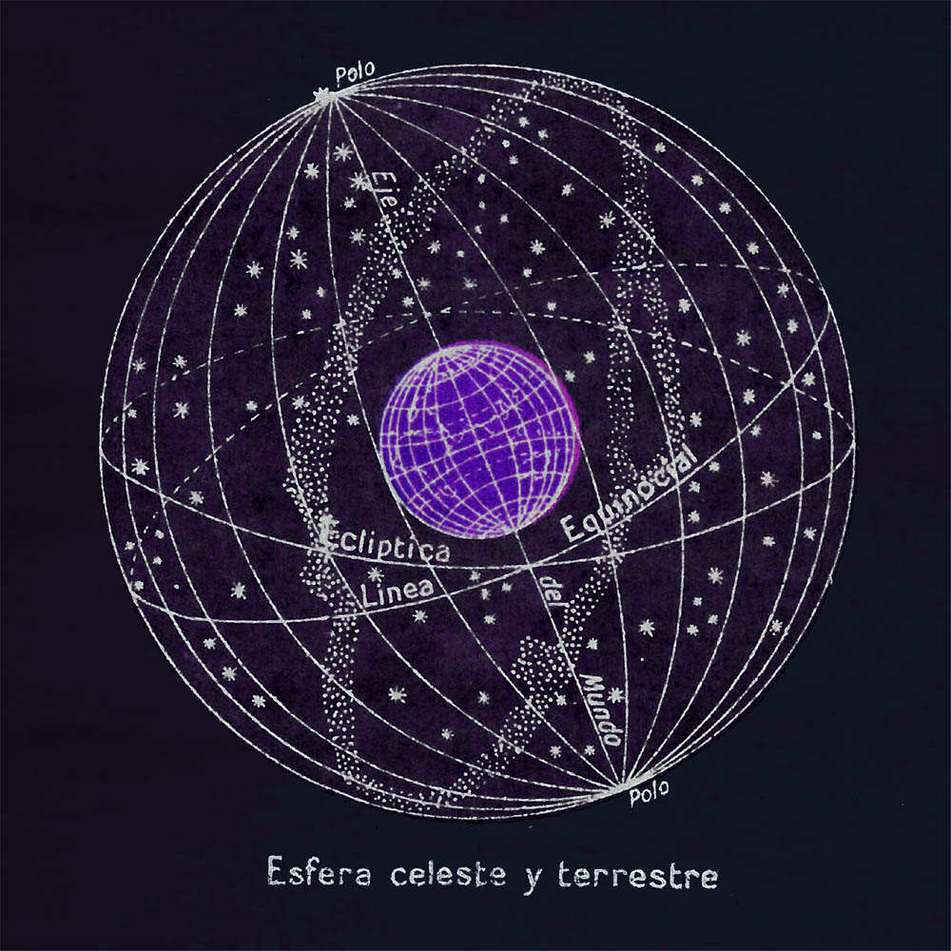
Ancient Astronomy
Ancient astronomers looked up at the night sky and saw that the stars are mostly unchanging
The sky appears as a sphere -- the celestial sphere -- and the stars were thought to be a sphere far away from the earth

Slide 18
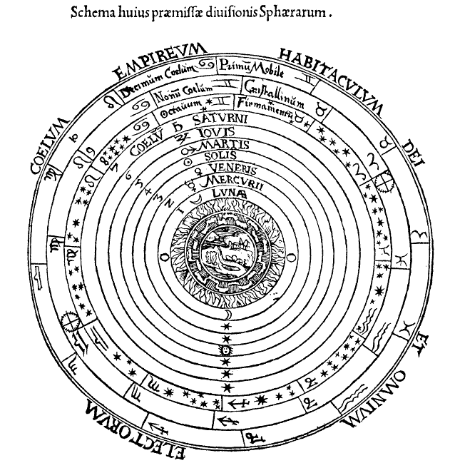
Ancient Astronomy
The celestial sphere is a convenient fiction for describing the motions of stars…
But ancient philosophers such as Aristotle really believed that the sky was composed of concentric, crystalline spheres to which the celestial objects were attached, with the Earth at the center
Peter Apian, Cosmographia, Antwerp, 1524

Slide 19
Ancient Astronomy
But the celestial spheres cannot describe the motions of everything
Stars are not completely unchanging: the Greeks noticed that there were bodies that move relative to the background of “fixed” stars
They called these bodies planets, or Greek for wandering star
The problem of the motion of the planets confounded the Greeks and early astronomers until Kepler (more on him later) came along

Slide 20
Motion of the planets
Why so hard?
You know that each day the celestial sphere appears to rotate once about an axis through the poles, taking the Sun, Moon and stars with it along circular paths.
The stars appear to be permanently fixed on the celestial sphere; the moon appears to move around it once a month from west to east through the zodiac constellations, due to its real revolution about the earth. The Sun similarly appears to move west to east through the constellations of the zodiac, this time due to the real revolution of the Earth about the Sun.
These motions are perfectly circular! So it is natural to think that the motions of the heavens have to follow perfect circles.
BUT the planets don’t seem to move this way. Why not?
Notes:
Also perhaps natural to think that everything rotates around the Earth, since it appears that way and we don’t feel like we’re moving

Slide 21
The path of a planet relative to the background stars appears to us a series of loops like this:
The backward motion is called retrograde motion. So, what’s going on here???

Slide 22
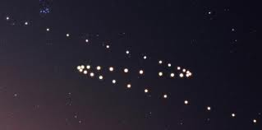
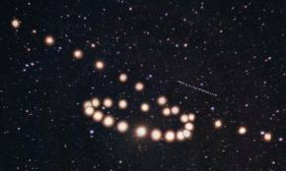
Observations I
Retrograde motion: Each planet has an overall apparent motion from west to east through the Zodiac constellations, with Mercury and Venus moving much faster than Mars, Jupiter and Saturn. But unlike all of the other celestial objects that the ancients saw, the planets do not move in simple circles on the celestial sphere, nor do they always move from west to east. Instead, during part of its orbit, each planet changes its direction, moving backwards (east to west) for a time and then turning again to move west to east. This is quite different from all other objects in the sky!
Notes:
What does our theory need to be able to explain?

Slide 23
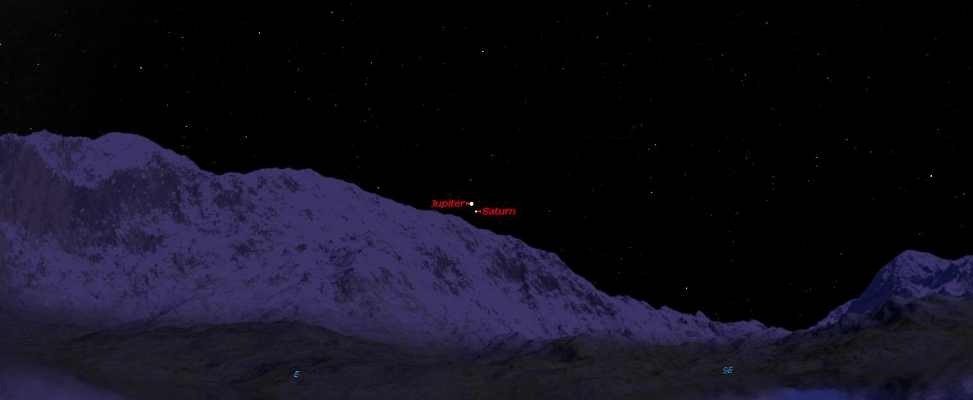
Observations II
There is also a strange coincidence: When Jupiter and Saturn are in the same direction in the sky, their retrograde motion starts and stops at nearly the same time: They seem to be dancing together! (The same thing is true when Mars and Jupiter or Mars and Saturn are in the same direction).

Slide 24
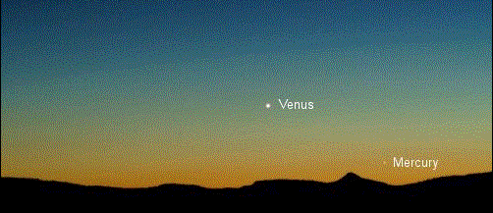
Observations III
Finally, the fastest planets, Mercury and Venus, are always in the same part of the sky as the Sun. The angle between Mercury and the Sun is never greater than 28 degrees (about twice the angular distance between your first and fourth fingers if you stretch them apart and hold your arm out straight). The angle between Venus and the Sun is never more than 47 degrees. Mercury and Venus are never opposite in the sky to the Sun. We can see Venus only for a few hours after sunset and it can rise only a few hours before sunrise.

Slide 25
These are the OBSERVATIONS. A MODEL must now be constructed to explain these OBSERVATIONS. And a good MODEL must be able to explain these OBSERVATIONS and make PREDICTIONS. This is the essence of the scientific method, which the Greeks were keenly aware of.

Slide 26
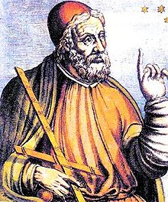
Ptolemy
In 140 AD, Ptolemy devised a model of the solar system with the Earth at rest at the center. Each planet in his system revolved about a large circle, called an epicycle, and the center of the epicycle in turn revolved about the earth. Ptolemy’s system did not have the beauty that the ancient Greek philosophers had envisioned, but its empirical accuracy was unprecedented.
It was Ptolemy’s years of work in finding periods, sizes, and centers of epicycles to match the hundreds of years’ worth of planetary observations that made it possible to use his system for fifteen centuries to predict the position of planets in the sky.

Slide 27
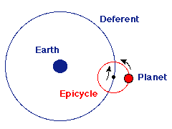
Each planet moves on a small circle called an epicycle
Center of the epicycle moves around the Earth in a larger circle called the deferent
This produces overall west-to-east motion of each planet. West-to-east (counterclockwise) motion of the epicycle reproduces the overall west-to- east motion of each planet. The looping motion is reproduced by the motion of each planet along its epicycle – in the animations that follows, the planet moves backwards when it is at the part of the epicycle closest to the earth.

Slide 28
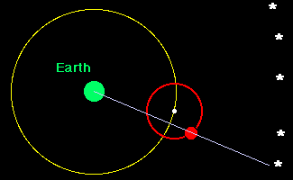
How do you get retrograde motion in the Ptolemaic model?

Slide 29
Ptolemy’s model is motivated by three things:
Everything moves in perfect circles
The earth is the center of the universe
The motions of the planets are explained and predicted
In fact it fails on all three counts!!
The REAL Ptolemaic Universe
The next few slides are an aside and will not be on any test or any quiz. However, it is important to show how scientific theory and history really works.
BEGIN ASIDE

Slide 30
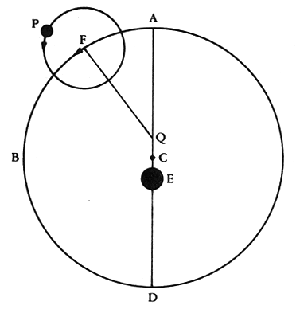
The REAL Ptolemaic explanation of retrograde motion is as follows:
equant
center
Earth
Notice that the Earth is not at the center of the universe
There is also a new construction known as the equant around which the large circle rotates at the uniform rate.

Slide 31
Here is an animation of the motion of the planets in this system

Slide 32
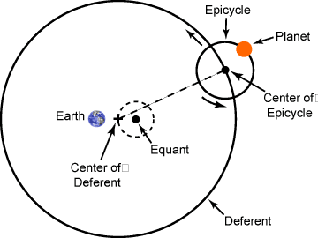
The Equant – Who ordered that??
To a hypothetical observer at the equant point, the planet would appear to move at a steady speed.
This is not uniform circular motion, which would be constant rotation around the center of the deferent.
However, Ptolemy needed a way to account for the differing speeds of the planets as they move in the sky.

Slide 33
Notice that the Earth is NOT at the center of the universe, just close to it.
Also the motion does not go around a uniform rate around the center, but rather something known as the equant.
Ptolemy’s universe is unpleasantly complicated – the full model required 80 circles to account for the Sun, Moon and five known planets. So why do this?
BECAUSE, in order to explain the observations, he had to do this!!
So even the Greeks knew that Earth could not be the center of the universe if everything moves in perfect circles!
Surprisingly people were ok with not being in the center, but the equant really bothered them – various people tried getting rid of it for the next 1500 years.
END ASIDE

Slide 34
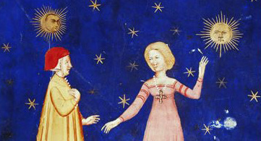
Astronomy in the Middle Ages
The pace of scientific discovery slowed after Ptolemy, after Rome conquered Greece. Finally, after the northern tribes conquered Rome, astronomy in Europe was virtually dead until 1,000 years had passed and the barbarians of northern Europe finally learned to read Greek. Muslim astronomers kept the subject alive but did not renew the Greek quest for an understanding of the motion of planets.

Slide 35
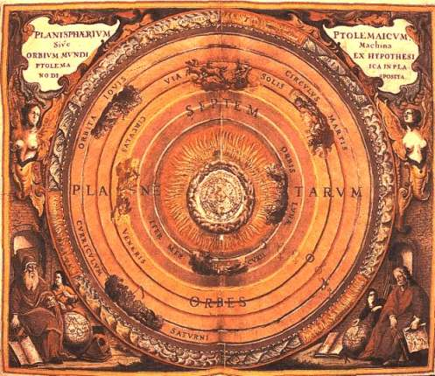
A lot of knowledge from the Greeks came through Arab to Latin translations done in the 13th century in Spain. These translations made their way into Europe and spurred the renaissance.
Alfonso X, king of Castile, sponsored much of this work in Toledo. Upon learning the very complicated to explain the motions of the planets of the Ptolemaic system he is rumored to have said:
"If I had been there with God when He made the world, I would have amended many things so that they would be better made than as He made them."

Slide 36
The Copernican Revolution
Copernicus (1473 – 1543)
Tycho Brahe (1546 – 1601)
Kepler (1571 – 1630)
Galileo (1564 – 1642)
Newton (1642 – 1727)
Copernicus
Copernicus was a contemporary of Columbus, born in Poland about 20 years before Columbus sailed.
He traveled to Italy, where he translated Greek texts and learned about Aristarchus’s system with the Sun at the center of the universe. Supposedly, he also got hold of some Islamic manuscripts, which were critical in forming his thinking. When he returned to Poland he began calculations in a remote outpost on the Baltic Sea. Copernicus argued that the rotation of the celestial sphere could be accounted for by assuming that the Earth rotates about a fixed axis while the sphere is stationary. Similarly, the apparent motion of the Sun – once around the celestial sphere per year – could be accounted for by assuming the Earth revolves yearly about the Sun.
The great simplification of Copernicus' work, however, was this: If the Earth were just another planet, and all planets moved about the Sun, then the peculiar retrograde motion that had plagued astronomers for two thousand years is explained. How does this work?

Slide 37
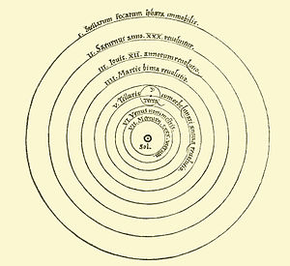
Copernicus placed the Sun at the center and had the planets move around the Sun in perfect circles. The speed of the orbits were adjustable, but he found that in order for this to work, he had to place the planets in the order of Mercury, Venus, Earth, Mars, Jupiter and Saturn. He also had to make the planets that were closer in orbit faster. So Mercury and Venus have periods (the time of one orbit is a period) shorter than one year, making Earth, with its period of one year, the third planet from the Sun. The Earth moves faster in its orbit than the outer planets, Mars, Jupiter and Saturn
The Stars
Mars
Earth and the moon
Venus
From Copernicus’ original manuscript

Slide 38
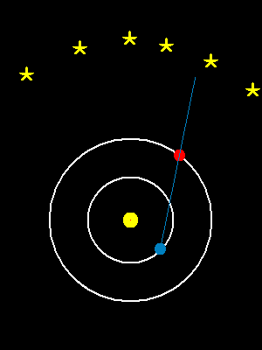
Ok - how does this give us retrograde motion?
When the Earth passes an outer planet, that outer planet appears to move backwards relative to the background stars. It is the same effect you see when you pass a car on a highway. If you watch that car, you see it appear to move backwards relative to the background trees, even though both you and the other car are moving in the same direction.

Slide 39
Here’s another animation:

Slide 40
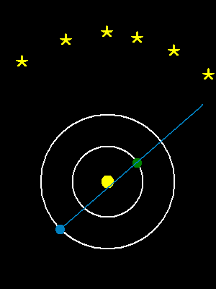
By adjusting the different speeds of the orbits, you can get different amounts of retrograde motion. Similar to Ptolemic model, where the speed of the deferent and epicycles were adjustable.
Mars
Venus

Slide 41
After Copernicus, it was difficult for serious astronomers to avoid this model:
1) It was the first workable heliocentric model to challenge the geocentric or (Ptolemic) model of the universe. For a lot of people it was something different to think about.
2) It was also somewhat simpler than the Ptolemic model in that it got rid of the hated equant. Motion was now all perfectly circular. For this reason alone, it was widely considered.
3) The Jupiter-Saturn coincidence is explained. Can anyone explain why?
(Reminder: The outer planets (Jupiter/Saturn) start and end their retrograde motion at about the same time when they are in the same direction)
4) For any planet closer to the Sun than the Earth we see a maximum angle between the planet and the Sun.

Slide 42
Why is it that for any planet closer to the Sun than the Earth we see a maximum angle between the planet and the Sun?
Orbit of Venus
Earth
Sun

Slide 43
The drawing arbitrarily puts the Earth on the right. Venus can be anywhere on its orbit – The purple dots show possible positions. What position is the one that gives the largest angle between Venus and the Sun?
c
b
d
Venus
a
Earth
Sun
1 AU
1 AU = 1 astronomical unit
Average distance from Earth to Sun

Slide 44
The drawing arbitrarily puts the Earth on the right. Venus can be anywhere on its orbit – The purple dots show possible positions. What position is the one that gives the largest angle between Venus and the Sun?
c
b
d
Venus
a
Earth
Sun
1 AU

Slide 45
You can see from the diagram that the largest angle occurs when the line from the Earth to Venus is tangent to Venus’ orbit.
Venus
48º
Earth
Sun
1 AU

Slide 46
For this triangle with a 48º angle and a side of 1 AU, the side that is the line from the Sun to Venus has a length of 0.7 AU. Copernicus found the distance to Venus (and to Mercury) in AU!
Venus
0.7 AU!!
48º
Earth
Sun
1 AU

Slide 47
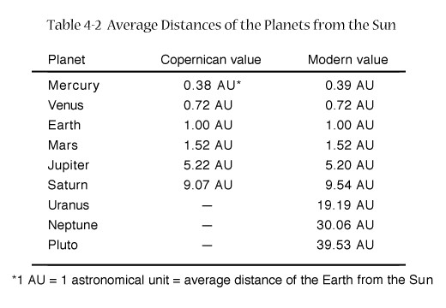
He found distances to the outer planets by using the time they spent on their retrograde loops (the apparent size of their retrograde loops would also have worked). The method is somewhat complicated… but the results were remarkably accurate.

