Slide 1
Announcements
Today: review for midterm 3
Midterm 3: Wednesday April 24
  Neutron stars and black holes (Ch 13)
  The solar system (Chs 4, 6, 7, + bits of Ch 5 [Earth] and 8 [moons of Jupiter, Saturn])
  The Milky Way Galaxy (Ch 14)
Review problem sets and quizzes for practice
No books, notes or calculator
Bring a #2 pencil!

Slide 2
Information provided on midterm:

Slide 3
Neutron Stars
Collapsed remnants of massive stars
Mass and size – neutron stars are 10-20 km in radius and have approximately the mass of the sun, so they are extremely dense
Rotation – as the parent star collapses, the neutron core spins very rapidly, conserving angular momentum. Typical periods are fractions of a second.
Magnetic field – again as a result of the collapse, the neutron star’s magnetic field becomes enormously strong.

Slide 4
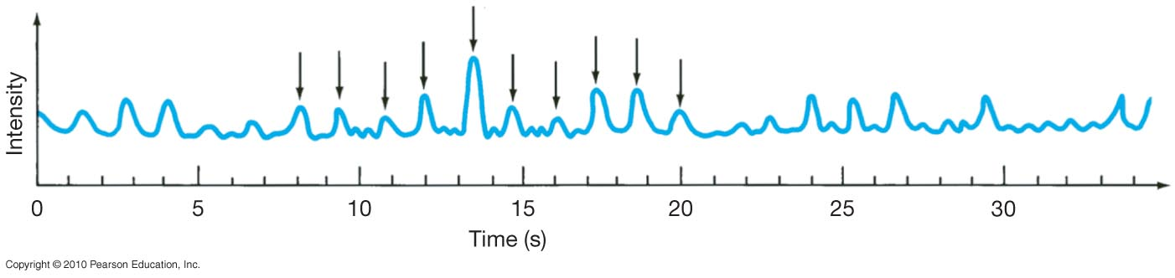
Pulsars
The first pulsar was discovered in 1967. It emitted extraordinarily regular pulses; nothing like it had ever been seen before.
After some initial confusion, it was realized that this was a neutron star, spinning very rapidly.

Slide 5
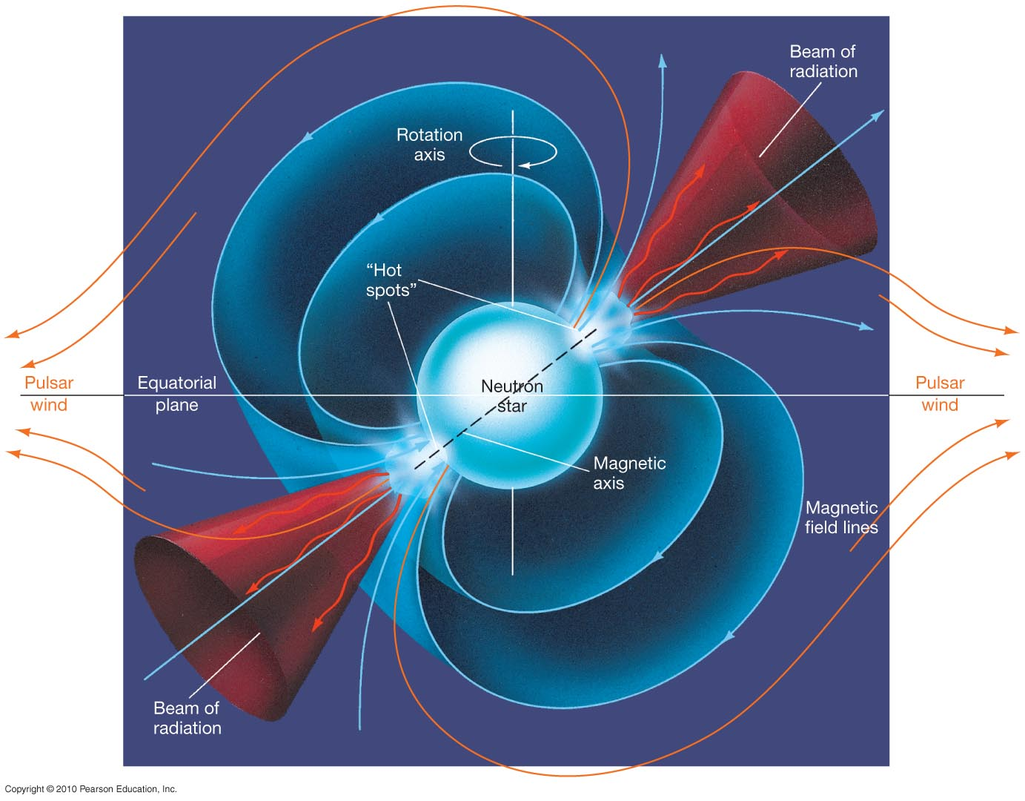
Pulsars
But why would a neutron star flash on and off?
This figure illustrates the lighthouse effect responsible.
Strong jets of matter are emitted at the magnetic poles, as that is where they can escape. If the rotation axis is not the same as the magnetic axis, the two beams will sweep out circular paths. If Earth lies in one of those paths, we will see the star blinking on and off.

Slide 6
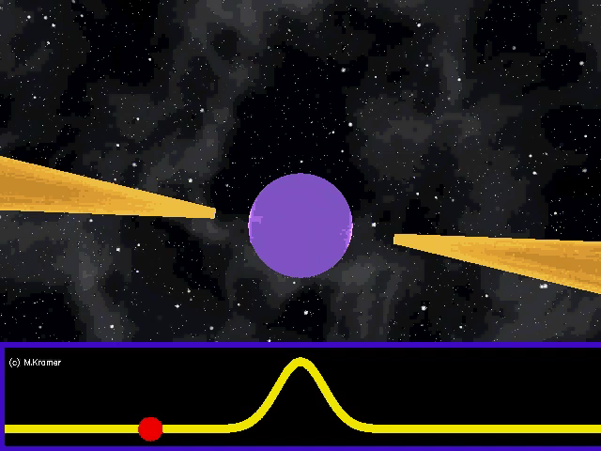
Neutron Star Fun Facts
R≈15 km and M≈1.5 M_{Sun}
Central density 2-10 times that of atomic nucleus
  1 teaspoon is about 10¹² kg
  a cube 300 meters on a side has the same mass as the Earth
Magnetic field >10¹² times that on Earth
  erase credit cards from 30,000 km & kill from 200 km
Spin frequencies from 0.1 Hz to 716 Hz → pulsars
  faster than a kitchen blender!

Slide 7
Pulsars
Pulsars radiate their energy away quite rapidly; the radiation weakens and stops in a few tens of millions of years, making the neutron star virtually undetectable.
Pulsars also will not be visible on Earth if their jets are not pointing our way.
However, some pulsars – millisecond pulsars – have been spun up; their rotation rate has increased to nearly 1000 times per second. This is believe to happen because of accretion from a binary companion.

Slide 8
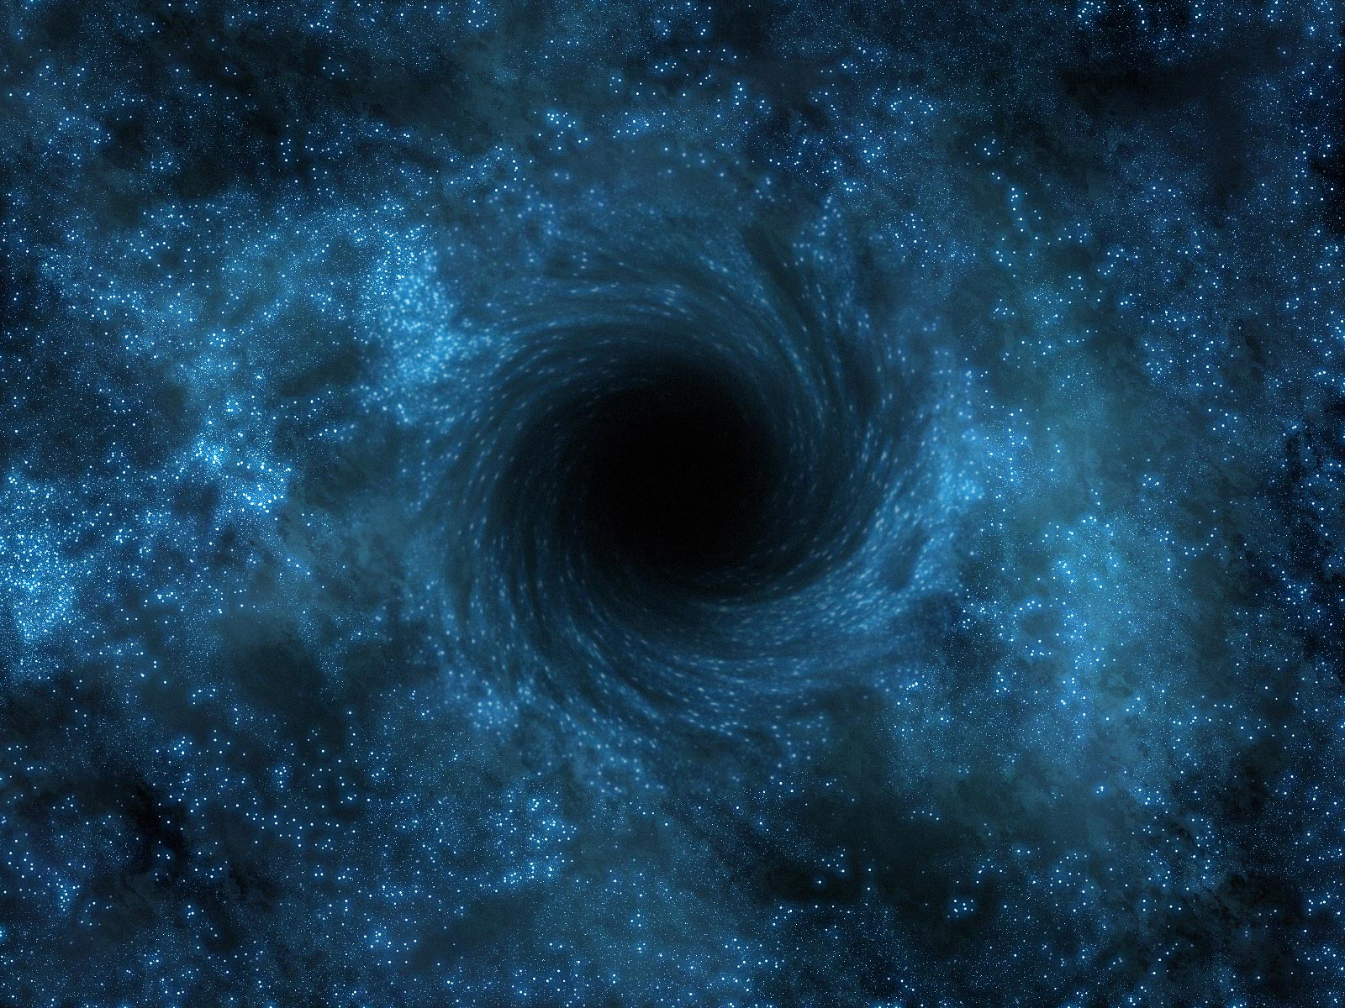
Black holes and an upper limit on the mass of neutron stars
The pressure from nuclear forces in a neutron star keep the star from collapsing.
But there is a maximum pressure that nuclear forces can exert and beyond 3 times the mass of the Sun, gravity must win.
At this point, the neutron star will collapse to a black hole, an object whose gravity is so strong that not even light can escape.
Nothing can escape from a black hole. How does this work?

Slide 9
Black Holes
The mass of a neutron star cannot exceed about 3 solar masses. If a core remnant is more massive than that, nothing will stop its collapse, and it will become smaller and smaller and denser and denser.
Eventually the gravitational force is so intense that even light cannot escape. The remnant has become a black hole.
The radius at which the escape speed from the black hole equals the speed of light is called the event horizon.
An Earth-mass black hole has an event horizon of about a centimeter; for the Sun it is about 3 km.

Slide 10
A black hole is an object in which the gravitational field is so intense that the escape velocity is greater than the speed of light, the upper limit on speed in our universe. Because nothing can travel faster than this, nothing can escape.
The region from which nothing can escape is the black hole.
Its boundary is called an event horizon because no one outside can see events that occur inside:
You can’t see anything inside of the horizon.
Event horizon

Slide 11
OBSERVING BLACK HOLES
Black holes are black, so how do we see them?
If a black hole is in a binary system with a companion star that is close enough for some of its matter to be caught by the black hole, the matter spirals in at speeds close to the speed of light, heats up by its own enormous friction, and emits energetic x-rays.
But matter spiraling in to neutron stars also emits x-rays. How do we know we’re looking at a black hole and not a neutron star? We measure the mass, and if it’s too massive to be a neutron star it must be a black hole.

Slide 12
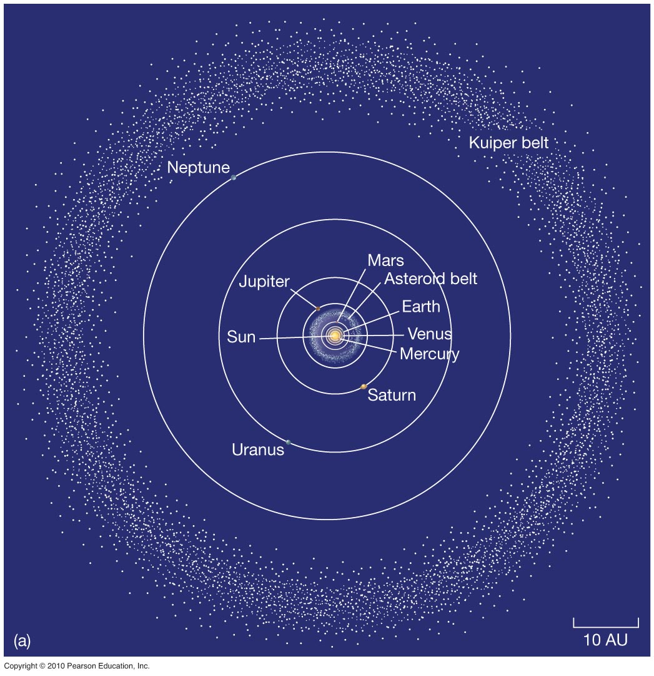
An Inventory of the Solar System
Early astronomers knew Moon, stars, Mercury, Venus, Mars, Jupiter, Saturn, comets, and meteors.
Now known: Solar system has 166 moons, one star, eight planets (added Uranus and Neptune), asteroids, comets, meteoroids, dwarf planets, and Kuiper Belt objects.

Slide 13
An Inventory of the Solar System
The Solar System consists of the sun and everything in orbit around it.
  Nearly all the mass is in the Sun (~ 99.8%)
  Nearly all the rest is in the planets and moons
  The rest are
    Plutoids – balls of ice and rock in the Kuiper belt
    Asteroids – rocky piles mostly between Mars and Jupiter
    Comets – Piles of ice and rocks
    Meteoroids – pebbles from comets that got ejected when comets came close to the Sun and fragments of asteroids

Slide 14
An Inventory of the Solar System
The planets orbit the sun from W to E along the plane of the ecliptic – looking down from Earth’s North pole, planets orbit counterclockwise.
Orbits are nearly circular – yes, Kepler says that they are ellipses, and they are, but they are nearly perfectly circular ellipses
Nearly all in the same plane – without Pluto, they are perfect to 1%
Inner planets are called terrestrial planets
Outer planets are called Jovian planets

Slide 15
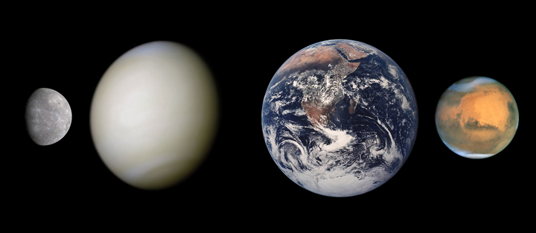
Terrestrial Planets
Close to the Sun
Made of rocks (silicon) and iron
High density
Small (~10000 km in diameter)
Mercury
Venus
Earth
Mars

Slide 16
Jovian Planets
Farther from the Sun
Made of gases (hydrogen, helium, methane, water, ammonia)
lower density
large (~100,000 km in diameter)

Slide 17
Comparison of Terrestrial and Jovian Planets

Slide 18
History of the Solar System
We want to understand the history of the solar system
However, large bodies like planets evolve
  Volcanism, erosion, plate tectonics…
So it is important to look at things that hold a better record of the past: small bodies that don’t change much
The small bodies that have the best clues are asteroids, comets, meteoroids (coming from asteroids and comets) and plutoids
The age and chemical composition of these things can tell us about the early solar system

Slide 19
Asteroids
Rocky bodies that are held together by gravity
Most live in a belt between Mars and Jupiter at 2.8 A.U. called the asteroid belt
  about 100,000 rocky objects bigger than 1km exist
Ceres is the largest asteroid with a diameter of ~1000 km
A few thousand have orbits that cross Earth’s orbit – called near-Earth asteroids (NEAs)
Some are near Jupiter (60 degrees ahead and behind) and are called Trojans

Slide 20
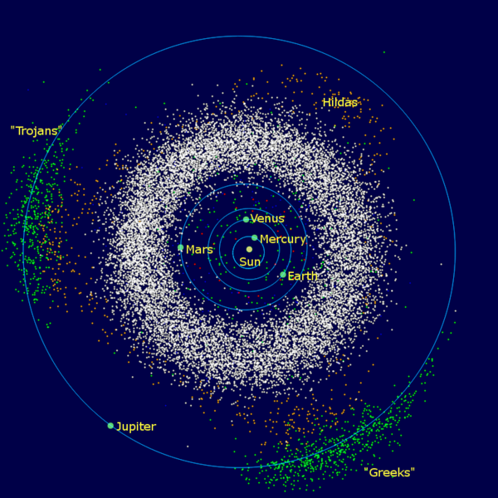
Asteroids
Trojans
Asteroid Belt
Near Earth Asteroids

Slide 22
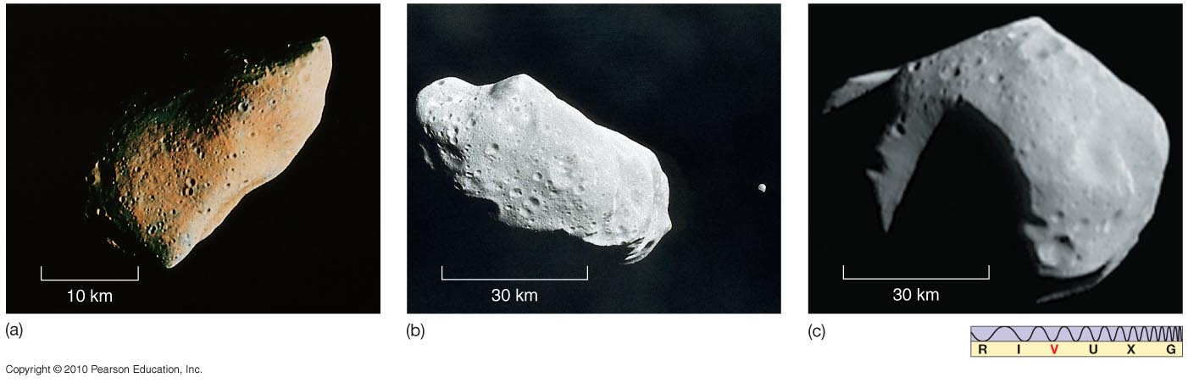
Asteroids and Meteoroids
Asteroids and meteoroids have rocky composition; asteroids are bigger.
(below) Asteroid Gaspra
(above) Asteroid Ida with its moon, Dactyl
(above) Asteroid Mathilde

Slide 23
Meteoroids
Small rocks in the solar system
Asteroid: >100 m in size
Meteroid: <100 m in size
If they enter the Earth’s atmosphere and burn up they are called meteors
Meteorites are meteors that penetrate though the atmosphere to hit the ground

Slide 24
Comets
Icy bodies – called “dirty snowballs” – made of rocks, water ice, frozen methane, frozen ammonia, and frozen carbon dioxide
~1 – 10 km in size.
When they pass close to the sun, the ices sublimate: solid -> gas. Blows out a halo of gas and rocks (pebbles), which is called a coma
Sunlight and the solar wind push on the gas and dust blowing the tail away from the sun
Comet tails point away from the sun, NOT opposite of direction of motion

Slide 25
Comets
Consist of the nucleus – main solid body of the comet
And the coma – diffuse halo of gas and dust around it
Very low density ~ 100 kg/m³ << water ice (1000 kg/m³), so they are loosely packed snowballs
Orbits are typically 1000s of years and originate far beyond the orbit of Pluto in the Oort cloud.
Short period comets (<200 years) originate in the region near Pluto known as the Kuiper belt

Slide 26
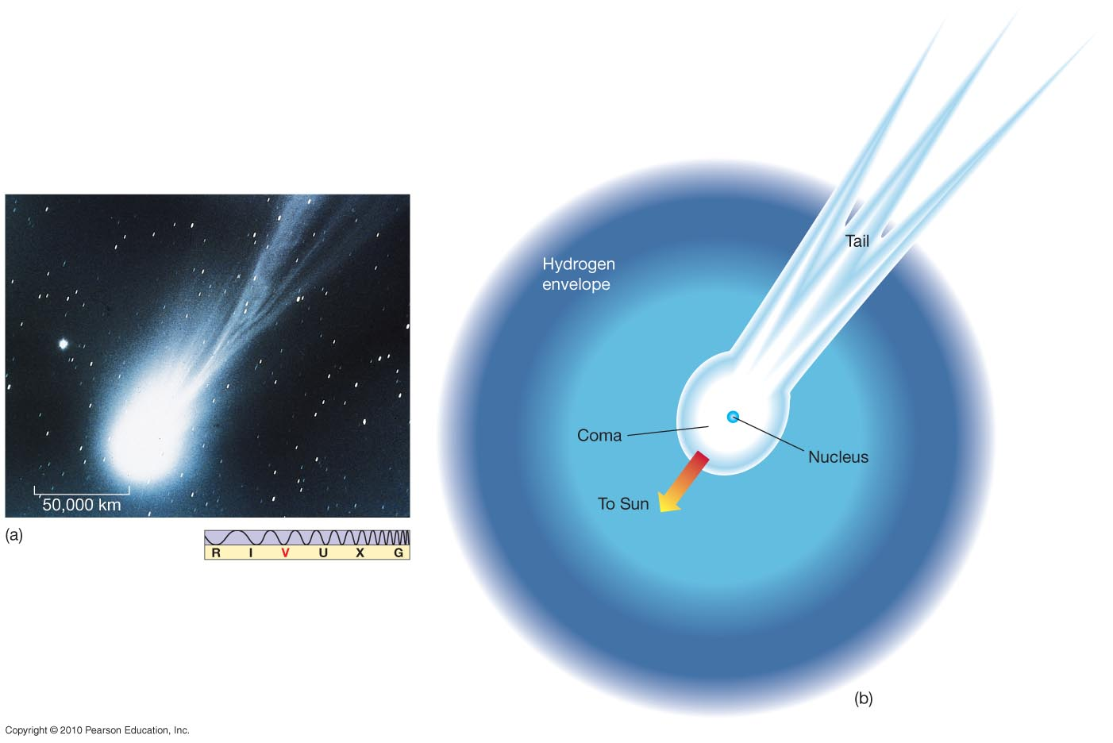
Comets
Comets are icy, with some rocky parts.
The basic components of a comet

Slide 27
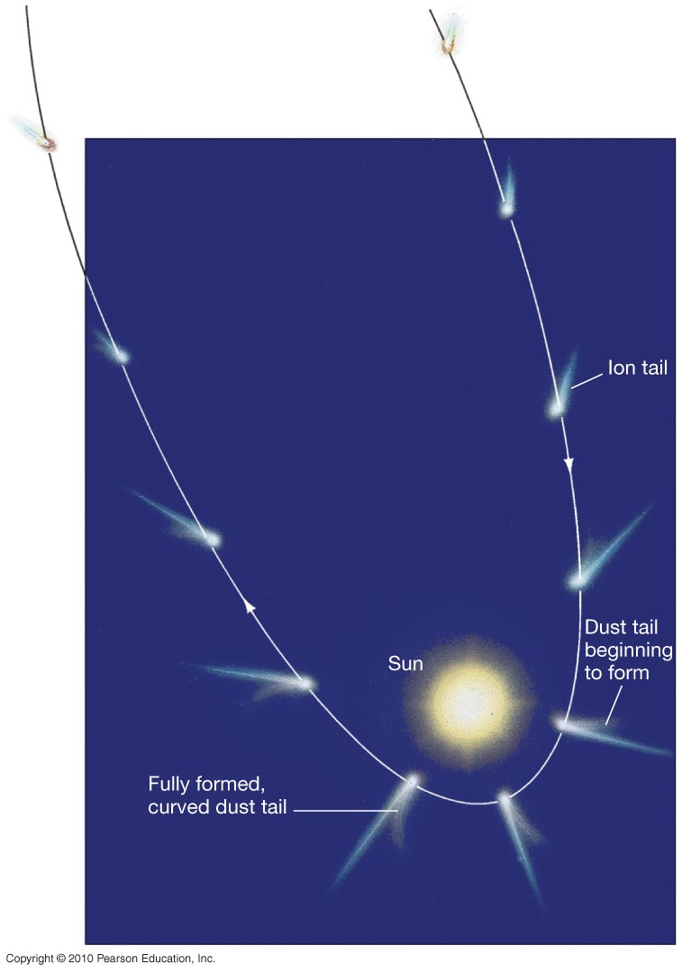
Comets
The solar wind means the ion tail always points away from the Sun.
The dust tail also tends to point away from the Sun, but the dust particles are more massive and lag somewhat, forming a curved tail.

Slide 28
Features of the solar system
Planets are all (nearly) in a plane to about 1%
All orbit in a counterclockwise direction (as viewed from Earth’s N pole) and nearly all rotate in the same direction as well
Orbits are nearly circular
Planets are relatively isolated – far away from their neighbors
Space between the planets is relatively empty

Slide 29
Can we develop a model for the formation of the solar system that explains these properties?
The nebular hypothesis suggests that the planets formed from a gas cloud which collapsed into a disk.
This gas cloud has roughly the same composition as the Sun (mostly hydrogen, helium, + a trace of carbon, oxygen, nitrogen, iron etc)
Small bits of dust in the cloud condense into larger objects, becoming planets. Beyond the snow line where ice can form, planets can grow larger and become gas giants.

Slide 30
The Nebular Hypothesis and the Solar System
  Planets form in a rotating disk
  Planets are all (nearly) in a plane to about 1%
  All orbit in a counterclockwise direction and nearly all rotate in the same direction as well.
  Orbits are nearly circular
Planets are relatively isolated – far away from their neighbors
  Planets accrete all the material in their neighboring orbits
The composition of the planets differ
  The presence of the snow line allows different materials to condense onto forming protoplanets.
Space between planets is relatively empty
  Planets scatter small bodies

Slide 31
Earth
Radius ~ 6400 km
Density ~ 5000 kg/m³ – five times density of water
Has a thick atmosphere of mostly nitrogen and oxygen
Has active volcanoes
Has a magnetic field

Slide 32
Structure of the Earth
Inner core is solid iron
Outer core is liquid iron and nickel.
Mantle is mostly molten rock (silicon and oxygen)
Crust (30 km thick) is solid rock.
Know this structure from looking at earthquake waves.

Slide 33
Mercury
Radius ~ 2400 km
Mass ~ 5% of Earth
Density 5400 kg/m³ – about the same as Earth
No atmosphere
No volcanoes
Has a magnetic field

Slide 34
Mercury
Temperature on Mercury varies drastically! On the day side it is hot, 700K, but on the night side it is cold, 100 K (-200 F)
Wide variation in temperature because there is no atmosphere to trap heat and moderate temperatures
Because Mercury has no atmosphere and no water, there is no erosion, so the surface is heavily cratered like the Moon

Slide 35
Venus
Radius ~ 6100 km
Mass ~ 82% of Earth
Density ~ 5300 kg/m³ – about the same as Earth
Very thick atmosphere
Volcanic features, indirect evidence of current volcanic activity
No magnetic field

Slide 36
Venus
Venus has a large, thick atmosphere which covers the entire surface with clouds of sulfuric acid.
Its atmosphere is 90x thicker than the Earth’s: pressure on the surface is 90 times higher than on Earth

Slide 37
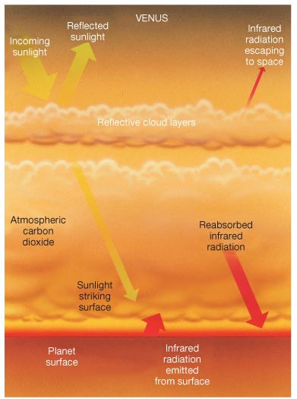
Venus
Venus is HOT! Its average temperature is 730 K – hotter than Mercury and hot enough to melt lead
This is because the atmosphere traps heat via the greenhouse effect
Sunlight strikes surface and is converted to heat, which is absorbed and re-radiated by carbon dioxide in the atmosphere instead of radiating out into space
Also operates on Earth

Slide 38
Mars
Radius ~ 3400 km – ½ radius of earth
Mass ~ 10% of Earth
Density ~ 3900 kg/m³ – smaller than Earth – density of rock.
Thin atmosphere
Extinct volcanoes
No magnetic field

Slide 39
Seasons on Mars: Changing CO2 ice caps

Slide 40
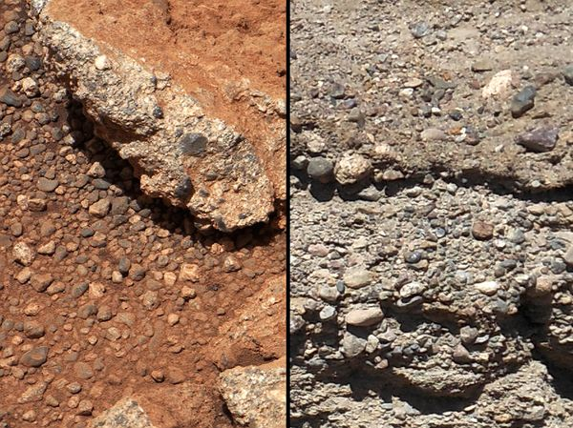
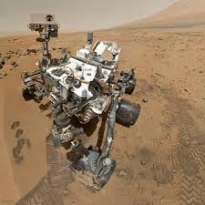
Evidence for water on Mars
Mars
Earth
September 2012: Curiosity rover finds ancient streambed, pebbles moved and smoothed by water, present for thousands to millions of years

Slide 41
Mars
Has huge volcanoes – now extinct. Olympus Mons is the largest volcano in the solar system.
3 x the size of Mount Everest!
These are also shield volcanoes. They are much larger than ones on earth and Venus because of lower gravity.

Slide 42
Jupiter
Radius ~ 10 x Earth’s
Mass ~ 300 x Earth’s
Density ~ 1300 kg/m³ –about same as water
Compose of mainly hydrogen and helium
No surface
Strong magnetic field
Rapid rotation ~ 10 hrs

Slide 43
Weather of Jupiter
Multicolored bands in atmosphere
Bands are caused by convective cells that are stretched by rotation
Most prominent feature is the Great Red Spot – a hurricane that has persisted for at least 300 years

Slide 44
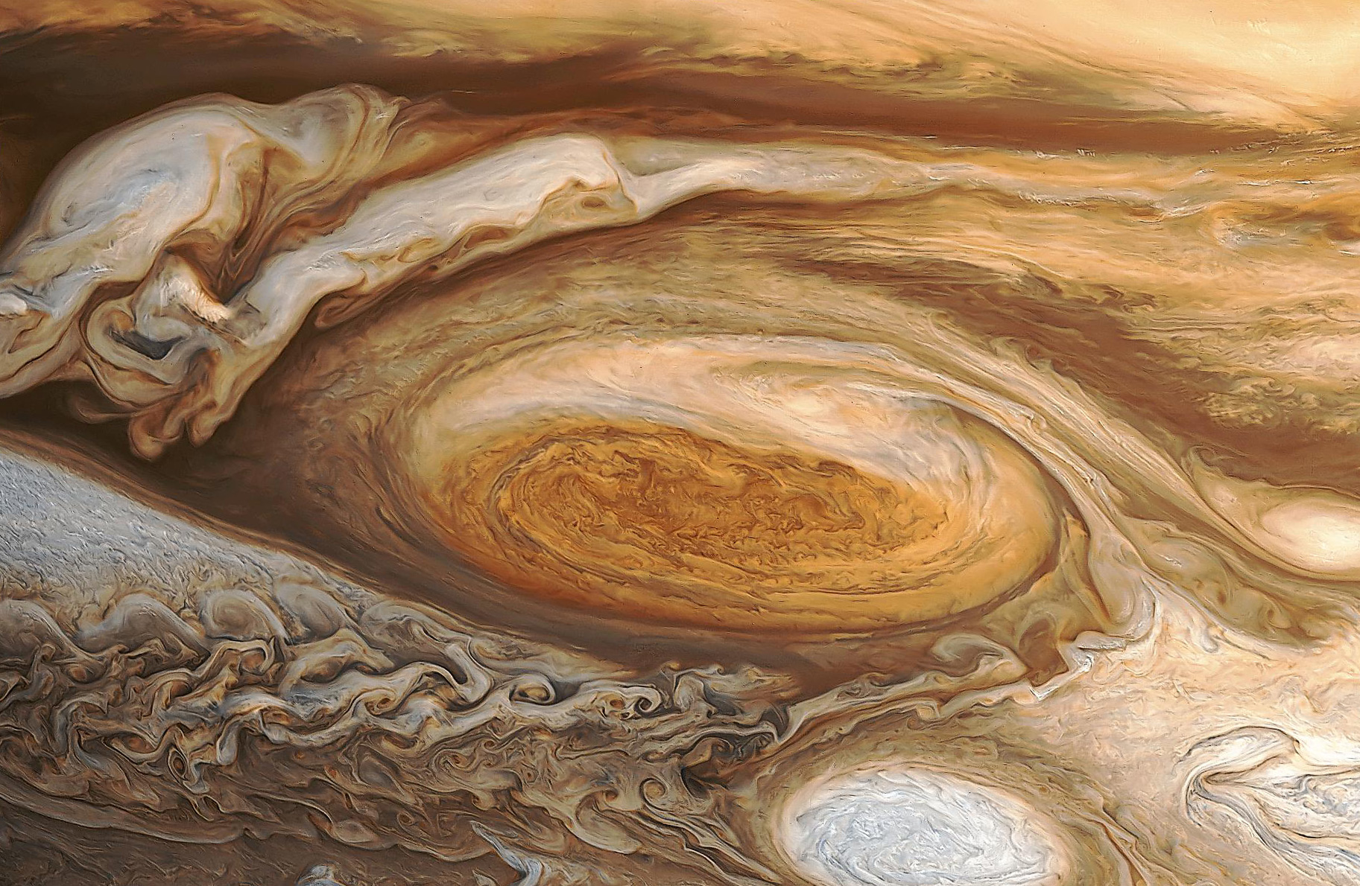
Jupiter’s Great Red Spot

Slide 45
Structure of Jupiter
Inner core rocky, like Earth
Mantle is liquid metallic hydrogen: under very high pressures, hydrogen becomes liquid and acts like a metal – able to conduct electricity
Outer mantle is molecular hydrogen
Atmosphere very convective with large, persistent weather features

Slide 46
Internal Heating
Jupiter gives off 2 times the heat it receives from the Sun.
This heat is from its formation 4.5 billion years ago – it is still cooling!
Transport of this heat drives convection in the metallic hydrogen mantle – produces a strong magnetic field

Slide 47
Moons of Jupiter
Jupiter has at least 67 moons!
The 4 largest are the ones first observed by Galileo – they are called the Galilean satellites.
They are from closest to farthest from Jupiter:
Io, Europa, Ganymede, and Callisto

Slide 48
Io
Io is the closest of Jupiter’s large moons and is the most volcanically active body in the solar system.
The volcanoes are powered by tides between Europa and Jupiter that trap Io in a tug-of-war. The heating melts the interior and drives the vulcanism.
Io’s surface is very new – no craters!

Slide 49
Europa
Europa is the next closest moon.
It has an icy surface with large cracks and no craters! This means that craters are filled in somehow.
This suggests liquid (probably water) under the icy surface.

Slide 50
For there to be an ocean under the surface, there must be some heat source – maybe tides from Jupiter.
This suggests that Europa could harbor life like that on the ocean’s floor on Earth

Slide 51
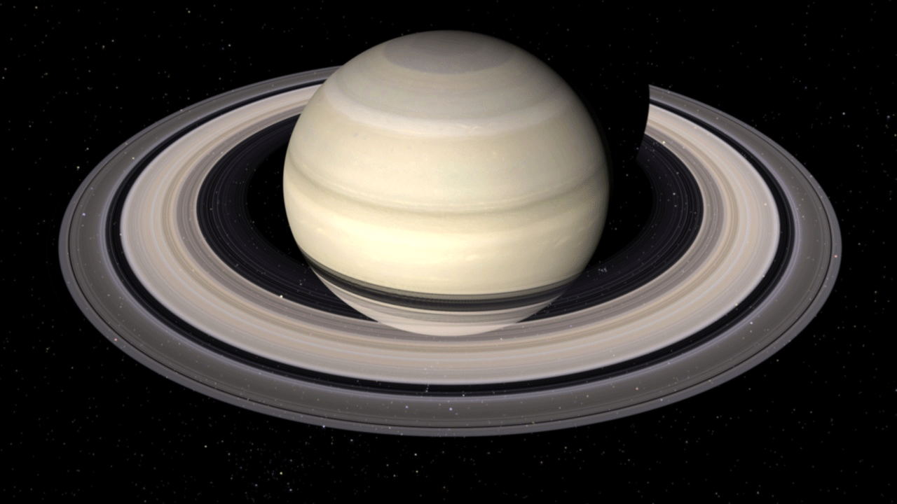
Saturn
Radius ~ 10 times Earth, mass ~ 100 times Earth
Density ~ 700 kg/m³ – less than water, Saturn would float!
Composed of mainly hydrogen and helium
No surface
Strong magnetic field

Slide 52
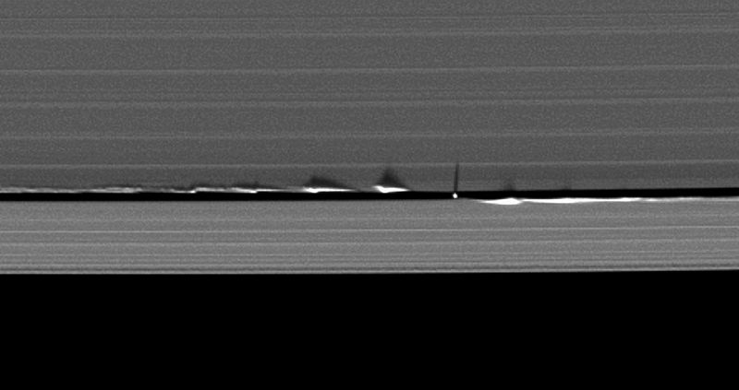
Saturn’s Rings
Made of icy particles from 1 cm to a few meters in size
The many divisions in the rings are due to tiny moons between the divisions known as shepherd moons

Slide 53
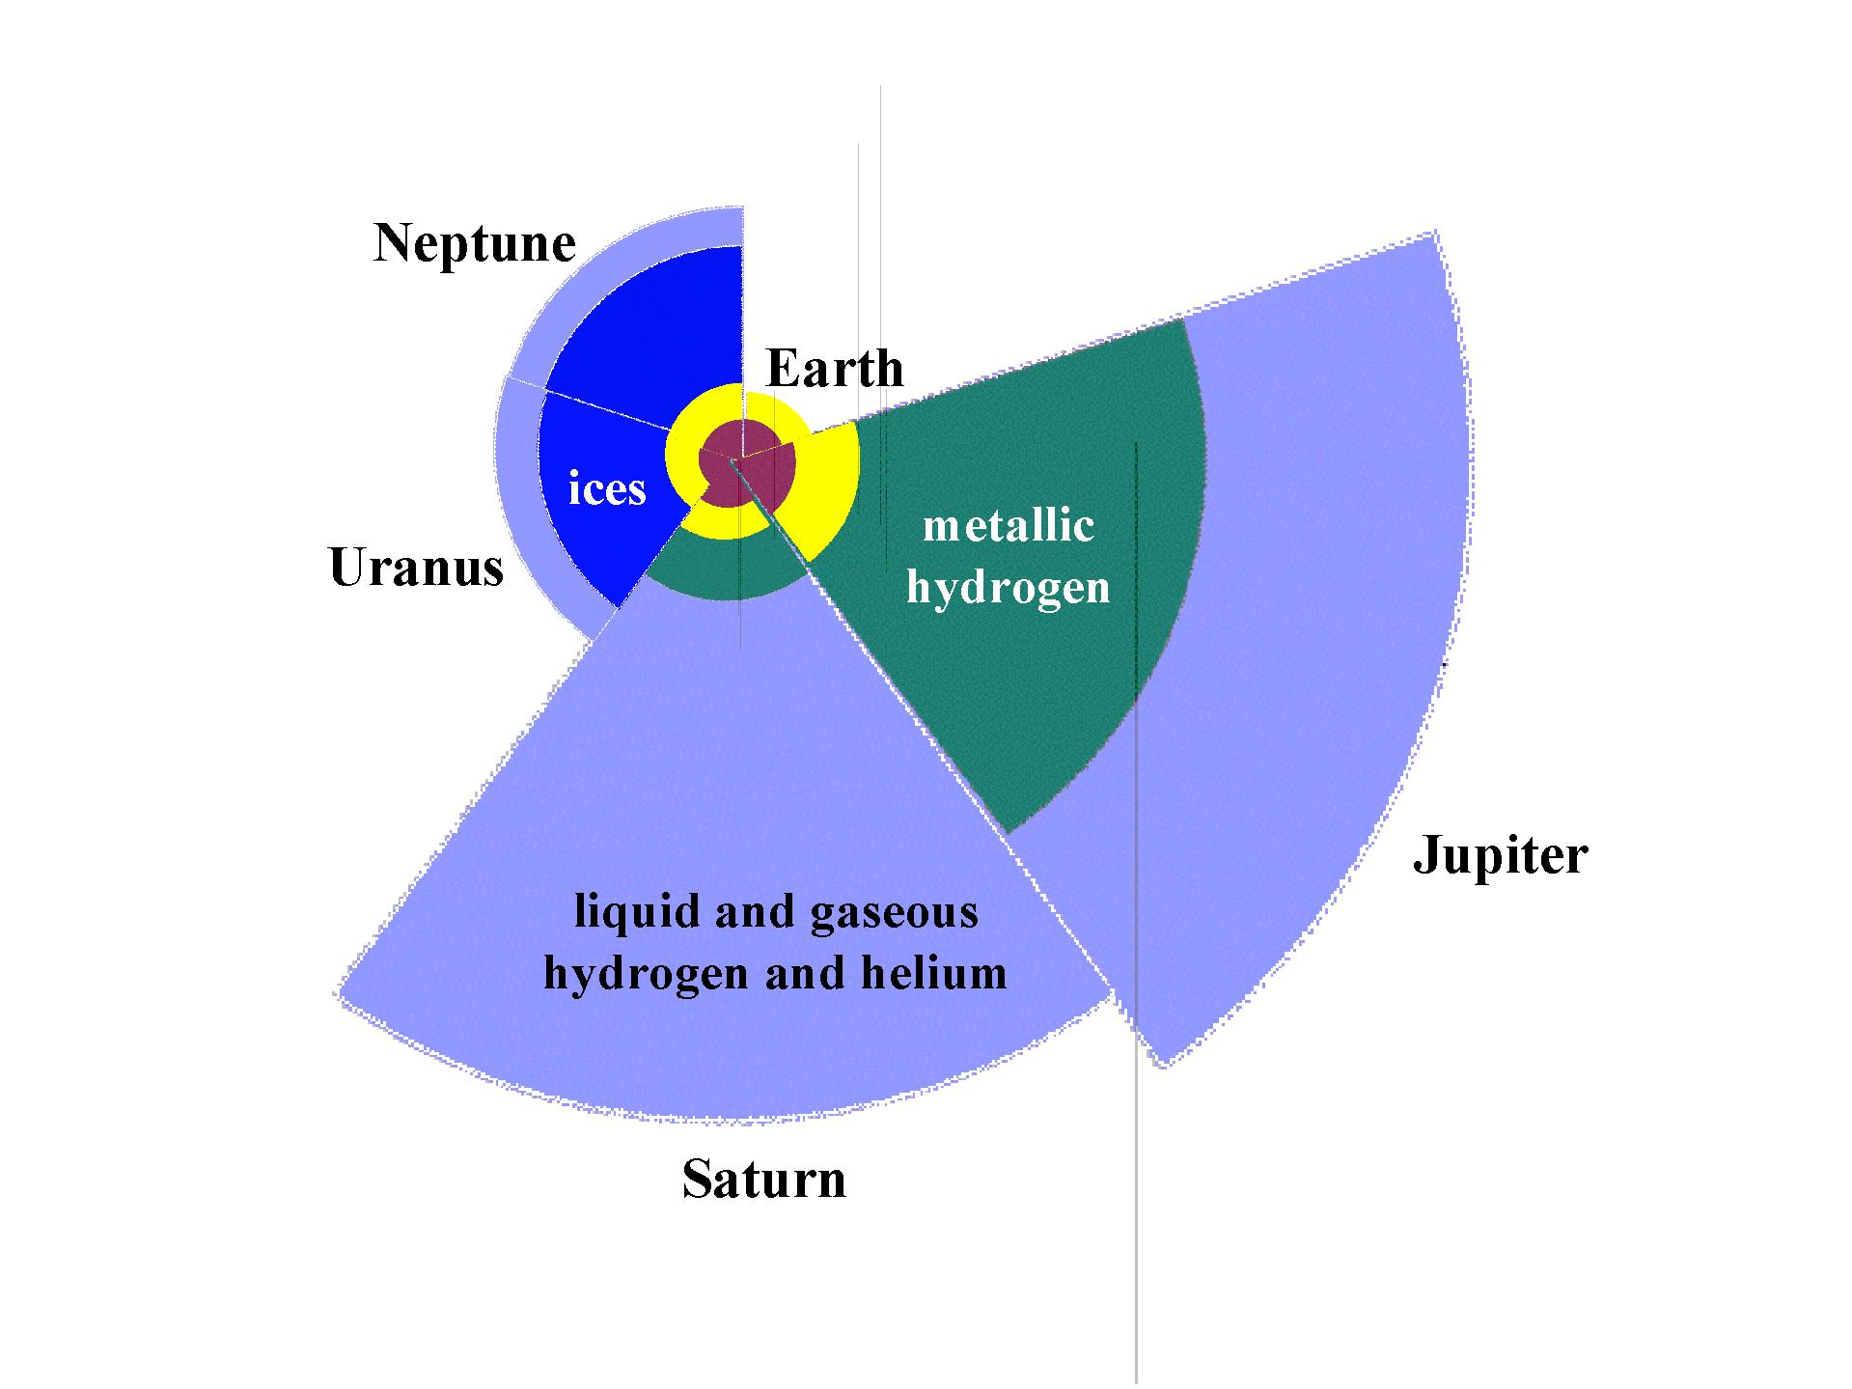
Structure of Saturn
The internal structure of Saturn is similar to Jupiter, but the amount of metallic hydrogen is much smaller.
Because there is less conducting material, Saturn has a weaker magnetic field – 1/20 that of Jupiter.
Cross-sections of the Jovian planets, with Earth for comparison

Slide 54
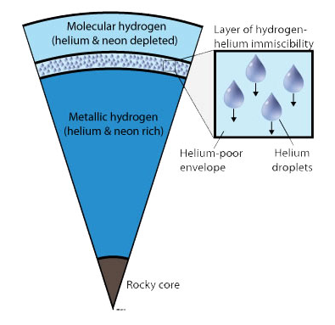
Internal Heating
Saturn gives off 3x more heat than it receives from the Sun – more than Jupiter
Can’t be explained by leftover heat from formation – Saturn is smaller than Jupiter, cooled quickly
It is thought that Saturn has helium rain: helium condenses into droplets at the temperature and pressure of Saturn’s upper atmosphere, and falls as rain – upper atmosphere is depleted in helium
Helium is compressed and heated as it falls, providing Saturn’s internal heat source

Slide 55
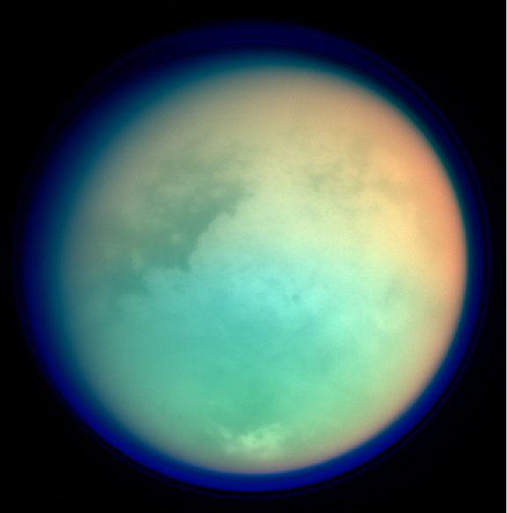
Titan
Saturn’s largest moon – 2nd largest in solar system (Jupiter’s Ganymede is largest)
Only other body in solar system with stable surface liquid: seas and lakes of methane
Nitrogen-rich (98%)atmosphere, thicker and denser than Earth’s
Evidence for methane rain
False color image of Titan

Slide 56
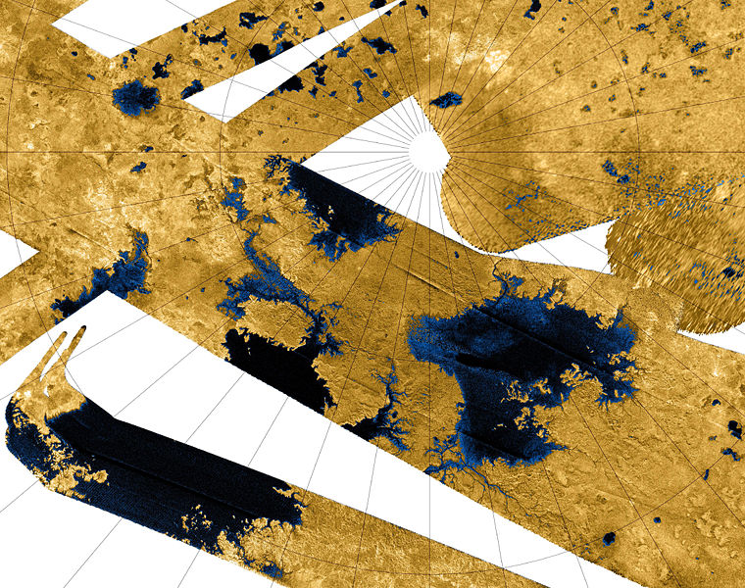
The Lakes of Titan
Titan is cold – methane becomes liquid
Radar mosaic of Titan’s north polar region. Blue coloring shows areas of low reflectivity caused by lakes of liquid ethane and methane.
Kraken Mare

Slide 57
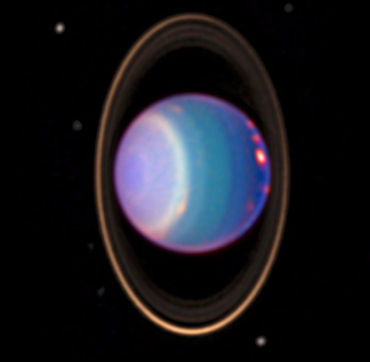
Uranus
Radius ~ 4 times Earth
Mass ~ 15 times Earth
Nearly featureless – image at right is a false color image.
Rotation axis is tilted 98 degrees!
The tilt may be result of a giant impact (?)

Slide 58
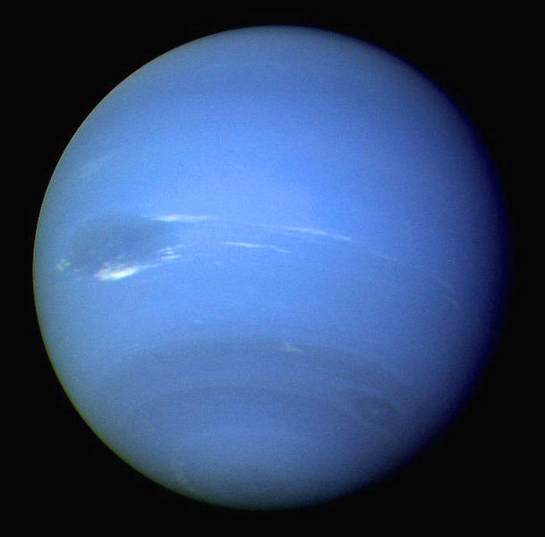
Neptune
Radius ~ 4x bigger than Earth.
Mass ~ 17x Earth
Has bands of clouds unlike Uranus
Has a large storm on it called the Great Dark Spot.

Slide 59
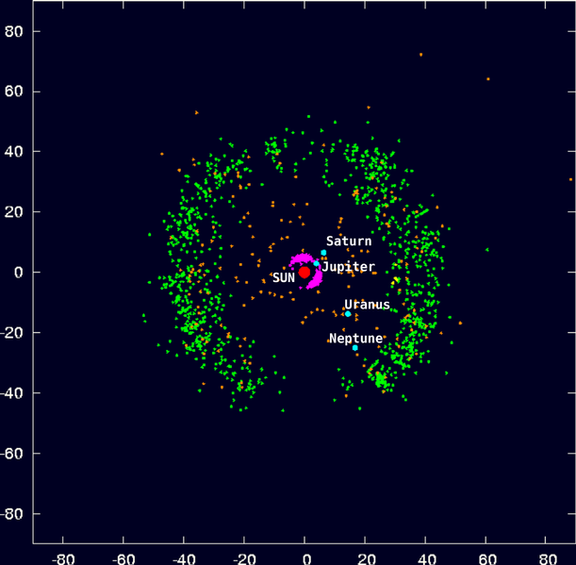
Pluto and the Kuiper Belt
Recall: Kuiper belt extends from orbit of Neptune (20 AU) to 50 AU from Sun
Contains many small, icy bodies
Confirmed Kuiper belt objects in green

Slide 60
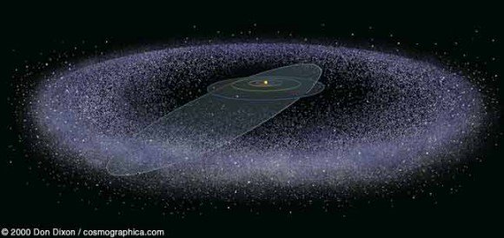
Pluto and the Kuiper Belt
Pluto is just one member of the Kuiper Belt
Consists of a large number of icy bodies that are not in a plane – more like a thick disk.
Contrast this with the 8 planets which are in a plane to an accuracy of 1%

Slide 61
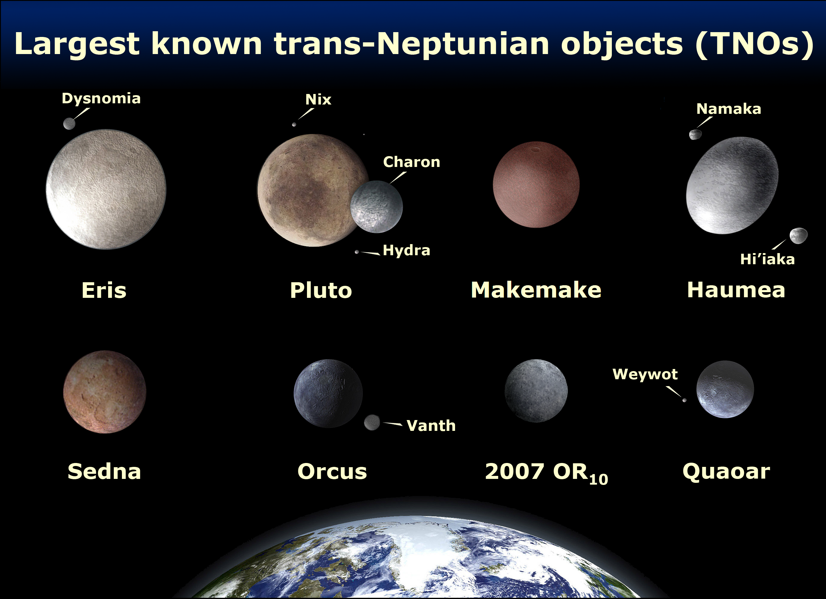
Pluto and the Kuiper Belt
Pluto is only the second largest of the Kuiper Belt objects – the largest is Eris

Slide 62
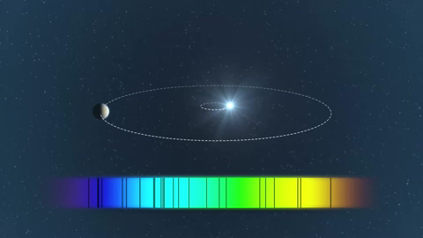
Finding Extrasolar Planets
Technique 1: Radial Velocity
Spectral lines of stars with planets have a Doppler shift due to planet tugging on star

Slide 63
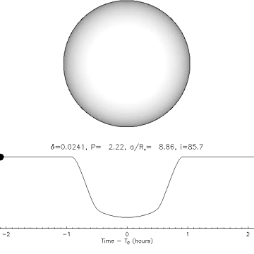
Finding Extrasolar Planets
Technique 2: Transits
Another way to find planets is to watch for eclipses, when planets pass in front of their parent star
Look for a very small drop in the amount of light received
This can tell us the radius of the planet, since we know how much of the light of the star is blocked

Slide 64
Low mass planets from Kepler
Massive planets from radial velocity surveys

Slide 65
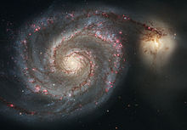
A galaxy is a huge collection of stars that is isolated in space and held together by gravity.
We happen to live in one called the Milky Way Galaxy or just the Galaxy (with a capital ``G’’)
The structure of the Galaxy looks like this:
Disk
Bulge
Spiral Arms
This is a picture of the Whirlpool galaxy – not the Milky Way

Slide 66
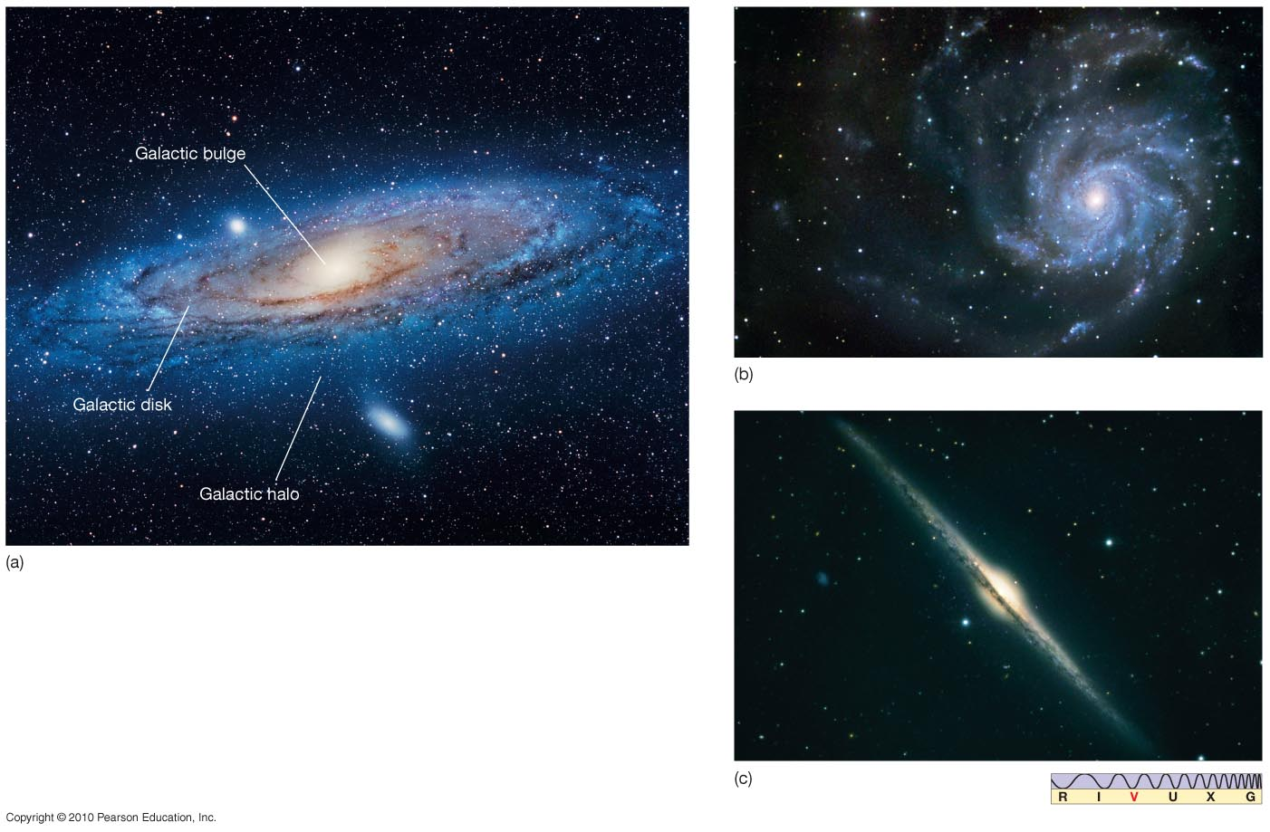
The Milky Way
Our Galaxy is a spiral galaxy. Here are three similar galaxies.

Slide 67
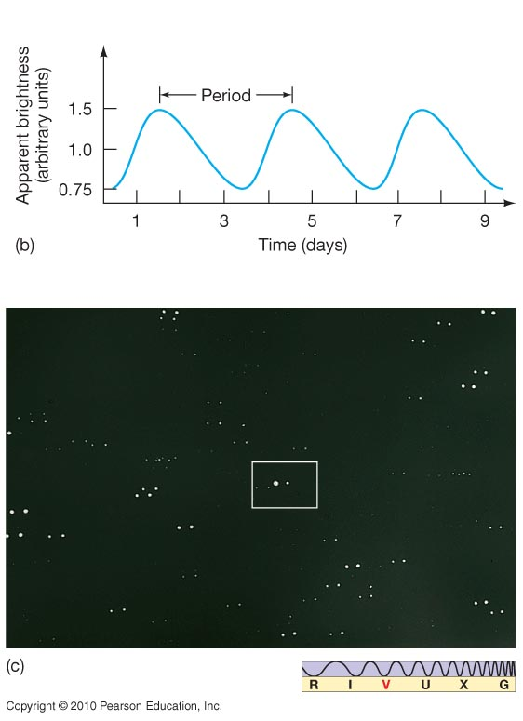
Cepheid variables: pulsating stars with period proportional to luminosity: distance indicator!
Cepheid light curve
Cepheid—two displaced images
taken at different times

Slide 68
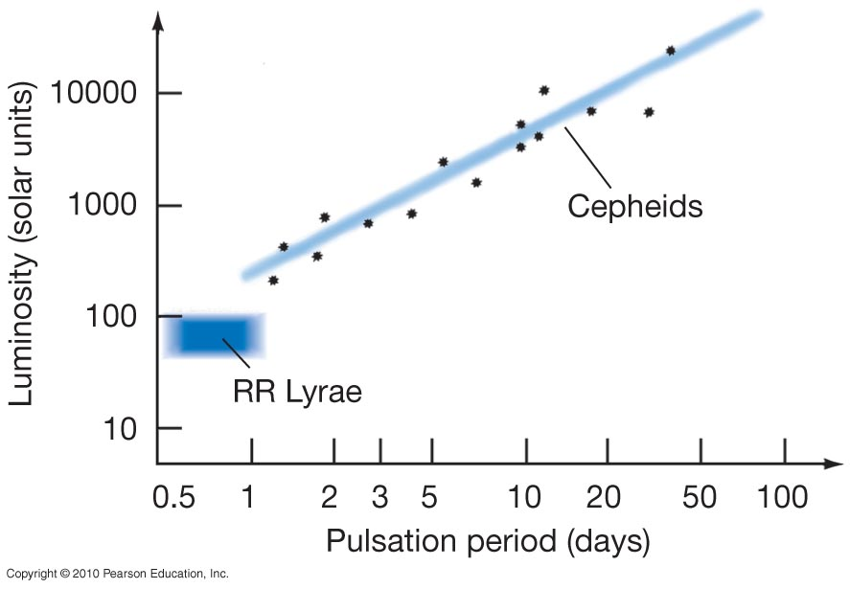
Leavitt’s Period-Luminosity Relation for Cepheid Variable Stars
Cepheids: measure period, get luminosity
RR Lyrae stars all have the same luminosity

Slide 69
As a result:
A Cepheid variable can be used as a standard candle:
1) Find its luminosity by measuring its period
2) Measure its apparent brightness and deduce its distance from the 1/r² formula

Slide 70
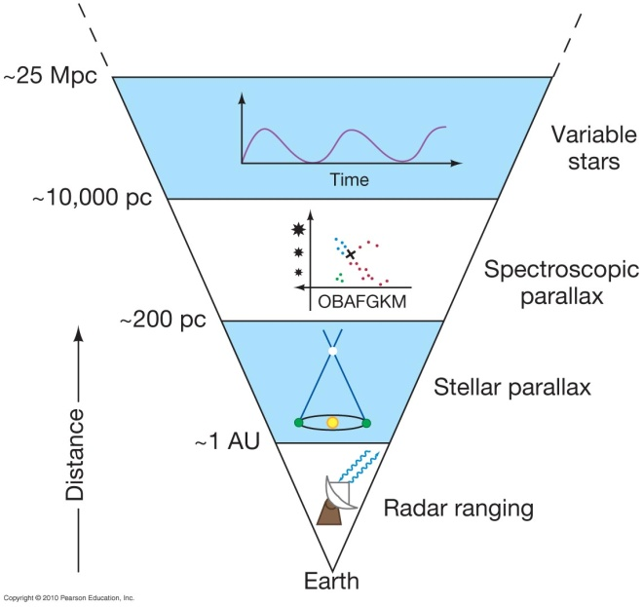

Slide 71
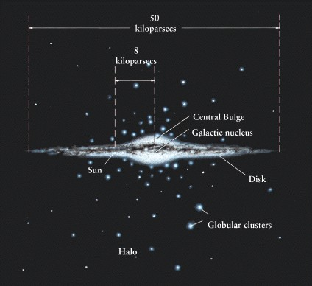
Structure of the Milky Way
100,000 ly

Slide 72
Structure of the Milky Way
The Milky Way Galaxy consists of several parts
  The Galactic disk
  The Galactic bulge
  The Galactic halo
  And the Galactic Center
The Galactic Disk is home to most of the young stars in the Galaxy
The Galactic Bulge contains a mix of old and young stars
The Galactic Halo has mainly old stars and is home to many globular clusters
And the Galactic Center contains a supermassive black hole

Slide 73
Structure: Halo, disk, central bulge
Diameter of disk = 100,000 ly
The spiral arms are in the disk, outside the bulge.
Nearly all the gas and dust, and new stars are in the disk and bulge
The disk rotates about the galaxy’s center, at first with stars closer to the central bulge moving faster than stars farther away, and with velocity approximately constant at larger radii
The Sun sits at 8000 pc from the Galactic Center in the disk and moves once around the Galaxy every 225 million years

Slide 74
Galactic Structure
The galactic halo and globular clusters formed very early; the halo is essentially spherical. All the stars in the halo are very old, and there is no gas and dust.
The galactic disk is where the youngest stars are, as well as star formation regions – emission nebulae, large clouds of gas and dust.
Surrounding the galactic center is the galactic bulge, which contains a mix of older and younger stars.

Slide 75
Stellar populations: Old and new stars
Stars formed at the time the Galaxy formed are called Population II stars. They are almost entirely hydrogen and helium with few heavier elements, because the matter in them had not previously been in another star. They lie in all parts of the galaxy, the halo (globular clusters), disk, and bulge.
Younger stars, formed from matter in the disk of the galaxy, are called Population I stars. They are made from reprocessed material, matter that was once in other stars and was redistributed to the galaxy when the star died.
Population I stars are thus younger and begin their lives with a larger fraction of heavier elements than Population II stars.

Slide 76
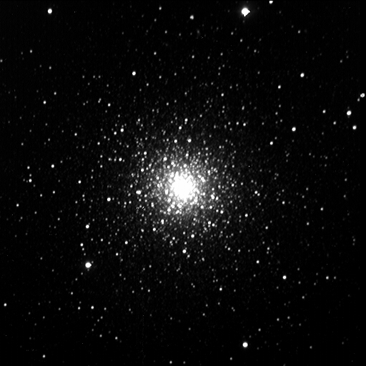
Both Population I and Population II stars are made mainly of hydrogen and helium. Even in Population I stars, like the Sun, heavier elements are a small fraction of the total mass.
Globular clusters formed at the time the galaxy formed. They are dense clusters of up to 1 million stars, all Population II.
An example of a typical globular cluster is M3
Globular clusters are among the oldest objects in the universe.

Slide 77
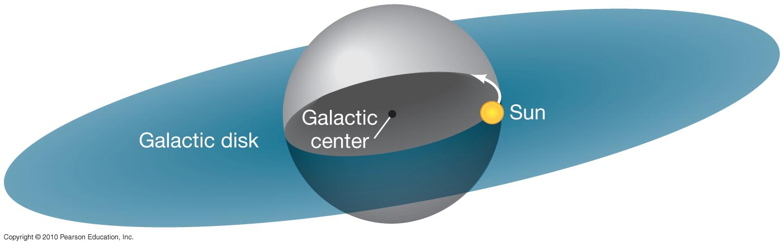
The Mass of the Milky Way Galaxy
The orbital speed of an object depends only on the amount of mass between it and the galactic center.

Slide 78
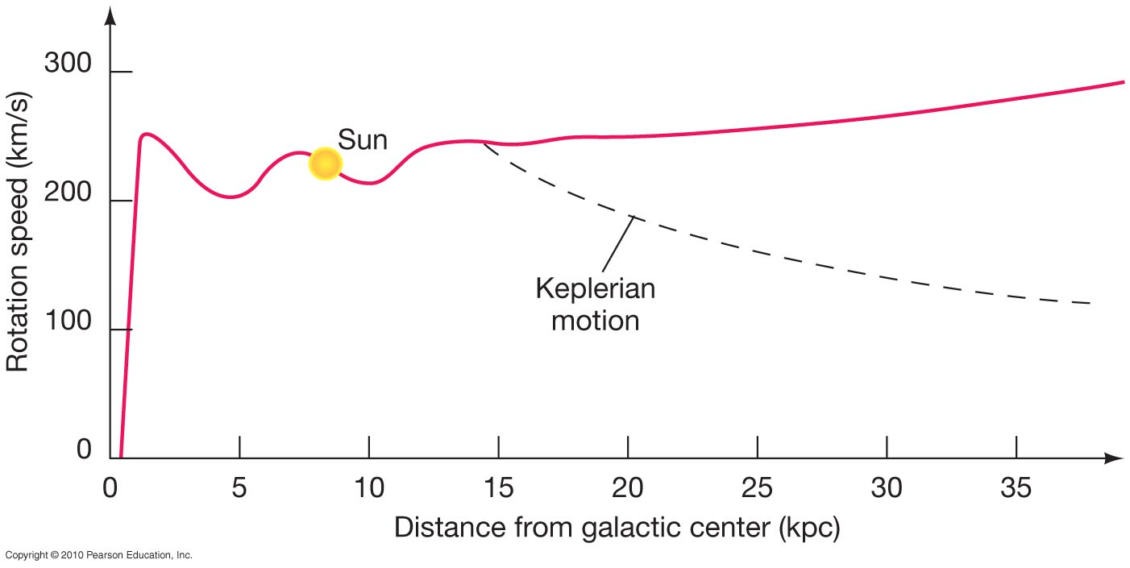
Rotation curve of the Galaxy: How fast objects move as a function of the distance to the galactic center.
actual motion observed
expected given mass that we can see

Slide 79
Instead, the speed at which stars, globular clusters and gas clouds orbit the galaxy implies a much larger mass than is visible:
Most of the Galaxy's mass is dark matter, matter too dim to see at any wavelength, that lies in the halo. We do not yet know what it is.
This is true of all other large galaxies whose mass we have measured. What constitutes most of the universe's mass is one of the most fundamental mysteries of current astronomy.

Slide 80
Dark Matter Summary
How fast a star orbits the galaxy tells us how much mass is inside the radius of the star’s orbit
The faster the star moves, the more mass must be pulling it to keep it from flying out of the galaxy
Stars far from the center of the galaxy move unexpectedly fast: Therefore there is much more mass in the galaxy than we can see
At least 90% of the Galaxy’s mass is “dark matter,” matter that we cannot see at any wavelength
We know where it is (mostly in the halo) but
we don’t yet know what it is

Slide 81
The Galactic Center
The galactic center appears to have
a stellar density a million times higher than near Earth
a ring of molecular gas 400 pc across
strong magnetic fields
a rotating ring or disk of matter a few parsecs across
a strong X-ray source at the center

Slide 82
Observations of orbiting stars near the Galaxy's center show that about 4 million solar masses lie within 6 light-hours of the center.
From the stars’ distance from the center and the very short time it takes them to complete their orbits, one finds that they are orbiting something whose mass is 3.7 million times the mass of the Sun! All of that mass is squeezed into something smaller than a few light-days across – about the size of the solar system.
This strongly suggests that there is a 4-million solar mass black hole in the center of the Galaxy.

Slide 83
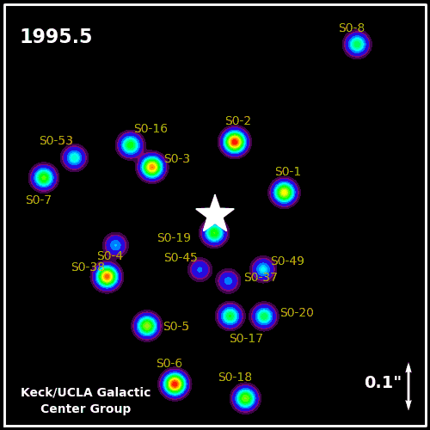
With 16 years of data, here’s what the orbits look like
Recently the star S0-2 completed an orbit that we observed from start to finish
It comes very close to the center and moves very quickly
This is evidence that something very massive and dense lives in the center

