Slide 1
Announcements
Quiz 8 on Chapter 12 due tonight
Midterm is Wednesday March 27 in class
  Will cover Chapter 3, 9-12
  Problems will be similar to those on quizzes
    Includes parts of quiz 4, up to quiz 8
  No book, notes or calculator
    Sheet of formulas will be given
    Calculations will be doable without a calculator
  Bring #2 pencil!
  Review in class today
Review session: Tuesday 4-5 pm, library east wing room 170, email coming on how to join online

Slide 2
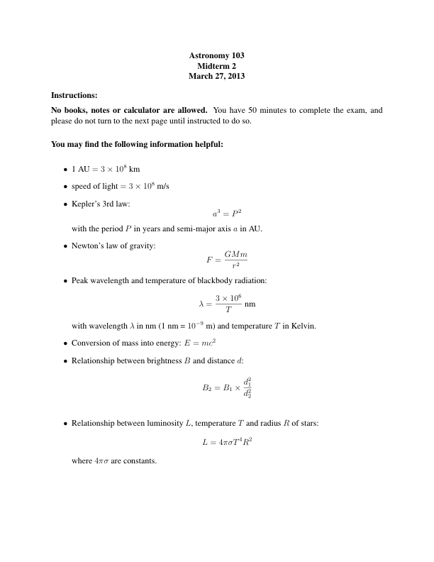
Information provided on midterm:

Slide 3
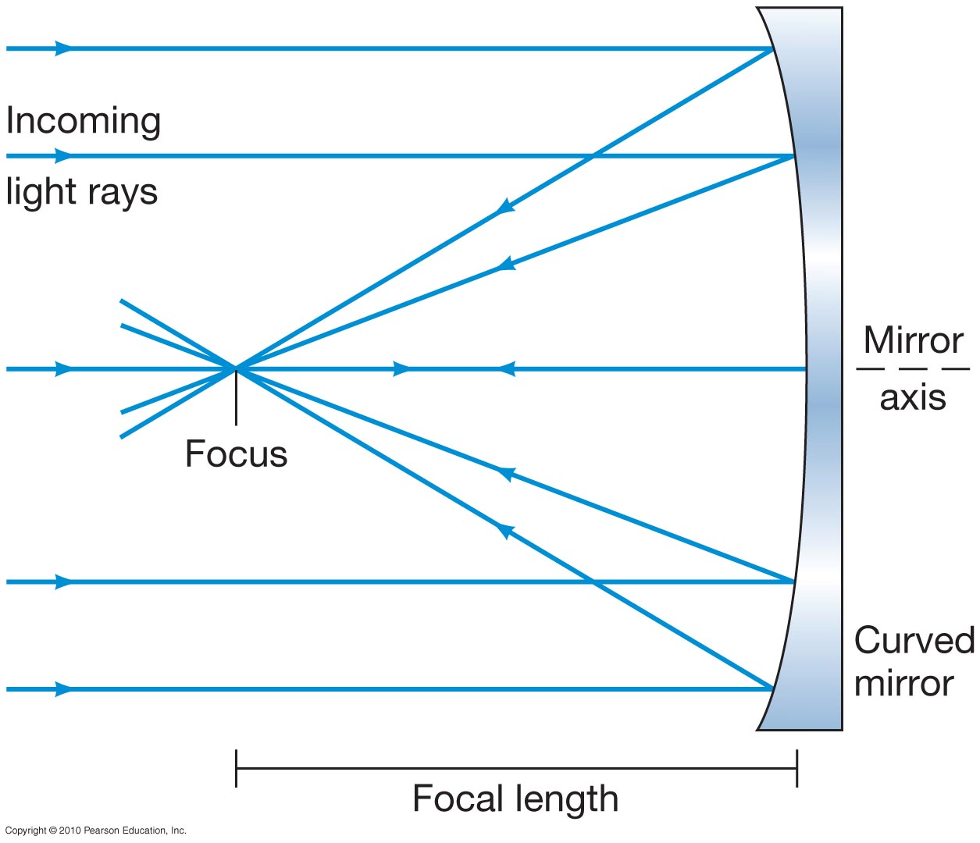
Figure 3.1
Optical Telescopes
Images can be formed through reflection or refraction.
Reflecting mirror
Note that the incoming light rays are parallel. This is because astronomical objects are so far away.

Slide 4
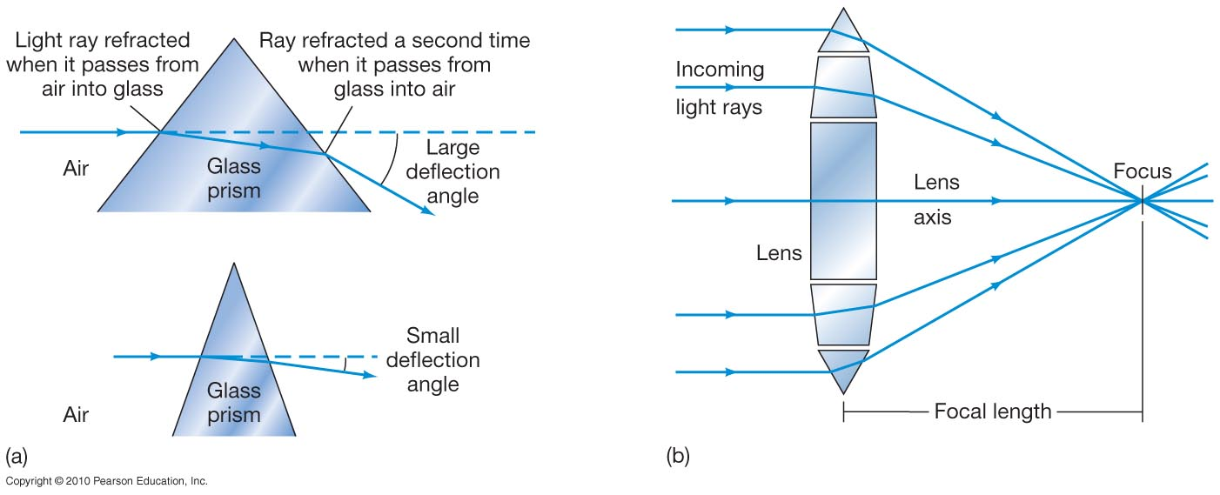
Refracting lens

Slide 5
Modern telescopes are all reflectors:
Light traveling through a lens is refracted differently depending on wavelength (chromatic aberration). Mirrors don’t suffer from this.
Some light traveling through lens is absorbed (especially IR and UV light). Mirrors can be made to reflect this IR and UV.
Large lens can be very heavy, and can only be supported at edge. Mirrors are supported at the back.
Lens needs two optically acceptable surfaces, mirror only needs one, though mirror surfaces have to be more precise.

Slide 6
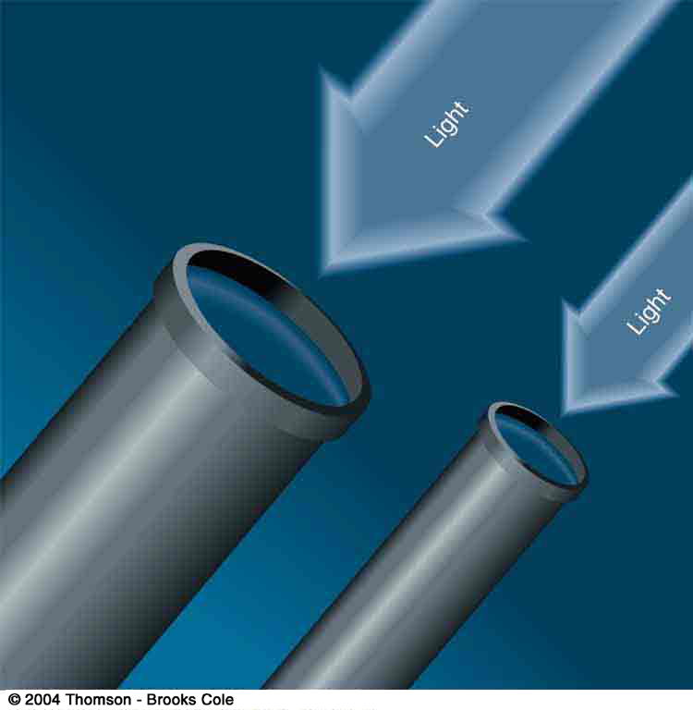
Bigger is Better in Astronomy
A larger telescope gathers more light and so can see dimmer objects.

Slide 7
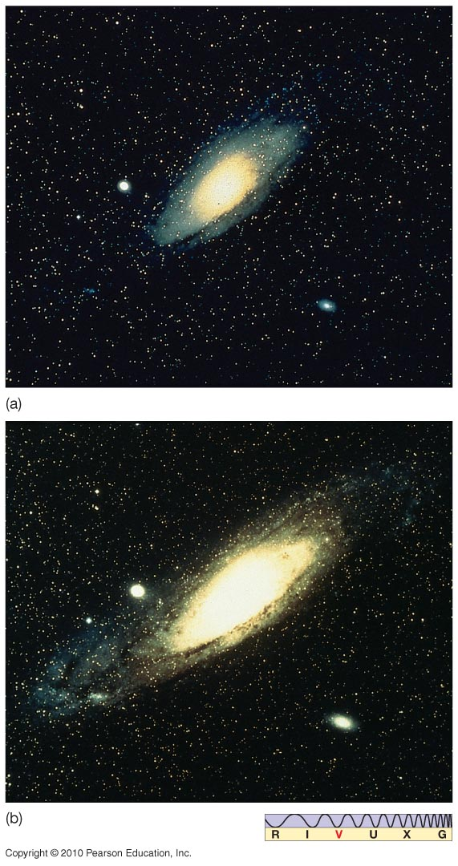
Light-gathering power:
Improves detail
The figure, part (b) was taken with a telescope twice the size of (a).
Twice the diameter means four times the light, since the area of the telescope is four times larger.

Slide 8
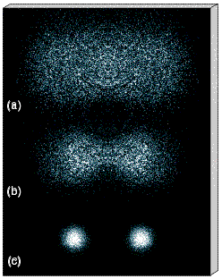
Angular resolution
The second major advantage of a large telescope is its ability to see a separation between two objects that are nearly in the same direction. In optical astronomy, one typically wants to see two distinct stars when looking at a binary system in which the two stars orbit their common center of mass. The resolving power is the smallest angle one can see with a given telescope.
Large telescopes have greater resolving power than small telescopes, but the resolving power of all earthbound optical telescopes is limited by the turbulence of the air.

Slide 9
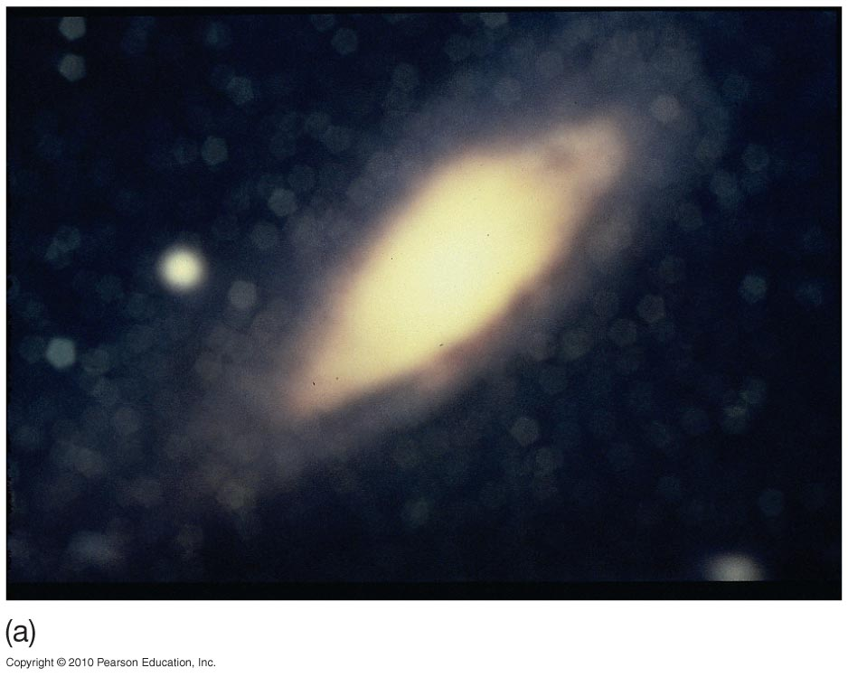
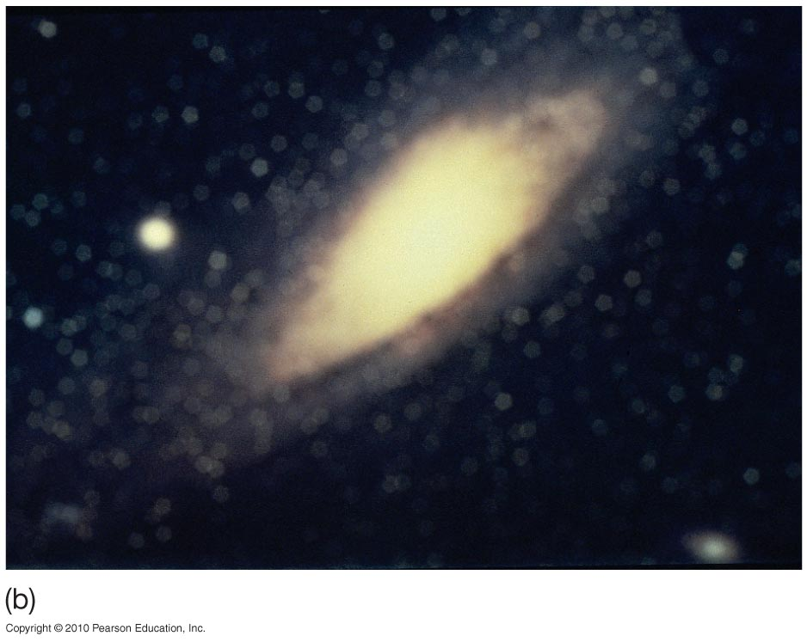
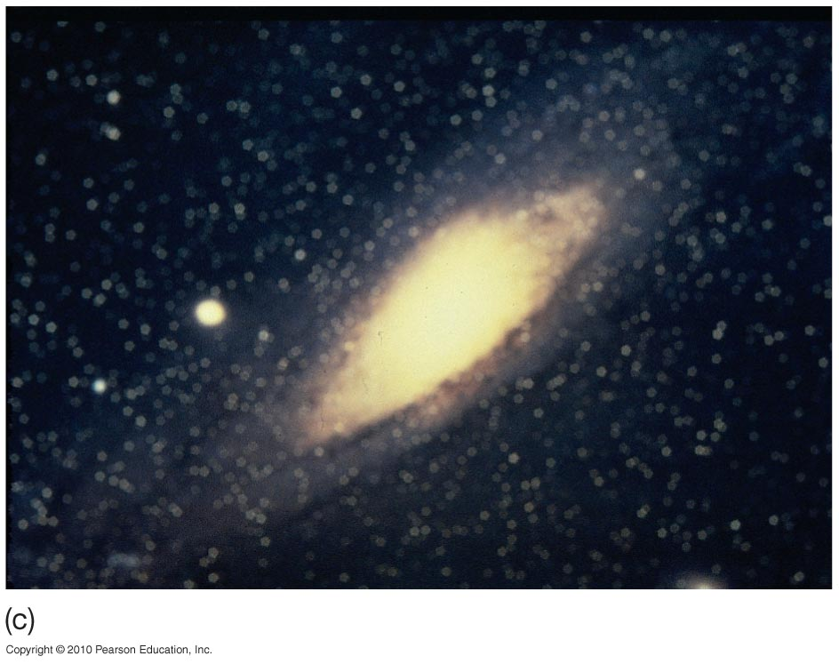
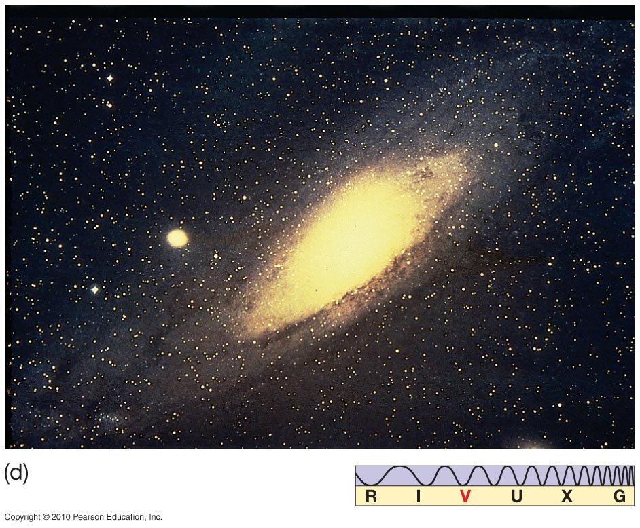
The effect of improving angular resolution
Low resolution
Higher resolution

Slide 10

The resolving power of all ground-based optical telescopes is limited by the blurring effect of turbulence in the atmosphere.

Slide 11

To avoid the problems with turbulence one places optical telescopes on mountains to get above most of the atmosphere, or, more expensively, on satellites.

Slide 12
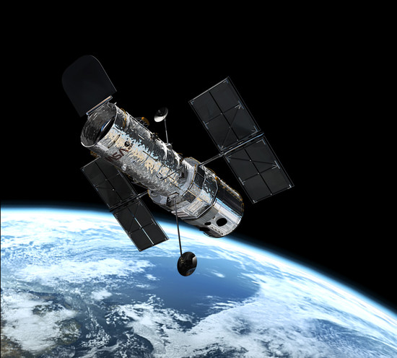
Go to space
The Hubble Space Telescope
One of the main advantages of a telescope in space is that its images are not blurred by the atmosphere

Slide 13
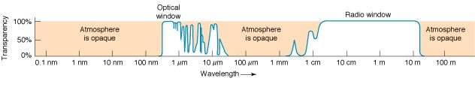
So far we have been talking about optical telescopes that observe visible light. We also observe other parts of the electromagnetic spectrum.
The atmosphere is opaque to light of most wavelengths, marked by tan shading in the diagram. Optical and radio wavelengths can be seen from the ground. For γ-rays, X-rays, most ultraviolet and most infrared light,
one uses satellite telescopes.
γ-rays X-rays UV visible infrared microwave RADIO

Slide 14
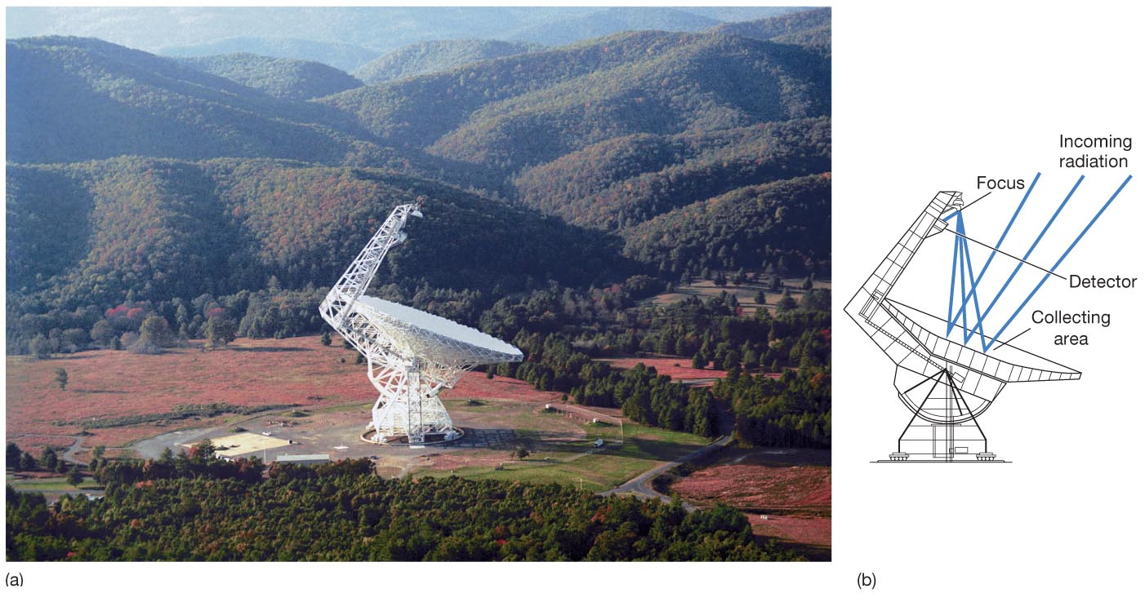
Radio telescopes:
Similar to optical reflecting telescopes
Less sensitive to imperfections due to longer wavelengths – surface has to be smooth on the scale of wavelengths of light observed
Can be made very large
Green Bank Telescope,
105 m diameter
National Radio Astronomy Observatory, West Virginia

Slide 15
Longer wavelength means poorer angular resolution
Atmospheric blurring isn’t an issue in radio
The diffraction limit is
  Ultimate limit in angular resolution comes from diffraction, the spreading of light as it passes a corner or opening
  Longer wavelength: poorer resolution
  Larger telescope: better resolution

Slide 16
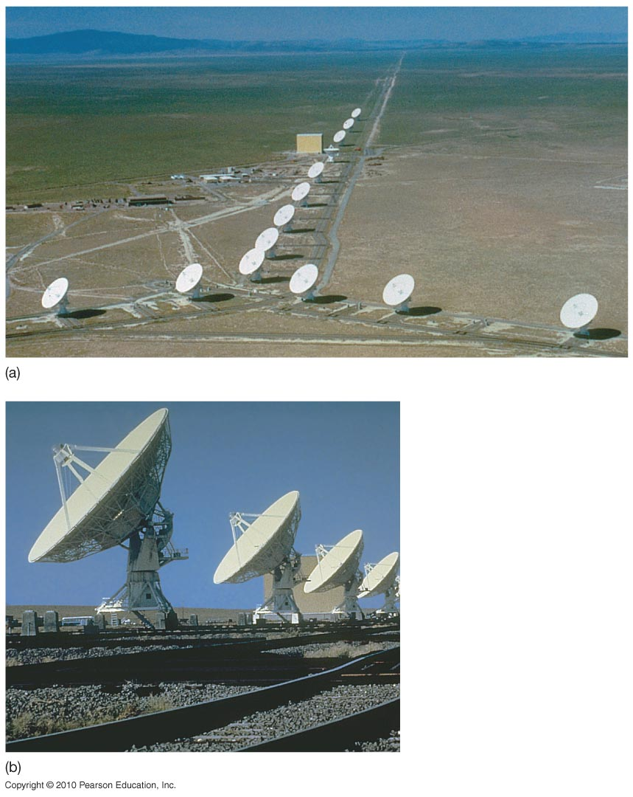
Interferometry
Combines information from several widely spread radio telescopes as if it came from a single dish.
Resolution will be that of dish whose diameter = largest separation between dishes.

Slide 17
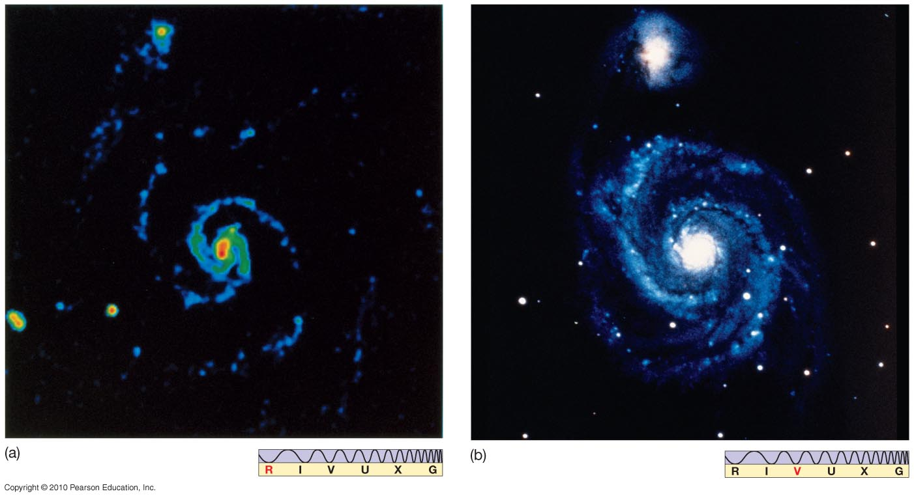
With interferometry we can get radio images whose resolution is close to optical.

Slide 18
There are still other wavelengths of light we would like to observe!
Optical and radio wavelengths can be seen from the ground.
For γ-rays, X-rays, most ultraviolet and most infrared light, one uses satellite telescopes.
γ-rays X-rays UV visible infrared microwave RADIO

Slide 19
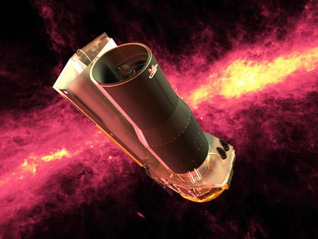
The Spitzer Space Telescope, an infrared telescope in space
Everything emits radiation because of its temperature. Cold things emit in the infrared, so to observe in the infrared our telescope must be very very cold, or else it will be much brighter than what we’re trying to look at!
Cooled to 4 K by liquid helium (until it ran out) – must be very very cold to keep thermal background low

Slide 20
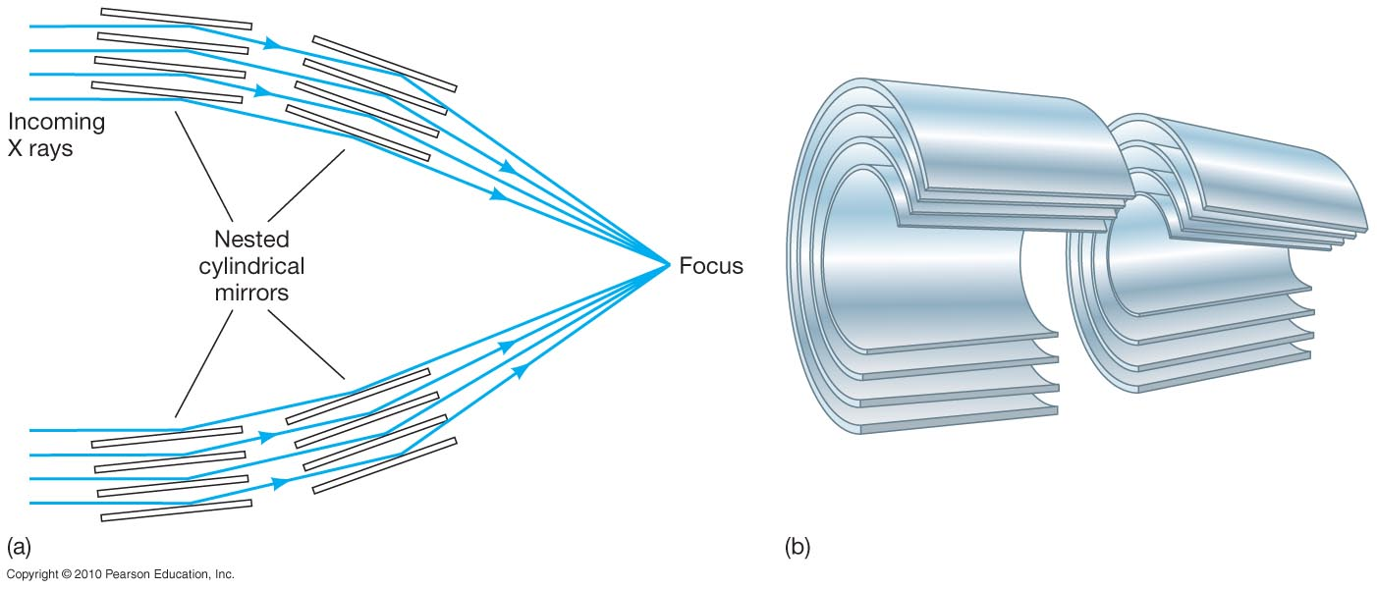
What about shorter wavelengths?
X rays and gamma rays will not reflect off mirrors as other wavelengths do; need new techniques.
X rays will reflect at a very shallow angle, and can therefore be focused.

Slide 21
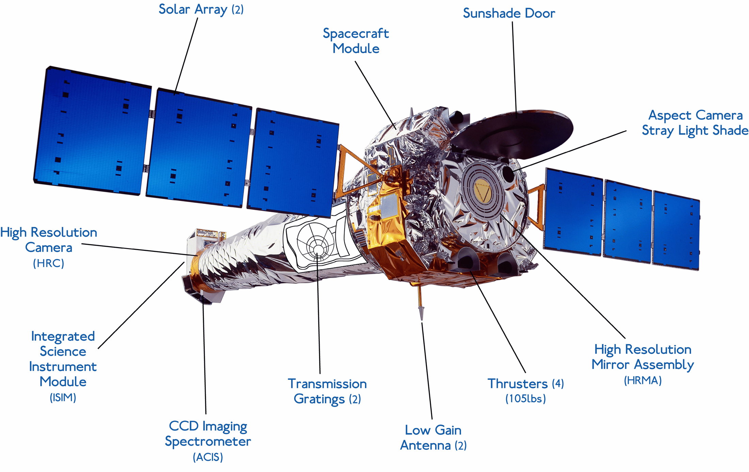
The Chandra X-ray Observatory

Slide 22
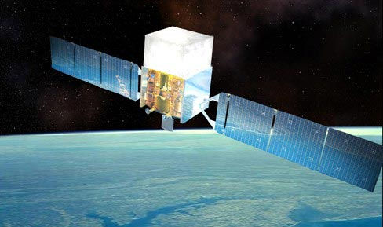
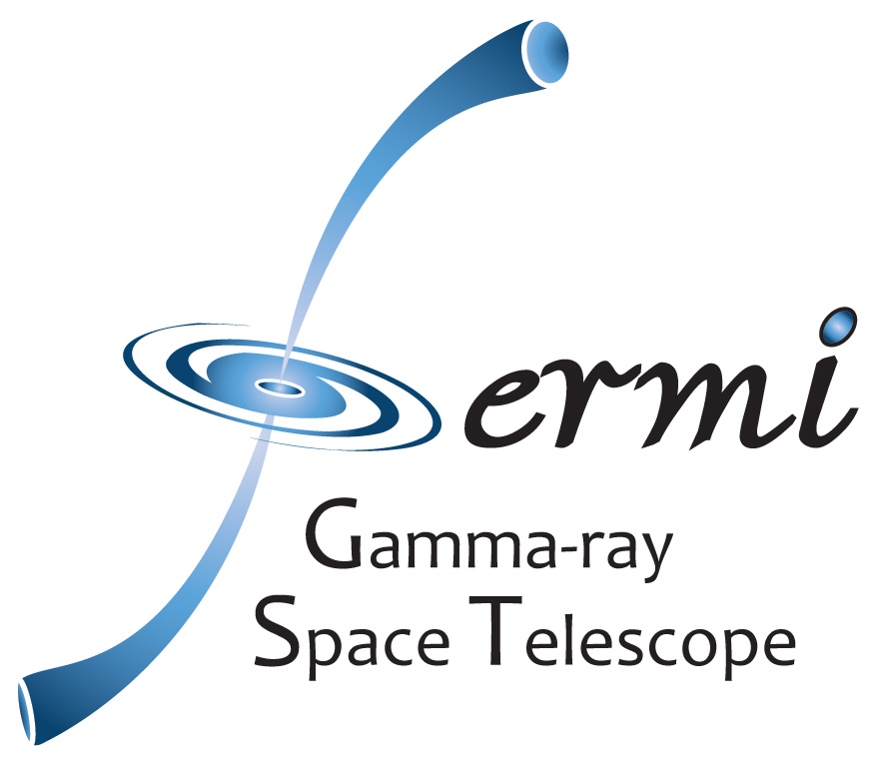
The Fermi Gamma Ray Telescope in Earth orbit
Gamma rays can’t be focused. We just put a detector in space and wait for them.

Slide 23
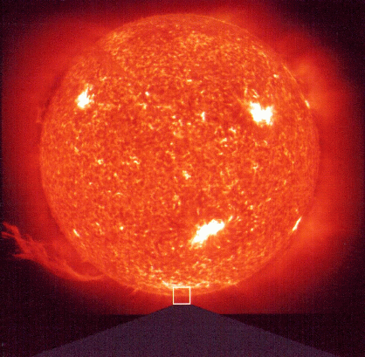
The Sun
The Sun is a star – the closest and most important star to us.

Slide 24
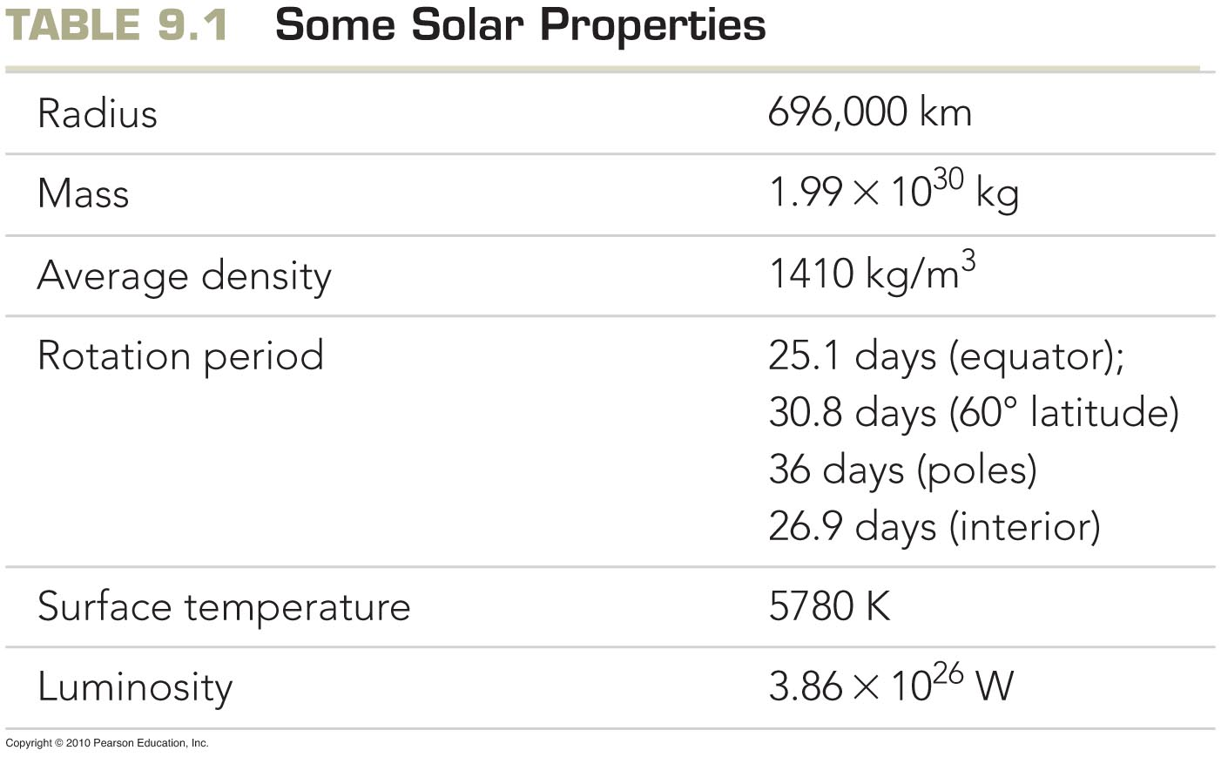
The radius of the Sun is more that 100 times the radius of the Earth, and the mass of the Sun is more than 300,000 times the mass of the Earth.
We know A LOT about the Sun - perhaps more than we know about the center of the earth.

Slide 25
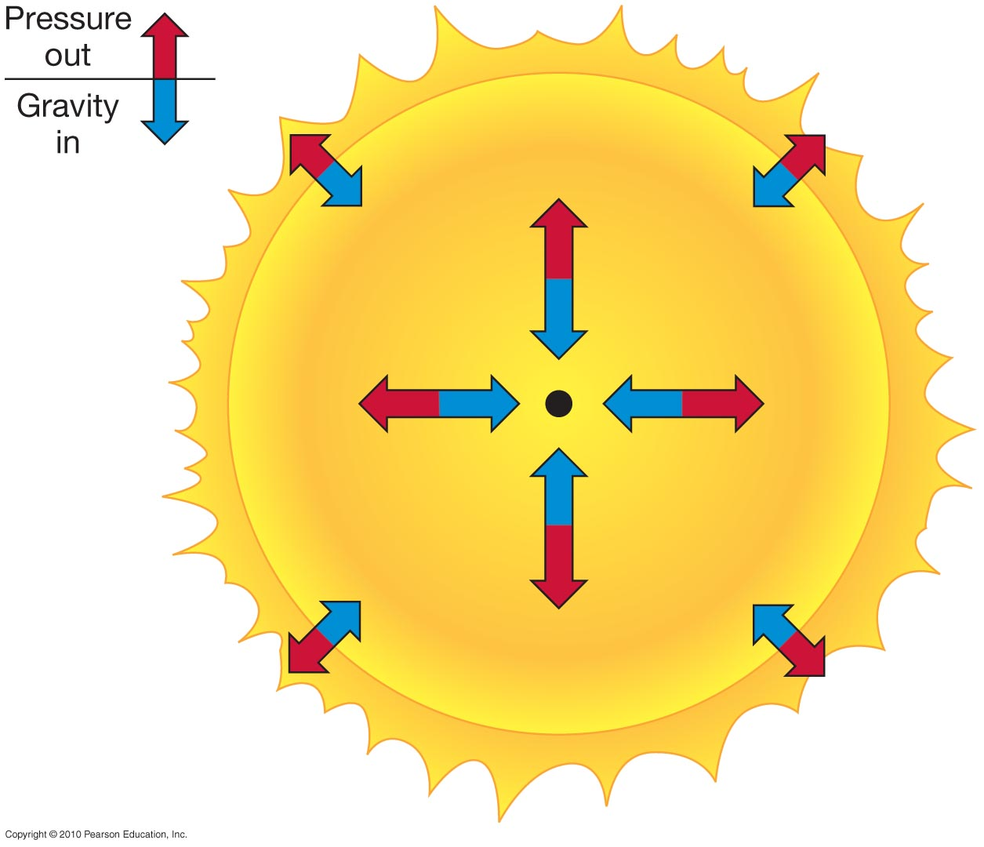
The Solar Interior
(core, radiation zone, and convection zone)
We cannot see inside the Sun. We use models and simulations to tell us what’s going on inside it.
Models start from the idea of hydrostatic equilibrium:
The pressure of gas exactly balances the gravitational pull of gravity.
Because the Sun is very massive, very high temperatures and pressures are needed to balance gravity.

Slide 26
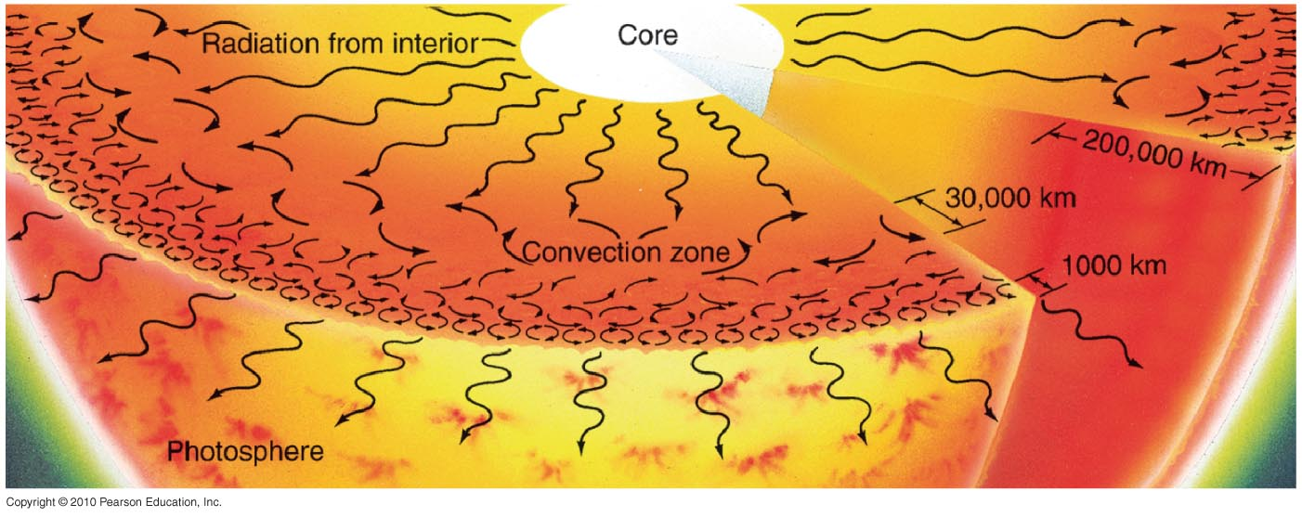
How does Energy get out of the Sun? Radiation and Convection
The radiation zone is relatively transparent; the cooler convection zone is opaque.

Slide 27
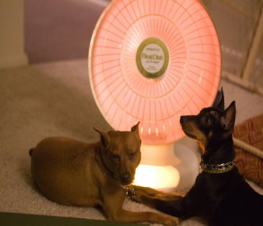
What is radiation?
All objects give off and absorb electromagnetic radiation.
But hotter objects gives off more than cooler objects.

Slide 28
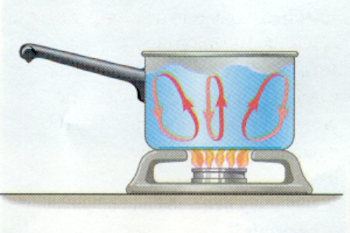
What is convection?
Convection transfers heat by moving stuff around. Hot stuff rises, cool stuff sinks.

Slide 29
The sun transports energy by radiation in certain parts and convection in others.
This is due to the different transparency of hydrogen and helium as a function of temperature.

Slide 30
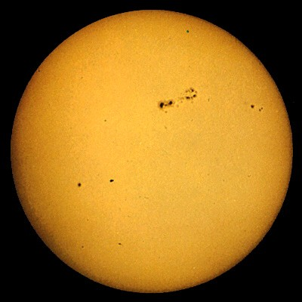
The Solar Atmosphere
Photosphere with sunspots

Slide 31
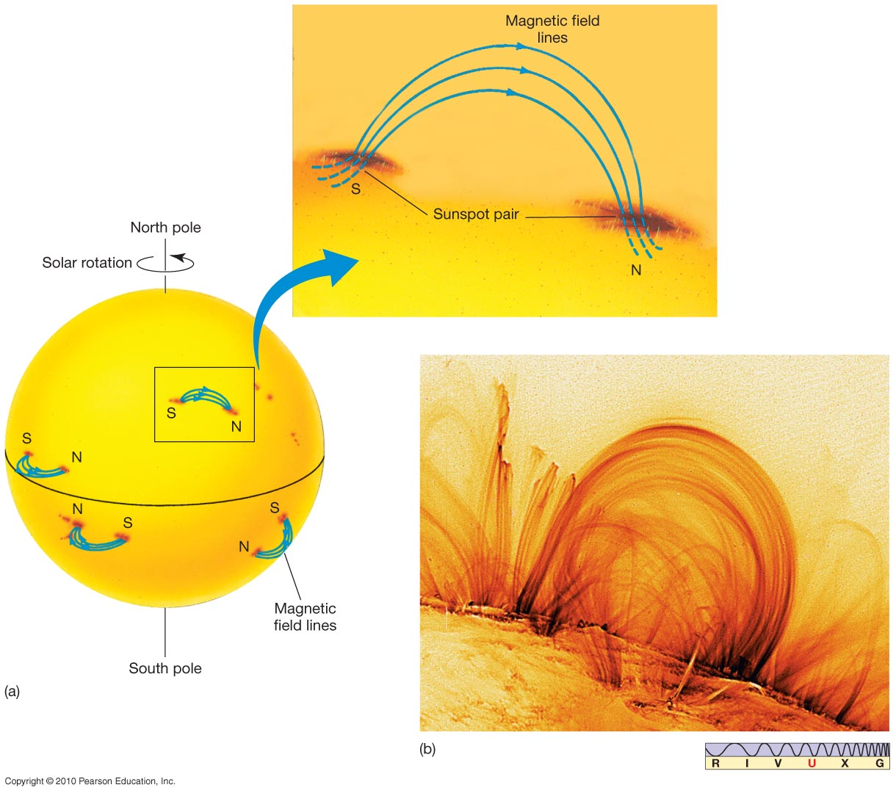
What are Sunspots?
Sunspots come and go, typically in a few days.
Sunspot pairs are linked by magnetic field lines, which drain energy from the photosphere
They are dark because they are cooler than the surrounding photosphere

Slide 32
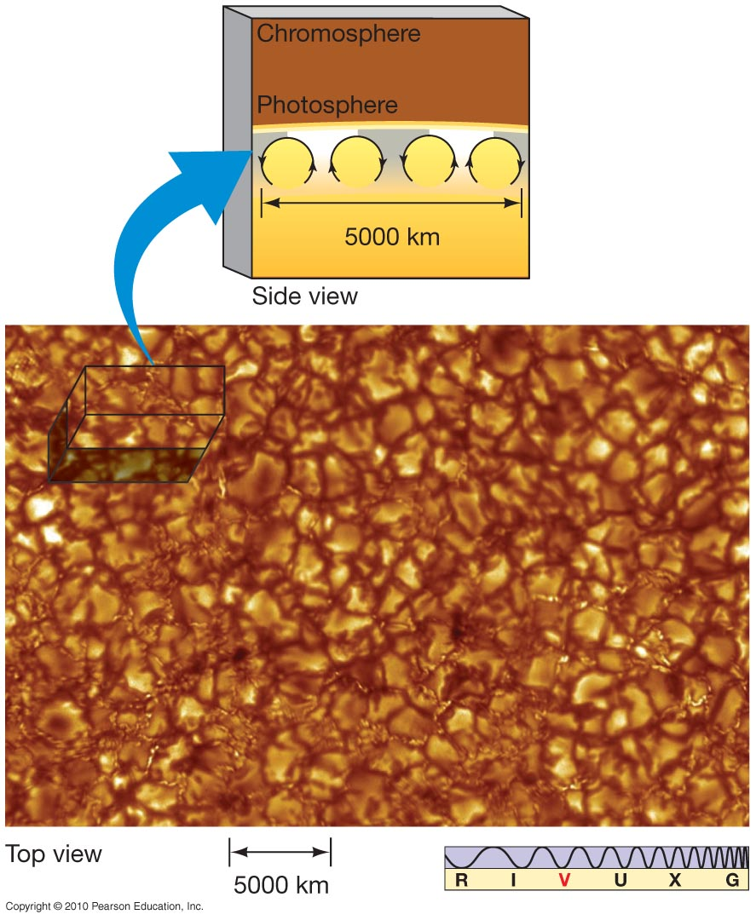
Looking closer at the photosphere
Convection on the photosphere is granulated, with areas of upwelling material surrounded by areas of sinking material.
These spots are called granules.

Slide 33
Summary: Features of the Photosphere
Heat from the interior moves by convection (hot hydrogen gas rising) to the photosphere
The tops of convection cells are called granules
Sunspots are the result of strong magnetic fields going in or out of the Sun’s surface
The magnetic field drains energy from the surrounding photosphere, cooling it; because the cooler gas is darker, it is seen as a dark spot.

Slide 34
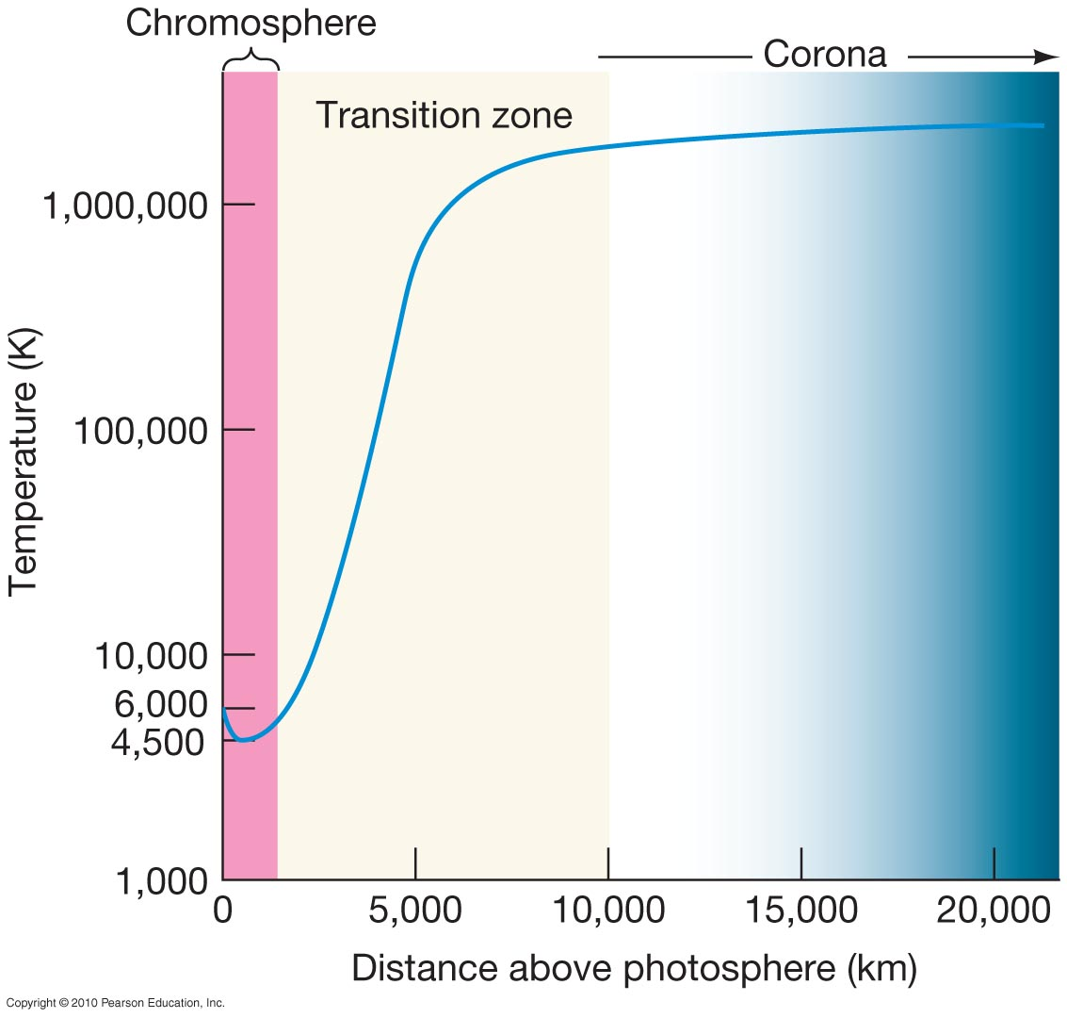
The temperature of the photosphere is about 6,000 K.
But outside the photosphere, the temperature (surprisingly) increases, reaching 3 million K in the Corona.
Notes:
Figure 7.2: (b) This model explains granulation as the tops of rising convection currents just below the photosphere. Heat flows upward as rising currents of hot gas and sinking currents of cool gas. The rising currents heat the solar surface in small regions that we see as granules.

Slide 35
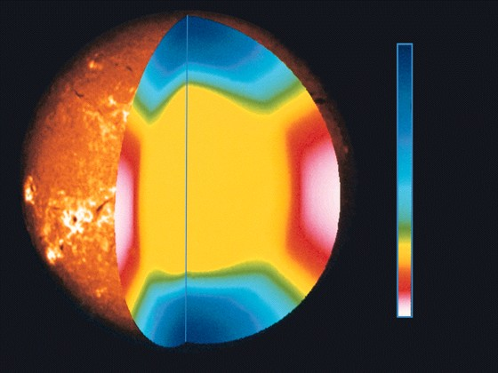
Rotation Period
35 days
35 days
27 days
25 days
25 days
Different parts of the Sun rotate at different speeds. This is called differential rotation.

Slide 36
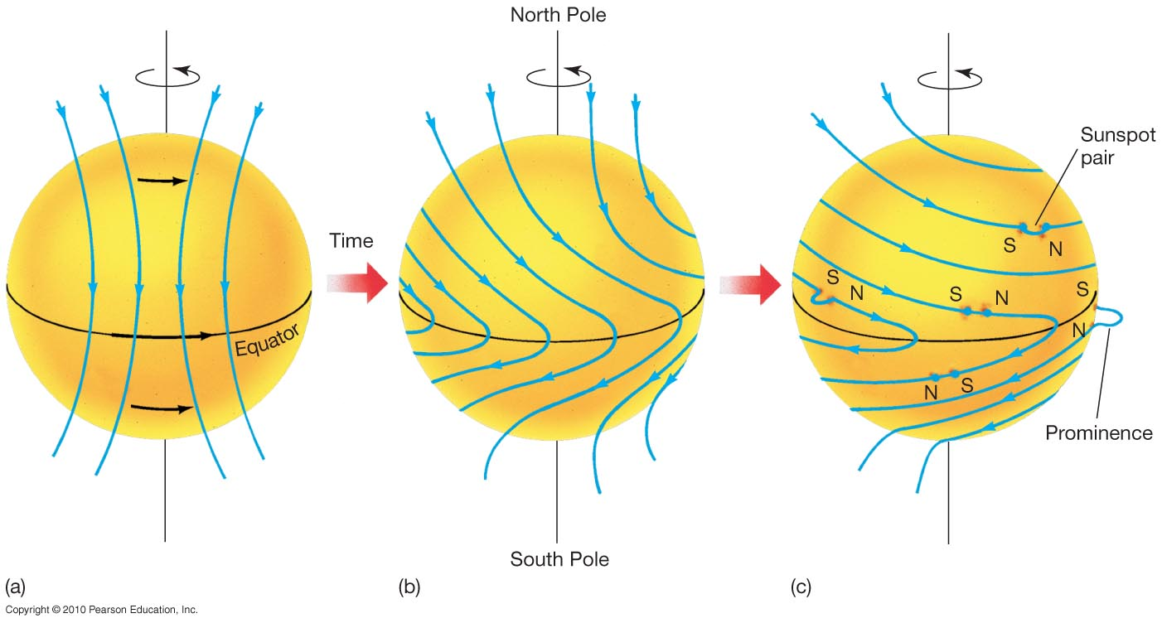
The rotation of the Sun drags magnetic field lines around with it, causing kinks in the field lines.
The sun spins faster at the equator than the poles

Slide 37
Why does the Sun shine?
Only one known process can account for the huge amount of energy generated by the Sun:
Conversion of mass into energy via nuclear fusion
E = mc²
Energy = mass x (speed of light)²

Slide 38
E=mc²
Mass m given in kg
Speed of light c is 3x10⁸ meters/second
Example: How much energy do you get if you can change 1 kg of matter entirely to energy?
This is more than 200 times the energy released by the most powerful nuclear bombs

Slide 39
Example 2: (Luminosity of the Sun)
If the Sun changes 4 x10⁹ kg to energy each second, how much energy does it produce each second?

Slide 40
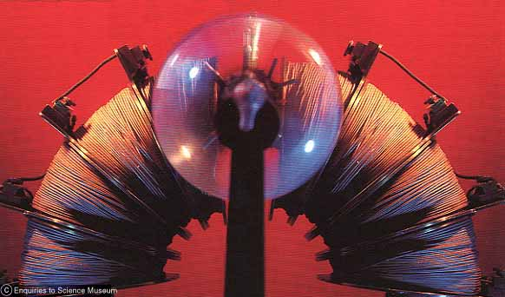
The Energy of Starlight
The mass of a helium atom is slightly less than the mass of 4 hydrogen atoms (by 0.7%=0.007):
This is the apparatus he used.
The coil of wire is a large electromagnet. Aston carefully measured how much the magnet bends the paths of helium and hydrogen nuclei . The more massive the nucleus, the less the path bends.
Mass of Helium precisely measured by Aston, 1920

Slide 41
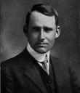
The Energy of Starlight
The Sun turns hydrogen into helium, and the mass of a helium atom is slightly less than
the mass of 4 hydrogen atoms (by 0.7%=0.007)
Eddington’s guess (1920):
Hydrogen can turn into helium, and when it does, 0.7% of its mass changes to energy, and that energy powers the Sun

Slide 42
Fusion of H to He in stars like the Sun
Basic process, neglecting intermediate steps:
4 protons ➔ helium-4 + 2 neutrinos + energy
neutrino
neutrino
proton
He⁴
proton
Gamma rays

Slide 43
Powering the Sun
Current energy output of Sun requires 600 million tons of hydrogen fused into helium every second
That’s a lot, but only a very tiny fraction of the total mass available
Sun can sustain this rate of fusion for another 5 billion years

Slide 44
Stars
What do we need to know?
How big are they? Mass and Size
How bright do they shine?
How do they shine? – we sort of know this already, at least for the Sun
To tackle this, we must first know how far away they are. How do you measure the distances to the stars?

Slide 45
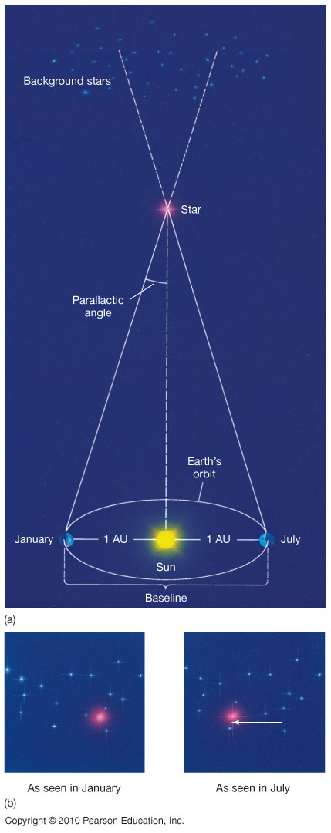
Method 1: Stellar Parallax
For the very closest stars you can measure how much they shift against more distant stars over the course of six months – the time it takes for the earth to move from one side of its orbit to another.
- Shift is about 1/3600 of a degree or 1 arcsecond.

Slide 46
Earth orbit
1 AU
Star
p
•The parallax angle, p of a star is the angle formed by the star and the radius of the Earth's orbit. (i.e. the angle subtended at a star by the radius of the Earth's orbit is the parallax angle, p, of the star)
•This is the apparent shift in the star's position due to the Earth's motion about the Sun.
When the angle is 1", the star's distance is 210,000AU or 3.26 ly.
This distance is called one parsec (for parallax second), or pc for short: 1 pc = 3.26 ly = 3.09 x10¹³ km

Slide 47
Method 2: Spectroscopic Parallax
How bright something seems depends on the distance
apparent brightness = luminosity/(4π r²)
How bright it seems
How bright it is
How far away it is
Some problems will be using the fact that apparent brightness is proportional to 1/(distance)²
There is a very good reason for this!

Slide 48
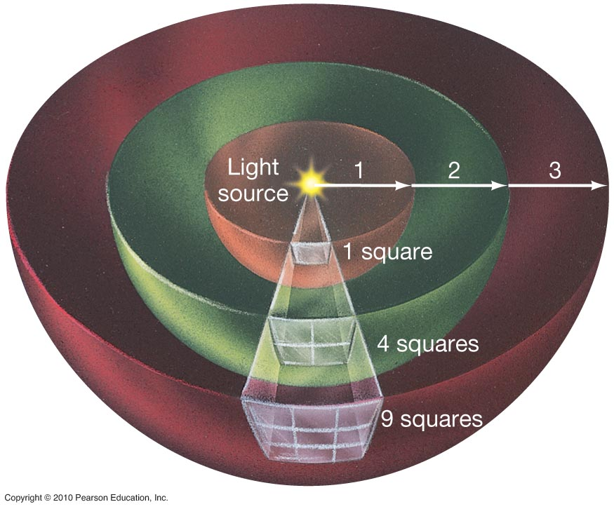
As light moves away from a star (or light bulb) its energy is spread out over a larger area. That area is proportion to d²

Slide 49
Example: The brightness of sunlight at the Earth is 1400 watts/meter². What is the brightness of sunlight at Saturn, 10 AU from the Sun?
Saturn is 10 times farther away from the Sun than the Earth, so sunlight is 1/10² = 1/100 times brighter.
The brightness of sunlight on Saturn is 1400/100 = 14 watts/meter². This is why the outer planets are cold!

Slide 50
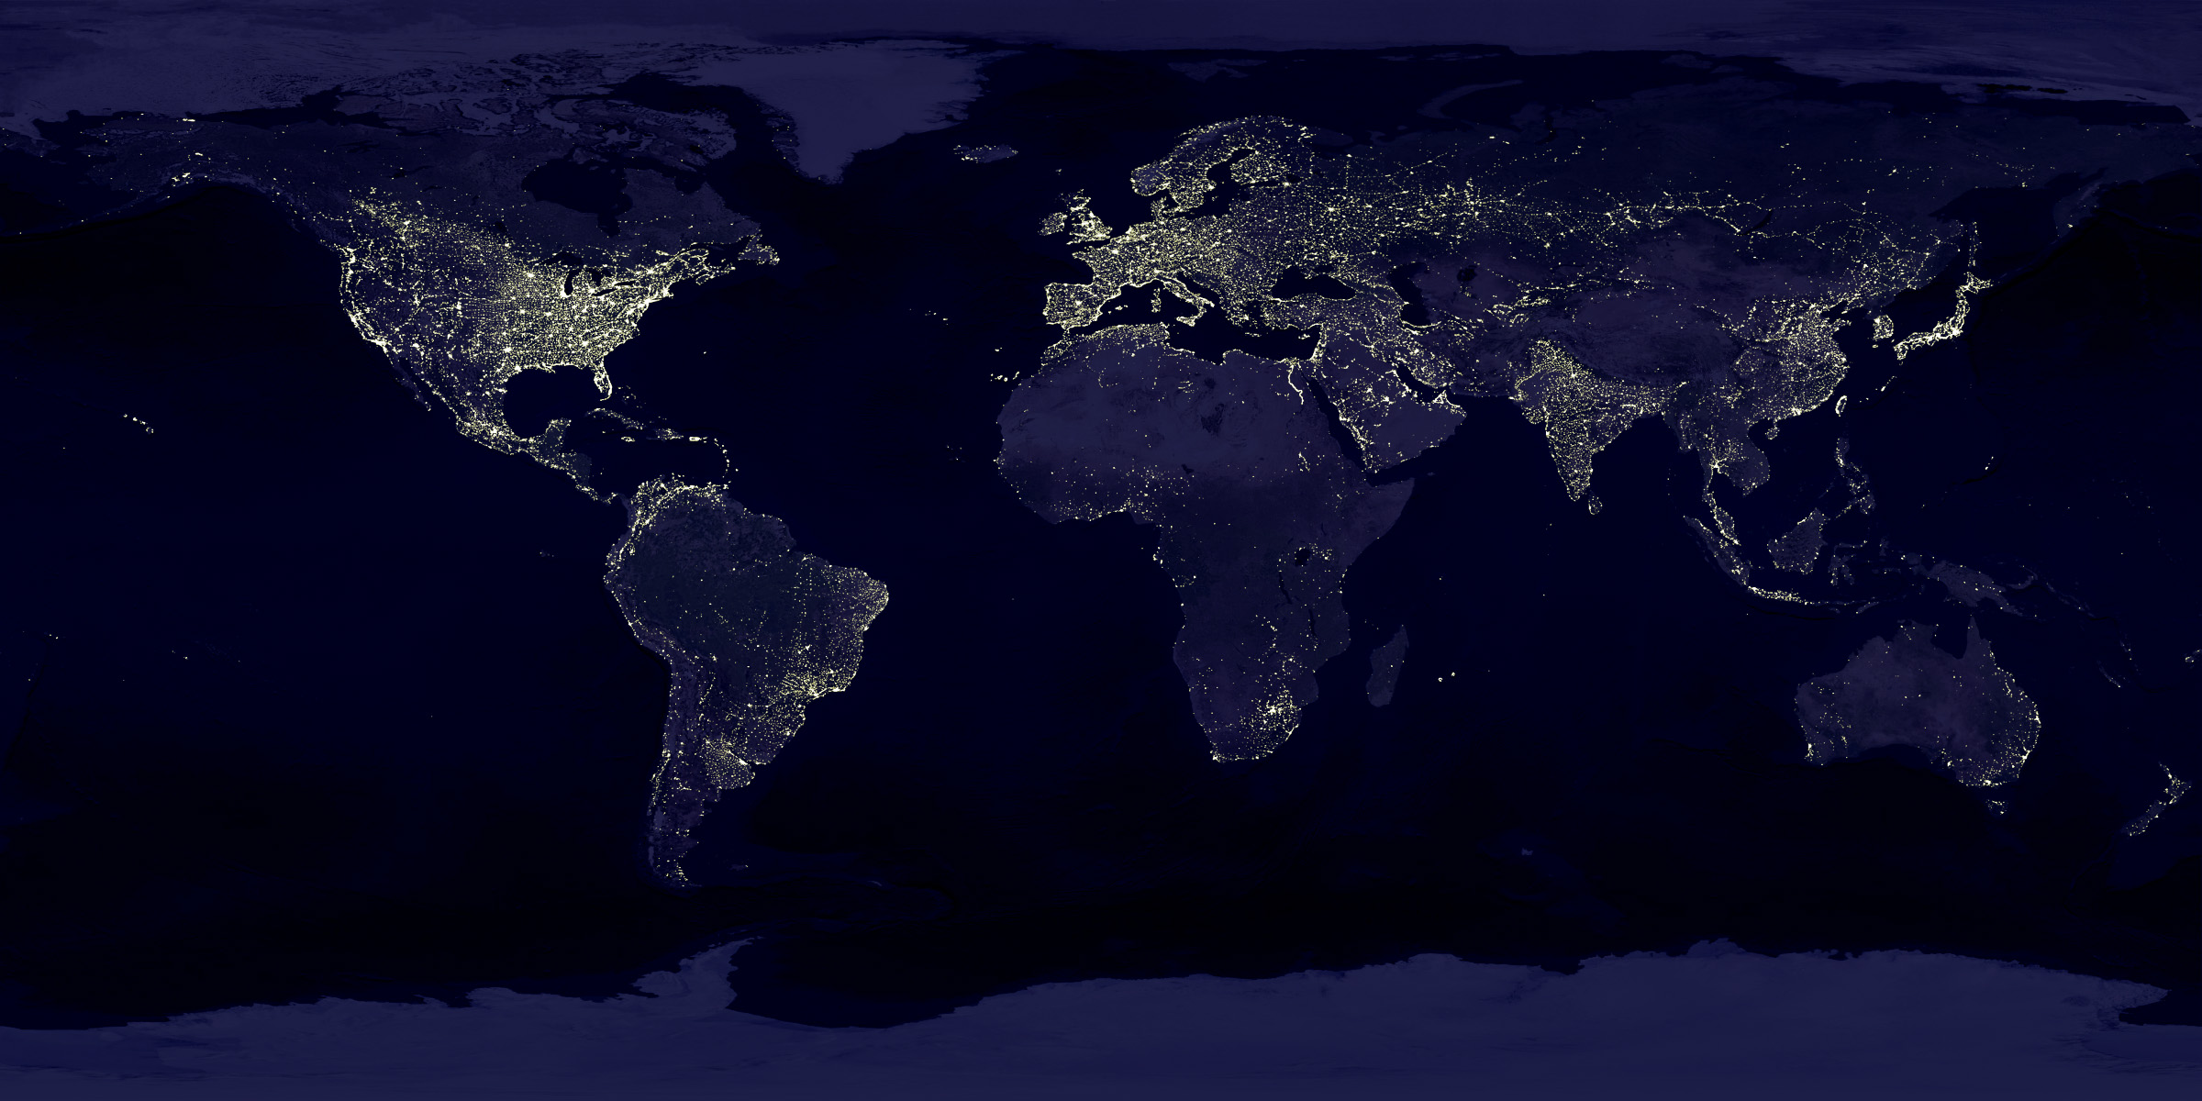
How bright are the stars?
How bright something appears depends on:
How much light per unit area it is putting out
How big it is

Slide 51
Stellar Temperatures
We now need the relation between temperature and color: The hotter the surface of a star, the shorter the average wavelength of the light it emits. Blue stars have hotter surfaces than red stars and stars whose peak wavelength is in the ultraviolet have still hotter surfaces.
1) The relation is, again,
2) Hotter stars also emit more energy per square meter of their surface.
The first relation lets us measure the temperature of stars. The second fact is the way we find the size of stars and their distances (!)

Slide 52
Stellar Classification
The classification of a star is its spectral type.
•Ordered from hottest to coolest, the spectral types are:
O, B, A, F, G, K, M
(Use the mnemonic Oh, Be A Fine Guy/Girl Kiss Me).
O stars are hottest with surface temperature > 25,000 K.
G stars (like the Sun) have surface temperature of approximately 6000 K.
M stars are coolest (Betelgeuse for example) with surface temperatures approximately 3000 K.

Slide 53
Stellar Sizes
So if you know the spectral type, you know the temperature. How do you know how luminous a star is?
The relation between temperature and luminosity is:
Some constants we won’t worry about
Temperature
Radius (size) of star
This relationship is for continuous, blackbody radiation.

Slide 54
So hot stars are (much!) brighter, and larger stars are also brighter.
Some constants we won’t worry about
Temperature
Radius (size) of star

Slide 55
The H-R Diagram
A plot of temperature vs luminosity for a collection of stars is called the Hertzsprung-Russell diagram or H-R diagram, and it’s the most important tool for classifying and understanding stars.
If the stars are all at the same distance:
This is what Hertzsprung did
Or if we know the distances to the stars
This is what Russell did
Luminosity
Apparent brightness
distance

Slide 56
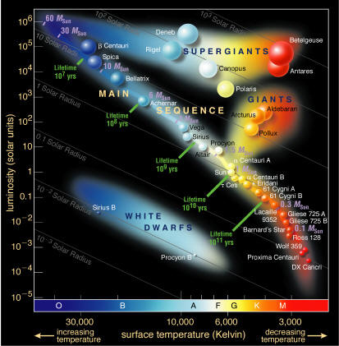
The H-R Diagram
Every star that we know lives on the HR diagram – after all, stars all have a temperature and a luminosity.

Slide 57
On the Hertzsprung-Russell (H-R) diagram, almost all stars lie along a curve called the main sequence.
The hottest stars on the sequence are also the most luminous stars, and the coolest stars are the dimmest (least luminous).
• About 90% of all stars lie on the main sequence, almost all of them below the Sun (cooler and less luminous than the Sun).
The hottest stars on the main sequence are also the brightest stars, and the dimmest are also the coolest.

Slide 58
About half of all stars are in binary systems – so the Sun is unusual in that it does not have a companion.
• A visual binary is a binary system whose stars can be distinguished with a telescope.
In most binary systems, stars are too close to be able to tell them apart with a telescope --- even through a telescope, they look like a single star. Close stars, however, move more quickly, and the spectral lines of each star are first blue-shifted and then red-shifted.
• Spectroscopic binaries are observed by a periodic Doppler shift in the spectral lines of each star.
• Eclipsing binaries are observed by periodic changes in the “light curve”

Slide 59
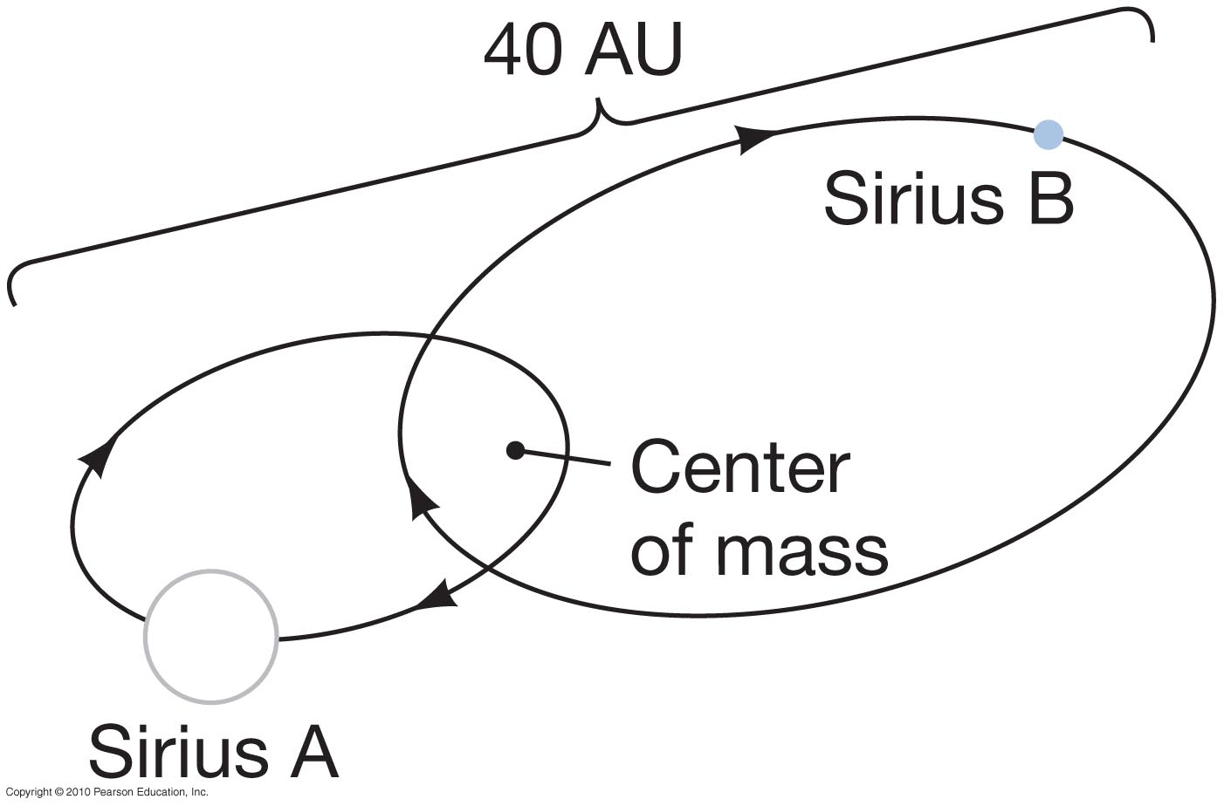
Stellar masses from binaries
If one knows the period and the orbit of each star, one can find the mass of each star. By looking at the speed of each star in a binary system, one measures the mass of the two stars.
This is done with Kepler’s third law; binary stars orbiting each other follow the same laws as a planet orbiting a star.
This is how we find the masses of stars.

Slide 60
From the masses of stars, one can understand the main sequence.
What determines where on the main sequence a star will be when it forms?
Stars on the main sequence are only distinguished by their mass

Slide 61
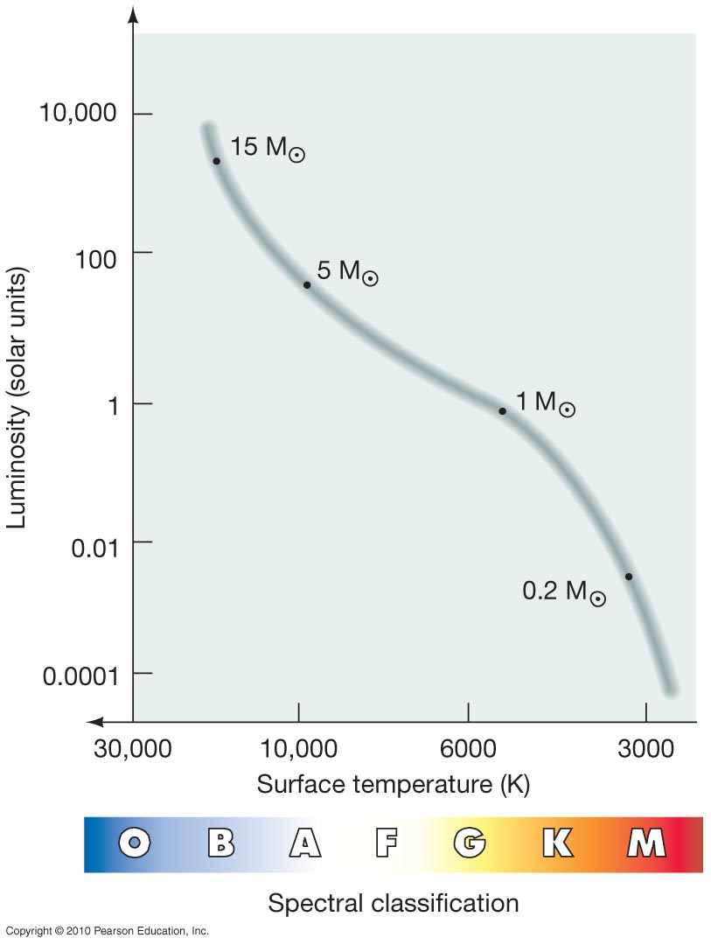
Stars with small masses are the stars that are low on the main sequence. They burn much more slowly, so they are much dimmer and their surfaces are cooler. Stars with larger masses burn much more quickly and have hotter surfaces (and hotter interiors).

Slide 62
Summary:
• The difference between stars on the main sequence is due to the difference in their masses.
• Low mass stars are low on the main sequence, and are much dimmer --- a star of 1/10 of a solar mass is only 1/1000 as bright as the Sun.
• Similarly, high mass stars are high on the main sequence, and are much brighter --- a star of 10 solar masses is 10,000 times brighter than the Sun

Slide 63
Massive stars burn bright, die young
M/L gets very small for more massive stars!
This tells us that massive stars have very short lifetimes
They burn very brightly and use up their fuel very quickly

Slide 64
II. Star formation
Star formation is the process of clouds of gas and dust collapsing to form a star. Pretty simple, but we still don’t understand it well.
Your book has it broken into 7 stages, which are phases in a single process:
Collapse of molecular gas and formation of stars (C-M stages 1-6)
Stage 1 – A molecular cloud begins to collapse. Usually we see this from spectral lines of molecules. Stars form in cold, dense molecular gas.

Slide 65
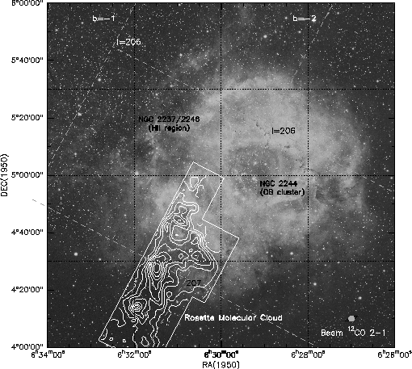
Stage 1: Start with a fragment of a molecular cloud
Rosette Molecular Cloud.

Slide 66
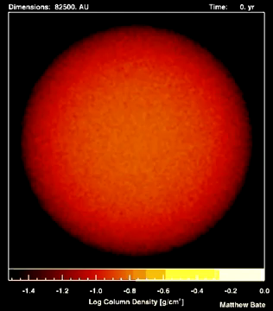
Stage 2 and 3: Cloud fragmentation and core collapse
The cloud collapses due to its own gravity
The collapsing cloud fragments into lots of tiny little pieces, called cores – all of which continue to contract and build mass from infalling gas.
Movie of collapsing and fragmenting cloud

Slide 67
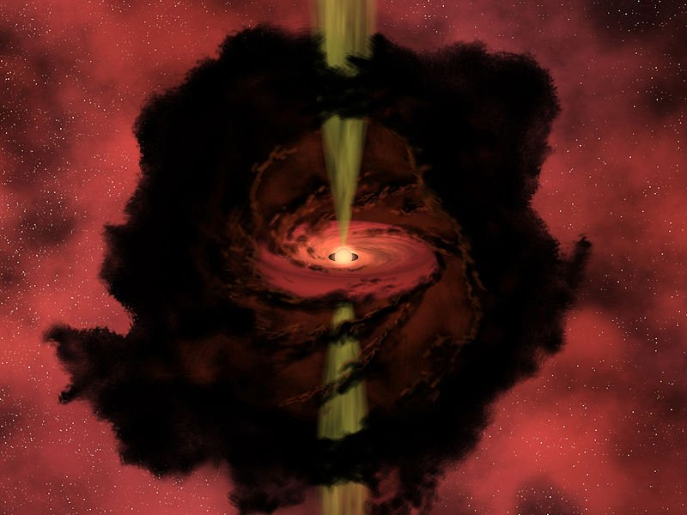
Stage 4: The protostar
The star is still forming, but the cloud has a hot central thing that can be considered a star already. It is surrounded by a disk of gas.

Slide 68
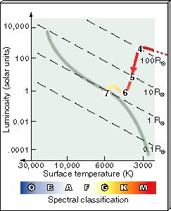
Stage 5: Protostellar evolution
As the protostar contracts, it heats up, but gets dimmer!! This is because the star is getting smaller
During this phase, many protostars give off jets of gas – these are called Herbig-Haro objects
Eventually nuclear fusion starts up and the protostar becomes a star

Slide 69
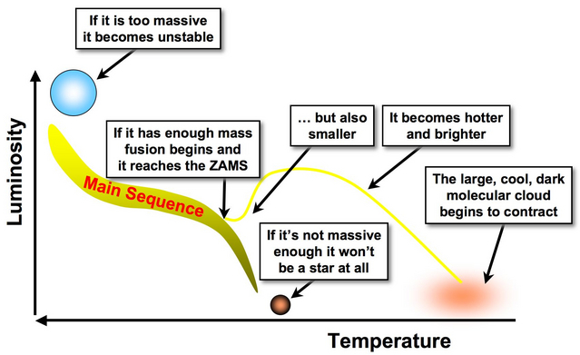
Stage 6/7: A star is born.
When the star starts hydrogen burning in its core, its collapse is halted and it reaches the zero-age main sequence (ZAMS)

Slide 70
Summary of evolution of stars like the Sun
Collapse of a gas cloud to form a star
Main Sequence: hydrogen fuses to helium in core
Red Giant: hydrogen shell fusion, helium core not fusing
Helium Flash: core gets hot enough to ignite helium fusion
Second Red Giant (Asymptotic Giant Branch [AGB]): non-fusing carbon core, shells of helium fusion and hydrogen fusion
Planetary Nebula and formation of White Dwarf: ejection of outer layers of star, cooling of dense core supported by degeneracy pressure

Slide 71
Novae: H-bombs at the surface of white dwarfs
Some white dwarfs are in binary systems with another star.
In a close binary, or when the other star becomes a red giant and is sufficiently large, hydrogen from the surface of the other star falls onto the white dwarf
Once enough hydrogen builds up on a white dwarf, it will suddenly fuse to helium. This is a nova, the sudden fusion of hydrogen to helium on the surface of a dwarf.

Slide 72
Late evolution of stars more massive than the Sun and the formation of the elements
More massive stars will build heavier elements up from carbon:
No fusion at all
H He only
H He, He C
C Ne, Na, Mg, O
Ne and O fuse to form higher mass elements up to Fe

Slide 73
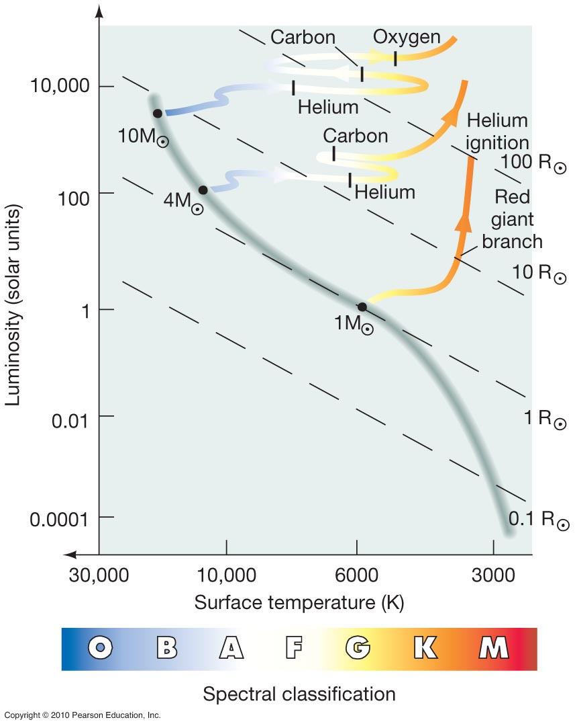
Evolution of Stars More Massive than the Sun

Slide 74
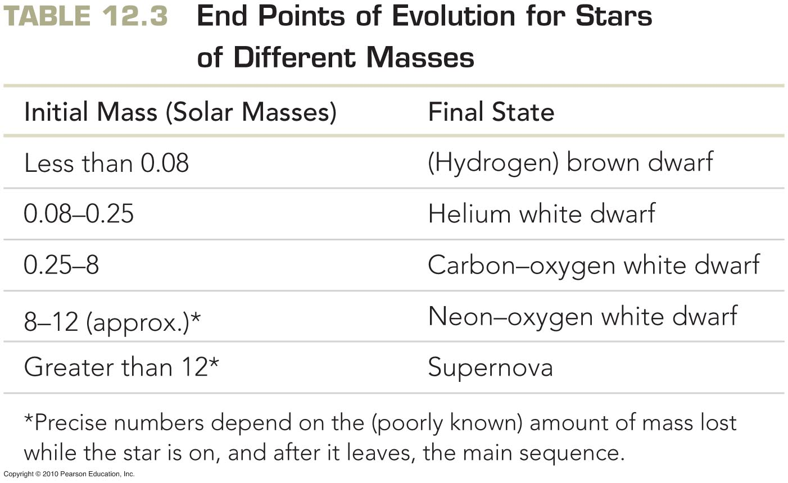
Evolution of Stars More Massive than the Sun

Slide 75
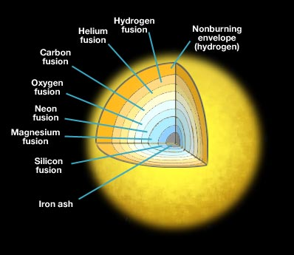
Evolution of the most massive stars
The most massive stars are hot enough to fuse heavier and heavier elements in their cores
Fusion of the heaviest element occurs in the center, surrounded by shells burning each of the lighter elements
Star has an “onion” structure
This happens until the core of the star has been fused into iron
Not to scale! The core containing the layers of fusion is only a small part of the star.

Slide 76
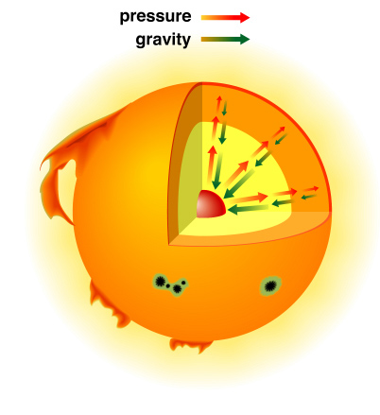
Evolution of the most massive stars
Recall that stars are in hydrostatic equilibrium: nuclear fusion at the center produces enough pressure to balance the force of gravity and keep the star from collapsing
Our very massive star now has a core made out of iron… and this is a very big problem!

Slide 77
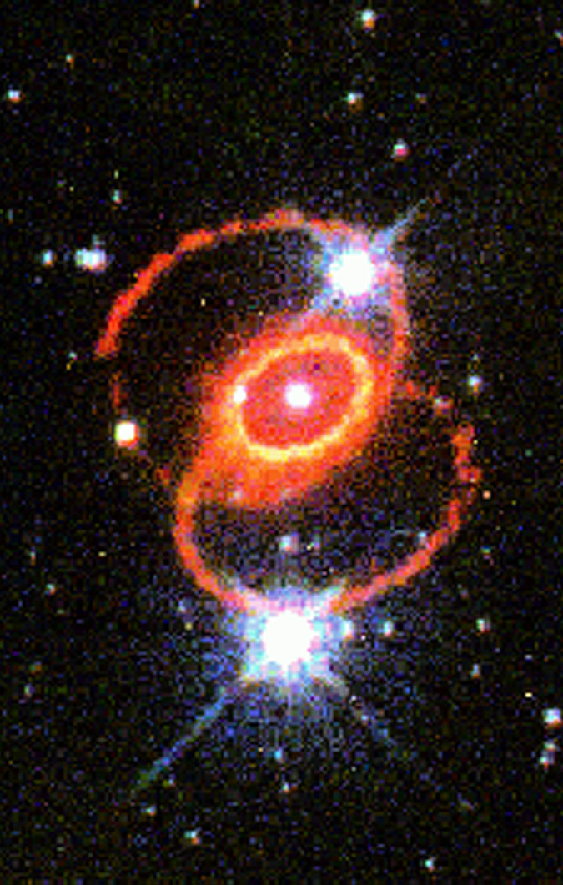
Evolution of the most massive stars
Iron is the most stable element – it has the most tightly bound nucleus
For elements lighter than iron, fusing them into heavier elements produces energy
This doesn’t work for iron: fusing iron atoms together into heavier atoms does not create energy
So our massive star suddenly no longer has fusion at its core, and it can’t create the pressure needed to support itself against gravity
This results in a sudden, catastrophic collapse of the star: a supernova

Slide 78
The Chandrasekhar limit
There is an upper limit c on the speed at which a particle can travel — and hence an upper limit on the pressure per unit mass that matter can exert.
But there is no upper limit on the gravitational force per unit mass.
When the mass of a dense object is too large, gravity overwhelms pressure and the object collapses.
This sets an upper limit on the mass of dead matter that can no longer provide energy via fusion:
A white dwarf or the dead iron core of a star cannot have more mass than 1.4 solar masses

Slide 79
Summary: Two types of supernovae
I. Type I supernova: The collapse of an accreting white dwarf when its mass reaches 1.4 solar masses.
II. Type II supernova: The collapse of the iron core of a massive star when its mass reaches 1.4 solar masses. The energy of matter falling during the gravitational collapse (and then rebounding) is the energy that explodes the rest of the star.

