Slide 1
Final Exam Info
Monday May 12, 10 am – noon, Physics 137
  no books, notes or calculator
  bring a #2 pencil
Practice exam on D2L under Quizzes: Extra Practice
  Practice Final: Part I and Practice Final: Part II
  The actual final exam will come from these questions
Reminder: Problem sets due Monday May 12, noon
  Best 12 are counted (10% of final grade)
Extra credit research paper due today
Today: final exam review, focus on math problems

Slide 2
Bonus Extra Credit:
You know more than Google
Go to http://www.google.com/doodles/earth-day-2013 (link will be on D2L) and watch the animation
There are at least 4 astronomical things wrong here, involving the sun, moon and stars
For up to three extra points on the final exam, explain three of them
Email me your answers before the start of the exam on Monday (erbd@uwm.edu)

Slide 3
Information that will be provided on final

Slide 4
Astronomy 103
Review for Final Exam
Quick Course Overview
and Practice Problems

Slide 5
Outline I
Scientific notation and powers of ten
Units, scale of the Universe
The celestial sphere: motions of the stars, the seasons, phases of the Moon, eclipses
Copernican revolution: Kepler’s laws, Newton’s law of gravity
Light and matter: the electromagnetic spectrum, emission and absorption lines, thermal radiation
Telescopes: different types for different wavelengths
The Sun: structure, power source

Slide 6
Outline II
Stars: luminosity, apparent brightness, temperature
The Hertzprung-Russell diagram
Stellar masses with binary stars
The interstellar medium: gas, dust and star formation
Stellar evolution: evolutionary stages of stars of different masses, white dwarfs, supernovae
Neutron stars and black holes
The solar system: terrestrial and Jovian planets, comets and asteroids, formation of the solar system
Extrasolar planets
The Milky Way galaxy: structure, mass (dark matter), the Galactic Center

Slide 7
Outline III
Normal and Active Galaxies
  The Hubble Sequence: spiral, elliptical and irregular galaxies
  The distance ladder
  The distribution of galaxies in space: clusters of galaxies
  Hubble’s law
  Active Galactic Nuclei: quasars, radio galaxies, accretion onto supermassive black holes

Slide 8
Outline IV
Galaxies and dark matter
  Evidence for dark matter: galaxy rotation curves, masses of galaxy clusters, gravitational lensing
  Galaxy collisions, galaxy evolution
Cosmology
  The universe on the largest scales
  The density, geometry and fate of the universe
  The Big Bang and the Early Universe
    Big Bang nucleosynthesis
  The Cosmic Microwave Background
  Inflation
  The formation of large scale structure

Slide 9
Things Involving Math
Kepler’s third law
Newton’s law of gravity
Temperature and peak wavelength of thermal (blackbody) radiation
Conversion of mass to energy in stars, stellar luminosities and lifetimes
Brightness and distance
Hubble’s law
We will do examples of these today

Slide 10
Kepler’s Third Law
The period of each planet is related to its average distance from the Sun by the formula
a = planet’s average distance from Sun
(semimajor axis) in AU
P = planet’s period in years

Slide 11
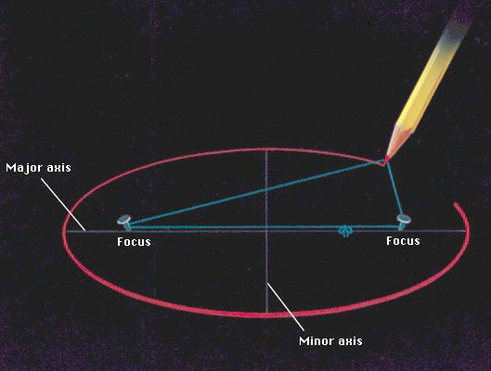
Let’s remind ourselves what the semi-major axis is
Semi-major axis
Semi-minor axis

Slide 12
Using Kepler’s Third Law: Examples
Earth has a period of 1 year and a semi-major axis of 1 AU:
1³ = 1² = 1.
A planet is at 2 A.U. What is its period?
Solve Kepler’s 3rd law for P:
The period of the planet is years

Slide 13
Using Kepler’s Third Law: Examples
Earth has a period of 1 year and a semi-major axis of 1 AU:
1³ = 1² = 1.
A planet is at 0.1 A.U. What is its period?
Solve Kepler’s 3rd law for P:
The period of the planet is years
Planets with a>1 AU have periods greater than 1 year, and planets at a<1 AU have periods less than 1 year.

Slide 14
Using Kepler’s Third Law: Examples
Earth has a period of 1 year and a semi-major axis of 1 AU:
1³ = 1² = 1.
A comet has a period of 1000 years. What is its distance from the Sun?
Solve Kepler’s 3rd law for a:
The distance of the comet from the Sun is AU

Slide 15
Using Kepler’s Third Law: Examples
Earth has a period of 1 year and a semi-major axis of 1 AU:
1³ = 1² = 1.
A planet has a period of 0.5 years. What is its distance from the Sun?
Solve Kepler’s 3rd law for a:
The distance of the planet from the Sun is AU
Objects with P>1 year are more than 1 AU from the Sun.

Slide 16
Newton’s law of gravity: Any two objects in the universe attract each other with a force given by
With
r in meters
m in kg
F in Newtons, where
1 Newton = 4.5 lb
G = 7x10⁻¹¹
m
M
r
Newton’s gravitational constant
M: mass of object 1
m: mass of object 2
r: distance between the objects

Slide 17
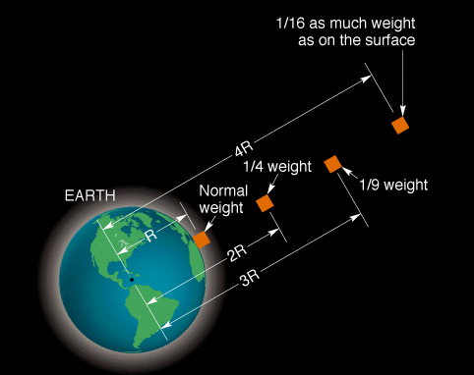
Force of gravity on an object proportional to 1/r²
Note: weight is a measurement of force, not mass. How much you weigh depends on your mass and on the strength of gravity where you are. Pounds are a unit of force; kilograms are a unit of mass.

Slide 18




Using Newton’s law of Gravity
An astronaut weighs 140 pounds on Earth. How much would she weigh on a planet that is the same size as Earth but ½ the mass?
35 pounds
140 pounds
70 pounds
280 pounds

Slide 19
Using Newton’s law of Gravity
An astronaut weighs 140 pounds on Earth. How much would she weigh on a planet that is the same size as Earth but ½ the mass?
35 pounds
140 pounds
70 pounds
280 pounds

Slide 20
Mass of new planet is ½ mass of Earth:
So the gravitational force on the new planet is half as strong as on Earth, and the astronaut weighs half as much.
Remember that weight is gravitational force! The mass of the astronaut m does not change!

Slide 21
Using Newton’s law of Gravity
An astronaut weighs 150 pounds on Earth. How much would she weigh on a planet that is the same size as Earth but 0.1 times the mass?
1.5 pounds
150 pounds
15 pounds
1500 pounds

Slide 22
Using Newton’s law of Gravity
An astronaut weighs 150 pounds on Earth. How much would she weigh on a planet that is the same size as Earth but 0.1 times the mass?
1.5 pounds
150 pounds
15 pounds
1500 pounds

Slide 23
Using Newton’s law of Gravity
An astronaut weighs 120 pounds on Earth. How much would she weigh on a planet that is the same mass as Earth but double the radius?
30 pounds
240 pounds
60 pounds
480 pounds

Slide 24
Using Newton’s law of Gravity
An astronaut weighs 120 pounds on Earth. How much would she weigh on a planet that is the same mass as Earth but double the radius?
30 pounds
240 pounds
60 pounds
480 pounds

Slide 25
Radius of new planet is twice the radius of Earth:
The gravitational force on the new planet is ¼ as strong as on Earth, and the astronaut weighs ¼ as much.

Slide 26
Using Newton’s law of Gravity
An astronaut weighs 100 pounds on Earth. How much would she weigh on a planet that is the same mass as Earth but 1/3 the radius?
11 pounds
300 pounds
33 pounds
900 pounds

Slide 27
Using Newton’s law of Gravity
An astronaut weighs 100 pounds on Earth. How much would she weigh on a planet that is the same mass as Earth but 1/3 the radius?
11 pounds
300 pounds
33 pounds
900 pounds

Slide 28
Radius of new planet is 1/3 the radius of Earth:
The gravitational force on the new planet is 9 times stronger than it is on Earth, and the astronaut weighs 9 times as much!

Slide 29
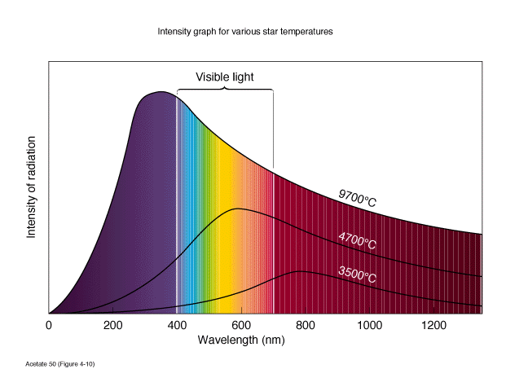
The radiation that something emits because of its temperature is called thermal or blackbody radiation, and we can use the peak wavelength of the blackbody curve to determine the temperature of an object.
Nothing radiates as a perfect blackbody, but stars come close!
So hotter stars emit more radiation, and the radiation peaks at a shorter wavelength.

Slide 30
With wavelength λ measured in nanometers and T in degrees Kelvin, the relation between the average wavelength of light emitted by a hot object and the temperature of the object is
To 2 decimal-place accuracy and with λ measured in cm
Example: Milwaukee at 17⁰ C = 290 K
Peak wavelength is 0.29/290 = 0.001 cm = 10,000 nm: infrared

Slide 31
A star has a temperature of 2000 K. What is the peak wavelength of light that it emits?

Slide 32
A star emits at a peak wavelength of 300 nm. What is the temperature of its surface?
0.9 K
9000 K
10,000 K
9 x 10⁸ K

Slide 33
A star emits at a peak wavelength of 300 nm. What is the temperature of its surface?
0.9 K
9000 K
If wavelength in nm –
so (3 x 10⁶)/300 = 10,000 K
10,000 K
9 x 10⁸ K

Slide 34
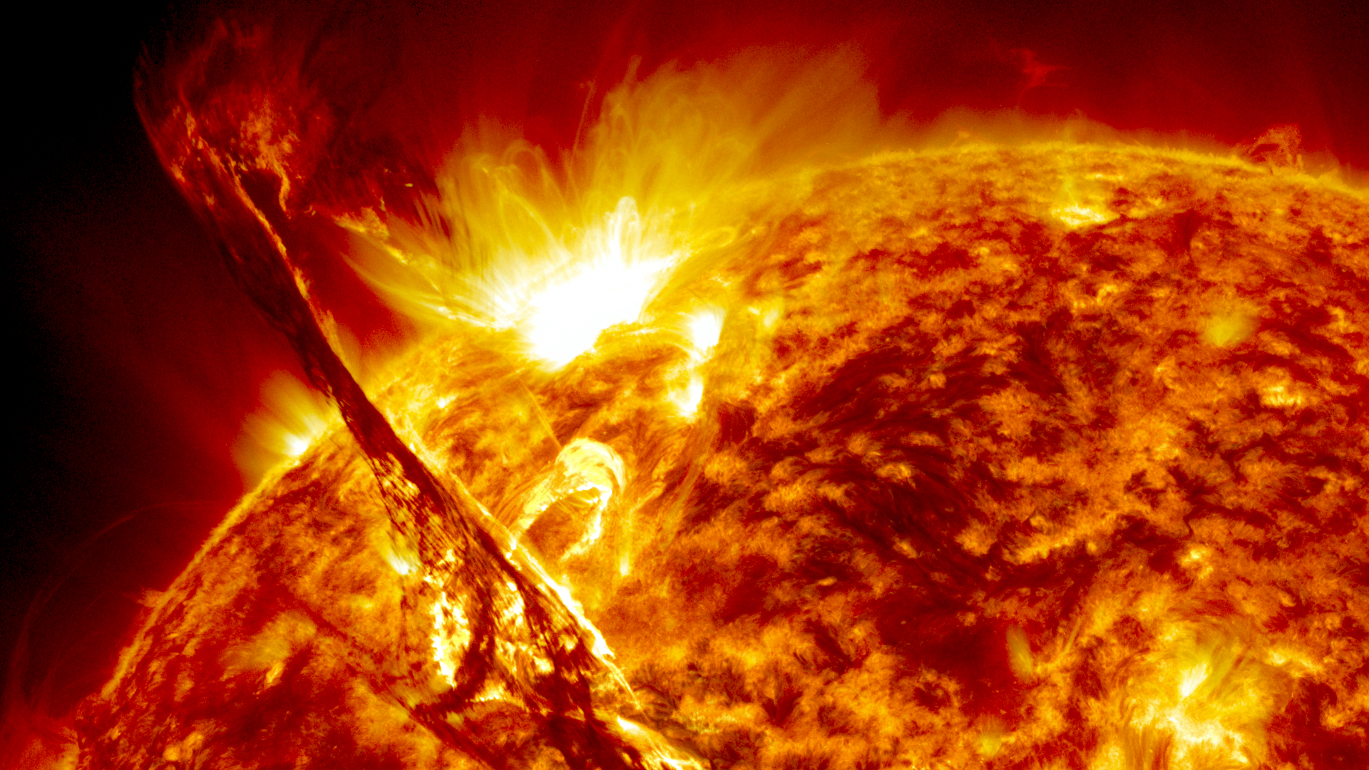
Stars
Energy source: nuclear fusion of hydrogen into helium
When 4 hydrogen atoms are fused into one helium atom, 0.7% of their mass is turned into energy:
E=mc²

Slide 35
Stars
The luminosity of the Sun is 4 x 10²⁶ watts.
So the sun produces 4 x 10²⁶ watt-seconds of energy every second.
How much mass does it fuse into energy to do this?
E=mc², so m=E/c²
The speed of light is c = 3 x 10⁸ m/s
m = 4 x 10²⁶ / (3 x 10⁸ )² = 4.4 x 10⁹ kg
The sun turns 4.4 x 10⁹ kg of mass into energy every second.

Slide 36
Stars
The Sun turns 4.4 x 10⁹ kg of mass into energy every second.
How much hydrogen does the Sun fuse into helium in one second to do this?
When 4 hydrogen atoms are fused into one helium atom, 0.7% of their mass is turned into energy.
mass turned into energy = total mass x 0.007
So the total amount of hydrogen fused is the amount of mass turned into energy divided by 0.007, which is the amount of mass turned into energy x 143.
The Sun fuses 143 x (4.4 x 10⁹ kg) = 6.3 x 10¹¹ kg of hydrogen into helium in one second.

Slide 37
Stars
The Sun fuses 143 x (4.4 x 10⁹ kg) = 6.3 x 10¹¹ kg of hydrogen into helium in one second.
How long will it live?
The mass of the Sun is 2 x 10³⁰ kg, and the mass of its core which will be fused into helium is about 10% of that. This is the total amount of fuel available.
total amount of fuel = 0.1 x 2 x 10³⁰ kg = 2 x 10²⁹ kg
The lifetime is the total amount of fuel divided by the amount of fuel consumed per second.
So the lifetime of the Sun is 2 x 10²⁹ kg/(6.3 x 10¹¹ kg/s) = 3.2 x 10¹⁷ seconds = 10¹⁰ years

Slide 38
Stars
We can repeat this calculation for other stars, given their masses and luminosities.
The total mass changed to energy is proportional to the mass of the star. If a star has 5 times the mass of the Sun it will change 5 times as much mass to energy in its lifetime.
The mass changed to energy each second is proportional to the luminosity of the star. If a star has 1000 times the luminosity of the Sun, it will change 1000 times as much mass to energy each second.
A star with 5 times the mass and 1000 times the luminosity of the Sun then has a lifetime 5/1000 = 0.005 times as long.

Slide 39
Lifetimes of Stars
The total mass changed to energy is proportional to the mass of the star. If a star has 5 times the mass of the Sun it will change 5 times as much mass to energy in its lifetime.
The mass changed to energy each second is proportional to the luminosity of the star. If a star has 1000 times the luminosity of the Sun, it will change 1000 times as much mass to energy each second.
A star with 5 times the mass and 1000 times the luminosity of the Sun then has a lifetime 5/1000 = 0.005 times as long.
A 5 solar mass stars lives for 10¹⁰ x 5/1000 = 5 x 10⁷ years.

Slide 40
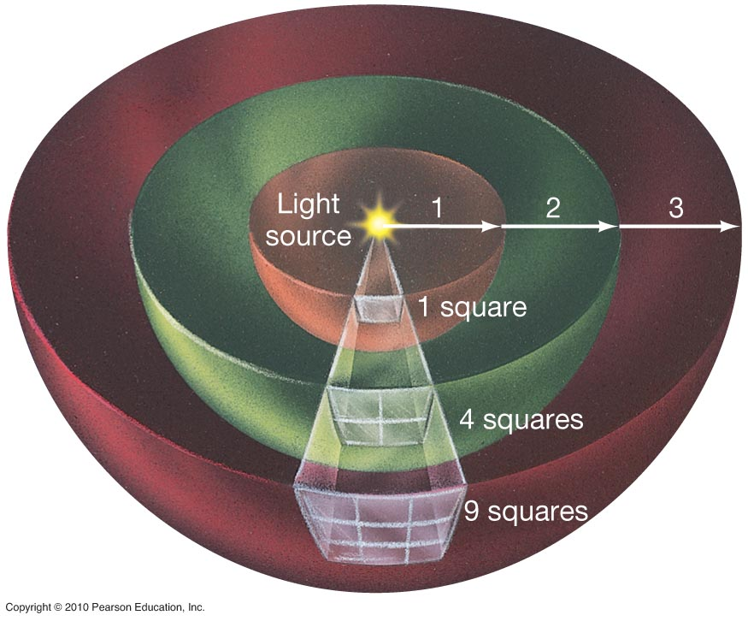
Brightness and distance
As light moves away from a star (or light bulb) its energy is spread out over a larger area. That area is proportional to d². So if you move twice as far away from a star, it will look 4 times fainter.

Slide 41
Example: The brightness of sunlight at the Earth is 1400 watts/meter². What is the brightness of sunlight at Saturn, 10 AU from the Sun?

Slide 42
Example: The brightness of sunlight at the Earth is 1400 watts/meter². What is the brightness of sunlight at Saturn, 10 AU from the Sun?
Saturn is 10 times farther away from the Sun than the Earth, so sunlight is 1/10² = 1/100 times brighter.
The brightness of sunlight on Saturn is 1400/100 = 14 watts/meter². This is why the outer planets are cold!

Slide 43
A few more examples:
What is the brightness of the sun at 40 A.U. if it is 1400 watts/m² at 1 A.U?

Slide 44
A few more examples:
What is the brightness of the sun at 40 A.U. if it is 1400 watt/m² at 1 A.U?
How about at 100 A.U.?

Slide 45
Galaxies outside our local group of galaxies are moving away from us, because the universe is expanding! Their speed increases with their distance from us according to the Hubble law:
v = H × d
v = velocity in km/s
d = distance in megaparsecs
(1 Mpc = 3.26 x 10⁶ light years)
The Hubble constant: H = 70 km/s/Mpc

Slide 46
Hubble’s Law
v = H × d is called the Hubble Law and H is the Hubble constant.
To determine it, we need to measure the velocity of many many galaxies, and their distances
Velocities are easy, from the Doppler shift
Distances are harder: we use Cepheid variable stars and other methods

Slide 47
Hubble’s Law
v = H × d, H = 70 km/s/Mpc
Let’s do a few examples.
A galaxy is 100 Mpc away. How fast is it moving away from us?
  v = H × d = 70 × 100 = 7000 km/s
A galaxy is 2000 Mpc away. How fast is it moving away from us?
    v = H × d = 70 × 2000 = 140,000 km/s

Slide 48
Hubble’s Law
v = H × d, H = 70 km/s/Mpc
Let’s do a few examples.
A galaxy is moving at 700 km/s away from us. How far away is it?
    d = v/H = 700/70 = 10 Mpc
A galaxy is moving at 21,000 km/s away from us. How far away is it?
    d = v/H = 21,000/70 = 300 Mpc

