Slide 1
Announcements
Today: Chapter 18, Life in the Universe
Wednesday: review for final exam
Quizzes
  Quiz 13 on Chapter 17 due tonight, last regular quiz
  Extra credit quiz with math problems, now through May 12
  Extra credit quiz on Ch 18 now through May 12
Extra credit research paper due Wednesday
Problem sets are due Monday May 12
  Best 12 count for final grade (10% of grade)
Final exam Monday May 12, 10 am

Slide 2
Astronomy 103
Life in the Universe
Please read chapter 18

Slide 3
Is there life in the Galaxy?
Liquid water may exist on Europa, used to exist on Mars…
And Kepler now tells us that planets are common
Amino acids are available in the interstellar medium
So the ingredients for life seem common.
What is the likelihood that life will develop?
And how do we detect it?

Slide 4
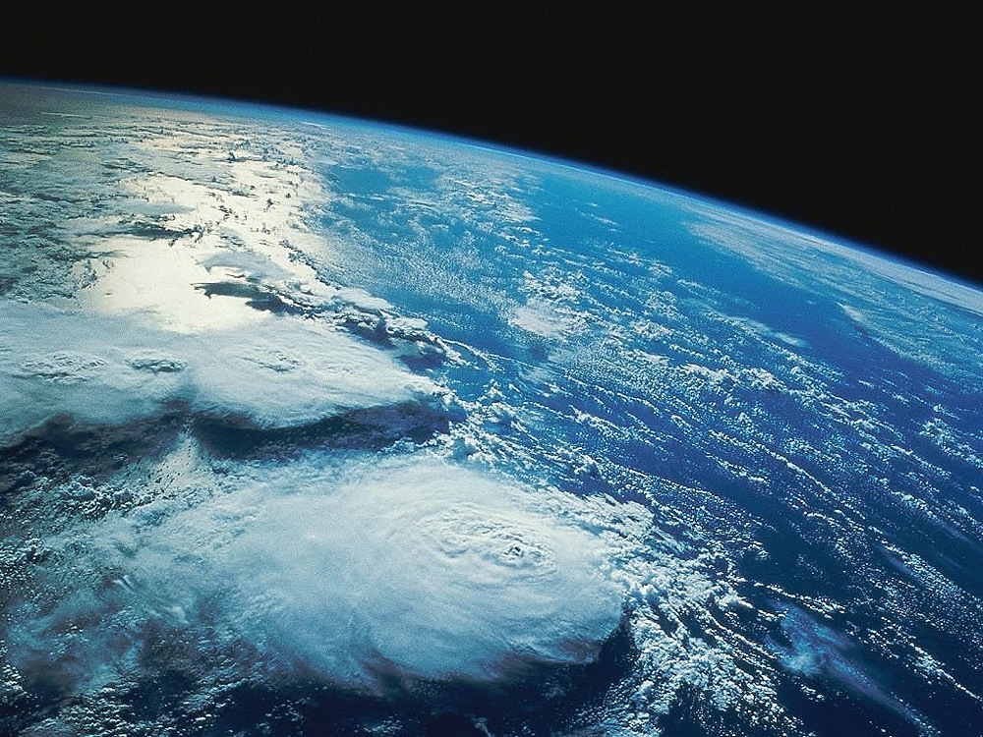
How do we detect life?
To detect life, we have to understand how life interacts with its environment – the presence of life may affect a planet in ways we could detect

Slide 5
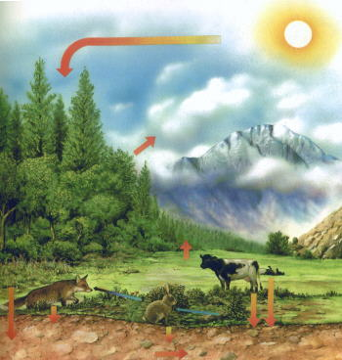
One Example: Carbon Cycle
One example of how life on Earth interacts with the environment is the carbon cycle: the movement of carbon as it’s reused and recycled throughout Earth’s biosphere
Plants take sunlight and consume carbon dioxide (CO₂) while animals eat the plants and release CO₂
The cycle maintains levels of CO₂

Slide 6
The Carbon Cycle
The full carbon cycle is much more complicated
Not just plants and animals
  Volcanoes produce CO₂
  Carbon is trapped in rocks and released through weathering
  Weathering on rocks is aided by plants such as lichen
  Carbon enters the oceans from the atmosphere and through rivers
  Sea life uses carbon in shells
And a later effect: carbon stored in coal, petroleum, natural gas released by human burning of fossil fuels, significantly increasing CO₂ in atmosphere
Life is a key part of the carbon cycle

Slide 7
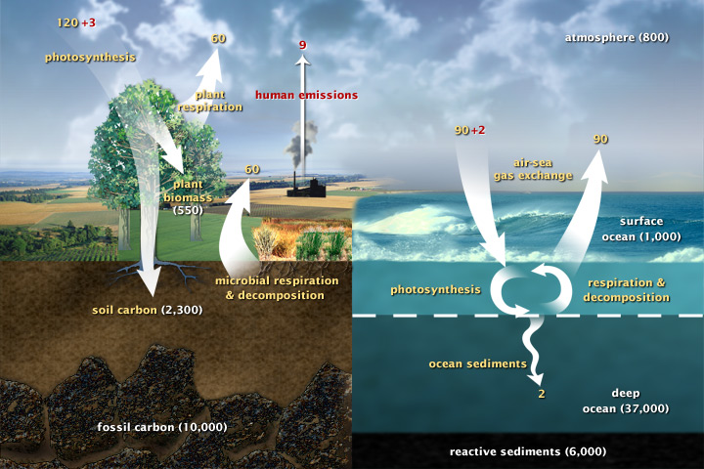
Carbon Cycle

Slide 8
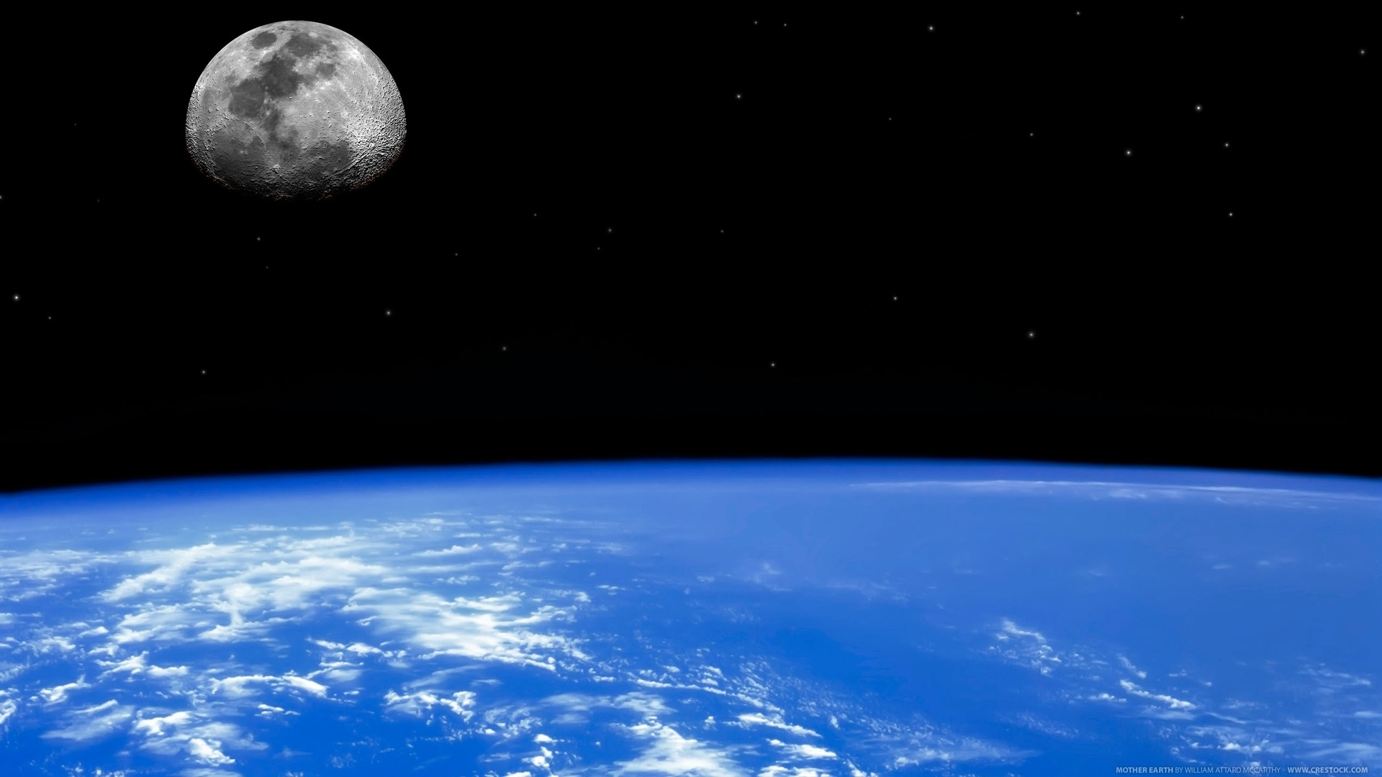
How can we use this to look for life?
Life alters the environment: look for planets with lots of oxygen and planets that show lots of photosynthesis

Slide 9
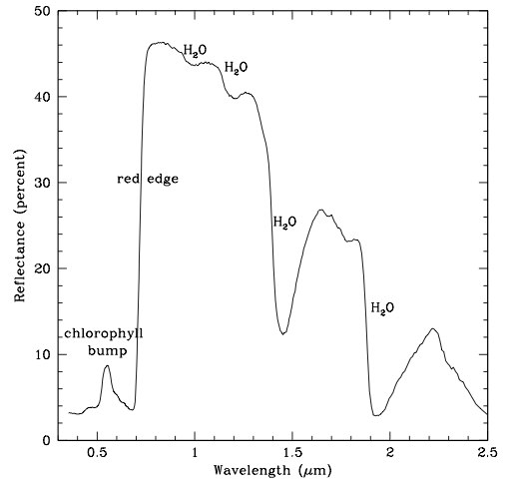
Photosynthesis and the red edge
Plants on Earth are optimized to absorb sunlight – they absorb most visible light
So the reflected light from Earth in the visible wavelength range has a ``red edge’’ inside of which plants absorb all the light

Slide 10
Looking for Life
We can test this by looking at the Earth – we can see light from Earth by looking at the reflected light from the Moon.
water +
plants
just water
Measurements show the detection of a red edge for Earth’s reflection, but not yet possible for other planets.

Slide 11
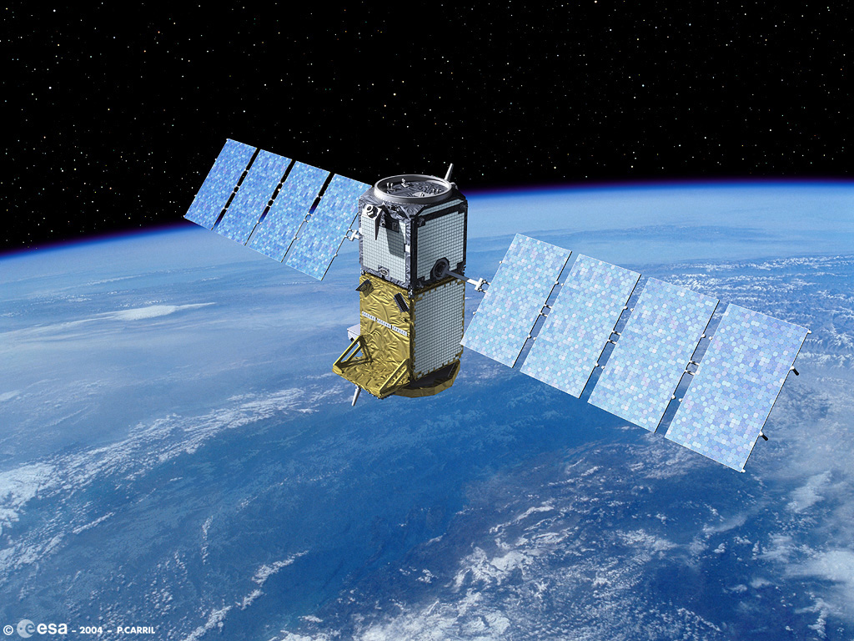

Intelligent Life in the Galaxy
Life may develop elsewhere, but we really want to know…
  Is that life is intelligent?
  And able to communicate?

Slide 12
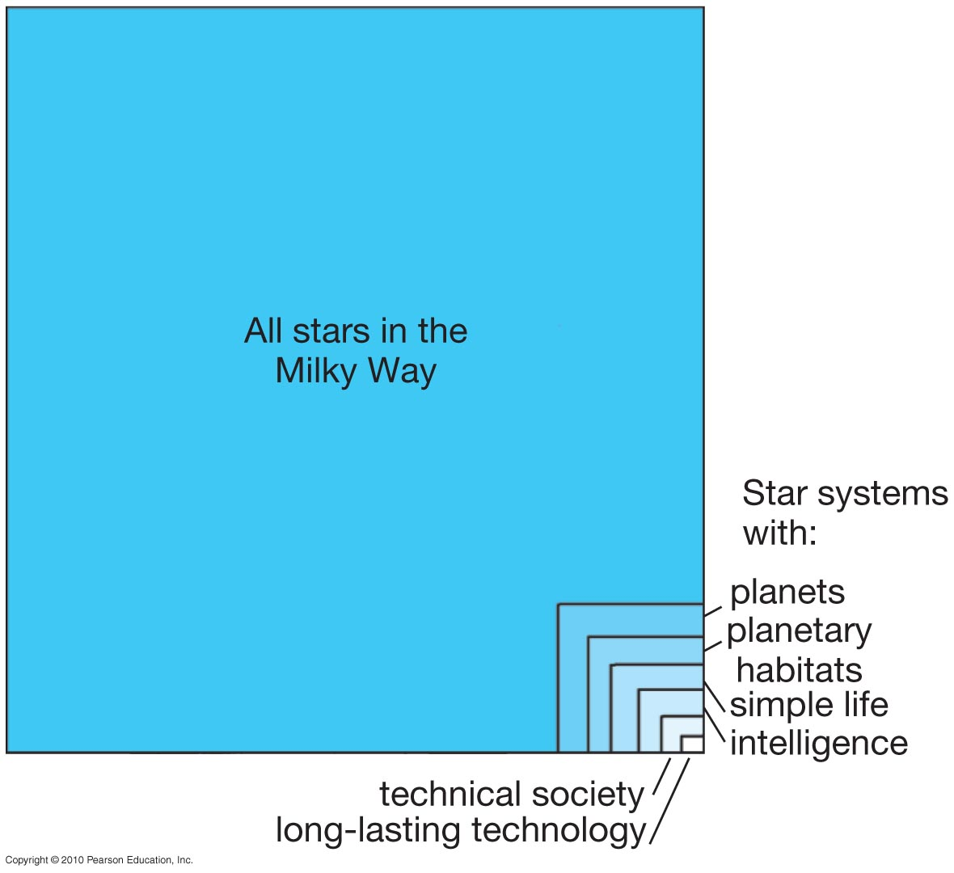
The Drake Equation
The Drake equation gives us a good way to think about this – lets us break a complicated question into lots of smaller (but still difficult!) questions

Slide 13
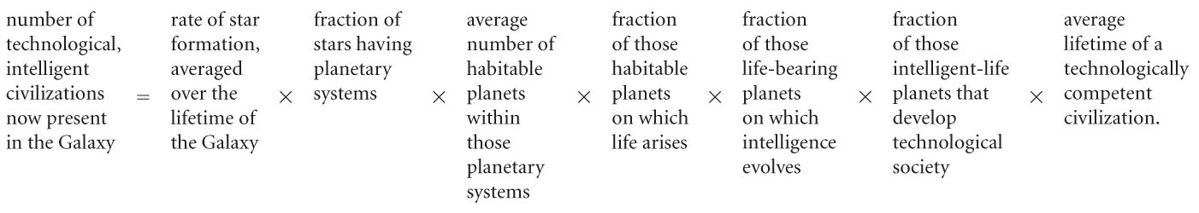
The Drake Equation

Slide 14
The Drake Equation
First: the rate of star formation: estimate 10 stars per year (dividing population of Milky Way by its present age)
Second: Fraction of stars having planetary systems.
Our model for the formation of the solar system suggests that planetary formation is a part of star formation, and Kepler is finding that planets around other stars are common. This fraction is probably high. We’ll guess 1.

Slide 15
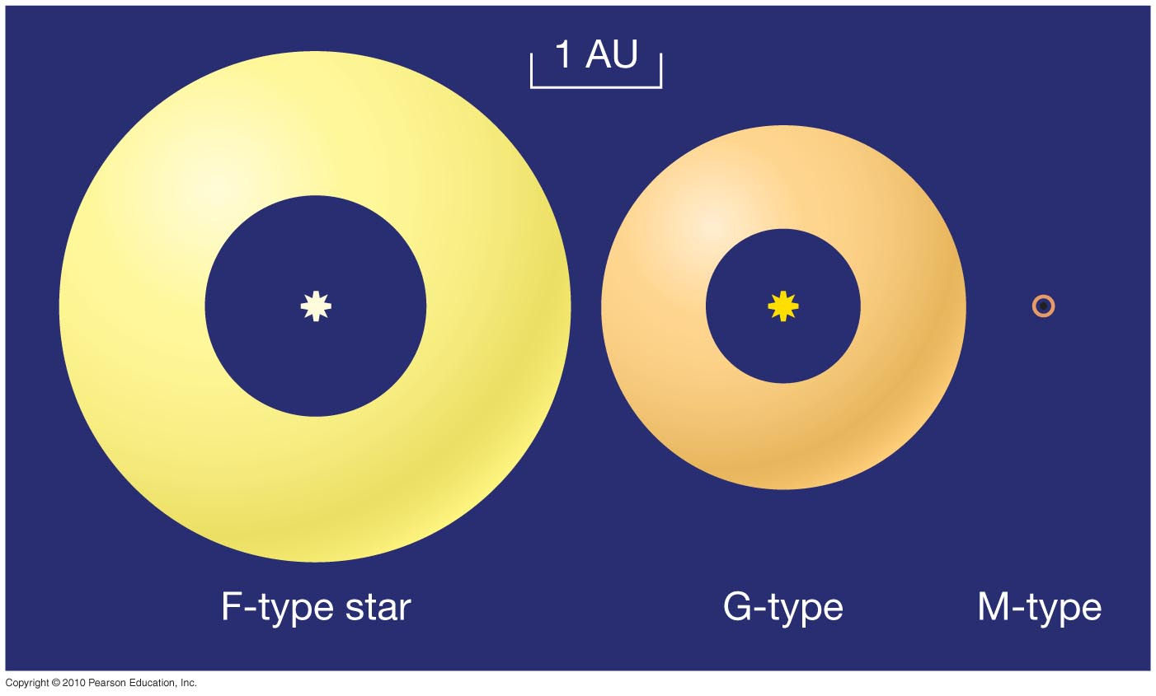
The Drake Equation
Number of habitable planets per planetary system: Probably only significant around A-, F-, G-, and K-type stars. Smaller stars have a too-small habitable zone, and larger stars a too-short lifetime.

Slide 16
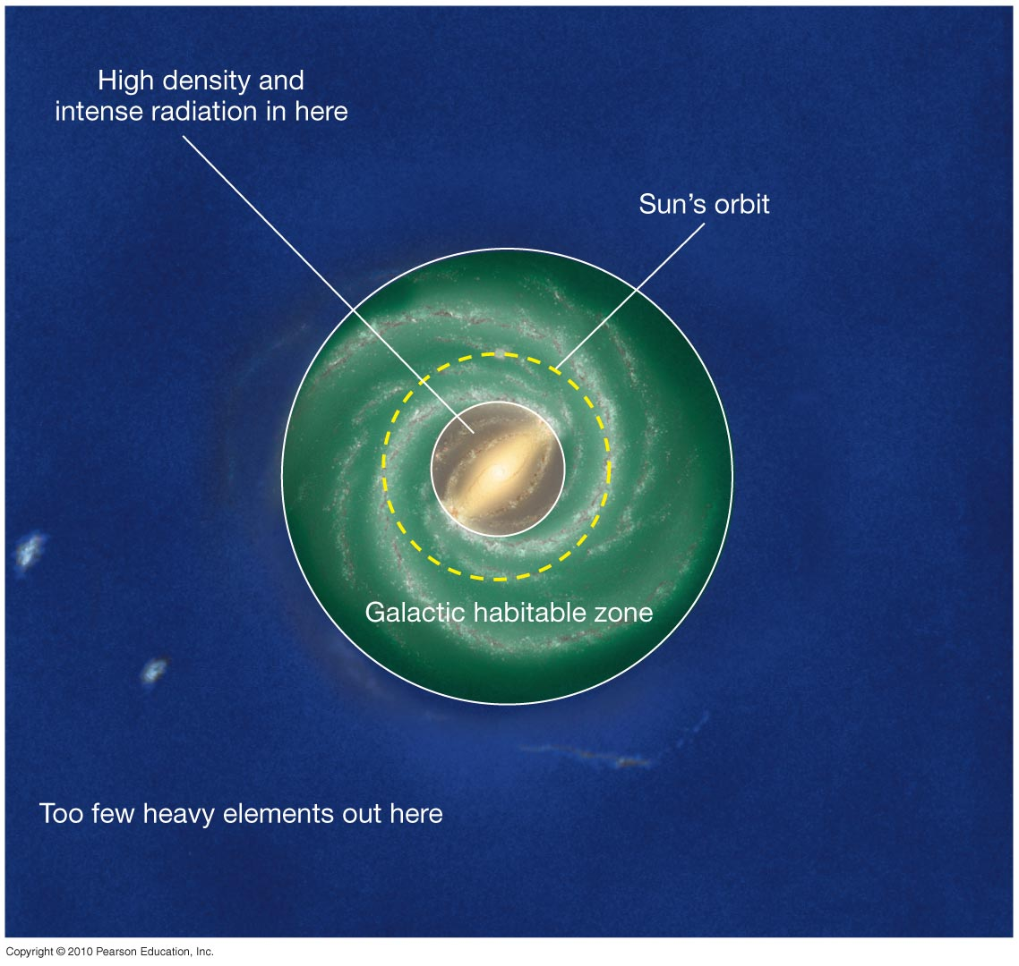
The Drake Equation
In addition, there are galactic habitable zones –
there must not be too much radiation, or too few heavy elements.

Slide 17
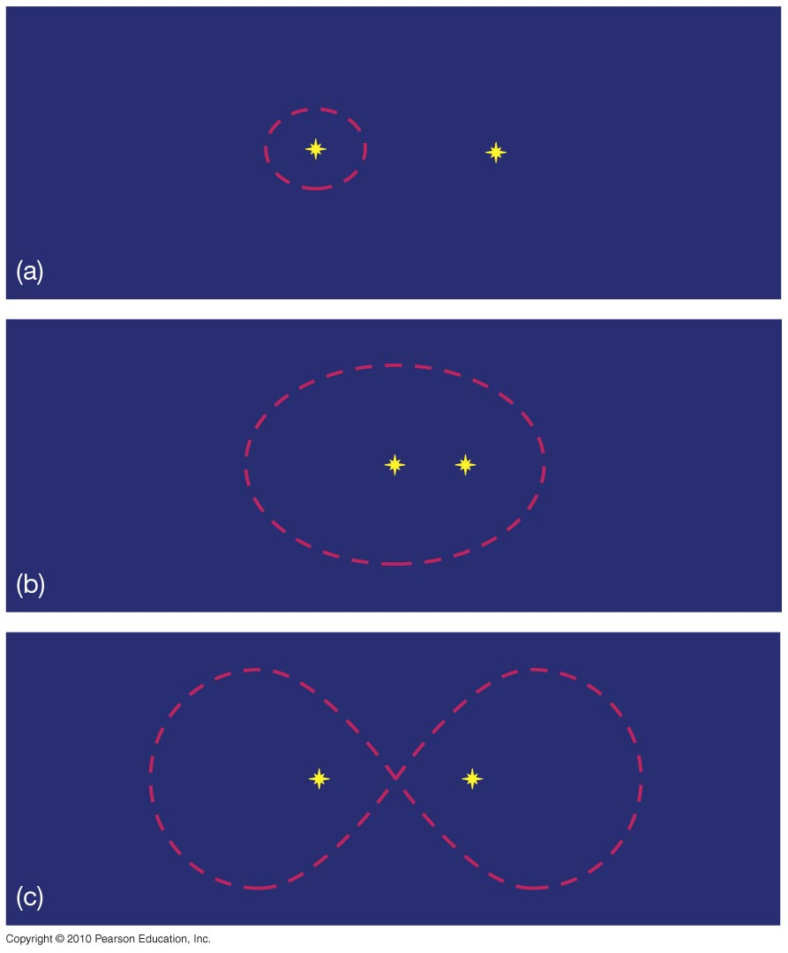
The Drake Equation
Finally, it is very unlikely that a planet in a binary system would have a stable orbit unless it is extremely close to one star, or very far away from both.
Give this factor a value of 1/10: one habitable planet in every 10 planetary systems.

Slide 18
The Drake Equation
Fraction of habitable planets on which life actually arises:
This is harder. Life arose very quickly on Earth, and experiments suggest that this may be quite likely. On the other hand, maybe we’re just lucky, and it might be extremely improbable.
We’ll be optimistic, and give this factor a value of 1.

Slide 19
The Drake Equation
Fraction of life-bearing planets where intelligence arises:
Here we have essentially no facts, just speculation and opinion.
We’ll continue being optimistic, and assign this factor a value of 1.

Slide 20
The Drake Equation
Fraction of planets where intelligent life develops and uses technology:
Again, we have no facts, but it does seem reasonable to assume that intelligent life will develop technology sooner or later.
We’ll give this factor a value of 1 also.

Slide 21
The Drake Equation
A reminder of the first six factors:
The values we’ve assigned to them give
10 x 1 x 1/10 x 1 x 1 x 1 = 1

Slide 22
The Drake Equation
So, according to our estimate:
number of technological, intelligent civilizations now present in the Milky Way Galaxy
average lifetime of a technologically competent civilization, in years
=

Slide 23
The Drake Equation
How long is that?
For the average lifetime of a technological civilization, we can’t even use ourselves as an example – our civilization has been technological for about 100 years, but who knows how long it will last?
Also, we assigned a value of one to several very uncertain factors; even if only one of them is low, the number of expected civilizations drops quickly.

Slide 24
The Drake Equation
If we optimistically suppose that the average lifetime of a technological civilization is 1 million years, there should be a million such civilizations in our Galaxy, spaced about 30 pc, or 100 ly, apart on average.
This means that any two-way communication will take about 200 years (if there is in fact a technological civilization 100 light-years or less away from us).

Slide 25
The Fermi Paradox, or
“Where is everybody?”
If there are indeed many long-lived civilizations, there would have been many more in the past – even a million years is very very short compared to the lifetime of the galaxy
Even if it takes millions of years for these civilizations to spread across the galaxy, they should be here already
Where are they?
This is called the Fermi Paradox

Slide 26
Solutions to the Fermi Paradox
They are already here
Maybe they just haven’t made it to Earth yet
Few civilizations have ever existed
We are the first and alone
  Rare Earth hypothesis: conditions for advanced life to arise are very rare
Intelligent life destroys itself (at least as far as reverting to a non-technological state)
Intelligent life destroys others
  Do civilizations regard other civilizations as a threat?
Life is destroyed by natural events

Slide 27
Solutions to the Fermi Paradox
They are too far away
  It is too hard or expensive to travel between the stars
  It takes too long to communicate
  Civilizations may not exist at the same time
They are avoiding us or don’t care
They are too advanced technologically
Their communications are too alien for us to recognize
We are in a zoo (i.e. the Prime Directive)

Slide 28
Detecting Extraterrestrial Intelligence
How can we find intelligent life in the universe?
  Send space probes
    Slow – fastest space probes will take 76,000 year to the nearest star
    Expensive – lots of stars in the galaxy
  Look for signals
    Cheap – the power costs are minimal
    Fast – nothing travels faster than light
    But where to look?

Slide 29
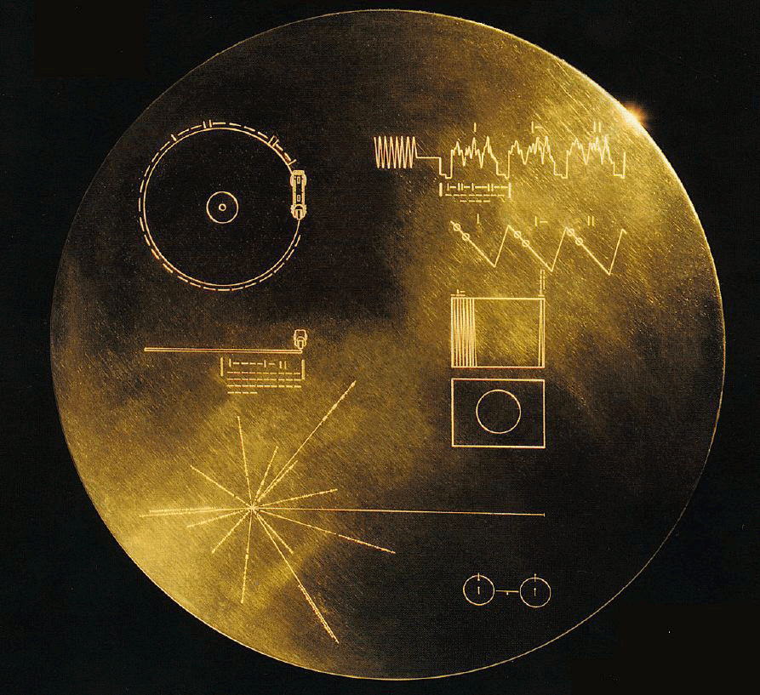
Space Probes
Voyager I will come close to another star in about 40,000 years
It carries a message from Earth called the golden record
But this isn’t really a serious attempt to communicate

Slide 30
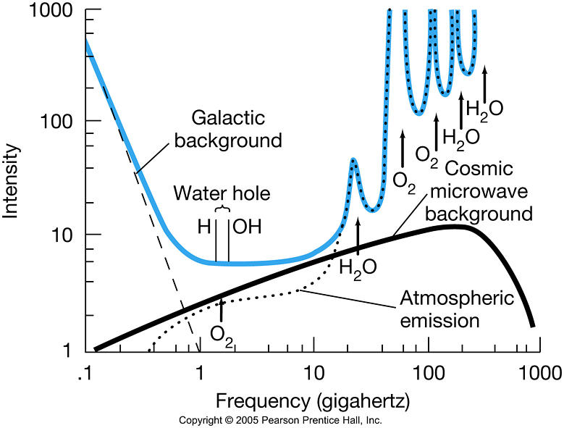
Looking for Signals
Radio is the easiest technology to use
  But what frequency?
There is a range of frequencies between 1420 and 1660 MHz which is especially quiet – “water hole”
H emits in this frequency so it might be a good choice

Slide 31
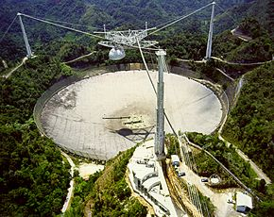
Detecting Extraterrestrial Intelligence
SETI: Search for Extraterrestrial Intelligence
One search is conducted with the Arecibo Observatory
Generates about 35 Gigabytes of data per day

Slide 32
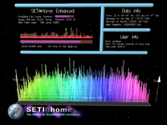
Detecting Extraterrestrial Intelligence
To analyze this data requires a lot of computers.
Solution: Outsource it to volunteers
SETI@home uses computer idle time to process radio data
No conclusive signals yet

Slide 33
Looking for Signals
But the phase of using radio to communicate may be short – even now on Earth we’re moving toward fiber optics, away from undirected radio broadcasts
Maybe alien civilizations don’t use radio anymore
Lasers? Look for optical signals?

Slide 34
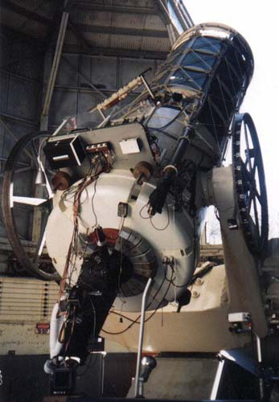
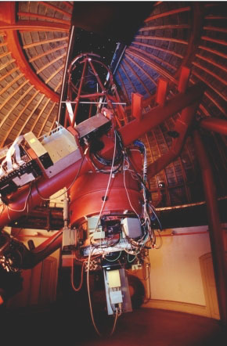
Optical SETI
A few searches underway – piggybacking on other observations

Slide 35
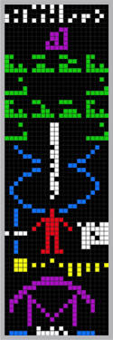
Communicating with ET?
Use universal languages – like mathematics
One example – in 1974, Arecibo sent a message to the globular cluster M13 consisting of 1679 bits
Why 1679? Because 73x23=1679, and 73 and 23 are prime numbers
Arranging the bits as 73x23, you get a picture

Slide 36
Life in the Universe: Summary
Living organisms should be able to react to their environment, grow by taking in nutrients, reproduce, and evolve
Amino acids could have formed in the conditions present on the early Earth, or in space
The necessary ingredients for life may be common

Slide 37
Life in the Universe: Summary
Other places in our solar system that may harbor life are Mars, Europa, and Titan
Planets in the habitable zones around other stars may have liquid water – the Kepler satellite is now finding these
The Drake equation can be used to estimate the total number of intelligent civilizations in our Galaxy, although a number of its factors are extremely uncertain
Even using optimistic assumptions, the next nearest technological civilization is likely to be hundreds of pc away

Slide 38
Life in the Universe: Summary
We have sent probes that will get to interstellar space eventually; they include information about us
We also “leak” radio signals, which to an outside observer would exhibit a 24-hour periodic variation
The “water hole” – a frequency around the hydrogen and OH frequencies – is a good place both to broadcast and to seek messages
We are listening (SETI, the Search for Extraterrestrial Intelligence), but no confirmed signals yet

