Slide 1
Announcements
Today:
  Solar system recap
  The Milky Way – Chapter 14
Stargazing for extra credit tonight, weather permitting
  9 – 10 pm, roof of Physics building
  More info on location and extra credit assignment on D2L (Content -> Handouts -> Stargazing)
  Also April 21, 22, 23, 24: last chance
Quiz 10 due Monday, last quiz on solar system

Slide 2
Solar System: Recap
Solar system consists of Sun and everything orbiting it
Asteroids are rocky, and most orbit between orbits of Mars and Jupiter
Comets are icy, and are believed to have formed early in the solar system’s life
Composition of asteroids and comets tells us about composition of early solar system
Major planets orbit Sun in same sense, and all but Venus rotate in that sense as well
Planetary orbits lie almost in the same plane

Slide 3
Solar System: Recap
Four inner planets – terrestrial planets – are rocky, small, and dense
Four outer planets – Jovian planets – are gaseous and large
Nebular theory of solar system formation: Cloud of gas and dust gradually collapsed under its own gravity, spinning faster as it shrank
Condensation theory says dust grains acted as condensation nuclei, beginning formation of larger objects
The Moon probably formed as a result of a large object colliding with Earth
Jovian planets form beyond snow line

Slide 4
Earth: Recap
Earth’s structure, from inside out: Core, mantle, crust
Can study interior by studying seismic waves
Crust is made of plates that move independently
Movement at plate boundaries can cause earthquakes, volcanic activity, mountain ranges, and rifts
Atmosphere is mostly nitrogen and oxygen; thins rapidly with increasing altitude
Greenhouse effect keeps Earth warmer than it would otherwise be
Earth’s magnetic field traps charged particles from solar wind

Slide 5
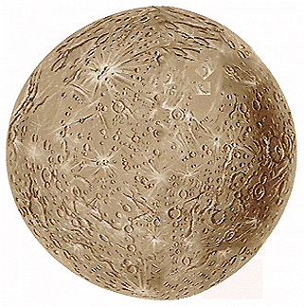
Terrestrial Planets: Recap
Mercury has no atmosphere; Venus has a very dense atmosphere; the atmosphere of Mars is very thin, mostly carbon dioxide
Mercury has large temperature variations because it has no atmosphere
Mercury is heavily cratered, has extensive intercrater plains and scarps (cliffs caused by cooling, shrinking of planet)
Mercury

Slide 6
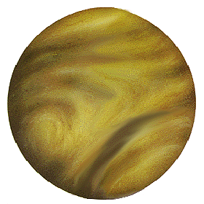
Terrestrial Planets: Recap
Venus never appears very far from the Sun, and is the brightest object in the sky (after the Sun and Moon)
It has many lava domes and shield volcanoes, and has indirect evidence for active volcanism
Venus is comparable to Earth in mass and radius
Large amount of carbon dioxide in atmosphere, and closeness to the Sun, led to runaway greenhouse effect and very hot surface
Venus

Slide 7
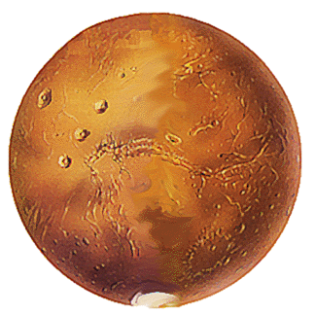
Terrestrial Planets: Recap
Mars: smaller and lower mass than Earth
Extinct volcanoes, and largest volcano in the solar system (due to low gravity)
Strong evidence for water on Mars in the past
Mars

Slide 8
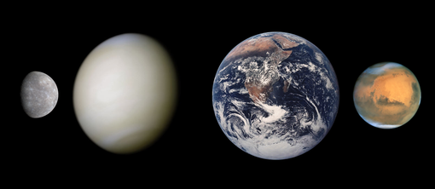
Terrestrial Planets: Recap
Mercury has very weak, remnant magnetic field
Venus has none, probably because of very slow rotation
Neither Venus nor Mars show signs of substantial tectonic activity

Slide 9
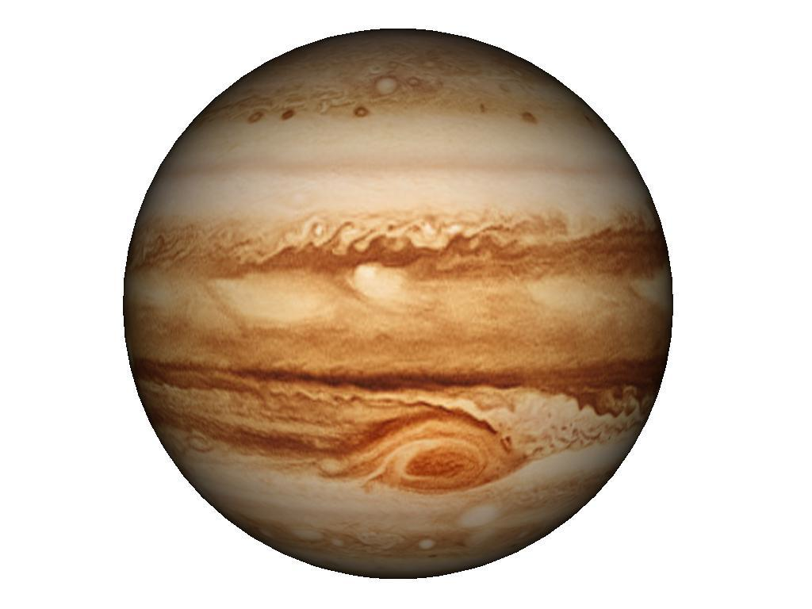
Jovian Planets: Recap
Jupiter and Saturn were known to the ancients; Uranus was discovered by chance, and Neptune was predicted from anomalies in the orbit of Uranus
Jovian planets are large but not dense; they are fluid and display differential rotation
Cloud layers have light zones and dark bands; wind pattern, called zonal flow, is stable
Jupiter

Slide 10
Jovian Planets: Recap
Storms appear with regularity; the Great Red Spot of Jupiter has lasted for hundreds of years (that we know of)
Due to conductive interiors and rapid rotation, Jovian planets have large magnetic fields
Jupiter, Saturn, and Neptune radiate more energy than they receive from the Sun
  Jupiter is still cooling
  Saturn is heated by energy released by helium rain
  Neptune may be insulated by methane – source of heat still uncertain

Slide 11
Jovian Planets: Recap
Galilean moons of Jupiter:
  Io, Europa, Ganymede, Callisto
  Io: most volcanically active body in solar system, heated by tidal forces from Jupiter and Europa
  Europa: surface of cracked ice, liquid ocean underneath. Perhaps most promising place to find life outside Earth?

Slide 12
Jovian Planets: Recap
Moons of Saturn
  Titan: Largest moon of Saturn, only other body in solar system with stable liquid on surface – lakes of liquid methane and ethane
  Enceladus: recently discovered ocean below surface. Another good place to look for life?
Kuiper belt: many icy bodies beyond orbit of Neptune. Eris, Pluto the largest

Slide 13
Extrasolar planets: Recap
Planets have been discovered in other solar systems
The first to be found are large and orbit much closer to the Sun than the large planets in our solar system do – radial velocity method is most sensitive to planets like this
The Kepler satellite is now finding Earth-mass planets, some in habitable zone
Earth-mass planets are probably common

Slide 14
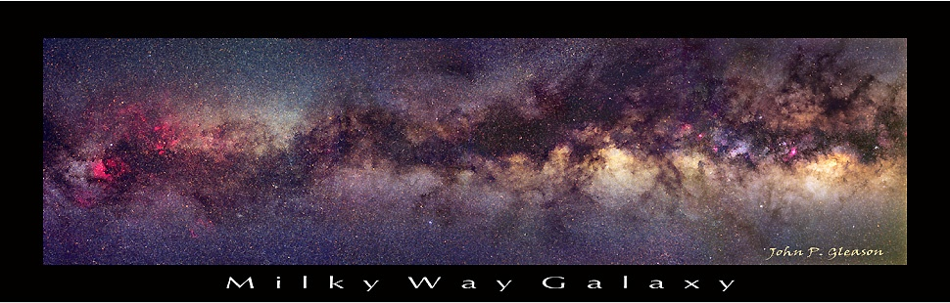
Astronomy 103
Our Galaxy
Please read Chapter 14

Slide 15
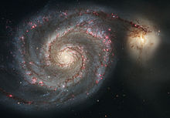
A galaxy is a huge collection of stars that is isolated in space and held together by gravity.
We happen to live in one called the Milky Way Galaxy or just the Galaxy (with a capital ``G’’)
The structure of the Galaxy looks like this:
Disk
Bulge
Spiral Arms
This is a picture of the Whirlpool galaxy – not the Milky Way

Slide 16
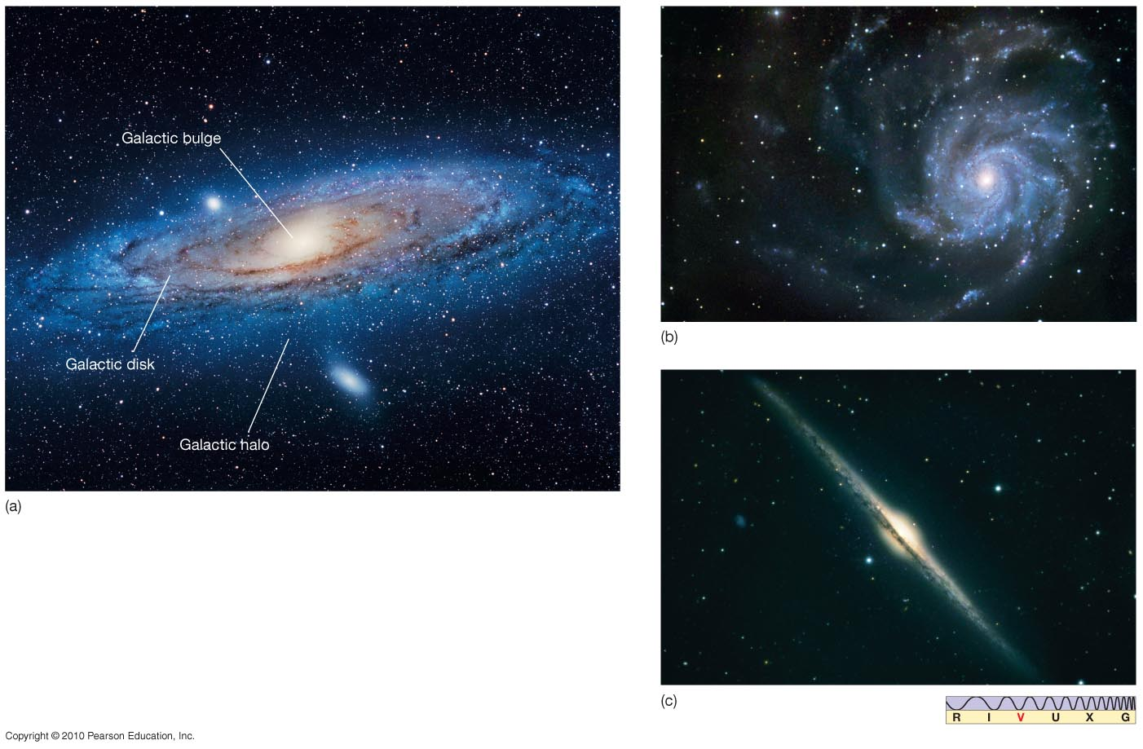
The Milky Way
Our Galaxy is a spiral galaxy. Here are three similar galaxies.

Slide 17

How do we know that the Galaxy looks like this?
Count the number of stars in different directions
William Herschel first did this in 1756 and discovered that the galaxy looks like a disk
Note that the Sun is in the center of the disk
This is not right! Sun is not at the center, and Herschel didn’t know that most of the light is blocked by dust, especially toward center of Galaxy

Slide 18
The new distance ladder
William Herschel didn’t have a way to measure distances to stars, so he just assumed that the stars are uniformly distributed
The real revolution in the study of our Galaxy (and other galaxies) came from building up the next rung of the distance ladder with the use of variable stars
Recall that the distance ladder is our collection of methods for measuring distances to astronomical objects: ladder because each step builds on the one before

Slide 19
Review of the distance ladder
1) Radar ranging to find distances to nearest planets and the AU.
2) Parallax for distances to the closest stars. The Hipparcos satellite extends the range of parallax to over 200 pc or about 700 ly, but beyond that, the parallax angle is still too small to be seen.
3) To measure the distance to stars beyond this one can use standard candles, objects whose luminosity is known. That is, if you know the luminosity of a candle, or a light bulb or a star, you can find its distance by measuring its brightness: the farther away it is, the smaller its apparent brightness: The energy is spread out over a sphere of area 4πr², with r the distance to the star, giving the relations that we have used:

Slide 20
The first standard candles we encountered were main sequence stars.
The H-R diagram tells you the luminosity of each spectral type of main sequence star.
To find the distance to a main sequence star,
(1) From its spectral type, find its luminosity
(2) From its luminosity and its apparent brightness find its distance
Using main sequence stars as standard candles (spectroscopic parallax), one can find distances to stars anywhere one can see them in our galaxy, more than 30,000 ly or 10,000 pc away

Slide 21
A second standard candle: Variable stars
All stars oscillate. Oscillations are long sound waves, and the oscillation time is the time it takes sound to cross the star. Large stars, like large bells, oscillate more slowly than small stars. Late in their evolution, bright stars have, for a short time, unusually large oscillations.
Stars that take between 1-100 days to pulsate are call Cepheids. Stars that take less than 1 day are call RR Lyrae stars. Stars that take longer than 100 days are called Mira variables.

Slide 22
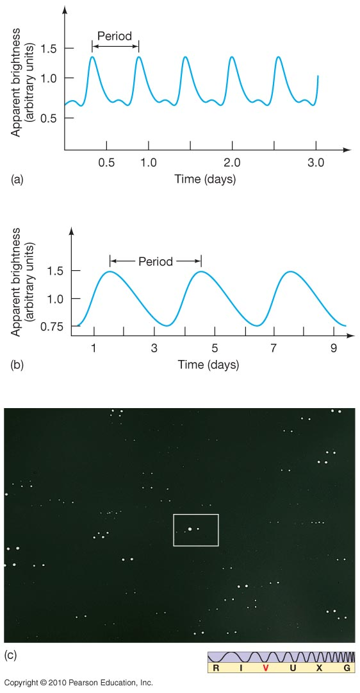
Variable Stars
The upper plot is an RR Lyrae star. All such stars have essentially the same luminosity curve, with periods from 0.5 to 1 day.
The lower plot is a Cepheid variable; Cepheid periods range from about 1 to 100 days.

Slide 23
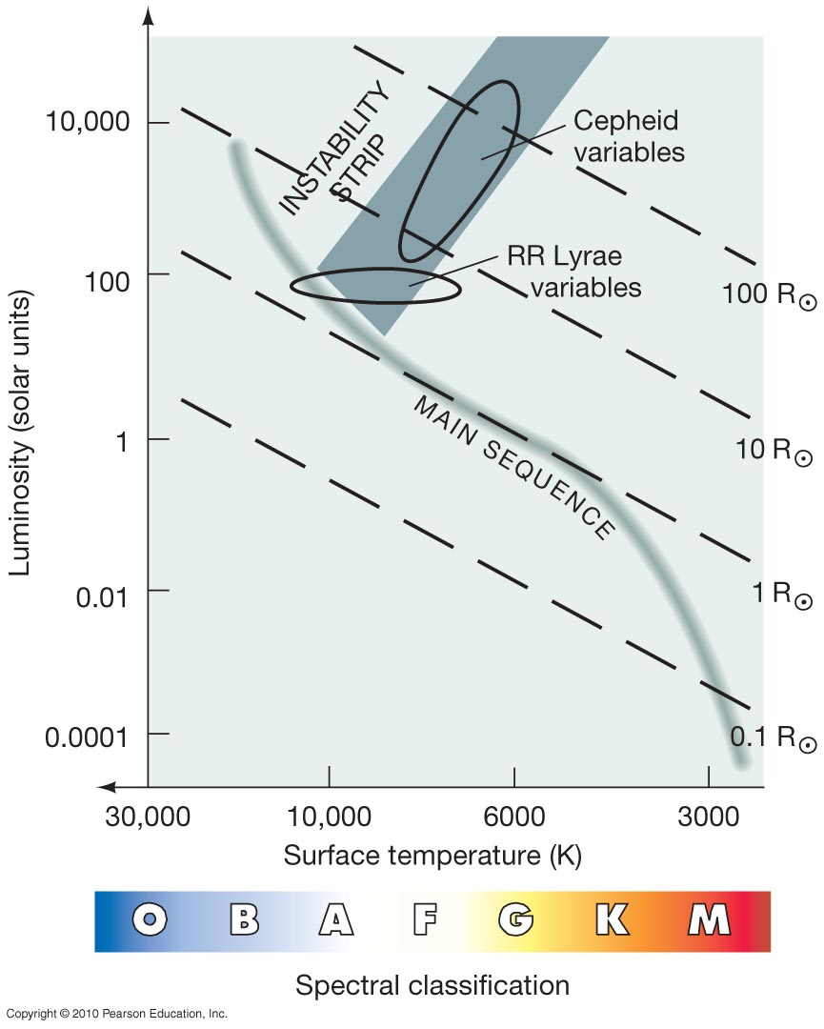
Variable Stars
This is a phase late in the evolution of stars, after they have left the main sequence.
The variability of these stars comes from a dynamic balance between gravity and pressure – they have large oscillations around stability.

Slide 24
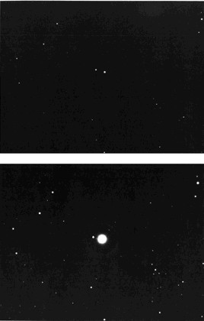
Variable Stars
Late in a star’s evolution, its oscillations can become unstable, growing enormously, and greatly changing the brightness of the star each oscillation
The larger a star is, the longer its period of oscillation
Τhe variable star Mira at its dimmest and brightest

Slide 25
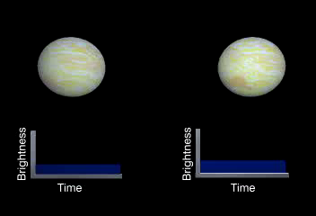
Cepheid Variables

Slide 26
Leavitt's period-luminosity relation
Because large stars are brighter than small stars, there should be a relation between the period and luminosity of oscillating stars: Stars with longer periods should be larger and brighter than stars with shorter periods.
The larger a star is, the longer its period of oscillation.
Henrietta Leavitt showed that this was true for Cepheid variables, looking at a set of variable stars in the Magellanic clouds in order to see stars at the same distance.
Henrietta Leavitt discovered the period-luminosity relation for Cepheids
The relation makes each Cepheid into a standard candle: a light source whose luminosity is known, once the period is measured.

Slide 27
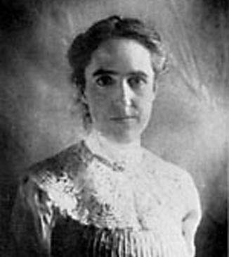
Henrietta Leavitt measured the relation between period and luminosity for variable stars with long periods (1-60 days), called Cepheids

Slide 28
RR Lyrae
Cepheid
Cepheid—two displaced images
taken at different times

Slide 29
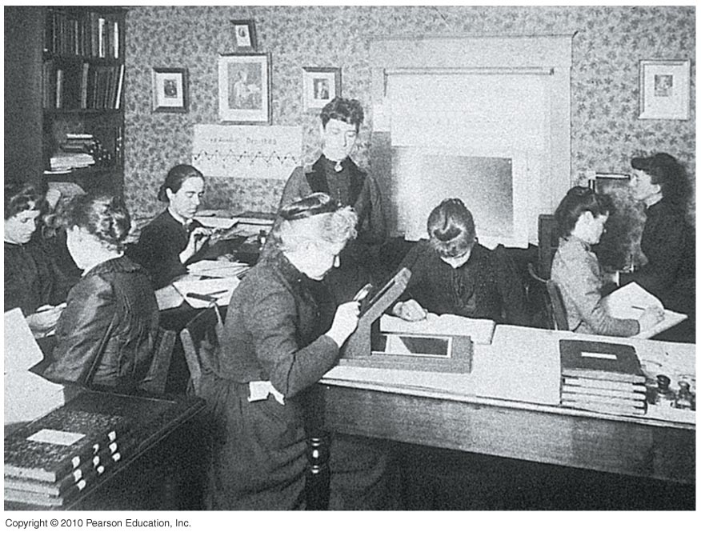
Leavitt was part of a group of women “computers” that looked over many thousands of plates and included Annie Jump Cannon in Harvard College Observatory

Slide 30
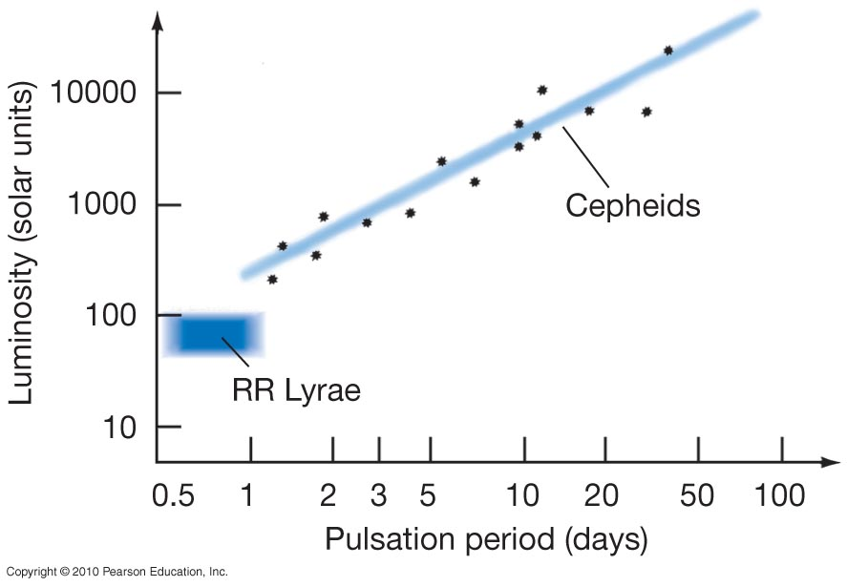
Leavitt’s Period-Luminosity Relation for Cepheid Variable Stars
Cepheids: measure period, get luminosity
RR Lyrae stars all have the same luminosity

Slide 31
As a result:
A Cepheid variable can be used as a standard candle:
1) Find its luminosity by measuring its period
2) Measure its apparent brightness and deduce its distance from the 1/r² formula

Slide 32
Summary of the distance ladder:
- Use radar bouncing to find distances to Mars and Venus and so to find 1 AU
- Knowing 1 AU, use parallax to find the distance
to stars within a few thousand light-years
- Knowing the distance to these stars, find the luminosity of main sequence stars. Using main-sequence stars as standard candles, find the distance to stars throughout our galaxy.
- Knowing the distance to clusters of stars in the galaxy, find the luminosity of Cepheid variables.
Using Cepheid variables as standard candles, find the distance to galaxies outside the Milky Way.

Slide 33
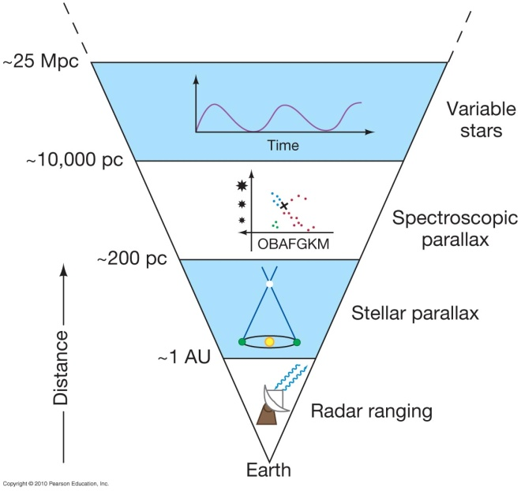

Slide 34
Size of the Milky Way
With variable stars as the standard candle, the size of the Milky Way can now be found
Harlow Shapley in 1917 found the distances to distant globular clusters using these variable stars
By assuming that the most distant globular clusters lie near the outside of the Milky Way, he found the extent of the Milky Way’s halo
And by noting that there are more globular clusters on one side of the sky than the other, he deduced that the Sun is not at the center of the Milky Way (globular clusters lie outside the disk of the galaxy, so they are less obscured by dust) and found the direction to the Galactic Center

Slide 35
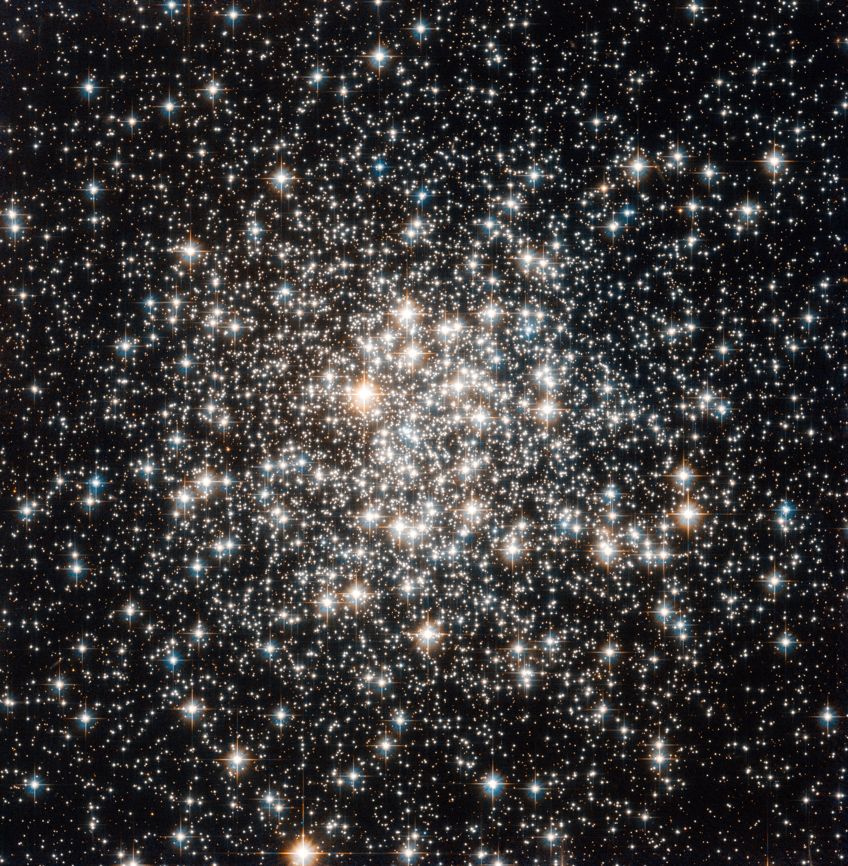
Globular Cluster
M107

Slide 36
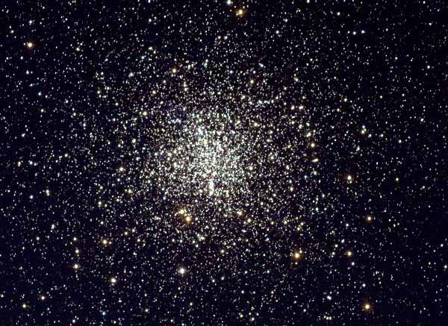
The globular cluster M4

Slide 37
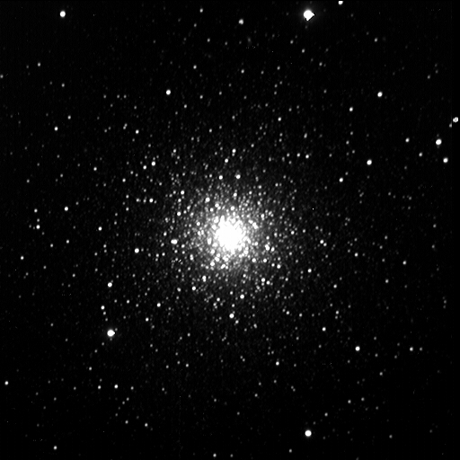
The globular cluster M3

Slide 38
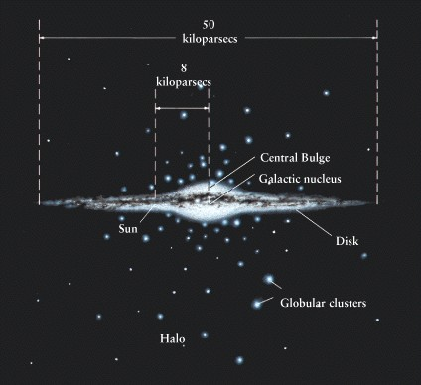
100,000 ly

