Slide 1
Announcements
Today: Galaxies in general
→ read Chapter 15
Tonight, 8-9pm: Stargazing
→ Earn 1 bonus-point on final grade
More bonus point opportunities featuring the Moon on D2L (modifications of the solar eclipse bonus points)
Going on right now: Philae landing on Rosetta
Notes:
<number>

Slide 2
The Hubble Sequence
Edwin Hubble again
1926: proposed galaxy classification
scheme still used today

Slide 3
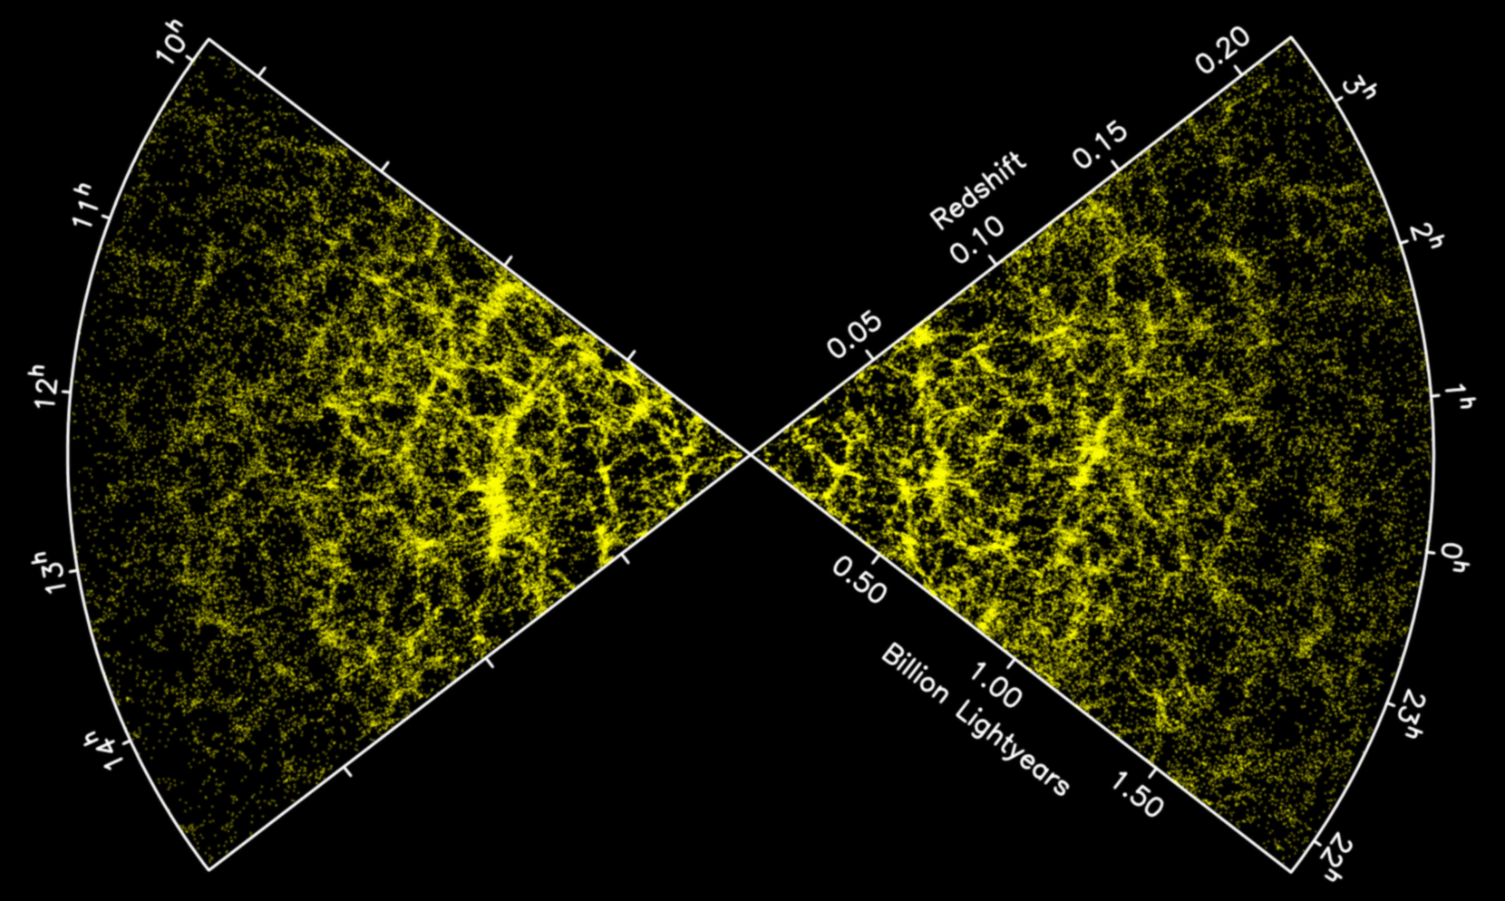
The Distribution of Galaxies in Space
you are here
increasing distance

Slide 4
Collections of Galaxies
Galaxies are not distributed randomly throughout the universe – they are usually found in associations of galaxies called groups and clusters
Groups are smaller associations, with usually less than 50 galaxies
Clusters are larger and can contain thousands of galaxies – galaxy clusters are the most massive gravitationally bound objects in the universe

Slide 5
Galaxy clusters and groups
Galaxy clusters and groups consist of a collection of galaxies orbiting one another, bound together by their own gravity
The Milky Way, Andromeda, and several other smaller galaxies form the Local Group
The nearest large galaxy cluster to the Local Group is the Virgo Cluster
Galaxy clusters themselves tend to clump together into superclusters. The Virgo Cluster, the Local Group, and several other nearby clusters form the Local Supercluster

Slide 6
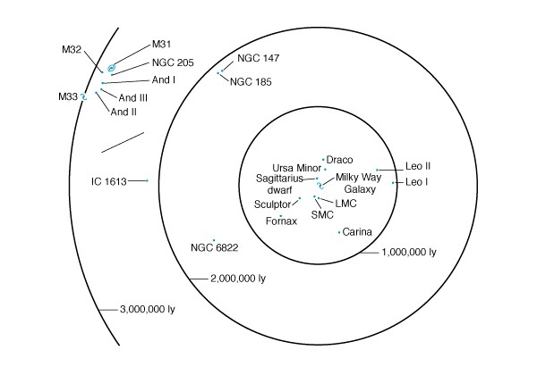
The Milky Way lives in a small group which also contains the Andromeda galaxy and many smaller galaxies. This is called the Local Group. The Milky Way and Andromeda make up about 90% of the mass of the Local Group.
The Local Group,
a small cluster of nearly 50 galaxies that includes the Milky Way

Slide 7
Galaxies in the Local Group are gravitationally bound to each other. The Milky Way and Andromeda are approaching each other, and will collide in billions of years.
The Local Group,
a small cluster of nearly 50 galaxies that includes the Milky Way

Slide 8
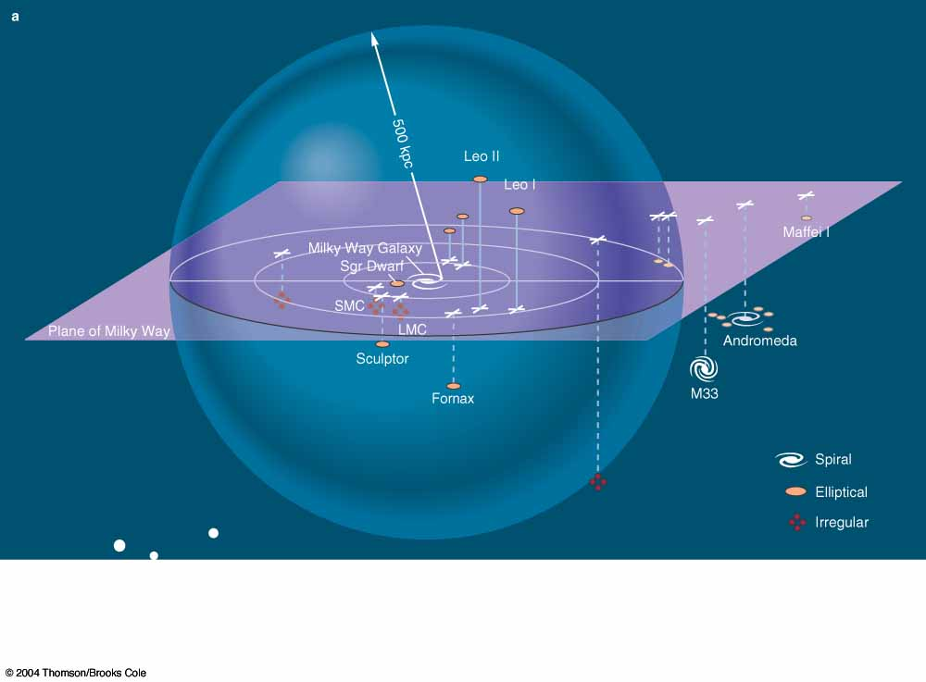
3-D diagram of the Local Group
3-D map of the Local Group

Slide 9
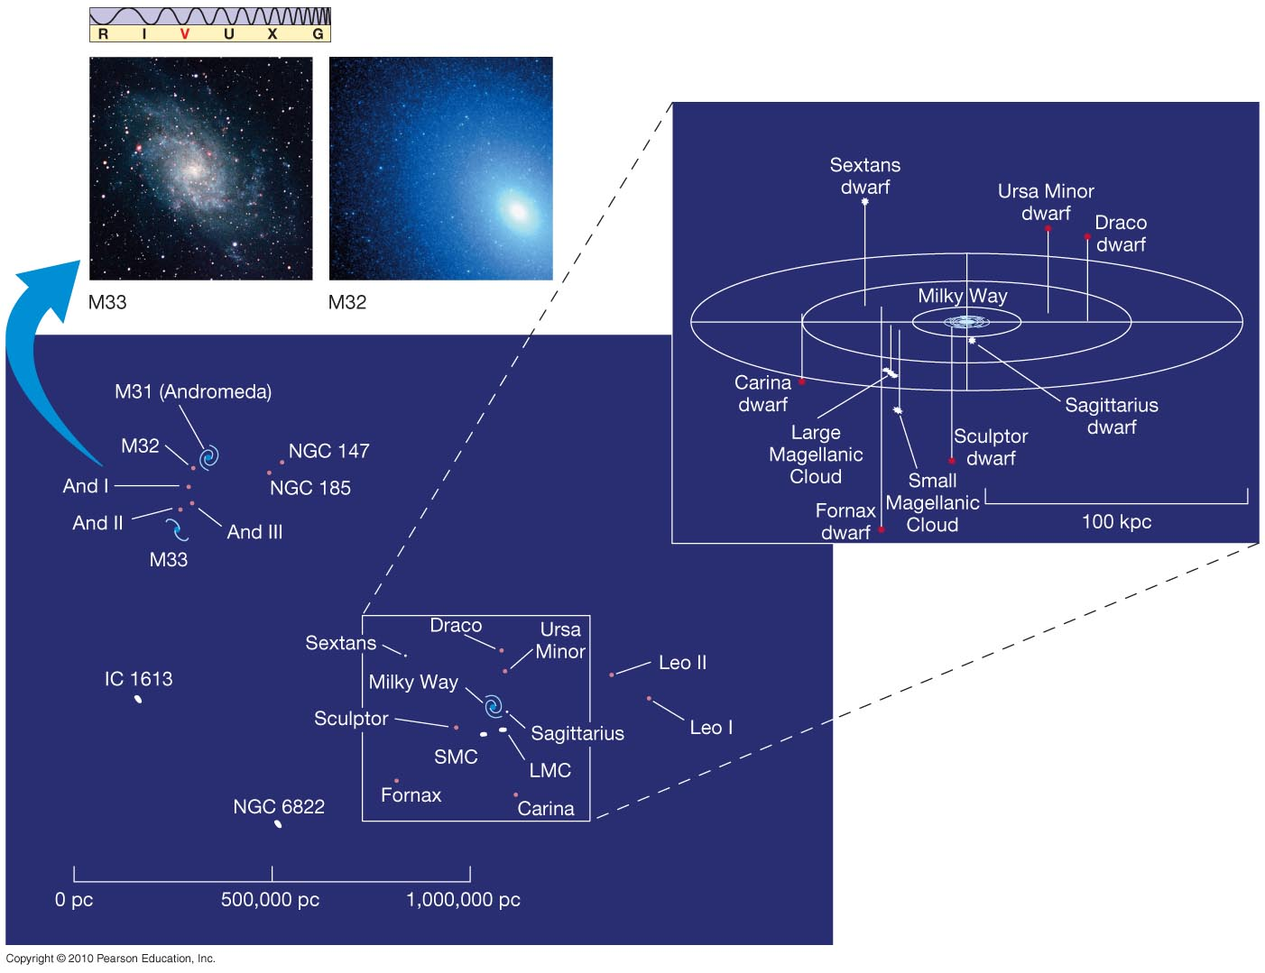
The Distribution of Galaxies
near the Milky Way
Here is the distribution of galaxies within about 1 Mpc of the Milky Way.
Notes:
<number>

Slide 10
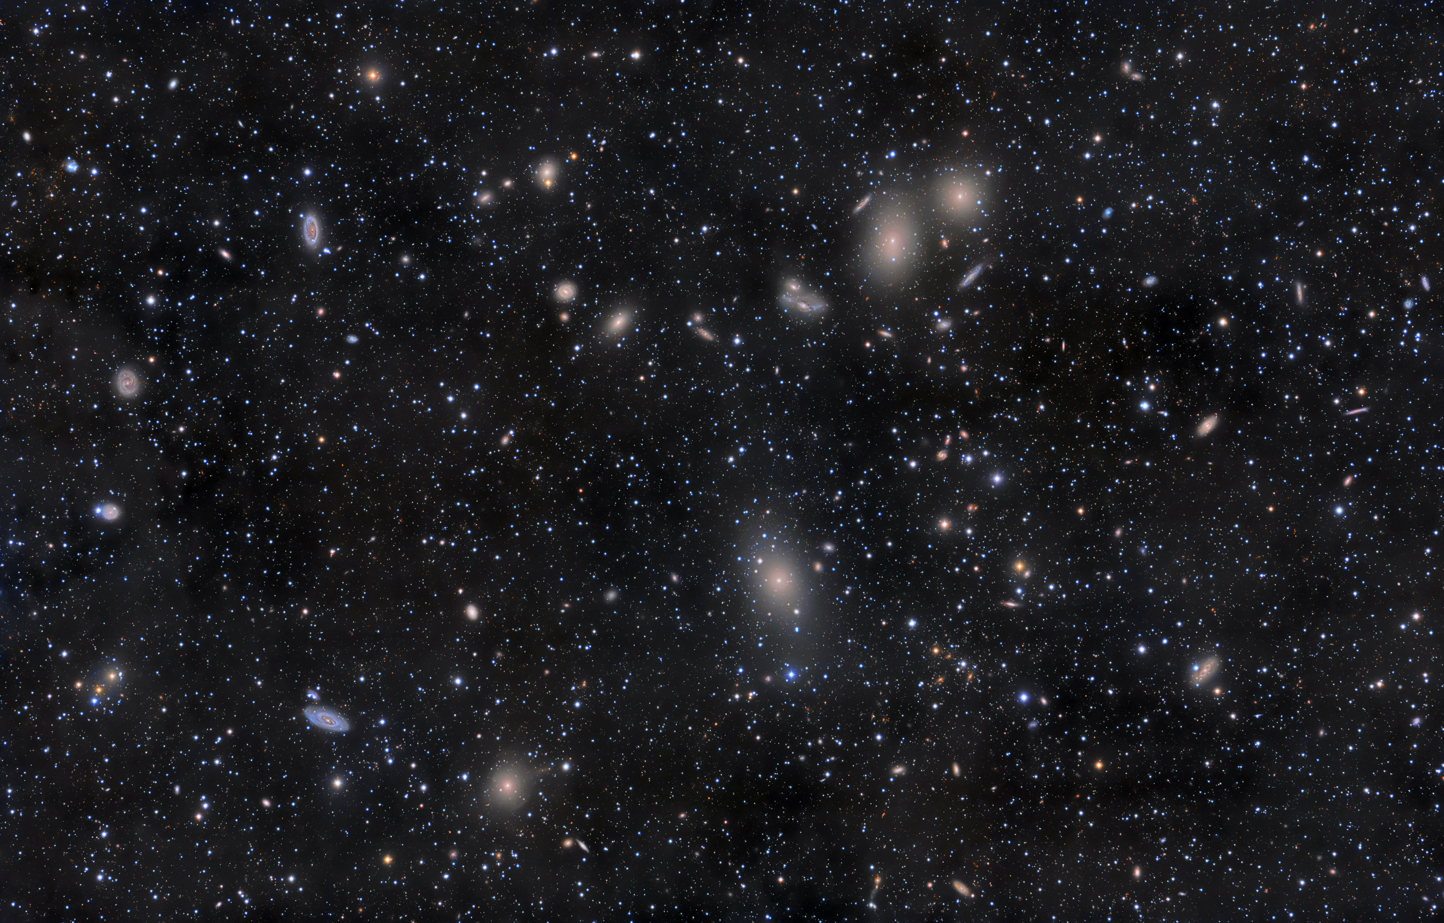
The Virgo Cluster: closest large cluster

Slide 11
Virgo Cluster
Covers about 10 x 10 degrees on the sky (~500 x full moon)!
Contains ~250 large galaxies and >2000 smaller ones
4 brightest galaxies are giant ellipticals, mix of spirals and ellipticals otherwise

Slide 12
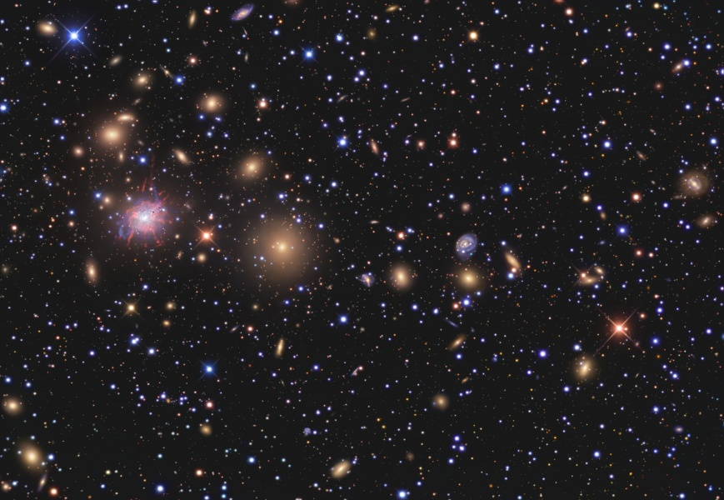
Perseus Cluster

Slide 13
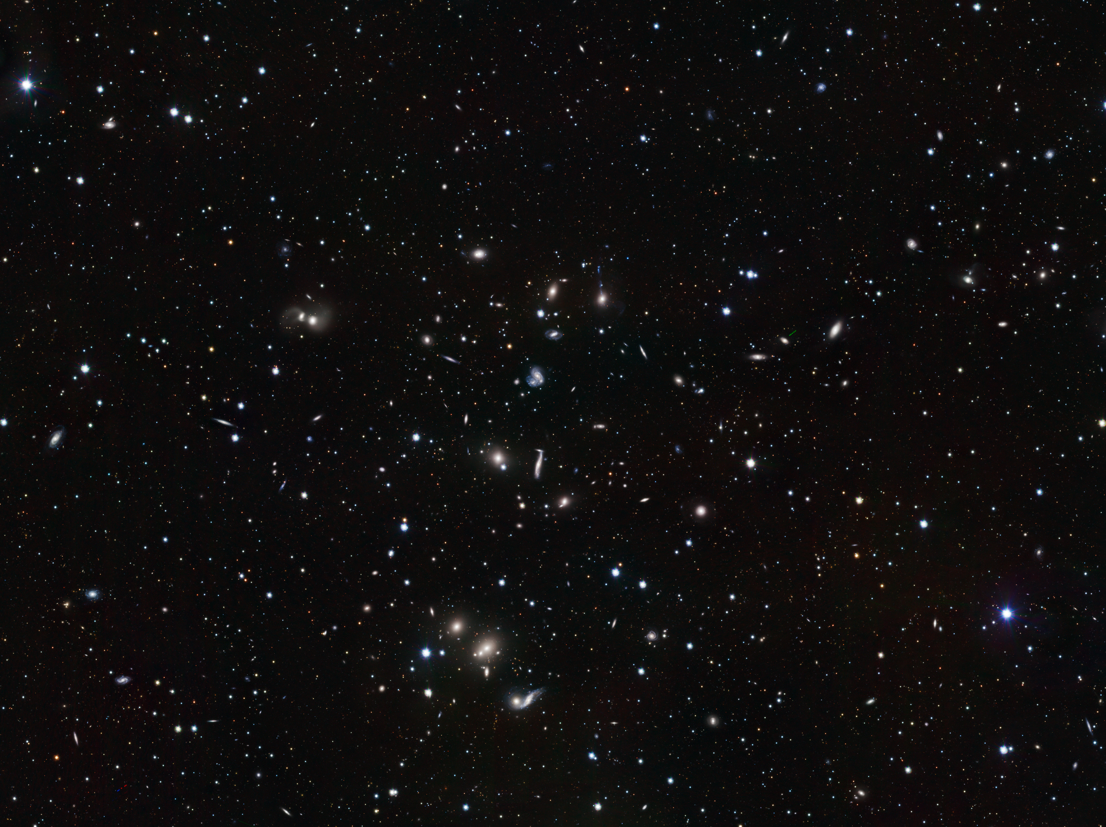
The Hercules Cluster

Slide 14
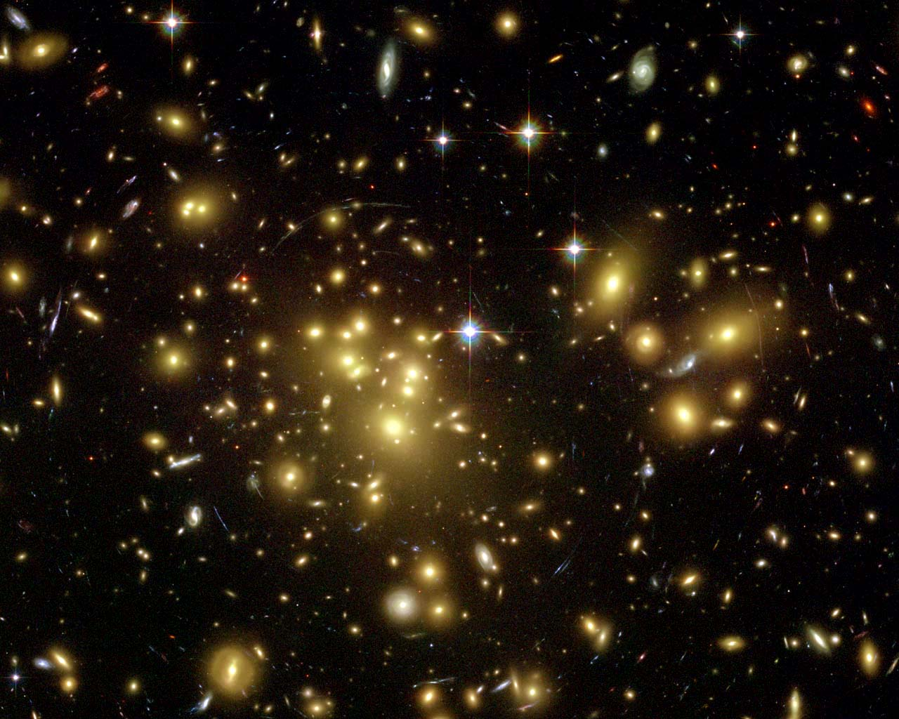
Galaxy cluster Abell 1689

Slide 15
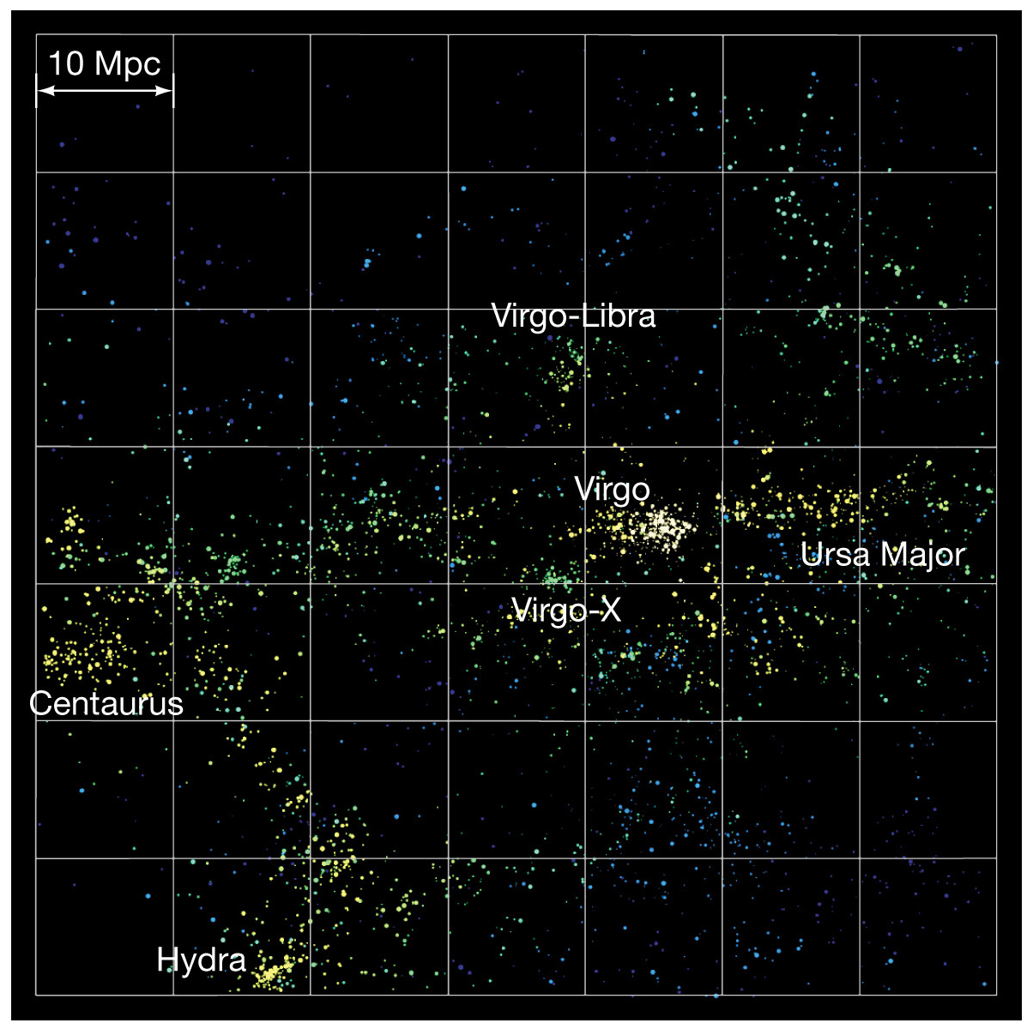
Local Supercluster

Slide 16
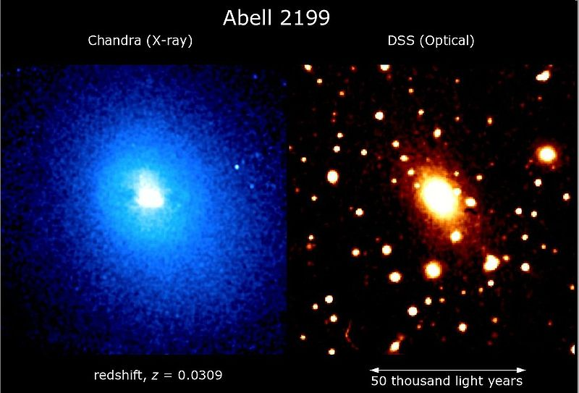
Masses of Galaxy Clusters
Most of the mass of a galaxy cluster is not galaxies!
Lots of very hot gas we see in x-rays: the intracluster medium
Lots of dark matter
First evidence for dark matter came from determining mass of Coma Cluster: more on that later!

Slide 17
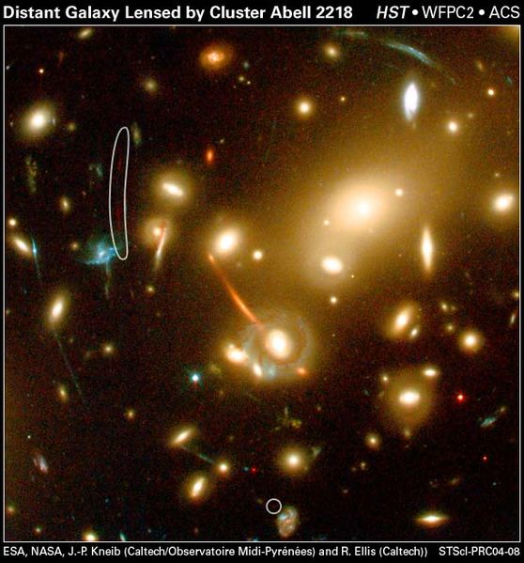
Gravitational Lensing by Clusters
Clusters are so massive that they distort the images of galaxies behind them.
Background galaxies are seen as stretched objects.
Lensed galaxies
Notes:
<number>

Slide 18
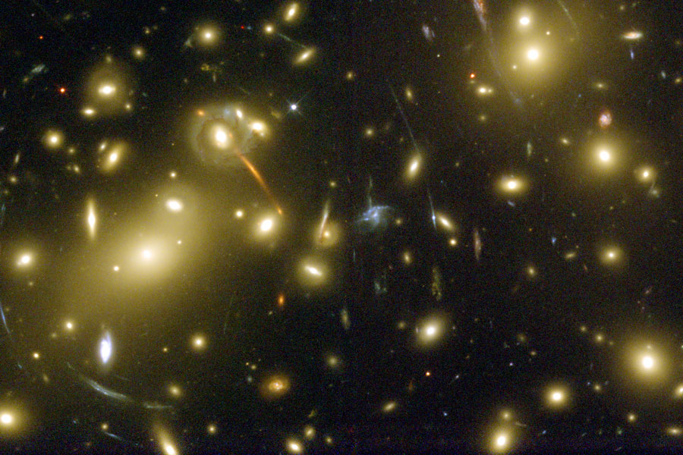
Gravitational Lensing by Abell 2218

Slide 19
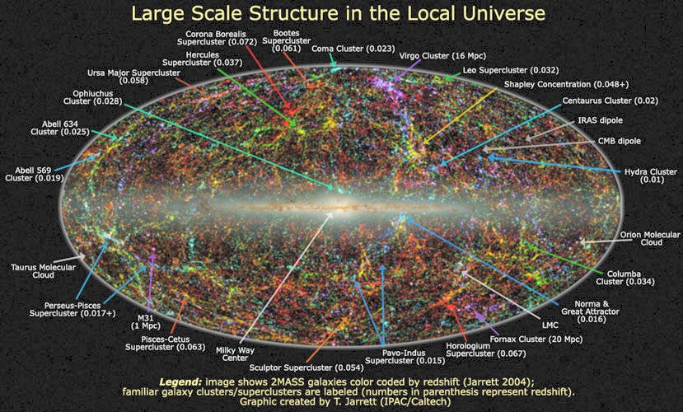

Slide 20
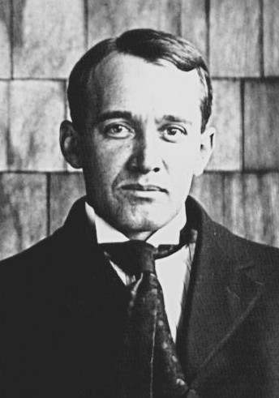
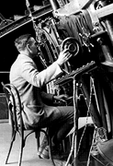
Measuring distances to galaxies
Starting in 1914, Vesto Slipher found
that galaxies outside the Local Group
are all moving away from us!
When Hubble started measuring their
distances using Cepheids, he found
that the speed at which they move
away increases as the distance to the
galaxy increases

Slide 21
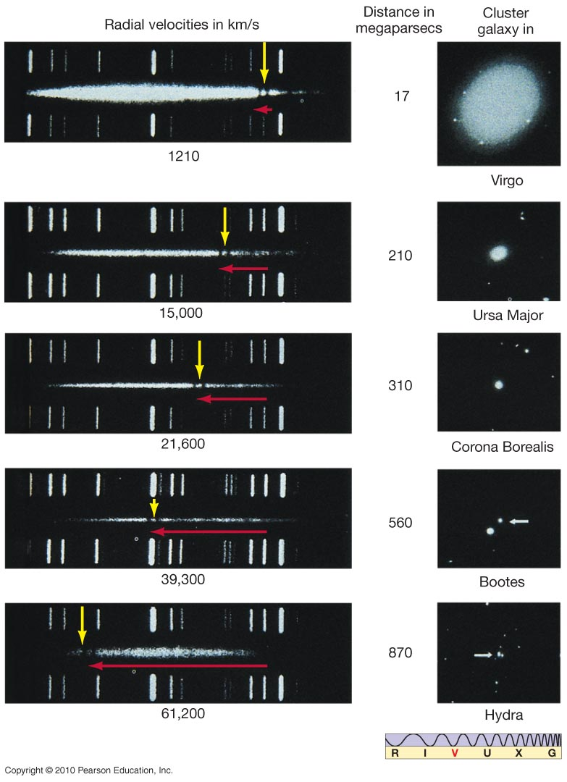
Velocity is measured from the redshift of absorption lines – the faster a galaxy is moving away, the larger the redshift

Slide 22
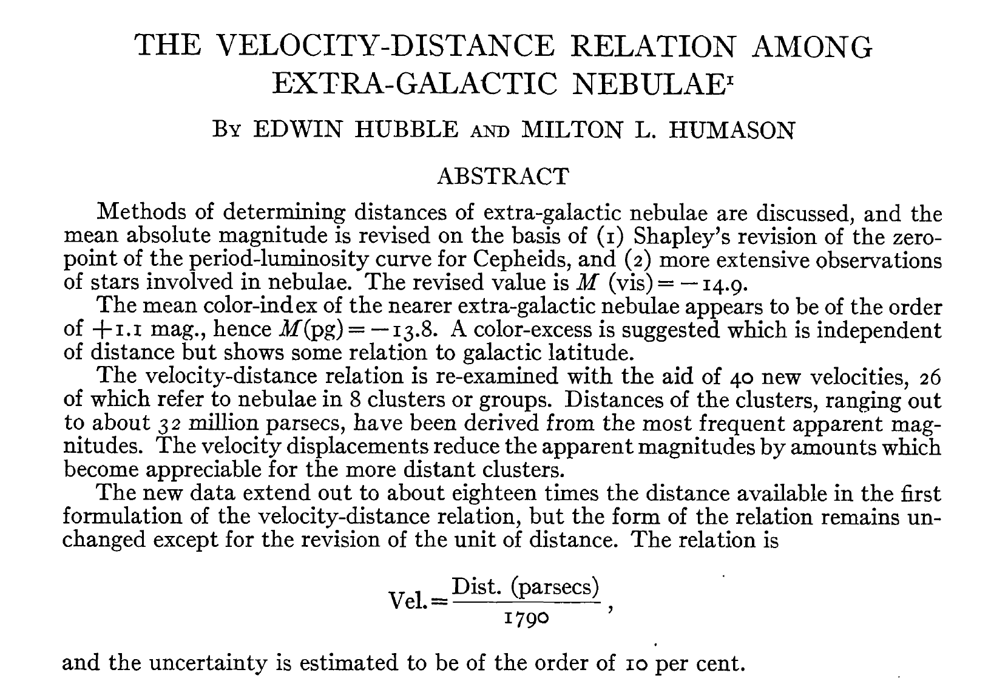
→ d [Mpc] = V [km/s] / 558

Slide 23
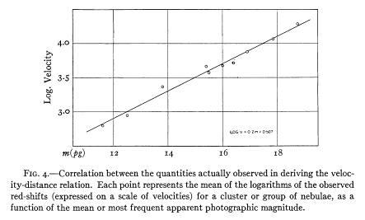
→ d [Mpc] = V [km/s] / 558
Each dot shows the distance to a galaxy and the speed with which it is moving away from us.

Slide 24
Hubble's Law
Galaxies outside our local group of galaxies are moving away from us, because the universe is expanding! Their speed increases with their distance from us according to the Hubble law:
v = H × d
v = velocity in km/s
d = distance in megaparsecs (1 Mpc = 3.26 x 10⁶ ly)
The Hubble constant: H = 70 km/s/Mpc
(Uncertainty: 65-75 km/s/Mpc)

Slide 25
Hubble’s Law
v = H × d is called the Hubble Law and H is the Hubble constant.
To determine it, we need to measure the velocity of many many galaxies, and their distances
Velocities are easy, from the redshift of spectral lines
Distances are harder: we use the Cepheid variable stars we talked about earlier and other methods

Slide 26
The Hubble Key Project
The value of Hubble’s constant relies on using Cepheids to obtain the distance to the Virgo Cluster (50 Mly or 18 Mpc) and to other galaxies within 100 Mly
→ This was one of the main scientific drivers to
build a telescope in space; this telescope was
later renamed to Hubble Space Telescope
Key Project of Hubble Space Telescope: Measure the Hubble constant using Cepheid variable stars

Slide 27
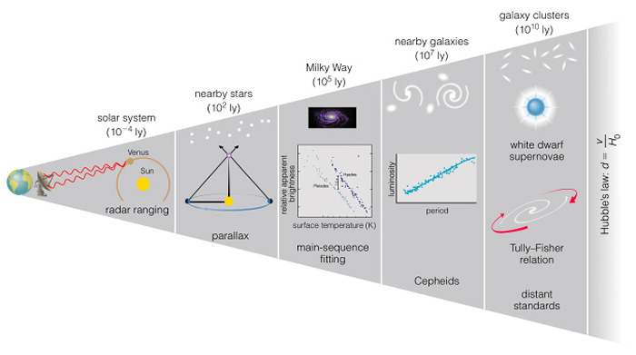
Hubble’s Law and the Distance Ladder
Once we figure out the value of Hubble’s constant, we can use the velocity of distant galaxies (easy to measure) to get their distance.
So our distance
ladder is
complete!

Slide 28
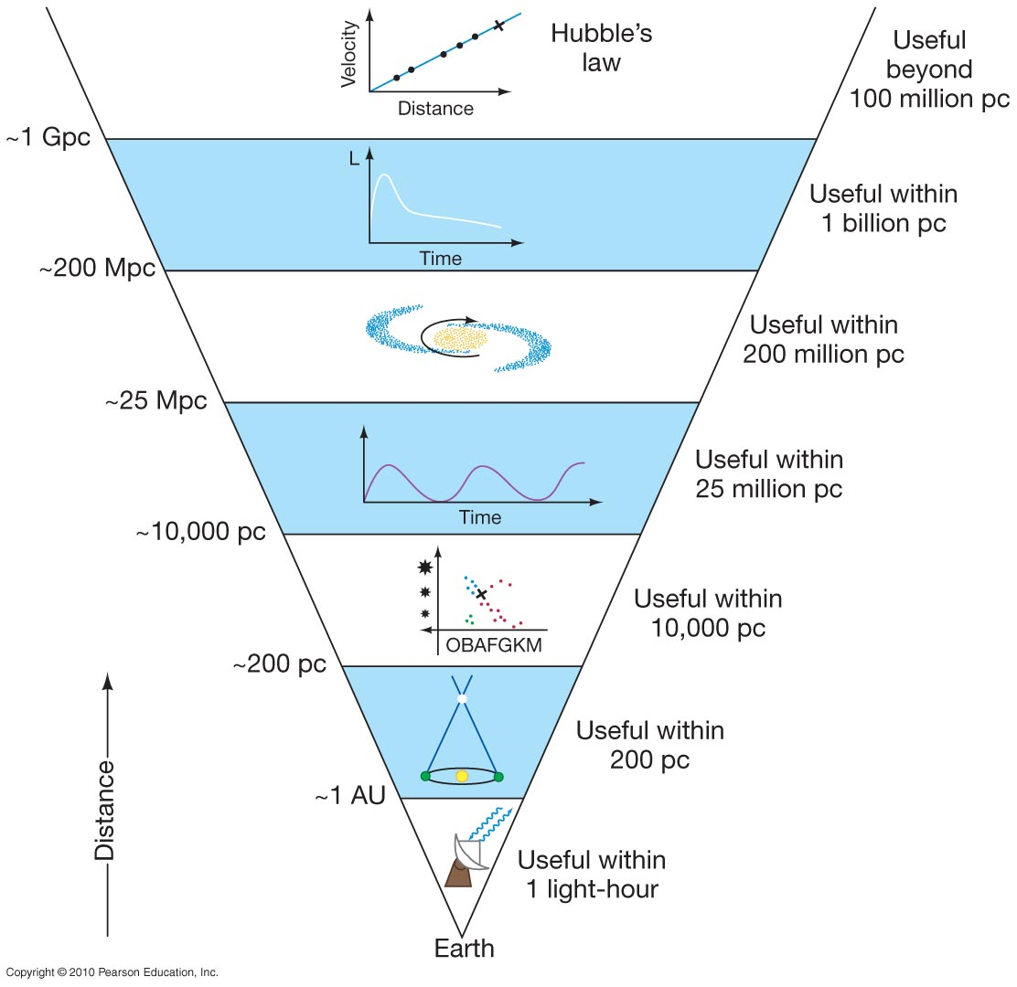
Hubble’s law
Type Ia supernovae
Cepheid variables
Main sequence stars (spectroscopic parallax)
Parallax
Radar bouncing
3 billion pc
(corrects C&M)
You don’t need to remember this one
Minor corrections to C&M’s diagram:
1. Hubble’s law and Type Ia supernovae both rely on distances from Cepheids.
You don’t need Type Ia supernovae to get Hubble’s law.
2. Type Ia supernovae have now been found at distances of 3 billion pc

Slide 29
Redshift Surveys Map the
Distribution of Galaxies
increasing distance
you are here

Slide 30
Hubble’s Law
v = H × d, H = 70 km/s/Mpc
Let’s do a few examples.
A galaxy is 100 Mpc away. How fast is it moving away from us?
v = H × d = 70 × 100 = 7000 km/s
A galaxy is 2000 Mpc away. How fast is it moving away from us?
v = H × d = 70 × 2000 = 140,000 km/s
v = H × d, H = 70 km/s/Mpc
Let’s do a few examples.
A galaxy is 100 Mpc away. How fast is it moving away from us?
  v = H × d = 70 × 100 = 7000 km/s
A galaxy is 2000 Mpc away. How fast is it moving away from us?
  v = H × d = 70 × 2000 = 140,000 km/s

Slide 31
Hubble’s Law
v = H × d, H = 70 km/s/Mpc
Let’s do a few examples.
A galaxy is moving at 700 km/s away from us. How far away is it?
  d = v/H = 700/70 = 10 Mpc
A galaxy is moving at 21,000 km/s away from us. How far away is it?
  d = v/H = 21,000/70 = 300 Mpc

Slide 32




Hubble’s Law is based on
More distant galaxies showing greater blueshifts
Distant galaxies appearing proportionally dimmer
More distant galaxies showing greater redshifts
Slowly varying Cepheid variables appearing brighter

Slide 33
Hubble’s Law is based on
More distant galaxies showing greater blueshifts
Distant galaxies appearing proportionally dimmer
More distant galaxies showing greater redshifts
Slowly varying Cepheid variables appearing brighter

Slide 34
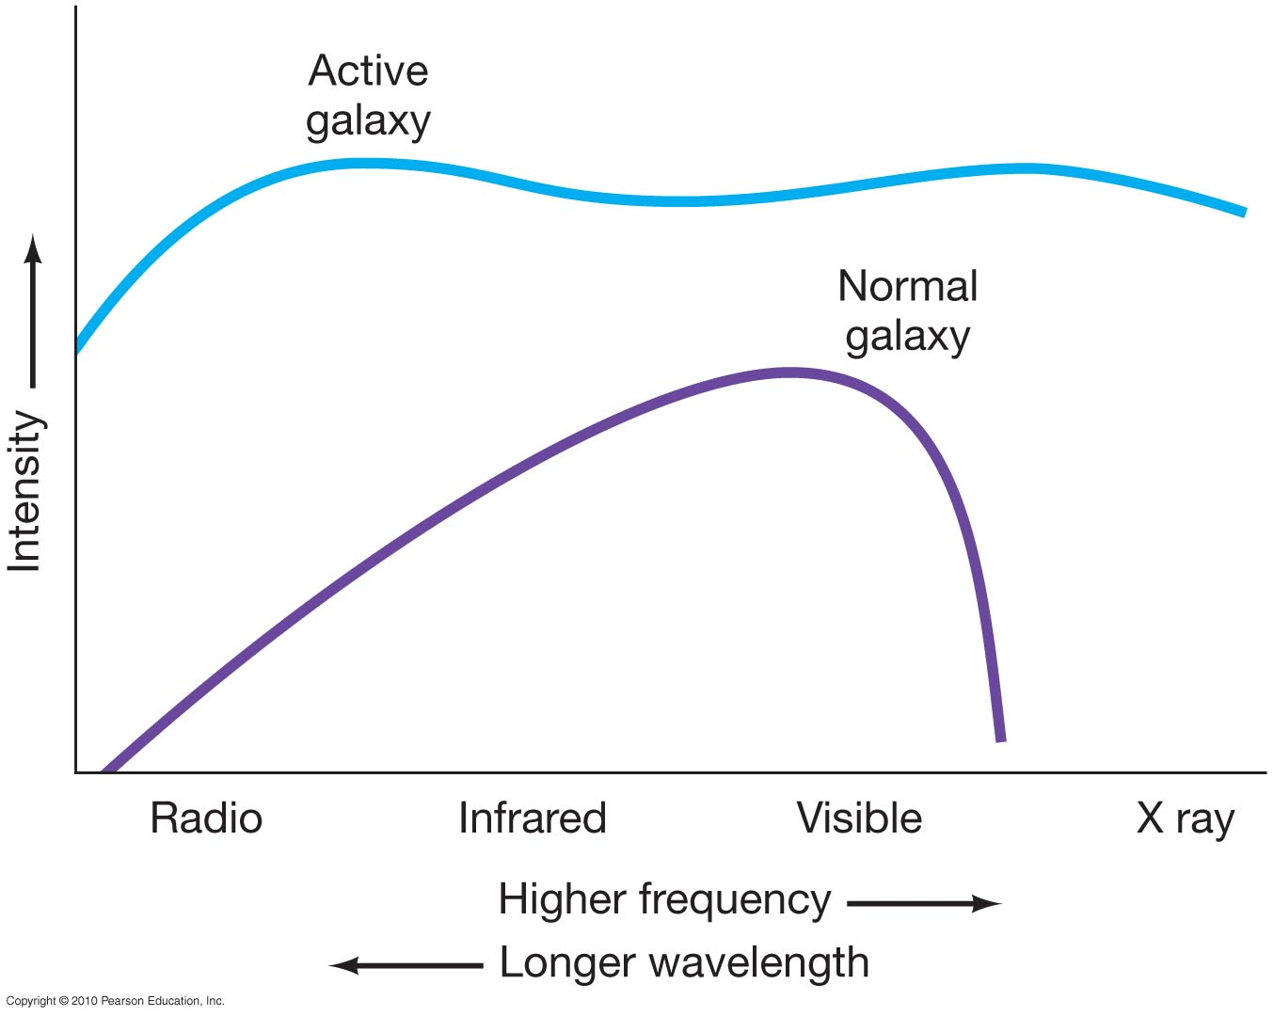
Active Galaxies
About 20–25 percent of galaxies don’t fit well into the Hubble scheme – they are far too luminous.
Such galaxies are
called active galaxies.
They differ from
normal galaxies
in both their
luminosity and
in the type of
radiation they
emit.
Notes:
<number>

Slide 35
Galactic Spectra
Galaxies are made of large collections of stars, so we might expect their spectra to look like the spectra of a bunch of stars, peaking in visible light
This is true for most galaxies, but not for all of them. Some galaxies show strong nonstellar radiation.
Because they are bright, they are called active galaxies

Slide 36
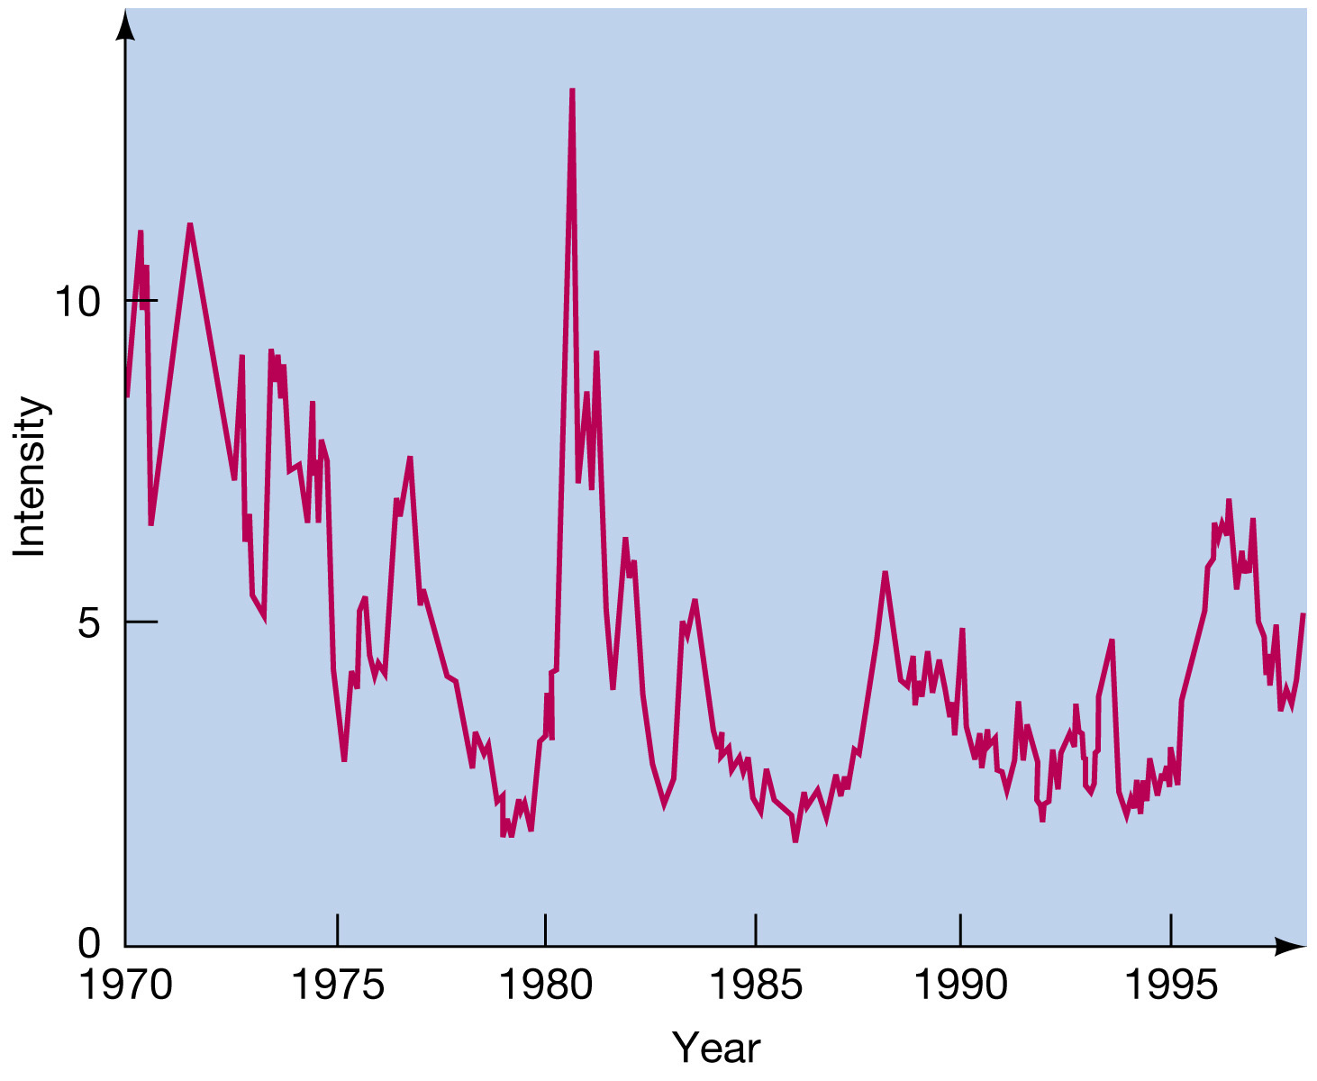
Seyfert Galaxies
Seyferts vary in brightness over a year to few years timescales.
Rapid variability implies that the central source is only a few light years (at most) across.

Slide 37
Seyfert Galaxies
Why does rapid variability
imply small size?
A source that changes in brightness in time t can’t be bigger in size than c x t, since light needs time to travel across the object
So something that changes in 1 year can’t be more than one light year in size!

Slide 38
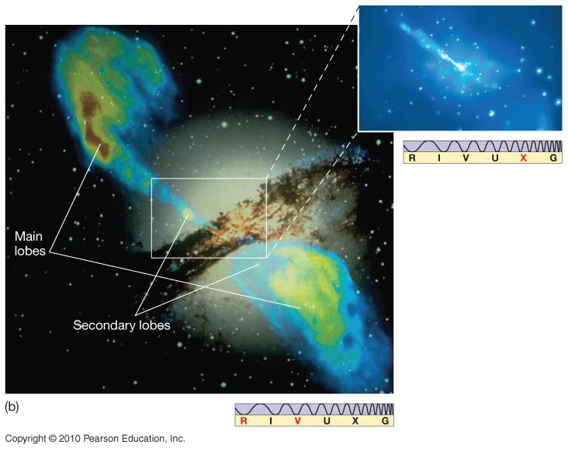
Other types of galaxies emit very strongly in the radio, but the radio emission doesn’t always come from the central source, but instead two giant lobes that extend away from it.
For obvious reasons, these are called radio galaxies.
This picture is a composite of Centaurus A.

Slide 39
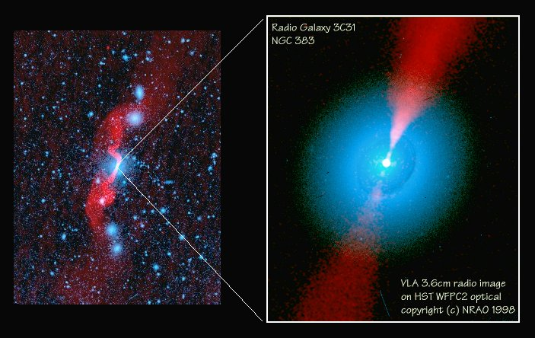
Radio galaxies
Radio galaxies emit large amounts of energy in the radio part of the spectrum. The corresponding visible galaxy is
usually
elliptical.

Slide 40
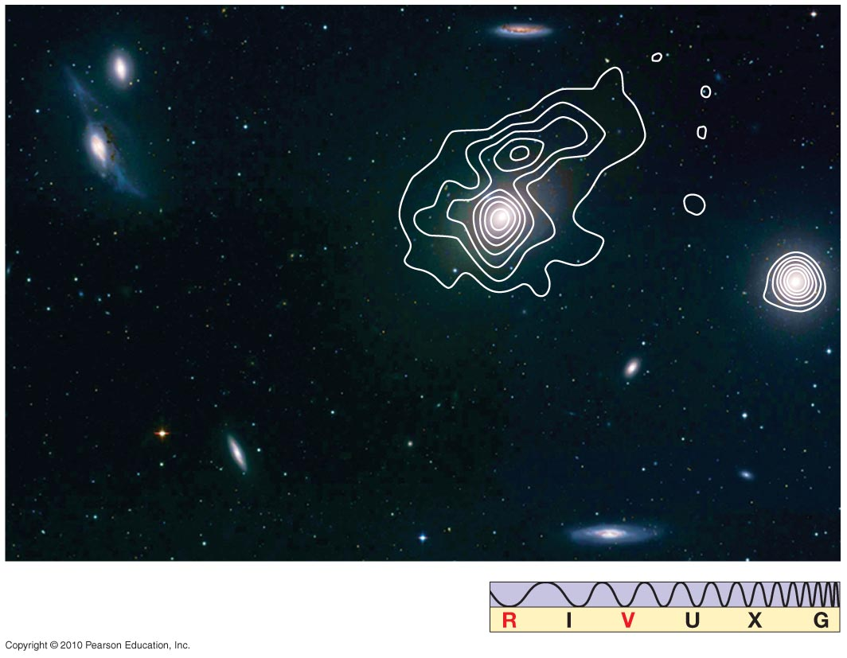
Radio Galaxies
Radio galaxies may also be core dominated.
Notes:
<number>

