Slide 1
Announcements
Today: Start with galaxies → start reading Chapter 14
November 12, 8-9pm: Stargazing
Notes:
<number>

Slide 2
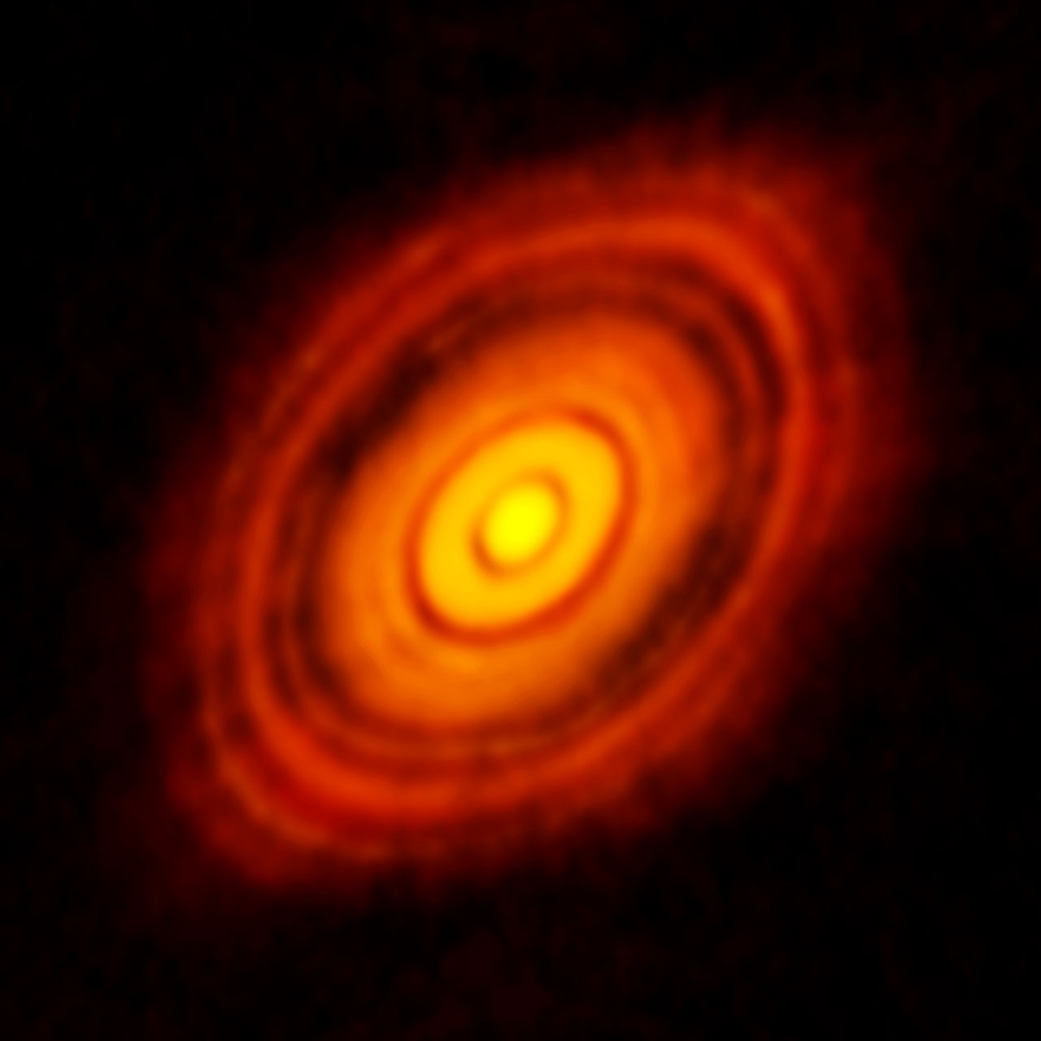
News flash
ALMA observes a protoplanetary disk around the young star HL Tauri.
This is the first time we can DIRECTLY actually observe a planetary system in formation around another star.
Source: http://www.eso.org/public/news/eso1436/

Slide 3
Astronomy 103
Our Galaxy
Please read Chapter 14

Slide 4
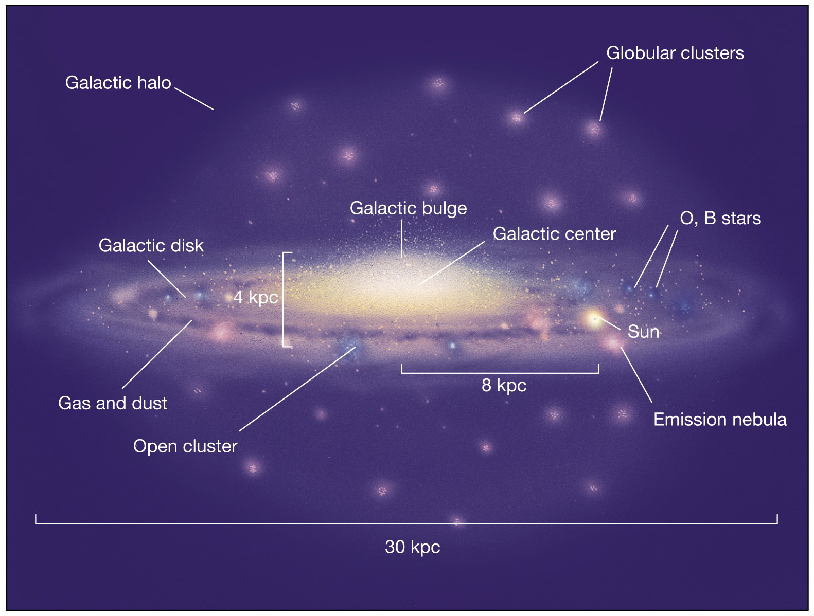

Slide 5
Structure of the Milky Way
The Milky Way Galaxy consists of several parts
The Galactic disk
The Galactic bulge
The Galactic halo
The Galactic Center
Each of these parts differs greatly in terms of stellar populations, chemical abundances, kinematics (motion) of stars

Slide 6
Structure of the Milky Way
The Galactic Disk is home to most of the young stars in the Galaxy, and contains most of the dust and gas in the Galaxy
The Galactic Bulge contains a mix of old and young stars
The Galactic Halo has mainly old stars and is home to many globular clusters
And the Galactic Center contains a supermassive black hole

Slide 7
The direction of the Galactic Center was identified using
supernova remnants
bright O and B stars in open clusters
white dwarf stars in the spiral arms
red giant variable stars in globular clusters

Slide 8
The direction of the Galactic Center was identified using
supernova remnants
bright O and B stars in open clusters
white dwarf stars in the spiral arms
red giant variable stars in globular clusters

Slide 9
Galactic Structure
Diameter of disk ~ 100,000 ly
The spiral arms are in the disk, outside the bulge.
Nearly all the gas and dust, and new stars are in the disk and bulge
The disk rotates about the galaxy’s center, at first with stars closer to the central bulge moving faster than stars farther away, and with velocity approximately constant at larger radii
The Sun sits at 8000 pc from the Galactic Center in the disk and moves once around the Galaxy every 225 million years

Slide 10
Galactic Structure
The galactic halo and globular clusters formed very early; the halo is essentially spherical. All the stars in the halo are very old, and there is no gas and dust.
The galactic disk is where the youngest stars are, as well as star formation regions – emission nebulae, large clouds of gas and dust.
Surrounding the galactic center is the galactic bulge, which contains a mix of older and younger stars.
Notes:
<number>

Slide 11
Stellar populations: Old and new stars
Stars formed at the time the Galaxy formed are called Population II stars. They are almost entirely hydrogen and helium with few heavier elements, because the matter in them had not previously been in another star. They lie in all parts of the galaxy, the halo (globular clusters), disk, and bulge.
Younger stars, formed from matter in the disk of the galaxy, are called Population I stars. They are made from reprocessed material, matter that was once in other stars and was redistributed to the galaxy when the star died.
Population I stars are thus younger and begin their lives with a larger fraction of heavier elements than Population II stars.
(Astronomers are still searching for evidence of Population III, stars that do not have any elements heavier then Helium in their atmospheres.)

Slide 12
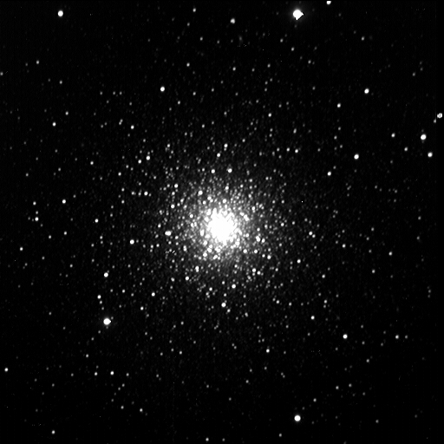
Population I and II stars
Both Population I and Population II stars are made mainly of hydrogen and helium. Even in Population I stars, like the Sun, heavier elements are a small fraction of the total mass.
Globular clusters formed at the time the galaxy formed. They are dense clusters of up to 1 million stars, all Population II.
→ Globular clusters are among the oldest objects in the universe.
An example of a typical globular cluster is M3.

Slide 13
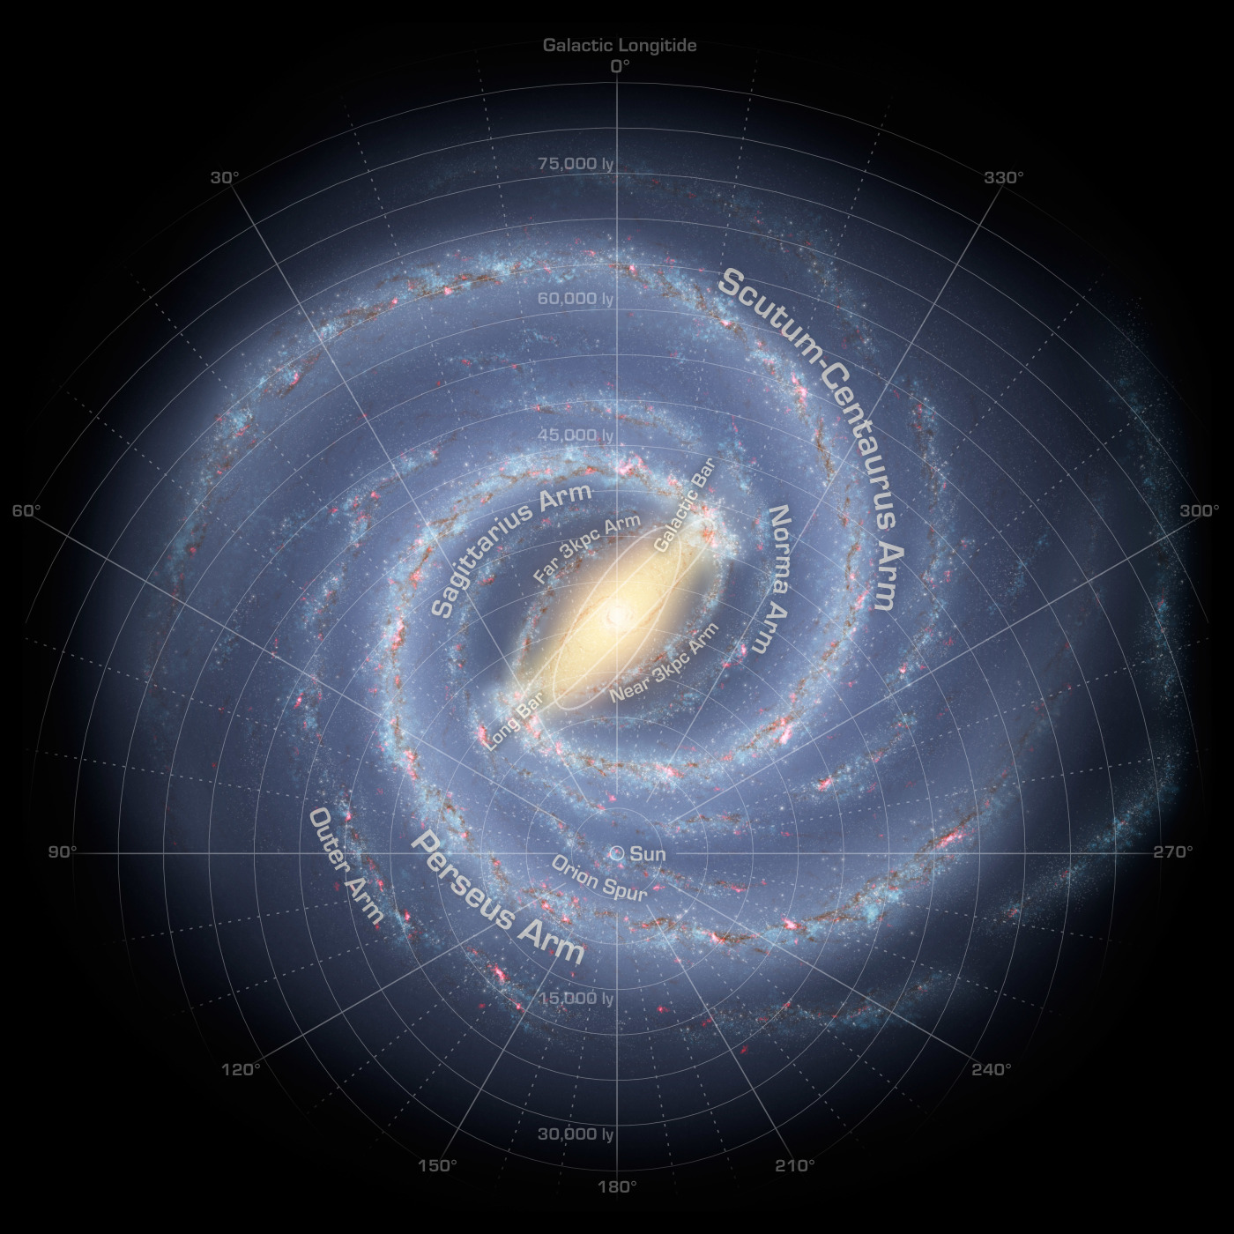
How do we know the Milky Way is a spiral galaxy?

Slide 14
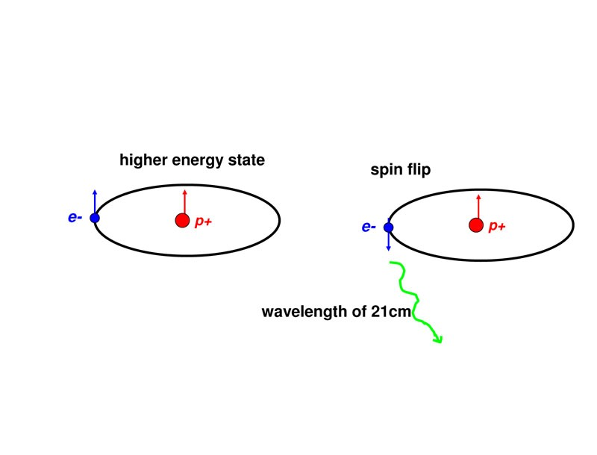
Hydrogen 21cm emission
The electron and proton in an atom of neutral hydrogen have spin. Their spins can be aligned, or they can point in opposite directions. Sometimes the spin of the electron flips, and when this happens a photon is emitted with wavelength 21 cm. This can be observed in the radio, and is used to map neutral hydrogen gas.

Slide 15
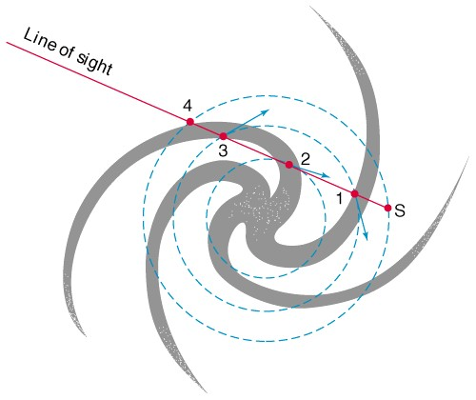
Mapping Milky Way's 21cm emission
Cold hydrogen gas emits 21 cm radio waves (called 21 cm radiation), and this gas lives in the disk of the Galaxy
The Doppler shift is different from different parts of the arm (and different arms!)

Slide 16
What are the spiral arms?
It is still not fully understood what causes the spirals arms that we see in spiral galaxies
We at least know that gravity plays an important role. Gravity causes things to clump up
But how it organizes into a spiral arm is not clear

Slide 17
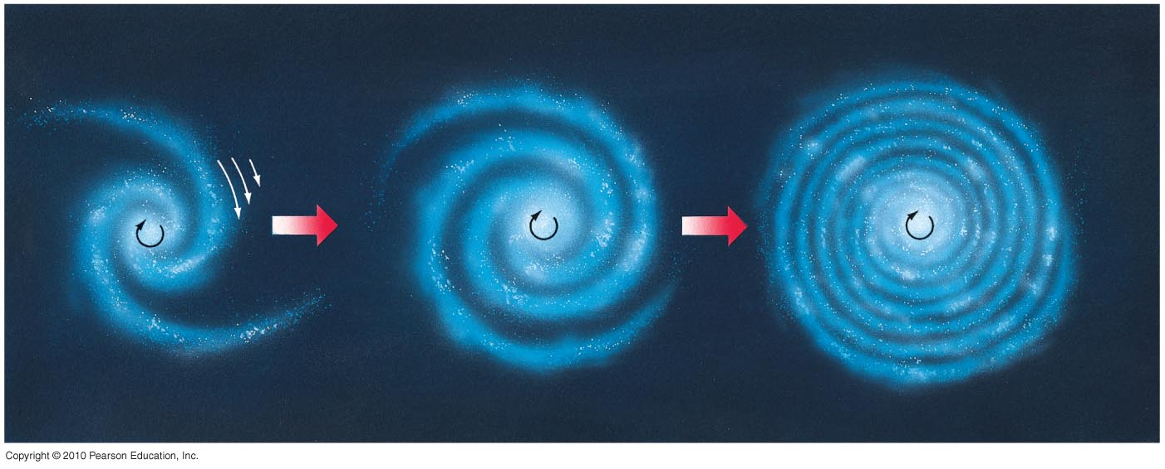
The Winding Problem
Spiral arms are not material formed into a spiral by the rotation of the galaxy –if this were the case, the arms would wind up until they disappeared
This is called the winding problem

Slide 18
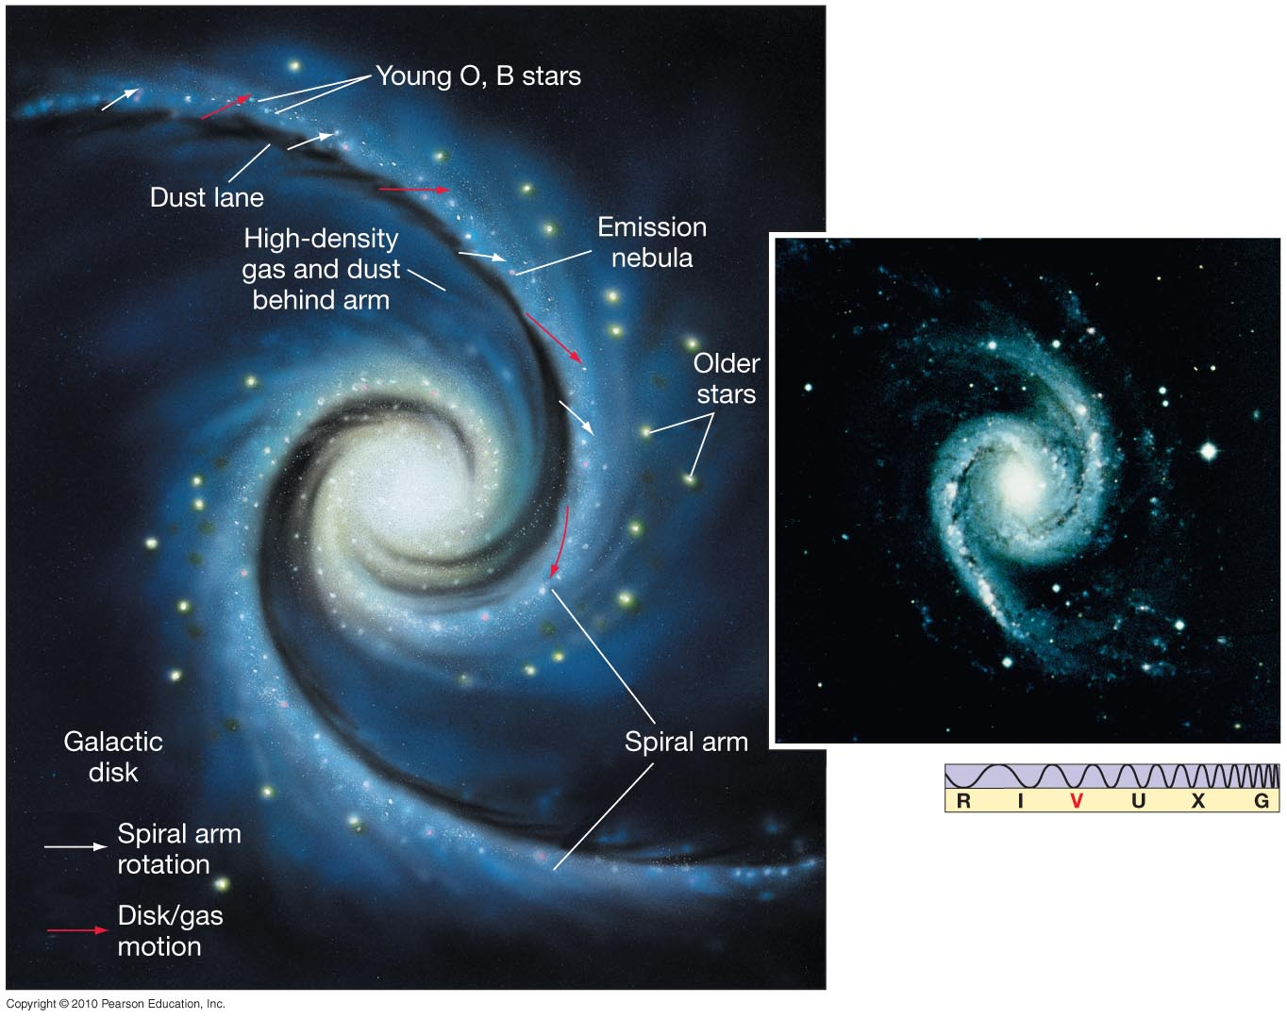
Alternatives: (1) Spiral density waves
Spiral arms are not material, but patterns instead. Stars and gas flow in and out of spiral arms.

Slide 19
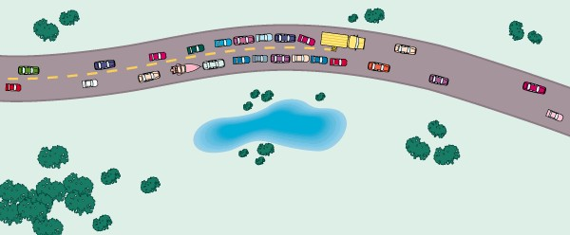
Alternatives: (1) Spiral density waves
It is like a traffic jam. The traffic jam is not a physical thing, just a pattern.
The cars that make up the traffic jam are not always the same. Cars in the jam eventually pass through it and escape, but new cars come in and the jam remains

Slide 20
Alternatives (1): Spiral density waves
If we apply this traffic jam analogy to stars, we can produce a spiral like pattern.
The spiral arms are just the slow regions of stellar traffic, and stars move through them

Slide 21
Alternatives (1): Spiral density waves
Compare the previous movie with this one, in which the stars stay fixed relative to the spiral arms.
This is not what we think happens.

Slide 22
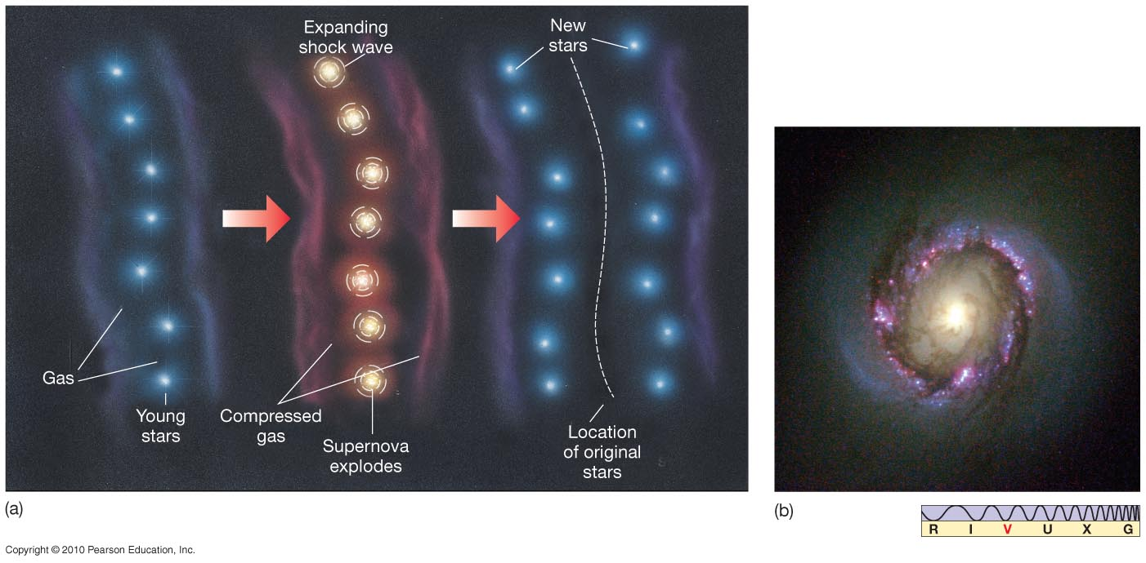
Alternative (2): Self propagating star formation
Stars form in waves and the wave of star formation makes the spiral arm - but it is not clear how whole spiral arms would appear with this mechanism.
→ Spiral arm formation is still being researched!!

Slide 23
The Mass of the Milky Way Galaxy
The orbital speed of an object depends only on the amount of mass between it and the galactic center.
Notes:
<number>

Slide 24
Mass of the Milky Way and Dark Matter
From Newton's law of gravity, one can, as usual, find the mass of the galaxy inside an orbiting star or globular cluster from the period of its orbit (just as one finds the mass of a star from another star in orbit about it). The mass in the Galaxy's disk is found in this way to be about 200 billion solar masses.
But as one looks at orbits of globular clusters and gas clouds that are further from the center of the Galaxy, a strange thing happens. The mass does not end with the edge of the disk, nor does it come mostly from the disk and bulge at all!

Slide 25
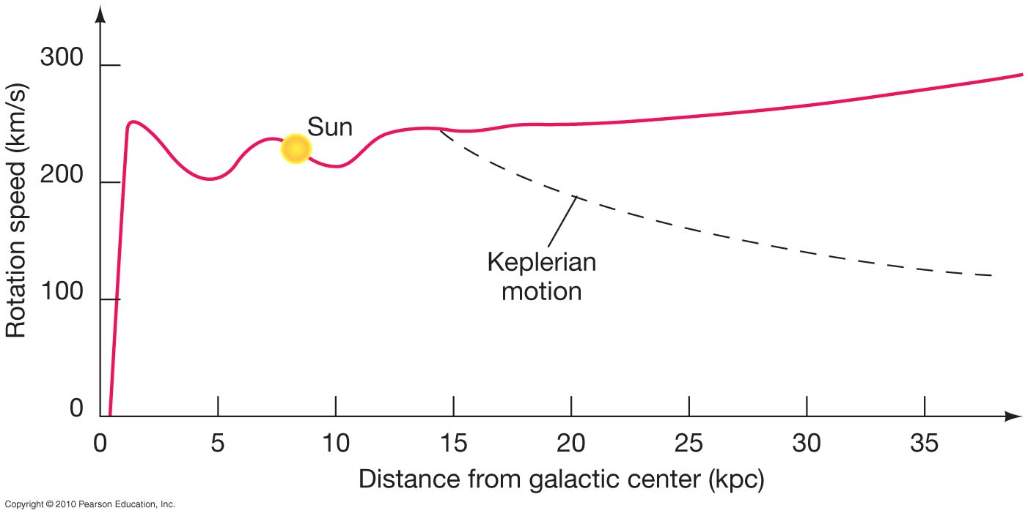
Galactic rotation curve
Rotation curve of the Galaxy: How fast objects move as a function of the distance to the galactic center.
actual motion observed
expected given mass that we can see

Slide 26
Rotation curve and Dark Matter
Instead, the speed at which stars, globular clusters and gas clouds orbit the galaxy implies a much larger mass than is visible:
Most of the Galaxy's mass is dark matter, matter too dim to see at any wavelength, that lies in the halo. We do not yet know what it is.
This is true of all other large galaxies whose mass we have measured. What constitutes most of the universe's mass is one of the most fundamental mysteries of current astronomy.

Slide 27
Dark Matter Summary
How fast a star orbits the galaxy tells us how much mass is inside the radius of the star’s orbit.
The faster the star moves, the more mass must be pulling it to keep it from flying out of the galaxy
Stars far from the center of the galaxy move unexpectedly fast: Therefore there is much more mass in the galaxy than we can see
At least 90% of the Galaxy’s mass is “dark matter,” matter that we cannot see at any wavelength.
We know where it is (mostly in the halo) but we don’t yet know what it is

Slide 28
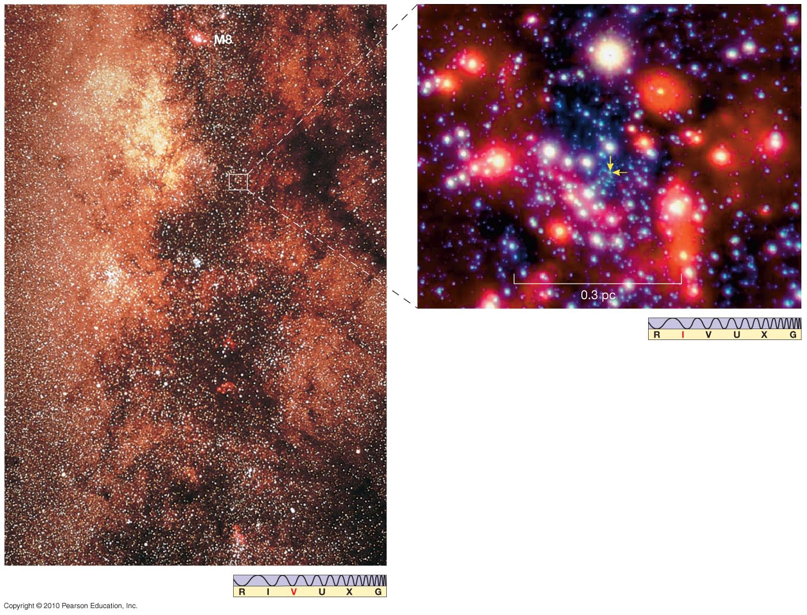
The Galactic Center
This is a view toward the galactic center, in visible light. The two arrows in the inset indicate the location of the center; it is entirely obscured by dust.
Notes:
<number>

Slide 29
Evidence for a supermassive black hole at the center of the Milky Way
The center of the Milky Way is a very bright radio source. Because the center of the Galaxy is in the direction of the constellation Sagittarius and because it is the brightest radio source in Sagittarius, the source is named Sagittarius A.
What provides the radio waves was debated for fifty years and is now answered: More than 15 years of images of the Milky Way's center have provided strong evidence for a large black hole.

Slide 30
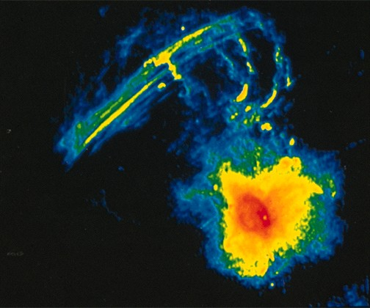
Radio emission from the Galaxy’s center Color code: red means brightest, blue dimmest
The region shown is 200 ly across (1/500 the size of the galaxy)

Slide 31
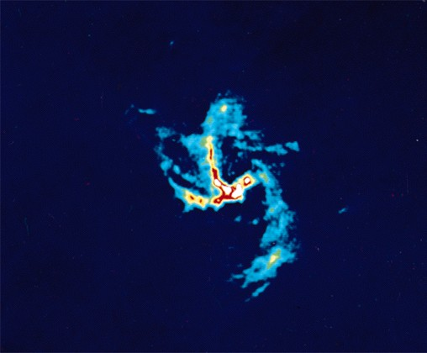
Close-up of the the central 20 ly

Slide 32
Milky Way's own Black Hole
Observations of orbiting stars near the Galaxy's center show that about 4 million solar masses lie within 6 light-hours of the center.
From the stars’ distance from the center and the very short time it takes them to complete their orbits, one finds that they are orbiting something whose mass is 3.7 million times the mass of the Sun! All of that mass is squeezed into something smaller than a few light-days across – about the size of the solar system.
This strongly suggests that there is a 4-million solar mass black hole in the center of the Galaxy.

Slide 33
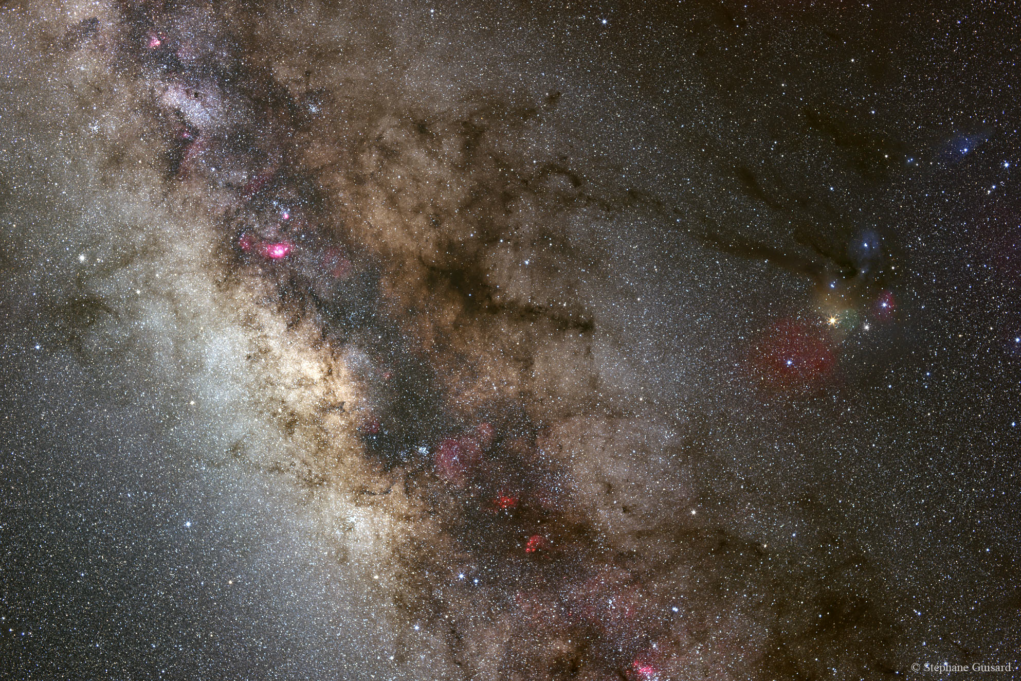
Observing Stars in the Galactic Center
1) Lots of dust
→ Can’t see in visible light, so observe in IR
2) Want to resolve stars on very small orbits, so need high spatial resolution
→ Adaptive optics correct for the blurring of the atmosphere

Slide 34
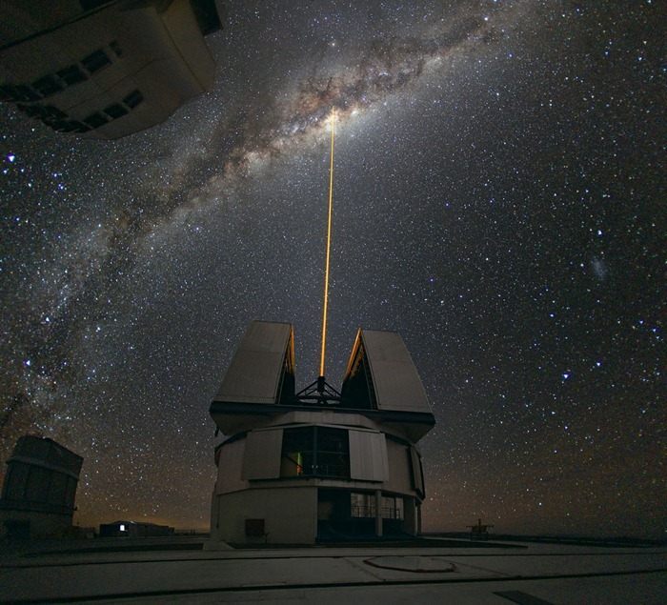
Remember from telescopes lecture: Adaptive Optics
Laser excites sodium atoms in upper atmosphere to create “artificial star”
Monitor distortions of atmosphere by looking at changes in image of artificial star
Note that laser is pointing at Galactic Center!

Slide 35
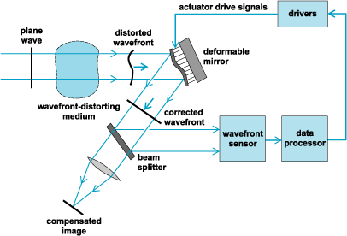
Adaptive Optics
Distortions are mapped and corrected in real time (10-1000 times a second) with a deformable mirror

Slide 36
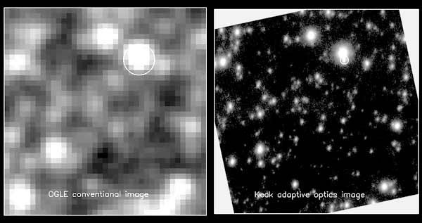
Adaptive Optics

Slide 38
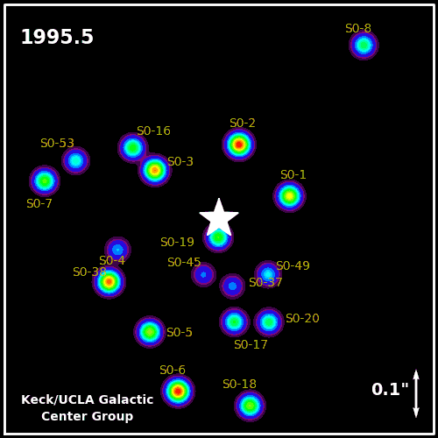
With 16 years of data, here’s what the orbits look like
Recently the star S0-2 completed an orbit that we observed from start to finish
It comes very close to the center and moves very quickly
This is evidence that something very massive and dense lives in the center

Slide 39
A Supermassive Black Hole
Applying Kepler’s third law to the orbits of the stars gives a mass for the central black hole of 3.7 million solar masses
This is a large black hole, but it’s only about 0.0004% of the total mass of the Galaxy
As we’ll see later, most galaxies have massive black holes at their centers, and many of them are much more massive than ours

Slide 40
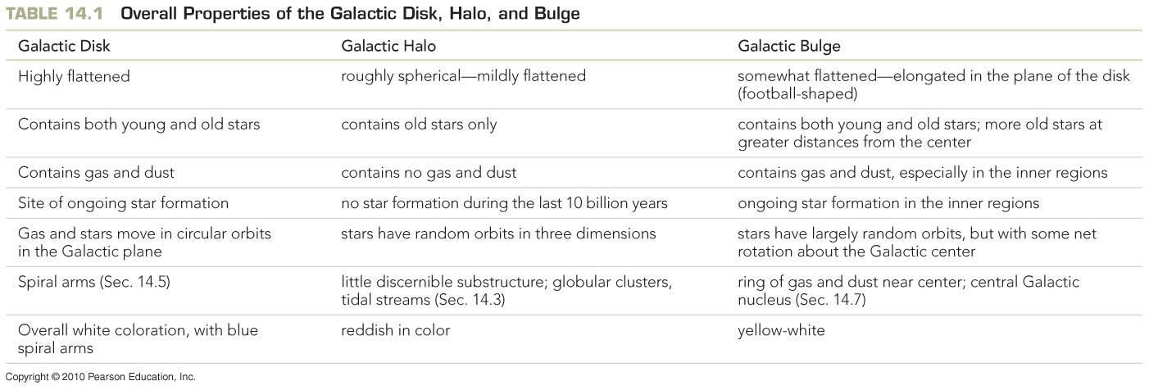
The Formation of the Milky Way
Any theory of galaxy formation should be able to account for all the properties below.
Notes:
<number>

