Slide 1
Announcements
Midterm 2
  Grades are posted on D2L
  Average 72%
  Scantron forms here if you want them
  Answers will be posted later today on D2L under Content: Course Handouts
Upcoming schedule
  Today: terrestrial planets (Ch 6, some Ch 5)
  Friday: Jovian planets (Ch 7, some Ch 8)
  Monday: Extrasolar planets (Section 4.4)
Later next week: start Chapter 14, the Milky Way Galaxy

Slide 2
Astronomy 103
The terrestrial planets
Please read chapter 6

Slide 3
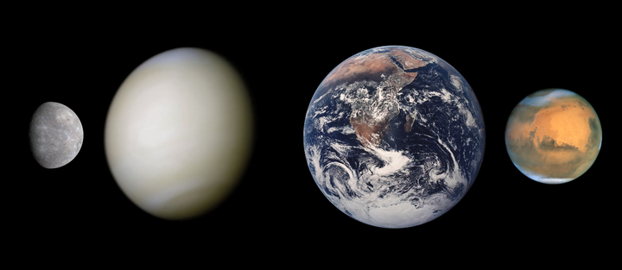
Terrestrial planets: Mercury, Venus, Earth, and Mars
We’ll start by looking at the most well-known terrestrial planet, Earth, and see how each of the others differ
The Earth is discussed in more detail in Chapter 5 of the text, which we mostly won’t cover. Just the basics here.
Mercury
Venus
Earth
Mars

Slide 4
Earth
Radius ~ 6400 km
Density ~ 5000 kg/m³ – five times density of water
Has a thick atmosphere of mostly nitrogen and oxygen
Has active volcanoes
Has a magnetic field

Slide 5
Structure of the Earth
Inner core is solid iron
Outer core is liquid iron and nickel.
Mantle is mostly molten rock (silicon and oxygen)
Crust (30 km thick) is solid rock.
Know this structure from looking at earthquake waves.

Slide 6
Structure of the Earth
Seismic waves:
Earthquakes produce both pressure and shear waves.
Pressure waves will travel through both liquids and solids.
Shear waves will not travel through liquids, as liquids do not resist shear forces.
Wave speed depends on density of material.

Slide 7
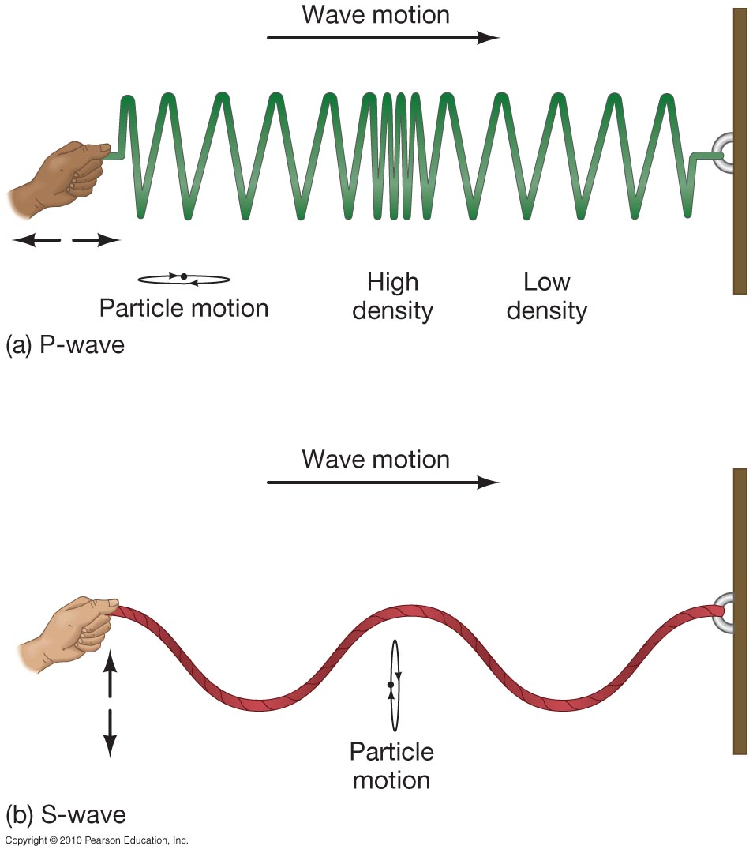
Structure of the Earth
The pressure wave is a longitudinal wave: material is compressed in the direction of the wave motion.
The shear wave is a transverse wave: material is compressed perpendicular to wave motion. A shear wave cannot propagate within a liquid.

Slide 8
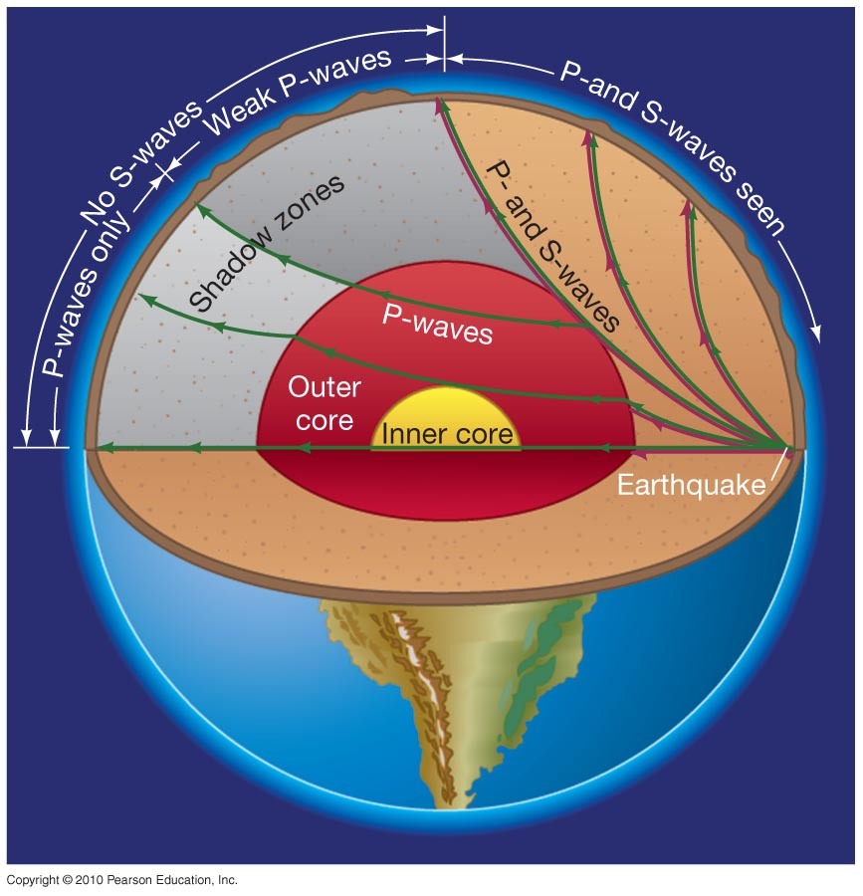
Structure of the Earth
Can use pattern of reflections during earthquakes to deduce interior structure of Earth.

Slide 9
Structure of the Earth
Combination of solid inner iron core and liquid outer iron core makes Earth’s magnetic field. Without a liquid core (that is in motion), we would have no magnetic field.
The mantle has large magma flows. Sometime these magma flows get close to the surface, giving volcanoes.
These flows in the mantle drag the stuff on the crust along with them. This makes continents move over time.
This is known as the theory of continental drift, one of the great discoveries in Earth science.

Slide 10
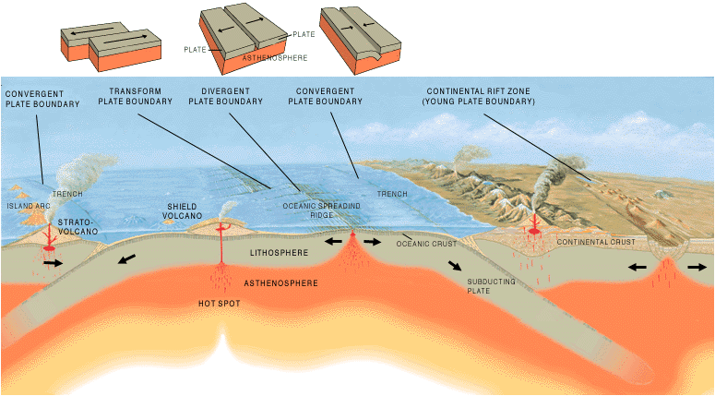
Plate Tectonics
Plate tectonics is driven by the motion of magma in the Earth’s mantle. Leads to motion of continents over time.

Slide 16
Mercury
Radius ~ 2400 km
Mass ~ 5% of Earth
Density 5400 kg/m³ – about the same as Earth
No atmosphere
No volcanoes
Has a magnetic field

Slide 17
Mercury
Temperature on Mercury varies drastically! On the day side it is hot, 700K, but on the night side it is cold, 100 K (-200 F)
Wide variation in temperature because there is no atmosphere to trap heat and moderate temperatures
Because Mercury has no atmosphere and no water, there is no erosion, so the surface is heavily cratered like the Moon

Slide 19
Mercury has one feature unique to it and not found on the Moon. It has scarps or cliffs.
These scarps result from the cooling (and shrinking) of Mercury, which resulted in compression and cracking of the surface.

Slide 20
Mercury
Mercury has a magnetic field that is 1/100 of the strength of Earth’s field.
So it has a liquid iron core like the Earth

Slide 21
Venus
Radius ~ 6100 km
Mass ~ 82% of Earth
Density ~ 5300 kg/m³ – about the same as Earth
Very thick atmosphere
Many volcanic features, indirect evidence of current volcanic activity
No magnetic field

Slide 22
Venus
Venus has a large, thick atmosphere which covers the entire surface with clouds of sulfuric acid.
Its atmosphere is 90x thicker than the Earth’s: pressure on the surface is 90 times higher than on Earth

Slide 23
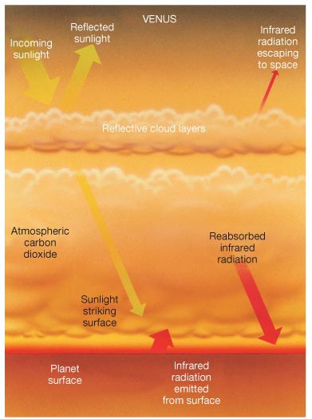
Venus
Venus is HOT! Its average temperature is 730 K – hotter than Mercury and hot enough to melt lead
This is because the atmosphere traps heat via the greenhouse effect
Sunlight strikes surface and is converted to heat, which is absorbed and re-radiated by carbon dioxide in the atmosphere instead of radiating out into space
Also operates on Earth

Slide 24
The greenhouse effect on Earth
Greenhouses gases (carbon dioxide, water vapor, methane) in the atmosphere trap heat
Sunlight strikes surface and is converted to heat, which is absorbed and re-radiated in the atmosphere instead of radiating out into space
An increase in the amount of greenhouse gases in the atmosphere increases the heat trapped

Slide 25
Runaway Greenhouse Effect

Slide 26
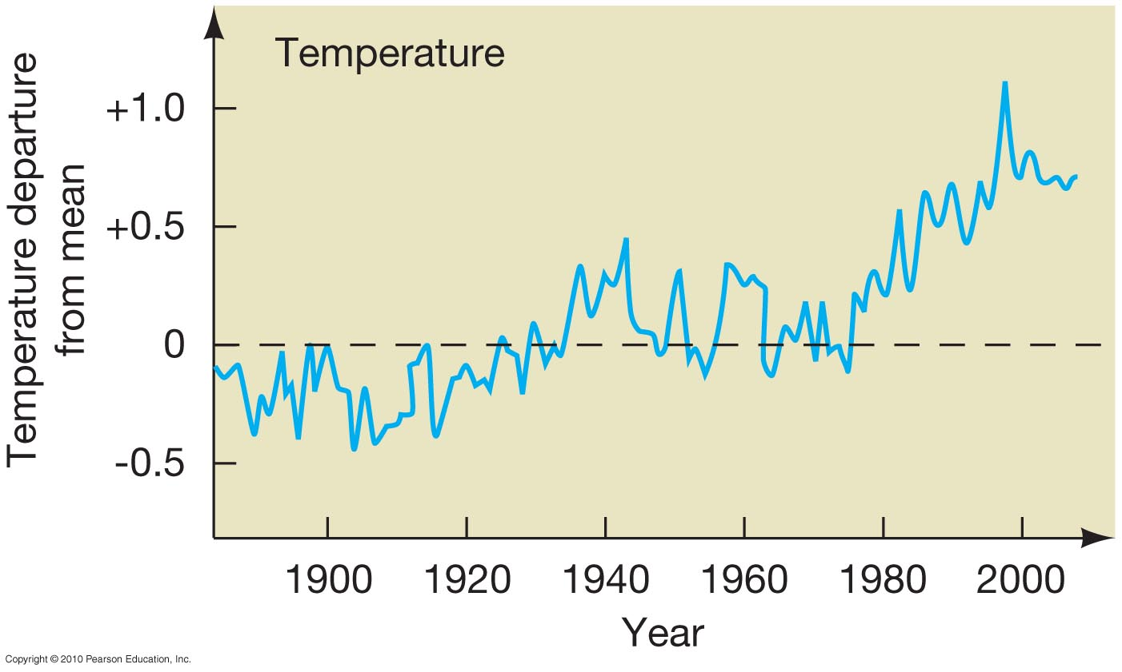
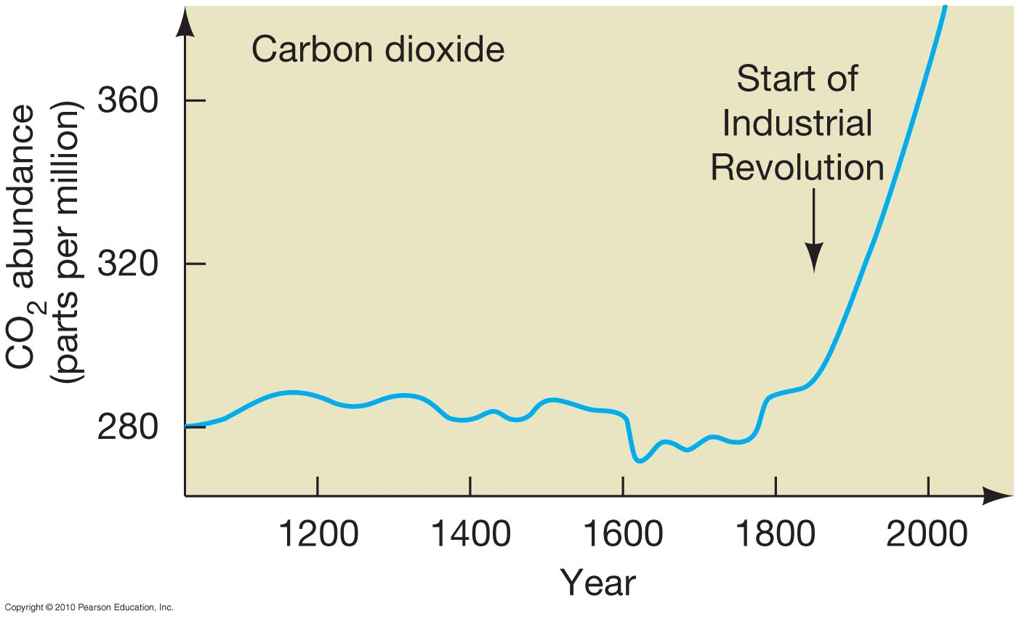
The Greenhouse Effect and Global Warming
There is extremely strong evidence that Earth is getting warmer, and that this warming is related to the increase in atmospheric carbon dioxide.

Slide 27
Venus
No plate tectonics on Venus – possible causes:
Slow cooling – weak convection
Soft crust – very plastic, so it doesn’t crack
No water – lack of lubricant
However, Venus has many volcanoes, and shows indirect evidence of current volcanic activity – young surface, changes in the sulfur content of the atmosphere, etc.

Slide 28
Venus
Gula Mons – a large shield volcano on Venus. It is 4 km in height and over 100 km across at the summit

Slide 29
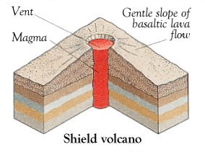
Venus
The volcanoes on Venus form from hot spots in the crust – these are called shield volcanoes. On earth the Hawaiian islands are shield volcanoes

Slide 30




Which gas is responsible for the greenhouse effect on Venus?
nitrogen
hydrogen
carbon dioxide
sulfuric acid

Slide 31
Which gas is responsible for the greenhouse effect on Venus?
nitrogen
hydrogen
carbon dioxide
sulfuric acid

Slide 32
Mars
Radius ~ 3400 km – ½ radius of earth
Mass ~ 10% of Earth
Density ~ 3900 kg/m³ – smaller than Earth – density of rock.
Thin atmosphere
Extinct volcanoes
No magnetic field

Slide 33
Mars
Called the red planet because of its red color – due to rust, iron oxide
Has nearly a 24 hour day – very similar to earth
Atmosphere is made mainly of carbon dioxide, but it is very thin – 1/150 that of earth. Remember Venus is 90x that of earth
Has seasons – tilt of Mars is close to that of earth.

Slide 34
Mars
Atmosphere is mainly CO₂ (carbon dioxide) with some nitrogen and argon.
It is so cold that the atmosphere freezes onto the poles as frozen CO₂ depending on the season

Slide 35
Mars

Slide 36
Seasons on Mars

Slide 37
Mars

Slide 38
Mars
The atmosphere of Mars might have been thicker in the past, so thick as to support liquid water on the surface. There is evidence of liquid water on the past Martian surface.

Slide 39
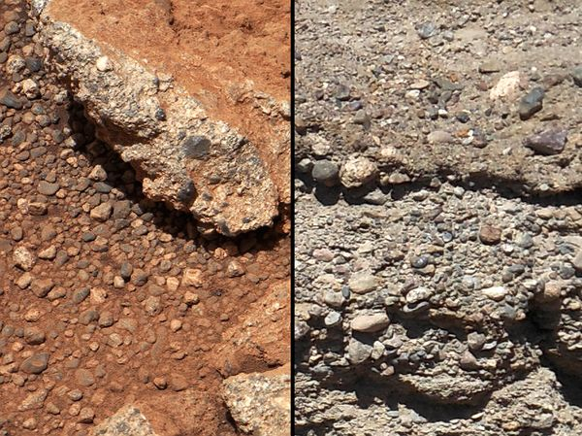
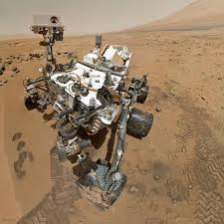
Evidence for water on Mars
Mars
Earth
September 2012: Curiosity rover finds ancient streambed, pebbles moved and smoothed by water, present for thousands to millions of years

Slide 40
Mars
Sedimentary rock builds up in layers, probably deposited by water
Very common on Earth

Slide 41
Sedimentary rock on Mars found in craters and other depressions

Slide 44
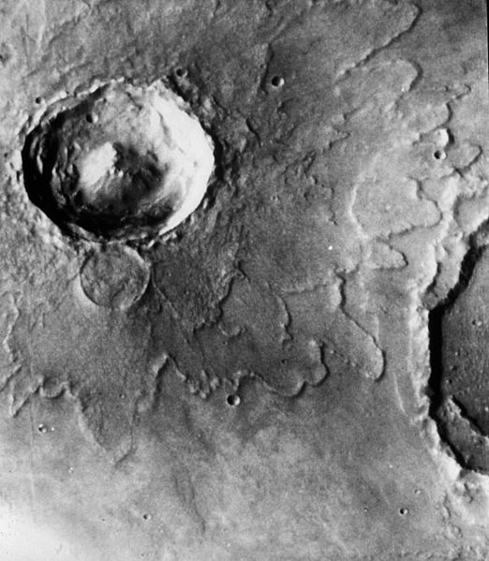
Mars
The water is likely to have been lost to space or permanently frozen into permafrost.
Some evidence in impact craters and possibly flowing mud.

Slide 45
Mars
Like the other terrestrial planets, Mars has a core.
It has a weak magnetic field – 1/800 that of the Earth.
The core is probably still molten, but large scale activity is largely dormant.

Slide 46
Mars
Has huge volcanoes – now extinct. Olympus Mons is the largest volcano in the solar system.
3 x the size of Mount Everest!
These are also shield volcanoes. They are much larger than ones on Earth and Venus because of lower gravity.

Slide 47

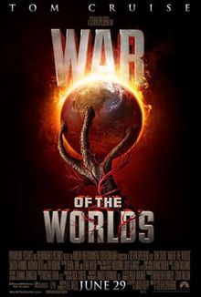
Life on Mars
The idea of life on Mars is a very old one.
The fact that Mars was so similar to Earth drove a lot of the early speculation.

Slide 48
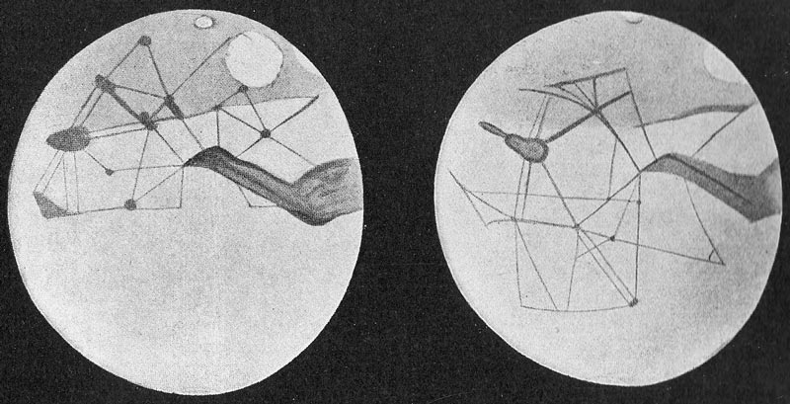
Life on Mars
In the 19th century astronomers believed that they saw canals on Mars – evidence of intelligent life

Slide 49
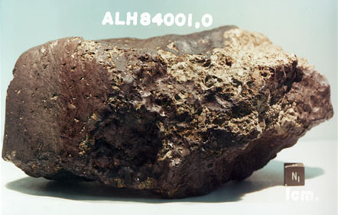
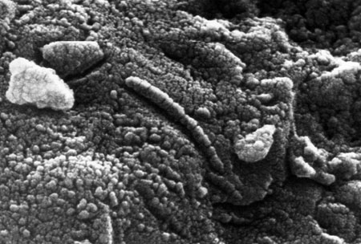
Life on Mars
Meteor ALH840001 is a Martian meteorite with possible indications of early Martian life.
Very controversial – shows both mineral deposits of magnetite and possible fossils of nanobacteria

Slide 50

Life on Mars

