Slide 1
Announcements
Today: Start with galaxies → start reading Chapter 14
November 12, 8-9pm: Stargazing
Notes:
<number>

Slide 2
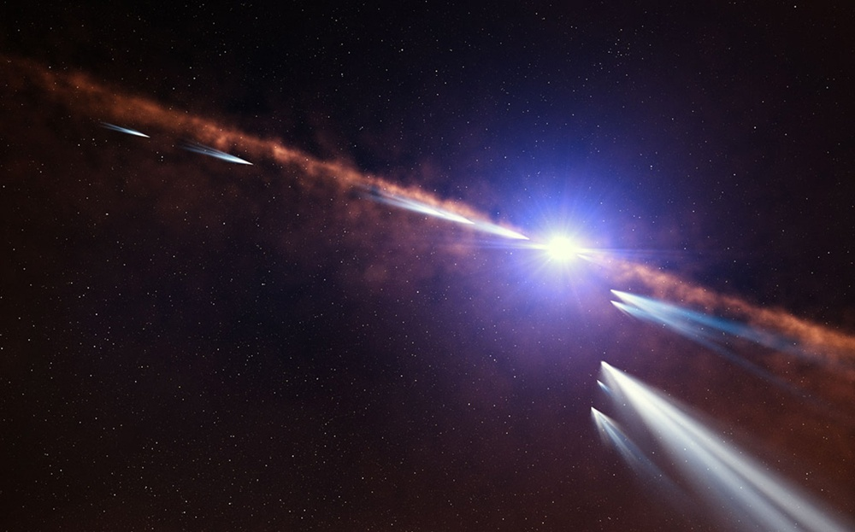
Astronomy in the news
Source: http://www.eso.org/public/news/eso1432/

Slide 3
Exocomets around β Pictoris
Beta Pictoris is a young star located about 63 light-years from the Sun. It is only about 20 million years old and is surrounded by a huge disc of material — a very active young planetary system where gas and dust are produced by the evaporation of comets and the collisions of asteroids.
For almost 30 years astronomers have seen subtle changes in the light from Beta Pictoris that were thought to be caused by the passage of comets in front of the star itself. Comets are small bodies of a few kilometres in size, but they are rich in ices, which evaporate when they approach their star, producing gigantic tails of gas and dust that can absorb some of the light passing through them. The dim light from the exocomets is swamped by the light of the brilliant star so they cannot be imaged directly from Earth.
To study the Beta Pictoris exocomets, the team analysed more than 1000 observations obtained between 2003 and 2011 with the HARPS instrument on the ESO 3.6-metre telescope at the La Silla Observatory in Chile.
The researchers selected a sample of 493 different exocomets. Some exocomets were observed several times and for a few hours. Careful analysis provided measurements of the speed and the size of the gas clouds. Some of the orbital properties of each of these exocomets, such as the shape and the orientation of the orbit and the distance to the star, could also be deduced.

Slide 4
Exocomets around β Pictoris
This analysis of several hundreds of exocomets in a single exo-planetary system is unique. It revealed the presence of two distinct families of exocomets: one family of old exocomets whose orbits are controlled by a massive planet, and another family, probably arising from the recent breakdown of one or a few bigger objects. Different families of comets also exist in the Solar System.
The exocomets of the first family have a variety of orbits and show a rather weak activity with low production rates of gas and dust. This suggests that these comets have exhausted their supplies of ices during their multiple passages close to Beta Pictoris.
The exocomets of the second family are much more active and are also on nearly identical orbits. This suggests that the members of the second family all arise from the same origin: probably the breakdown of a larger object whose fragments are on an orbit grazing the star Beta Pictoris.
“For the first time a statistical study has determined the physics and orbits for a large number of exocomets. This work provides a remarkable look at the mechanisms that were at work in the Solar System just after its formation 4.5 billion years ago.”

Slide 5
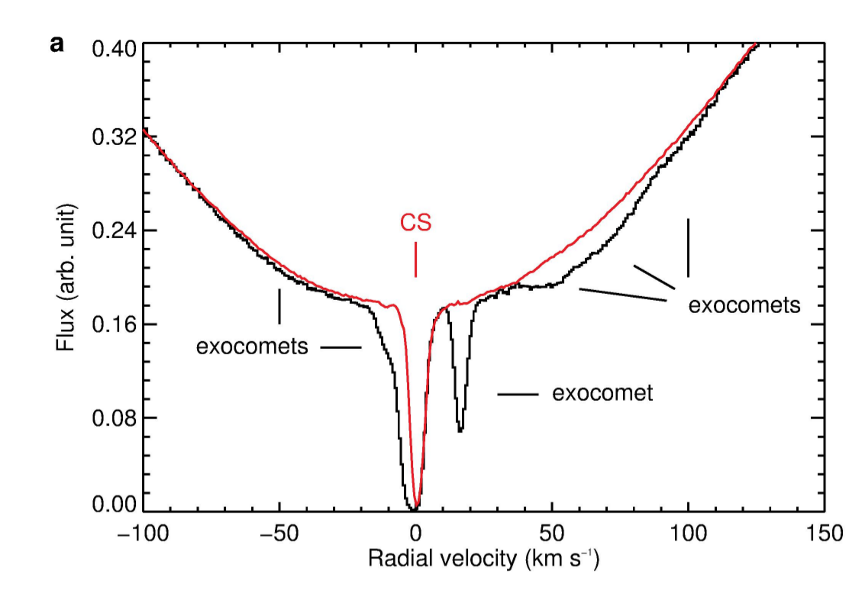
The science behind the press release
The authors took many many spectra of the central star, zooming in on a particular absorption line of calcium. What they find are the signature of the star and a circumstellar disk (labeled CS in the plot), plus many other features that are highly variable. Each comet basically produces a small transit signature, very much like extrasolar planets produce transits when they move across the star's disk.

Slide 6
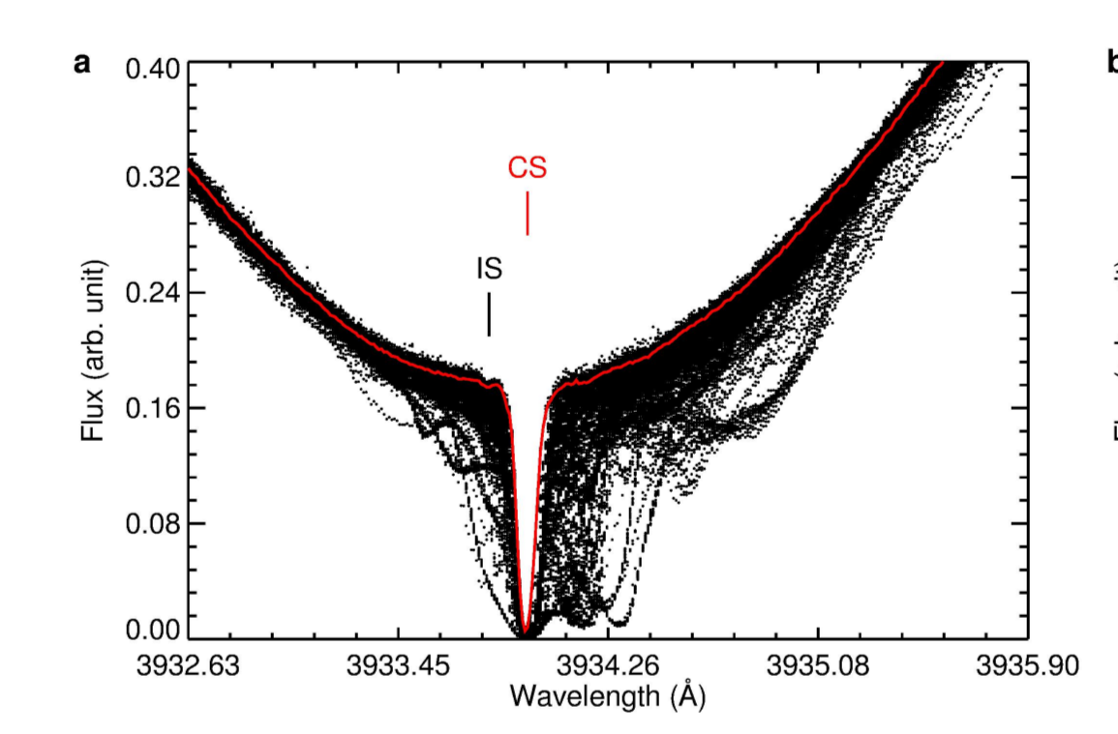
The science behind the press release
By observing the star repeatedly you can track these comet transits and study their nature in more detail, in particular their orbital sizes (from the transit timing).

Slide 7
Galaxies
read Chapter 14

Slide 8
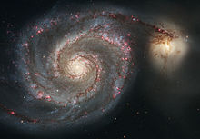
What is a galaxy?
A galaxy is a huge collection of stars that is isolated in space and held together by gravity.
We happen to live in one called the Milky Way Galaxy or just the Galaxy (with a capital “G”)
Disk
Bulge
This is a picture of the Whirlpool galaxy – not the Milky Way
Spiral Arms

Slide 9
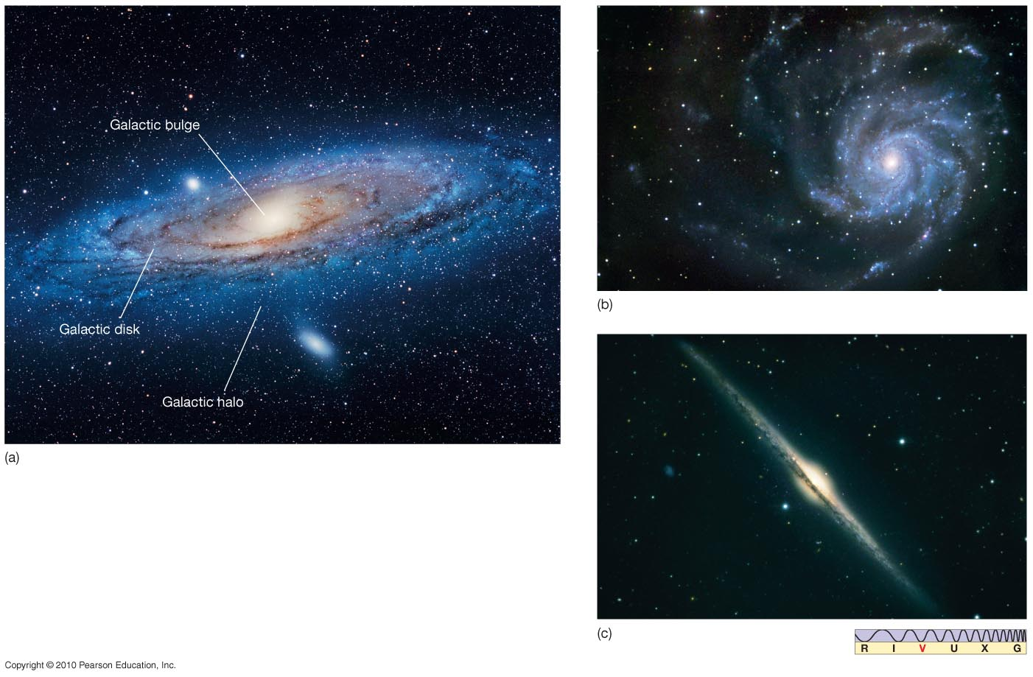
The Milky Way
Our Galaxy is a spiral galaxy. Here are three similar galaxies.
Notes:
<number>

Slide 10
How do we know that the Galaxy looks like this?
Count the number of stars in different directions
William Herschel first did this in 1756 and discovered that the galaxy looks like a disk
Note that the Sun is in the center of the disk
This is not right! Sun is not at the center, and Herschel didn’t know that most of the light is blocked by dust, especially toward center of Galaxy

Slide 11
The new distance ladder
William Herschel didn’t have a way to measure distances to stars, so he just assumed that the stars are uniformly distributed
The real revolution in the study of our Galaxy (and other galaxies) came from building up the next rung of the distance ladder with the use of variable stars
Recall that the distance ladder is our collection of methods for measuring distances to astronomical objects: ladder because each step builds on the one before

Slide 12
Review of the distance ladder
Radar ranging to find distances to nearest planets and the AU.
Parallax for distances to the closest stars. The Hipparcos satellite extends the range of parallax to over 200 pc or about 700 ly, but beyond that, the parallax angle is still too small to be seen.
To measure the distance to stars beyond this one can use standard candles, objects whose luminosity is known. That is, if you know the luminosity of a candle, or a light bulb or a star, you can find its distance by measuring its brightness: the farther away it is, the smaller its apparent brightness: The energy is spread out over a sphere of area 4πd², with d the distance to the star, giving the relations that we have used:
luminosity = apparent brightness x 4πd²

Slide 13
Standard Candles
The first standard candles we encountered were main sequence stars.
The H-R diagram tells you the luminosity of each spectral type of main sequence star.
To find the distance to a main sequence star,
From its spectral type, find its luminosity
From its luminosity and its apparent brightness find its distance
Using main sequence stars as standard candles (spectroscopic parallax), one can find distances to stars anywhere one can see them in our galaxy, more than 30,000 ly or 10,000 pc away

Slide 14
Standard Candles: Variable stars
All stars oscillate. Oscillations are long sound waves, and the oscillation time is the time it takes sound to cross the star.
Large stars, like large bells, oscillate more slowly than small stars. Late in their evolution, bright stars have, for a short time, unusually large oscillations.
Stars that take between 1-100 days to pulsate are call Cepheids.
Stars that take less than 1 day are call RR Lyrae stars.
Stars that take longer than 100 days are called Mira variables.

Slide 15
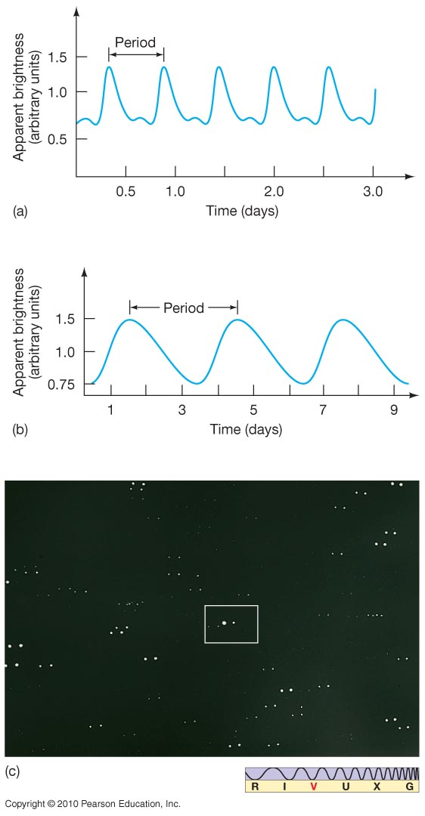
Variable Stars
The upper plot is an RR Lyrae star. All such stars have essentially the same luminosity curve, with periods from 0.5 to 1 day.
The lower plot is a Cepheid variable; Cepheid periods range from about 1 to 100 days.
Notes:
<number>

Slide 16
Variable Stars
Late in a star’s evolution, its oscillations can become unstable, growing enormously, and greatly changing the brightness of the star each oscillation
The larger a star is, the longer its period of oscillation
This is a Mira variable star at its faintest and at its brightest.

Slide 17
Cepheid Variables

Slide 18
Leavitt's period-luminosity relation
Because large stars are brighter than small stars, there should be a relation between the period and luminosity of oscillating stars: Stars with longer periods should be larger and brighter than stars with shorter periods.
The larger a star is, the longer its period of oscillation.
Henrietta Leavitt showed that this was true for Cepheid variables, looking at a set of variable stars in the Magellanic clouds in order to see stars at the same distance.
Henrietta Leavitt discovered the period-luminosity relation for Cepheids
The relation makes each Cepheid into a standard candle: a light source whose luminosity is known, once the period is measured.

Slide 19
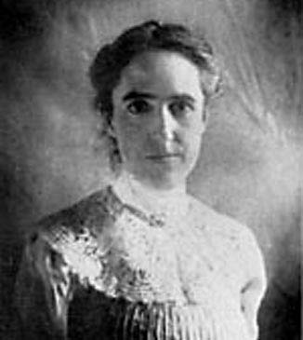
Henrietta Leavitt
Henrietta Leavitt measured the relation between period and luminosity for variable stars with long periods (1-60 days), called Cepheids

Slide 20
RR Lyrae
Cepheid
Cepheid—two displaced images
taken at different times

Slide 21
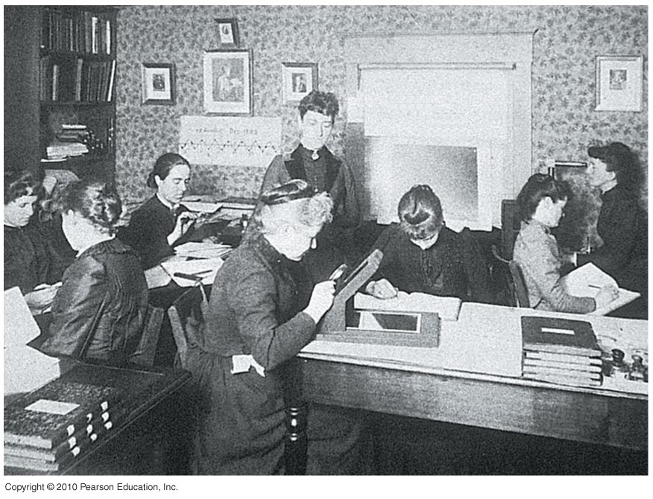
Leavitt was part of a group of women “computers” that looked over many thousands of plates and included Annie Jump Cannon in Harvard College Observatory

Slide 22
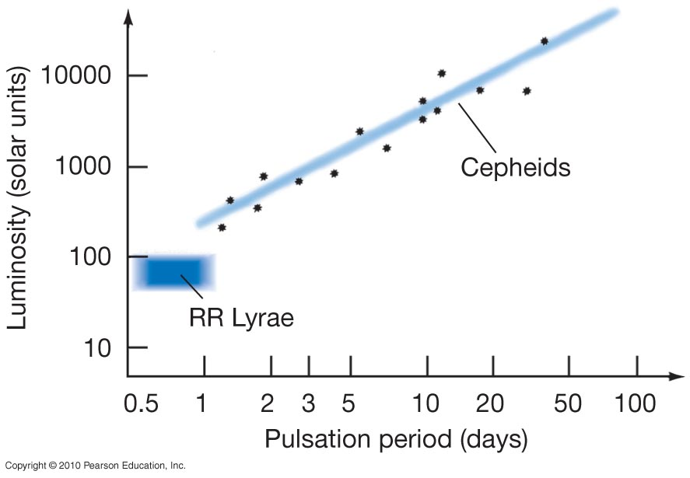
Leavitt’s Period-Luminosity Relation for Cepheid Variable Stars
Cepheids: measure period, get luminosity
RR Lyrae stars all have the same luminosity

Slide 23
Cepheids as standard candles
A Cepheid variable can be used as a standard candle:
Find its luminosity by measuring its period
Measure its apparent brightness and deduce its distance from the 1/r2 formula

Slide 24
Summary of the distance ladder
Use radar bouncing to find distances to Mars and Venus and so to find 1 AU
Knowing 1 AU → use parallax to find the distance to stars within a few thousand light-years
Knowing the distance to these stars, find the luminosity of main sequence stars. → Using main-sequence stars as standard candles, find the distance to stars throughout our galaxy.
Knowing the distance to clusters of stars in the galaxy, find the luminosity of Cepheid variables. → Using Cepheid variables as standard candles, find the distance to galaxies outside the Milky Way.

Slide 25
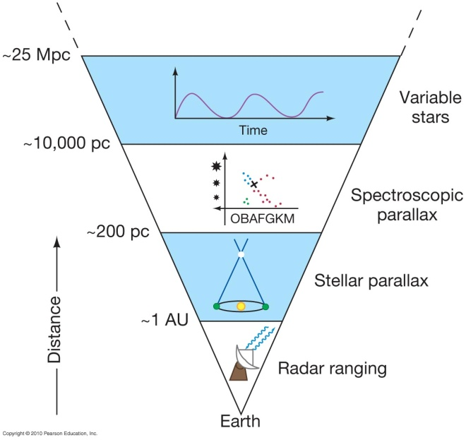

Slide 26
Size of the Milky Way
With variable stars as the standard candle, the size of the Milky Way can now be found
Harlow Shapley in 1917 found the distances to distant globular clusters using these variable stars
By assuming that the most distant globular clusters lie near the outside of the Milky Way, he found the extent of the Milky Way's halo
And by noting that there are more globular clusters on one side of the sky than the other, he deduced that the Sun is not at the center of the Milky Way (globular clusters lie outside the disk of the galaxy, so they are less obscured by dust) and found the direction to the Galactic Center

Slide 27
Globular
Cluster
M107

Slide 28
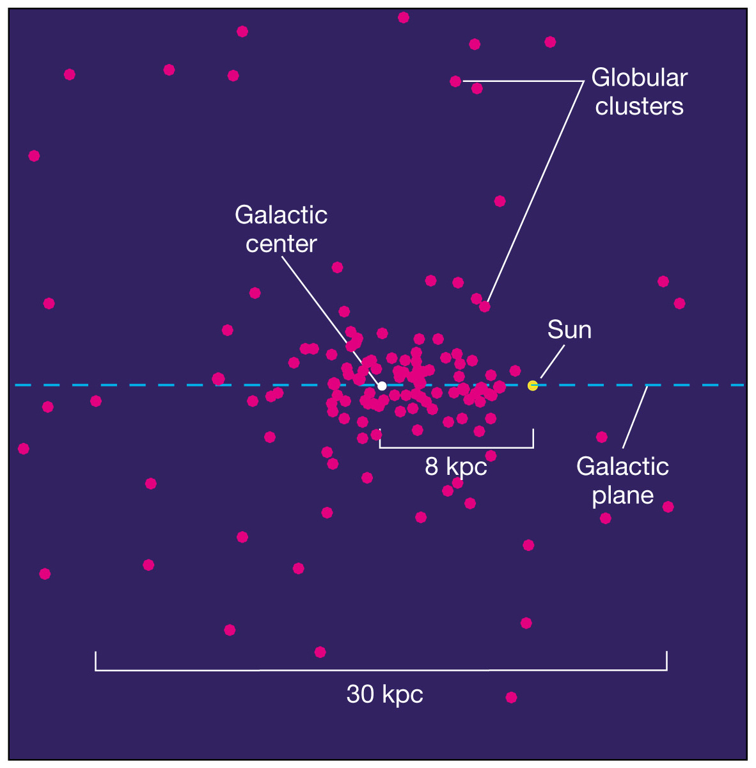

Slide 29
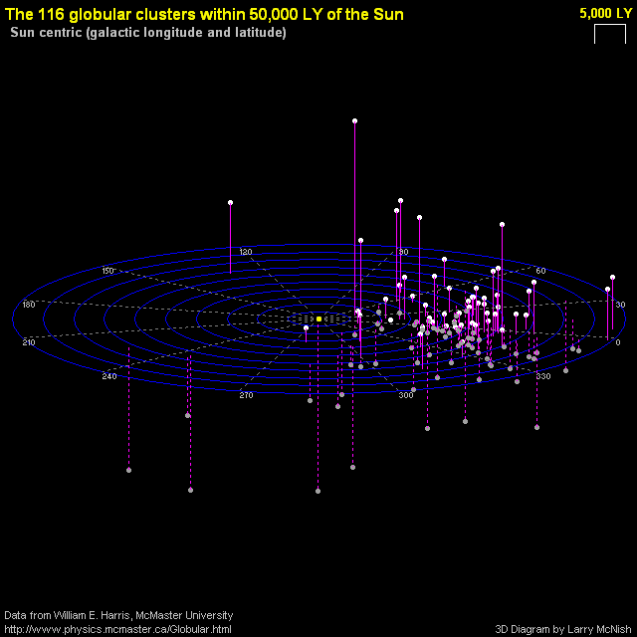
Source: http://calgary.rasc.ca/globulars.htm

Slide 30
