Slide 1
Announcements
Midterm grades soon…
Quiz 8B on Chapter 13 due tonight
Now: the Solar System
  Upcoming schedule:
  Today: Chapter 4 Sections 4.2 and 4.3 (we’ll do Section 4.4 on extrasolar planets later)
  Wednesday April 3: Terrestrial planets (Chapter 6, a bit of Chapter 5)

Slide 2
New things in the solar system

Slide 3
New things in the solar system

Slide 4
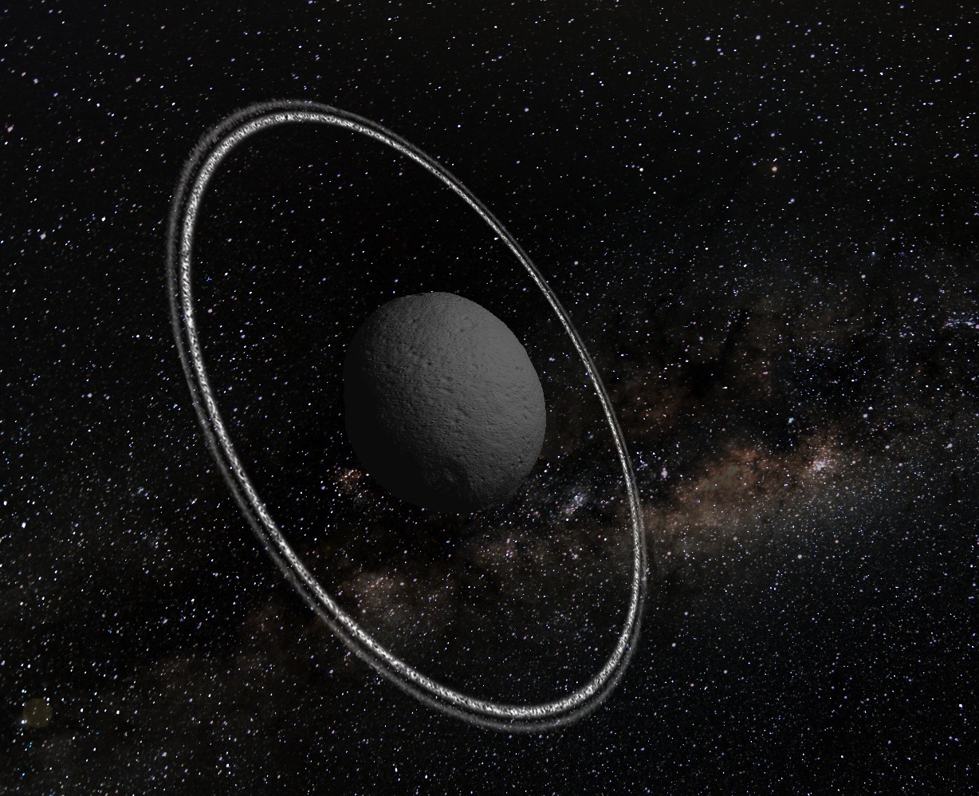

Slide 5
An asteroid with rings
Artist’s conception
Chariklo, orbits between Saturn and Uranus
155 miles across, biggest in the neighborhood
Rings discovered when asteroid eclipsed a star
Two rings: inner about 4 miles wide, outer about 2 miles, made partially of water ice
First rings known around a non-planet
How did they get there? Debris from a collision?

Slide 6
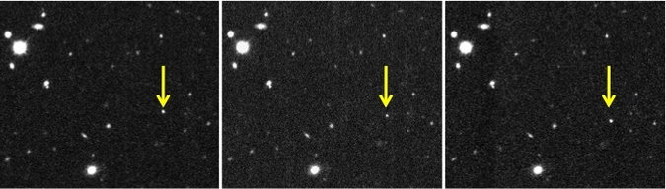
A new dwarf planet
2012 VP113 (“Biden”): found in Kuiper Belt, far beyond Neptune
About 250 miles across
Called a “Sednoid,” after another similar object called Sedna
How did it get out there?
Does orbit indicate an unseen planet in outer solar system??

Slide 7
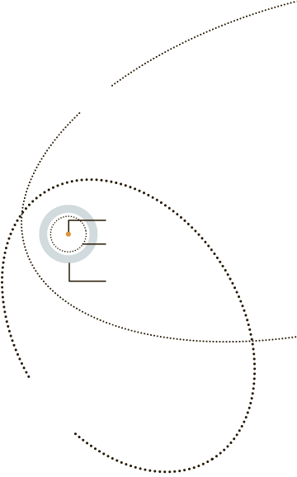
A new dwarf planet
Sedna
Sun
Neptune
Kuiper Belt
2012 VP113
Graphic from the New York Times

Slide 8
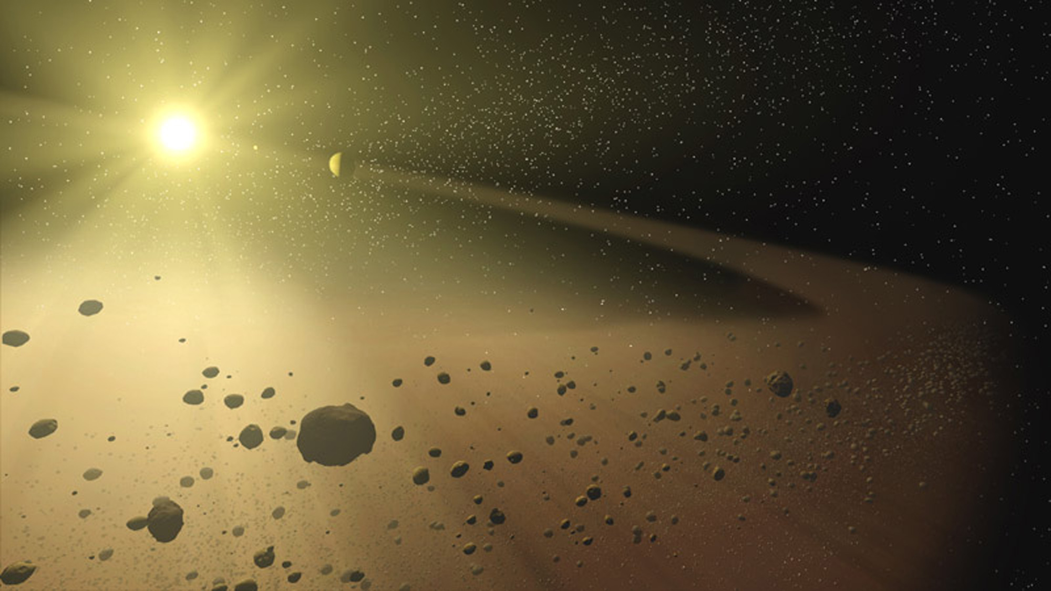
Small Things in the Solar System: Recap

Slide 9
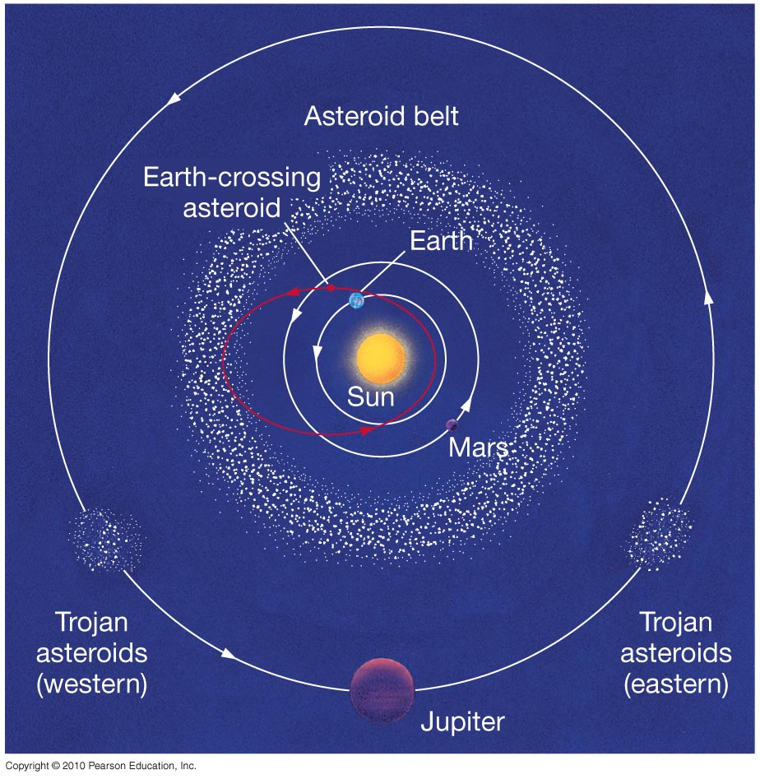
Asteroids
Small, low density, loosely packed rocky bodies
Mostly found in belt between Mars and Jupiter
Some cross Earth’s orbit

Slide 10
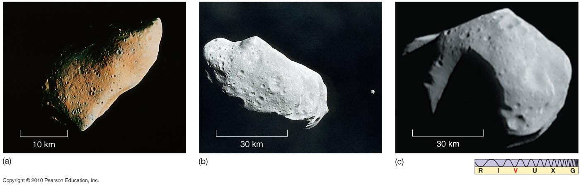
Asteroids and Meteoroids
Asteroids and meteoroids have rocky composition; asteroids are bigger.
(below) Asteroid Gaspra
(above) Asteroid Ida with its moon, Dactyl
(above) Asteroid Mathilde

Slide 11
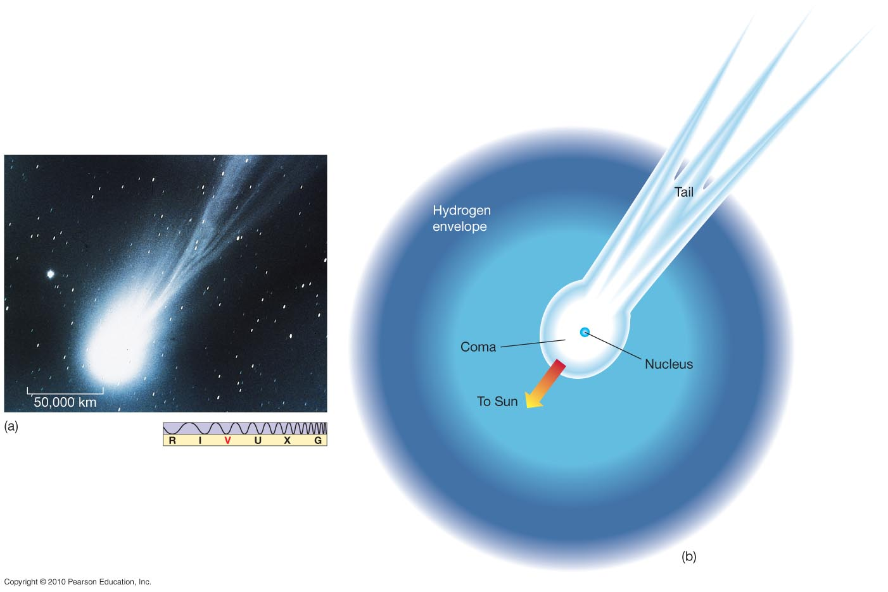
Comets
Comets are icy, with some rocky parts, and very low density
The basic components of a comet: nucleus, coma, tail

Slide 12
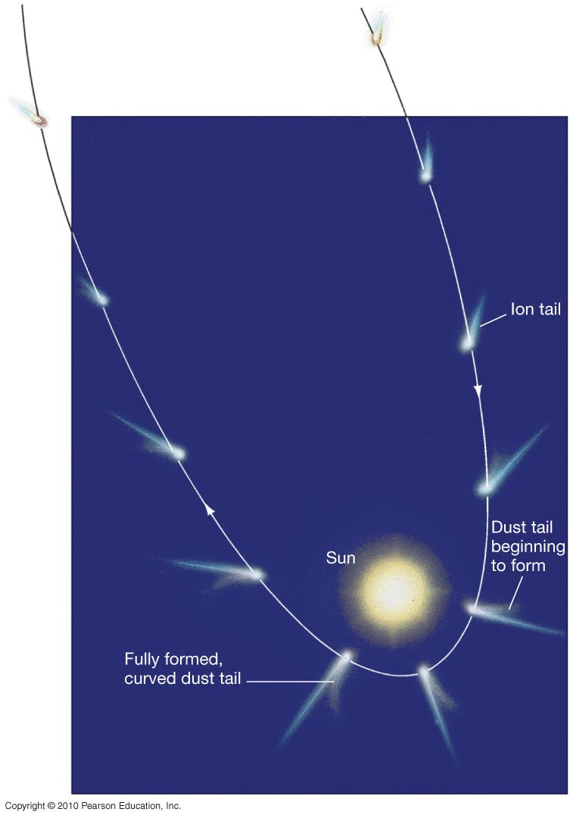
Comets
Comets sublimate (parts of them turn from solid to gas) when they come near the Sun, producing the tail.
The solar wind means the ion tail always points away from the Sun.
The dust tail also tends to point away from the Sun, but the dust particles are more massive and lag somewhat, forming a curved tail.

Slide 13
Meteoroids
Small rocks in the solar system
Asteroid: >100 m in size
Meteroid: <100 m in size
If they enter the Earth’s atmosphere and burn up they are called meteors
Meteorites are meteors that penetrate though the atmosphere to hit the ground

Slide 14




The asteroid belt is evidence of
a planet that once orbited the Sun but was later destroyed
ancient material from the formation of the solar system
a collision between Jupiter and one of its larger moons
comets that were trapped by Jupiter’s gravitational field

Slide 15
The asteroid belt is evidence of
a planet that once orbited the Sun but was later destroyed
ancient material from the formation of the solar system
a collision between Jupiter and one of its larger moons
comets that were trapped by Jupiter’s gravitational field

Slide 16
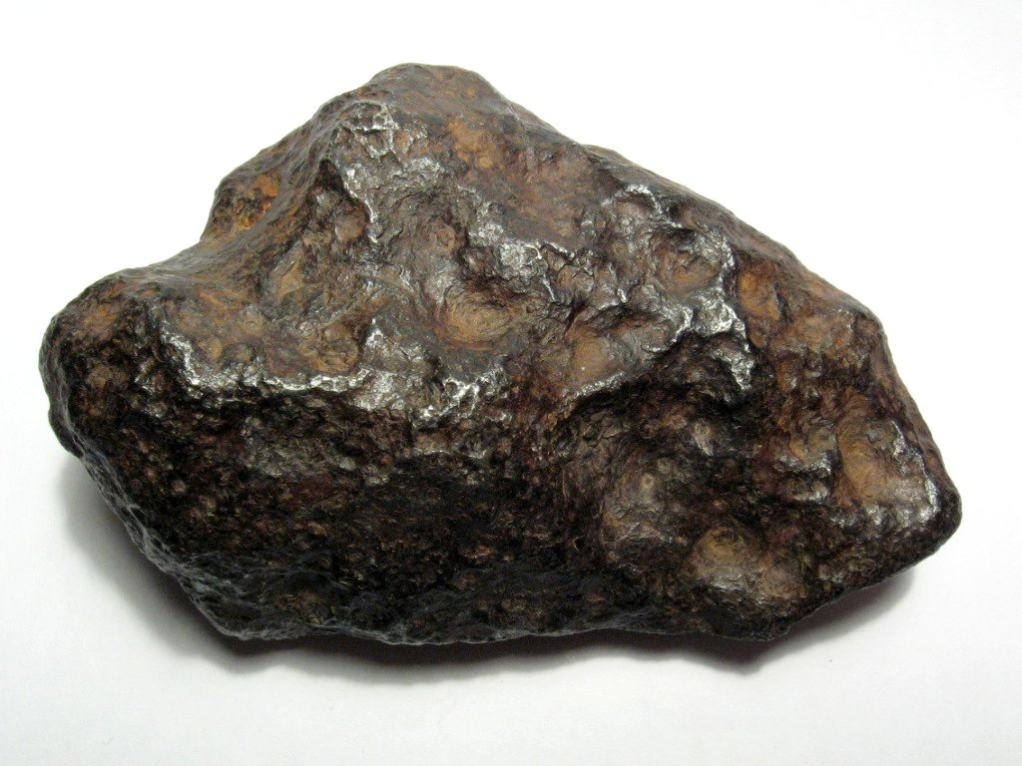
Meteorites: Meteors that do not burn up in the atmosphere and hit the Earth

Slide 17
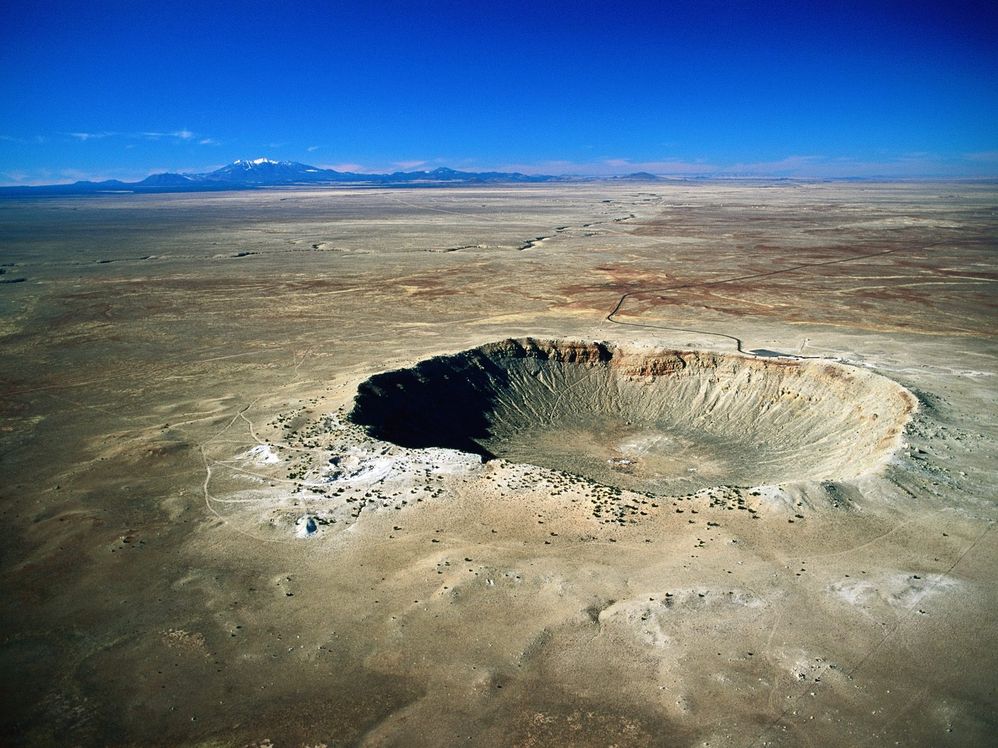
Barringer Crater, Arizona: 1 km across, from a 50 m iron meteor landing about 50,000 years ago

Slide 18
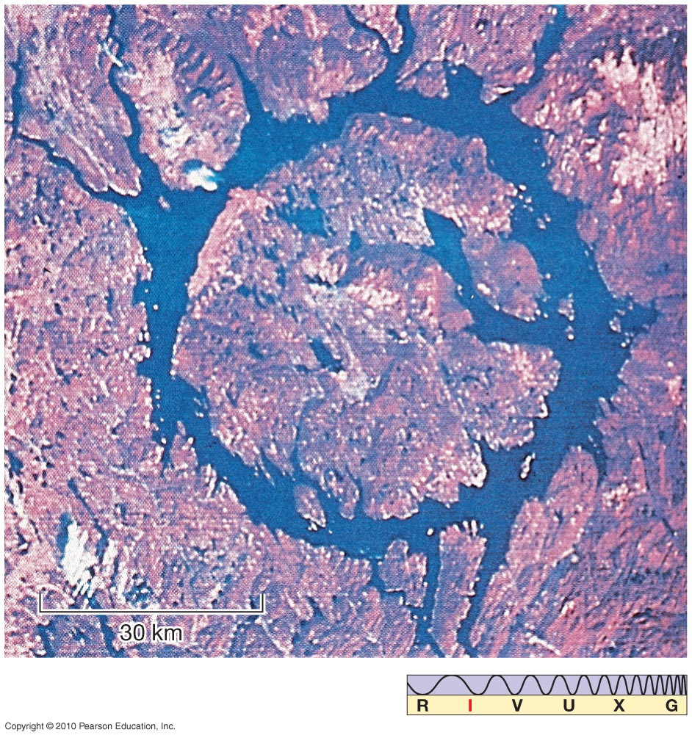
The Manicouagan reservoir in Quebec

Slide 19
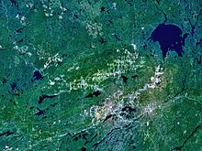
Sudbury Basin, Ontario, Canada
Formed from the impact of a 10-15 km diameter asteroid 1.8 billion years ago.
Area is extremely rich in minerals, especially iron. Canada is mining asteroids!

Slide 20
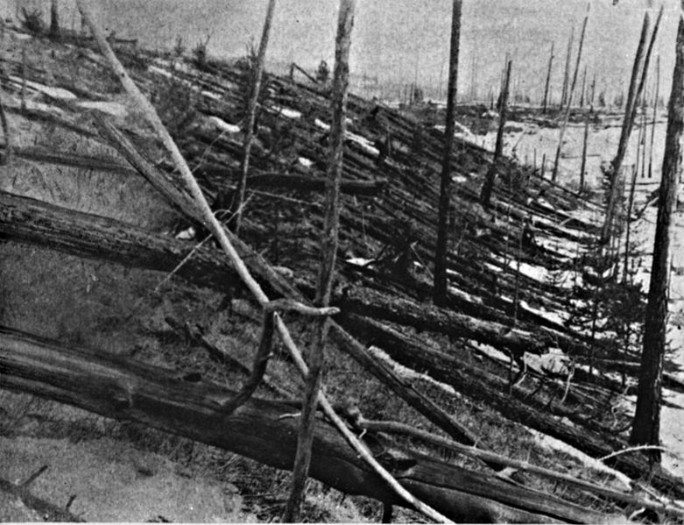
Giant Impacts
Tunguska explosion 1908: result of a 30 m meteor which exploded above the ground.
Exploded with the power of a 10 megaton nuclear bomb.
Fortunately hit in Siberia.

Slide 21
Russian meteor of February 15, 2013

Slide 22
Russian meteor of February 15, 2013
Largest known object to have entered Earth’s atmosphere since Tunguska event – exploded over Chelyabinsk, Russia
Not detected before explosion
Estimated mass 11,000 tons, size 17-20 m in diameter, speed when entering atmosphere 18 km/s (40,000 mph)
Total energy before impact equivalent to ~440 kilotons of TNT, 20-30 times more energy than atomic bombs of Hiroshima and Nagasaki
Explosion generated flash of light, small fragmentary meteorites, powerful shock wave
Not all energy released in form of explosion – about 20% of energy emitted as visible light

Slide 23
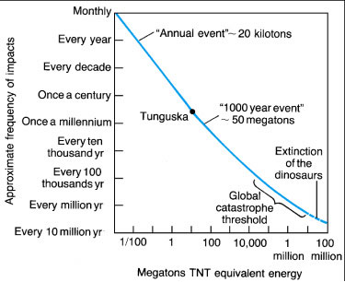
Giant Impacts and Mass Extinctions
Chelyabinsk

Slide 24
Giant Impacts and mass extinctions
A widely accepted hypothesis is that an impact of a 10 km asteroid hit the Earth 65 million years ago and killed off the dinosaurs.
A layer of iridium is found in 65 million year old rock sediments worldwide – iridium is rare on Earth because it sank to the center, but found in meteorites

Slide 25
A crater of the right age and size has been found in the Yucatan peninsula in Mexico: the Chicxulub crater.

Slide 26
Such an impact would have generated mega-tsunamis kilometers high – seen in fractured rocks that are piled in regions around the impact site
Material thrown up from the impact would re-enter the Earth’s atmosphere around the world and heat the surface up to a temperature of 400+ degrees – triggers world-wide forest fires
Production of dust and sulfate would block out the sun for years and bathe the Earth in acid rain – death of many plant species, and bad news for the food chain

Slide 27
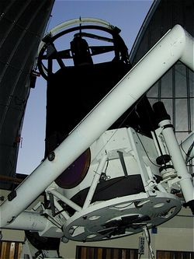
Giant Impacts
To help understand the threat of Earth-crossing objects, we need to find all of them.
One such effort is the Catalina sky survey being run in Arizona
Uses a bunch of (relatively) small telescopes to look for near-Earth asteroids.

Slide 28
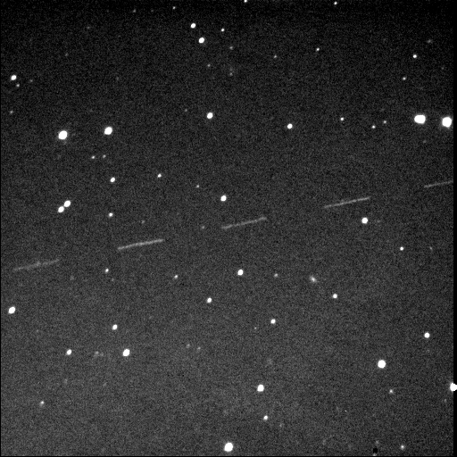
Giant Impacts
First detection of an rock that actually hit the earth (2008 TC₃)
Detected it on Oct 6 2008 – 20 hours before impact.

Slide 29
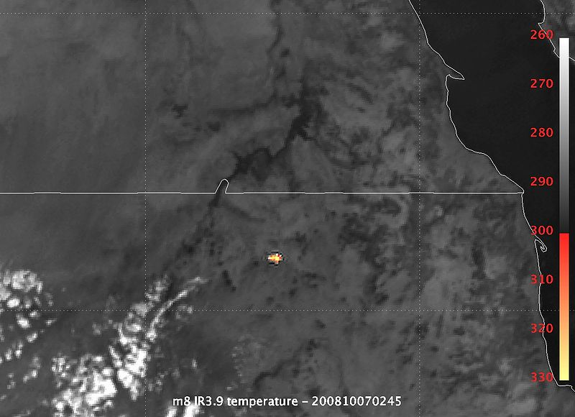
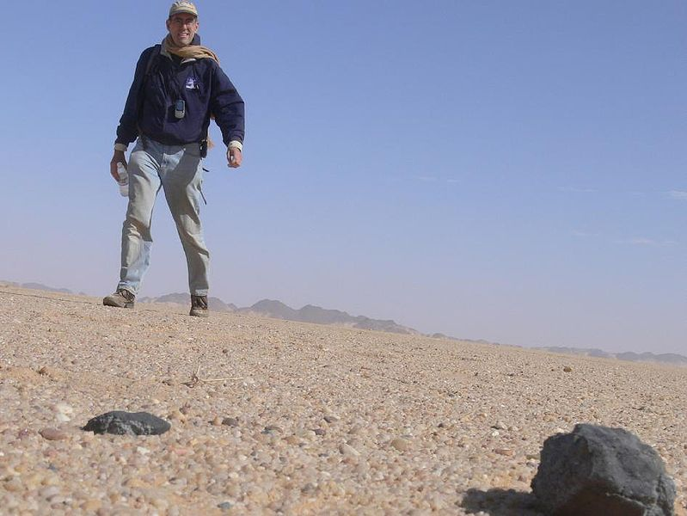
Giant Impacts
Hit the earth on Oct 7, 2008 in Northern Sudan
Exploded with a force of 2.1 kilotons (1/5 of the Hiroshima bomb)
The fragments were collected by geologists who flew into the area.

Slide 30
Astronomy 103
Formation of the Solar System
Please read Chapter 4

Slide 31
Features of the solar system
Planets are all (nearly) in a plane to about 1%
All orbit in a counterclockwise direction (as viewed from Earth’s N pole) and nearly all rotate in the same direction as well
Orbits are nearly circular
Planets are relatively isolated – far away from their neighbors
Space between the planets is relatively empty

Slide 32
Can we develop a model for the formation of the solar system that explains these properties?
The nebular hypothesis suggests that the planets formed from a gas cloud which collapsed into a disk.
This gas cloud has roughly the same composition as the Sun (mostly hydrogen, helium, + a trace of carbon, oxygen, nitrogen, iron etc)

Slide 33
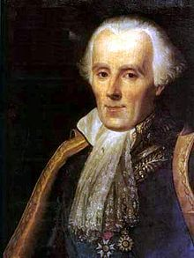
The Nebular Hypothesis or Theory
The idea that the planets form from a disk is called the nebular hypothesis.
This idea was proposed by many people, one of which was Pierre Simon Laplace, a mathematician in 18th century France
However, this was not the only idea

Slide 34
Other Alternatives
Alternatives to the nebular hypothesis
  Tidal model: a passing star ripped material from the Sun and that material collapsed to form the planets
  Capture model: The sun and planets formed separately, but the planets were captured later by the Sun
  Accretion model: The sun moved through a gas cloud, got some gas and that gas formed the planets
However, the nebular hypothesis eventually won out over all competitors because of the many observations of disks around young stars

Slide 35
Formation of the Sun
Remember that most of the mass of the solar system is in the Sun. So the formation of the solar system is a footnote to the formation of the Sun.
Recall that stars form from molecular clouds.

Slide 36
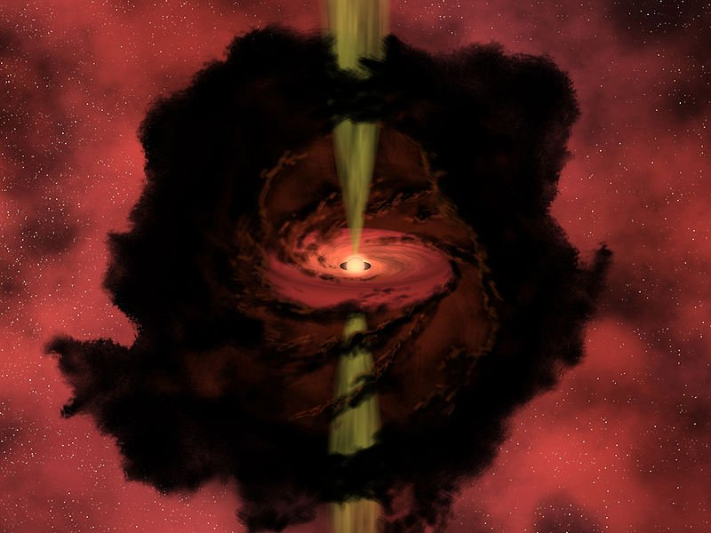
The protostar
The collapse of one of these clouds forms a protostar and the disk of gas that surrounds it

Slide 37
Formation of the disk
As the cloud collapses, the angular momentum in the gas makes it spin faster and faster until the the gas moves fast enough to orbit the protostar.
This is a general principle in astronomy. Collapse of stuff leads to the formation of a disk due to angular momentum

Slide 38
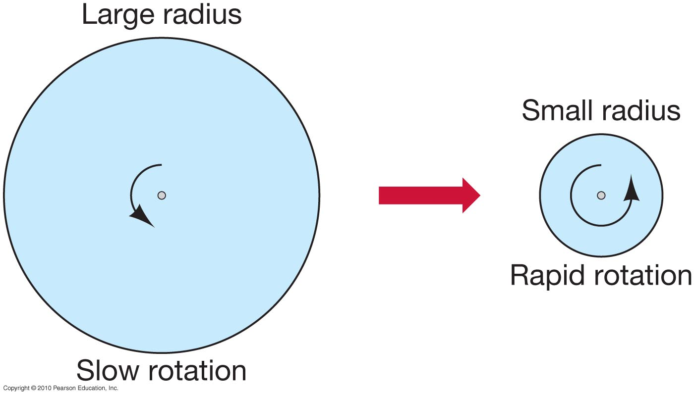
The Concept of Angular Momentum
Angular momentum: spinning things keep spinning, and in the same direction
Conservation of angular momentum says that product of radius and rotation rate must be constant.
Therefore, as a dust cloud collapses, its rate of rotation will increase.

Slide 39
Formation of the disk
One way to look at this in action is to look at an ice skater as she moves her arms in. The ice skater spins faster as a result of angular momentum causing her to spin up.

Slide 40
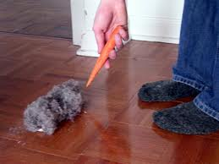
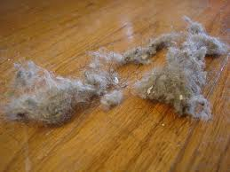
Condensation of the planets
Gas does not condense (because it remains gas), but dust can gather – tiny chunks of rocky and icy matter, with sizes of about 10⁻⁵ m
Dust grains form in cool atmospheres of old stars, are ejected, grow by accumulating molecules from interstellar gas
Dust collects into larger bodies: dust bunnies!

Slide 41
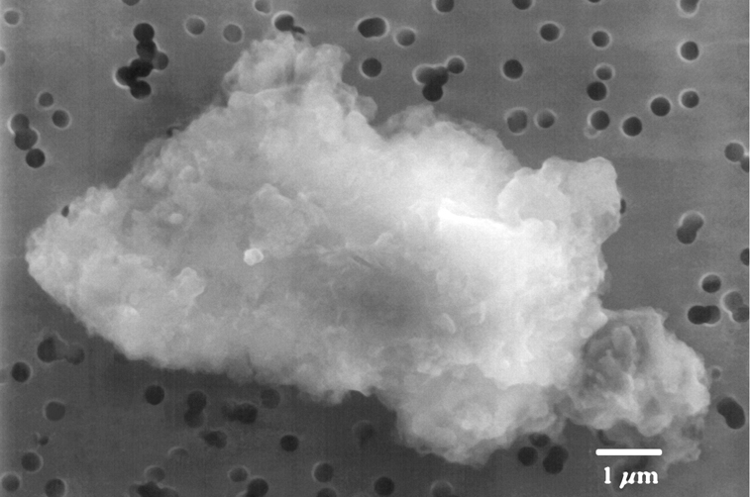
Forming dust bunnies
Dust bunnies or dust coagulations are stuck together by molecular forces.
Small grains stick together to make larger grains which stick together to make even larger grains.

Slide 42
Condensation of the planets
Clumps of dust grow larger, become able to sweep up more and more material: this process is called accretion
Eventually we get objects a few hundred km in size, which have gravity strong enough to affect their neighbors and sweep up even more material: planetesimals
Eventually nearly all material swept up into protoplanets
Stuff that escapes capture becomes asteroids and comets
Also: high-speed collisions between protoplanets and planetesimals

Slide 43
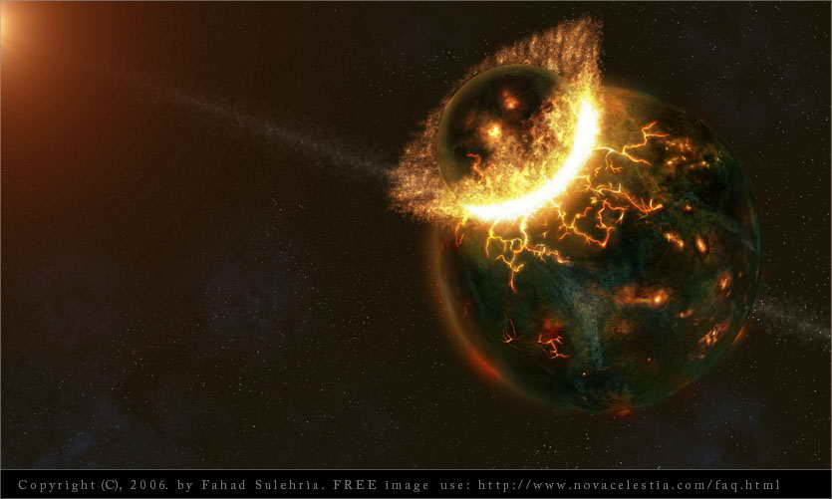
Forming the Moon
One of these high-speed collisions is thought to be responsible for the formation of Earth’s Moon.

Slide 44
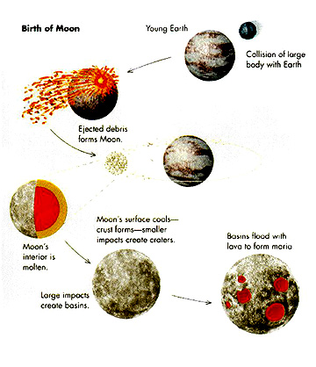
Forming the Moon
During the formation of the Earth, the young Earth suffered a collision with a Mars-sized body that threw up material into orbit that condensed to form the Moon.
This is a rare event, and Earth is the only terrestrial planet with a large moon

Slide 45
Forming Jupiter and Company
Up to this point, the story has produced rocky bodies, perfect for terrestrial planets, but the Jovian planets are different because they are gaseous.
To form the Jovian planets, we need one more stage of planet formation in which the gas accretes
onto these rocky cores
However, to accrete gas we need a big core

Slide 46
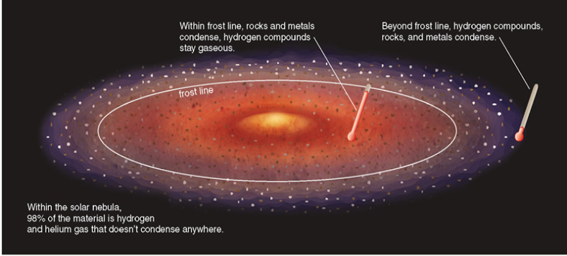
Forming Jovians
Bigger cores are possible if you can gather more material. In regions where the gas is so cold that ices form – beyond the snow line or frost line – we have the extra stuff to make this possible.

Slide 47
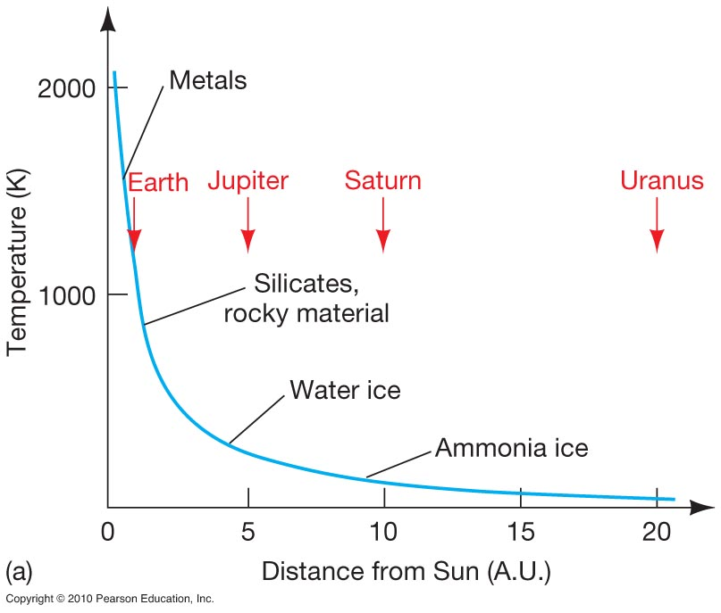
Forming Jovians
This plot shows the types of material that could condense at different radii as the solar system was forming.
In the early solar system, the snow line was roughly at the position of Jupiter today!

Slide 48
End of planet formation
We see this process in action in observations of young protostars with disks.
This plot shows that as protostars get older, they are less likely to have a disk – probably because it has condensed into planets.

Slide 49
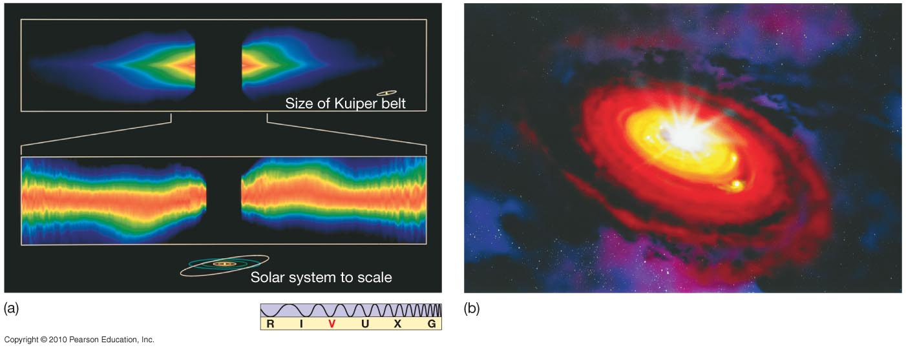
Disks around other stars
The star Beta Pictoris is surrounded by a disk of warm matter, which may indicate planetary formation.

Slide 50
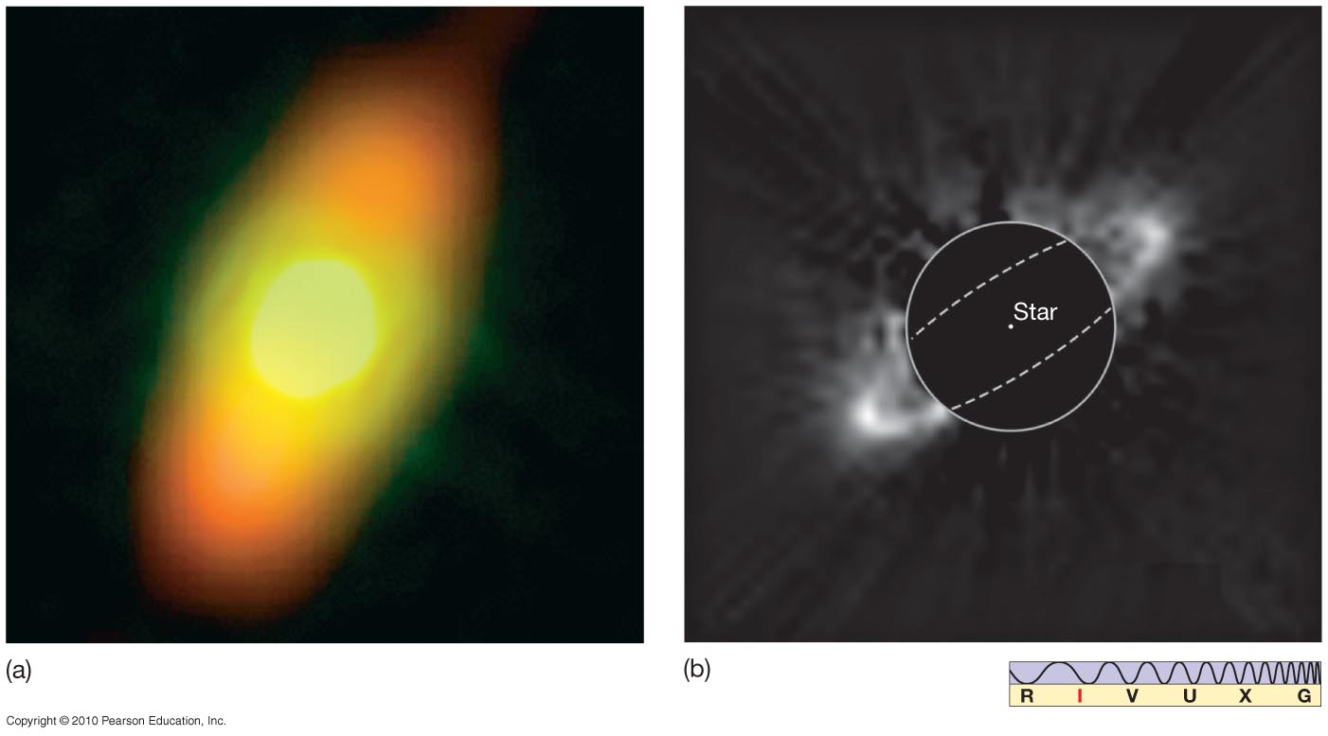
Disks around other stars
These images show possible planetary systems in the process of formation – disks around the stars Fomalhaut and HR4796A.

Slide 51
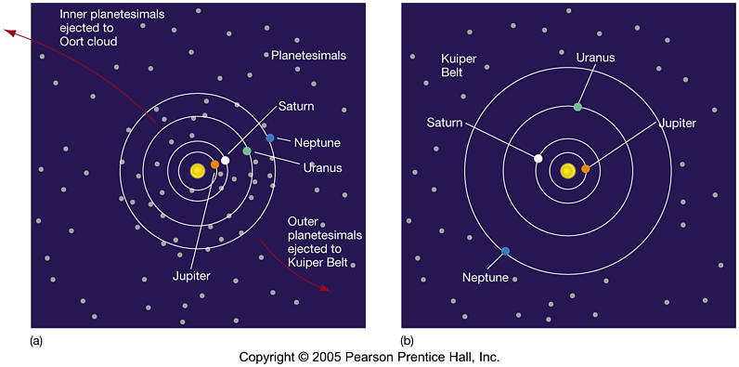
Scattering and Ejection
The early solar system was filled with debris that was ejected by the planets (mainly Jupiter).

Slide 52
Scattering and Ejection
The larger pieces of this debris in the early solar system are called planetesimals. The ejection and scattering of planetesimals allowed the planets to change their orbits.
Generally Neptune, Uranus and Saturn move outward at the expense of Jupiter, which moves inward.
Jupiter being the biggest planet tends to fling stuff out of the solar system, causing it to move inward, while the other three planets tend to move planetesimals inward – so they move outward.

Slide 53
The Nebular Hypothesis and the Solar System
  Planets form in a rotating disk
  Planets are all (nearly) in a plane to about 1%
  All orbit in a counterclockwise direction and nearly all rotate in the same direction as well.
  Orbits are nearly circular
Planets are relatively isolated – far away from their neighbors
  Planets accrete all the material in their neighboring orbits
The composition of the planets differ
  The presence of the snow line allows different materials to condense onto forming protoplanets.
Space between planets is relatively empty
  Planets scatter small bodies

